Slide 2
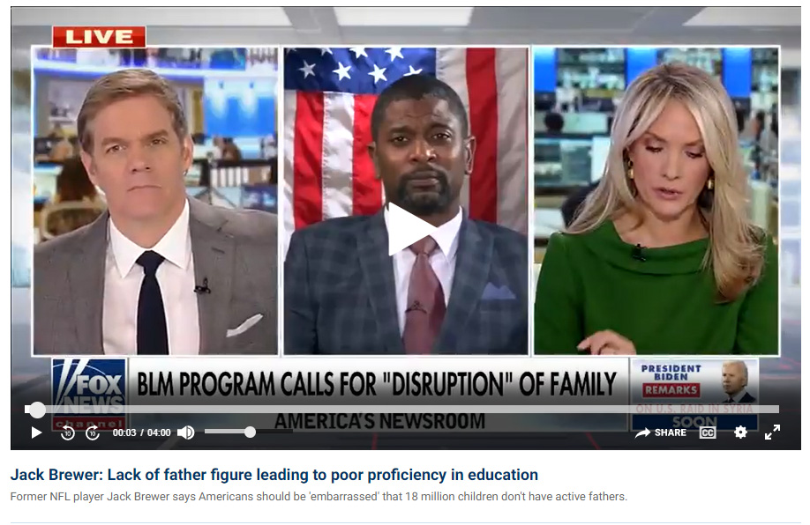

Slide 3
America’s Crisis Is a Lack of Fathers
“As our country commemorates Father’s Day this weekend, it is important that we recognize the millions of children throughout our nation who are growing up without their fathers. Data from the United States Census Bureau shows that nearly 18.5 million children grow up without their fathers, which has in return led to the United States owning the title of the world’s leader in fatherlessness.”
“This staggering statistic has not only destroyed the nuclear family but has devastated communities across the nation. For example, 85% of children and teens with behavioral disorders come from fatherless homes, and over 70% of all adolescent patients in drug and alcohol treatment centers originate from homes without fathers” (“America’s Crisis Is a Lack of Fathers,” Fox News, June 17, 2022).

Slide 6
Modern Image of Manhood
Fr. Bryan Owen wrote, “Most men do not know the critical role that they have in the lives of their children. And they don’t know the first thing about how to engage their children in important matters like this. Why? Because the culture and Hollywood have teamed up to declare that men are stupid. Just think of the last few sitcoms or family-style shows that you have seen. What role does the father have? More than likely, he is the hapless idiot who is the ‘extra child’ that the mom needs to deal with. Many men are portrayed on television as some version of Homer Simpson” (https://anglicancompass.com/should-you-preach-a-fathers-day-sermon-on-fathers-day

Slide 7
What Is Your Image of Fatherhood?

Slide 8
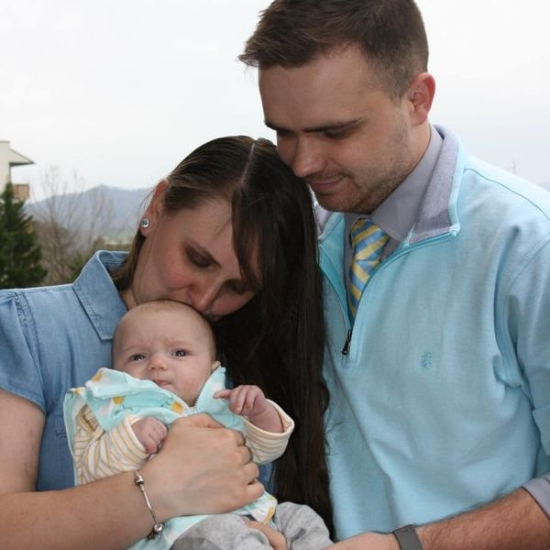
Fathers’ Influence on the Faith of Their Children

Slide 9
The Father’s Awesome Role in the Family
Owen also wrote about the significant influence fathers have on whether or not their children will go up to go to church. Here is what he wrote:
“After 35 years of marital counseling and coffee conversations, I have come to see that many men simply do not understand the role that they have in the life of their children and family. The findings that I have read suggest what every pastor knows through experience: Fathers shape their children’s faith. Period. There is no escaping that.
“Consider this: If a father does NOT go to church regularly, only 1 child in 50 will grow up as a regular worshipper. That is staggering.
“But, if the father DOES attend church regularly, nearly 35 children out of 50 will make worship and church a part of their adult life.
“Other research findings might tweak the numbers here and there, but they do not substantially change the point: Fathers are the most effective discipleship leaders for their children” (ibid.)

Slide 10
God Said It First!
“For I have known him, in order that he may command his children and his household after him, that they keep the way of the Lord, to do righteousness and justice, that the Lord may bring to Abraham what He has spoken to him” (Gen. 18:19).
Passing your faith down to your children is a responsibility of fathers.
“Only take heed to yourself, and diligently keep yourself, lest you forget the things your eyes have seen, and lest they depart from your heart all the days of your life. And teach them to your children and your grandchildren, especially concerning the day you stood before the Lord your God in Horeb, when the Lord said to me, ‘Gather the people to Me, and I will let them hear My words, that they may learn to fear Me all the days they live on the earth, and that they may teach their children’” (Deut. 4:9-10).

Slide 11
God Said It First
“And these words which I command you today shall be in your heart. You shall teach them diligently to your children, and shall talk of them when you sit in your house, when you walk by the way, when you lie down, and when you rise up” (Deut. 6:6-7).
“And if it seems evil to you to serve the Lord, choose for yourselves this day whom you will serve, whether the gods which your fathers served that were on the other side of the River, or the gods of the Amorites, in whose land you dwell. But as for me and my house, we will serve the Lord” (Josh. 24:15).

Slide 12
Psalm 78:1-8
“Give ear, O my people, to my law; Incline your ears to the words of my mouth. I will open my mouth in a parable; I will utter dark sayings of old, Which we have heard and known, And our fathers have told us. We will not hide them from their children, Telling to the generation to come the praises of the Lord, And His strength and His wonderful works that He has done. For He established a testimony in Jacob, And appointed a law in Israel, Which He commanded our fathers, That they should make them known to their children; That the generation to come might know them, The children who would be born, That they may arise and declare them to their children, That they may set their hope in God, And not forget the works of God, But keep His commandments; And may not be like their fathers, A stubborn and rebellious generation, A generation that did not set its heart aright, And whose spirit was not faithful to God” (Psa. 78:1-8).

Slide 13
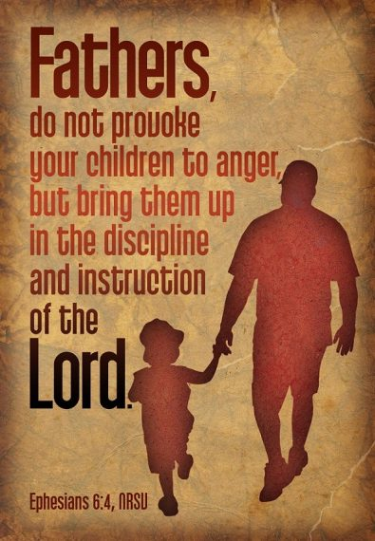

Slide 14
What God Has Entrusted to Fathers
God has entrusted to the care of fathers the most important possessions He has on this earth—the souls of those children whom God has formed in the womb and created in His own image!
There is no job on earth more important than shaping the lives of your children!

Slide 15
Fathers Should Take the Lead in Disciplining Their Children!

Slide 16
Fortunate to Have Been Loved
I am not minimizing the role of mothers in the home. We were blessed to be reared in a home where both mother and father were united in discipline.
When we misbehaved, we faced mother’s tongue and her switch.
If the offense was greater, we faced father’s lecture and his belt.
My parents never abused me. I can honestly look back and say that they conscientiously disciplined me.

Slide 17
God Used A Father’s Discipline to Instruct
“And you have forgotten the exhortation which speaks to you as to sons: ‘My son, do not despise the chastening of the Lord, Nor be discouraged when you are rebuked by Him; For whom the Lord loves He chastens, And scourges every son whom He receives’” (Heb. 12:5-6).
“Furthermore, we have had human fathers who corrected us, and we paid them respect. Shall we not much more readily be in subjection to the Father of spirits and live?” (Heb. 12:9).
“For they indeed for a few days chastened us as seemed best to them, but He for our profit, that we may be partakers of His holiness” (Heb. 12:10).
“Now no chastening seems to be joyful for the present, but painful; nevertheless, afterward it yields the peaceable fruit of righteousness to those who have been trained by it” (Heb. 12:11).

Slide 18
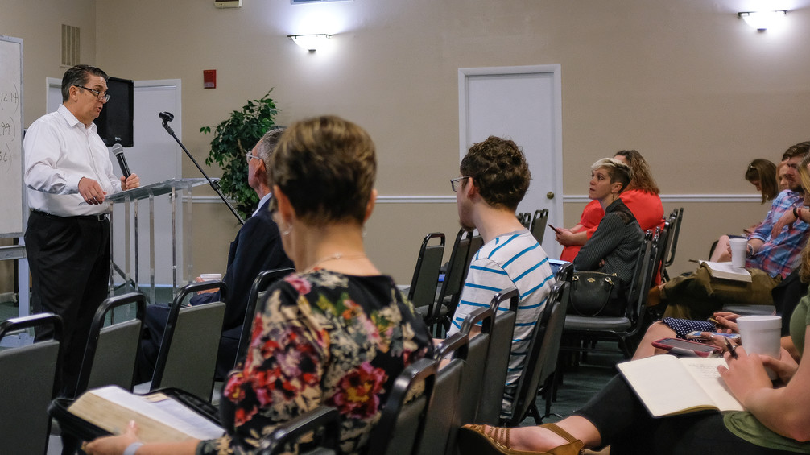
The Father’s Example in Church Attendance
We Need to Improve Our Bible School Attendance

Slide 19
Robbie Low, Anglican Bishop
“In 1994 the Swiss carried out an extra survey that the researchers for our masters in Europe (I write from England) were happy to record. The question was asked to determine whether a person’s religion carried through to the next generation, and if so, why, or if not, why not. The result is dynamite. There is one critical factor. It is overwhelming, and it is this: It is the religious practice of the father of the family that, above all, determines the future attendance at or absence from church of the children.
“If both father and mother attend regularly, 33 percent of their children will end up as regular churchgoers, and 41 percent will end up attending irregularly. Only a quarter of their children will end up not practicing at all. If the father is irregular and mother regular, only 3 percent of the children will subsequently become regulars themselves, while a further 59 percent will become irregulars. Thirty-eight percent will be lost.
“If the father is non-practicing and mother regular, only 2 percent of children will become regular worshippers, and 37 percent will attend irregularly. Over 60 percent of their children will be lost completely to the church.
(“The Truth about Men & Women, June 2003. https://www.touchstonemag.com/archives/article.php?id=16-05-024-v&readcode=&readtherest=true#therest).

Slide 20
Raising the Bar
I ask you fathers to step up and be the example your children need so that they are more likely to honor God throughout their lives.
Your children, despite your best example, still have free will!
But, you do not want to come to church without seeing your children there and beat yourself because of the poor example you gave to them in their early years.
It is getting very late for fathers to have much influence if they begin during their teenaged years!
If we want to get serious about church attendance, we have to face these facts about the role of the father in bringing up his children in the nurture and admonition of the Lord.

Slide 22
Let the Bible Speak
“I have made a covenant with my eyes; Why then should I look upon a young woman?” (Job 31:1-2).
“But I say to you that whoever looks at a woman to lust for her has already committed adultery with her in his heart. If your right eye causes you to sin, pluck it out and cast it from you; for it is more profitable for you that one of your members perish, than for your whole body to be cast into hell” (Matt. 5:28-29).
“. . . having eyes full of adultery and that cannot cease from sin, enticing unstable souls. They have a heart trained in covetous practices, and are accursed children” (2 Pet. 2:14).

Slide 23
Michael P. Green on 2 Peter 2:14
“They lust after every girl they see; they view every female as a potential adulteress. Peter makes another shrewd psychological observation. Lascivious thoughts, if dwelt upon and acted upon, become dominant. It becomes impossible for them to look at any woman without reflecting on her likely sexual performance, and on the possibilities of persuading her to gratify their lusts.
“Not only does lust act as an irritant; it never satisfies. It always leaves a man restless, longing for more (which in its turn, equally fails to satisfy). These libertines had such eyes that they never stop sinning (akatapaustous hamartias). It may be that this phrase should be translated, as in NEB, ‘never at rest from sin’, in which case Peter would be referring not to the unsatisfactory nature of lust, but to the bondage it brings with it” (2 Peter and Jude: An Introduction and Commentary, Tyndale New Testament Commentaries, 133–134.

Slide 24
“You’ve got mail!”

Slide 25
Probably not the Father’s Day Message you wanted, but hope that it is a message that will make us better fathers!

Slide 26
Conclusion

Slide 27
As the Journey Nears Its End
As I come to the latter years of my life, the most satisfying accomplishments of my life are Jenny and Corey, their faithful Christian marriage companions (Robbie and Meagan) and my four Christian grandchildren: Corbin, Ian, Raven and Tori. Nothing compares to this.
I reflect on attending my Mother and Dad’s sixtieth anniversary. We had speeches from different family memories which I do not recall. I can’t even recall whether or not I spoke. However, I do remember what my Mother said. She looked out at the room filled with her children, grandchildren, and great-grandchildren, most of whom were Christians. By the accounting methods used by financial advisors, they were poor. But my Mother said, with tears dripping down her cheeks as she spoke, “I am the richest woman alive!”

Slide 28
Step Up
Fathers, I am calling upon you to step up and accept your responsibilities which God will hold you accountable for fulfilling: Be a man of God!
A man of God is not made in the magazine image of “the sexiest man alive.”
A man of God is not likely to be the most decorated soldier from an important military campaign.
A man of God is not likely to be a political leader, such as ______________ (I will leave it to you to fill in the blank of most admired politician).
I am challenging you to be a man of God who accepts his roles as husband to his wife and father to his children!

