Slide 2
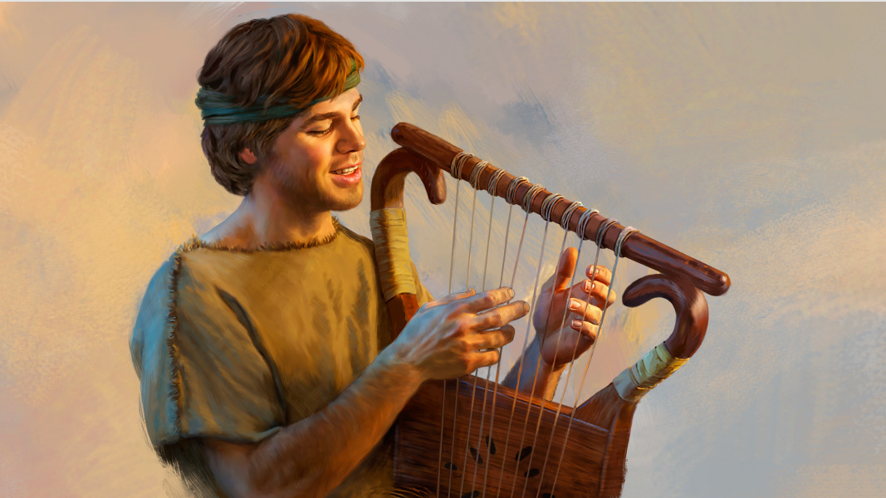
Saved to Sing
Psalm 57

Slide 3
Background Information
The superscription indicates that this is a psalm of David when he was fleeing from Saul and was in a cave.
The narrative of David fleeing from Saul and entering a cave is found in 1 Samuel 24:1-15.
It is the narrative when David cut off a corner of the robe of Saul when he was relieving himself and soon regretted what he had done.
When danger comes, some people are cowed and others are spurred into action. David was obviously the latter, as shown by his fighting with a lion and bear, with Goliath, and his military accomplishments in the service of King Saul.
The psalm moves from a cry for help, invocation, and complaint (vv. 1-6) to confidence and praise (vv. 7-11).
We see David in a vulnerable situation turning to God as his refuge in the time of trouble.

Slide 4
Superscription
The word michtam is understood by Blackmore to be “a writing” (729) and “do not destroy” (al-taschith) may be a tune to which the writing is sung or instructions that the psalm not be destroyed (Blackmore, 727-728).
The psalm contains a refrain (vv. 5, 11) which binds the psalm together.

Slide 5
I. David’s Cry for Help
(57:1-6)

Slide 6
Psalm 57:1
“Be merciful to me, O God, be merciful to me! For my soul trusts in You; And in the shadow of Your wings I will make my refuge, Until these calamities have passed by.”
David had fled from Saul into a cave, but a cave can be a refuge in a storm or it could become a walled in prison house where one is left to starve to death. So David’s refuge is not the cave but in God.
He pleads for God’s “mercy” (chānan), “to feely sympathy, have pity” and then “to favour someone” (HALOT, 334).
The word “trusts” (chāsāh) means “to take refuge in”; the word is used two times (“trusts” and “I will make my refuge”).

Slide 7
What Is My Refuge?
Sometimes one might take refuge in people (among the Philistines), but that had most recently failed when David fled to Achish, king of Gath.
In this verse David affirms that he will take refuge in God.
He was resolved not to trust in his own military tactics to escape King Saul or the weapons he would use for self-defense, but in God.

Slide 8
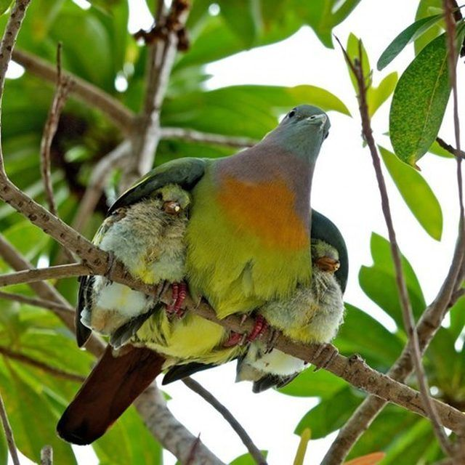
“And in the shadow of Your wings I will make my refuge.”

Slide 9
Other Passages
“I will abide in Your tabernacle forever; I will trust in the shelter of Your wings. Selah” (Psa. 61:4).
“The Lord repay your work, and a full reward be given you by the Lord God of Israel, under whose wings you have come for refuge” (Ruth 2:12).
“O Jerusalem, Jerusalem, the one who kills the prophets and stones those who are sent to her! How often I wanted to gather your children together, as a hen gathers her chicks under her wings, but you were not willing!” (Matt. 23:37).

Slide 10
Facing the Storms of Life
The metaphor of fleeing somewhere for safety in the midst of bad weather is compared to the storms of life.
The word hawwāh is “destruction” or “threats.”
Various things can threaten a person (storms, sickness, enemies, etc.).
Every person will face storms and calamities in his life. The message of this psalm is to show us how to handle them when they come.
Some men see the storms in their life and curse God for allowing them to come upon them.
Others run toward God when the storms come, like a child runs to its parents when a sudden thunderbolt crashes.

Slide 11
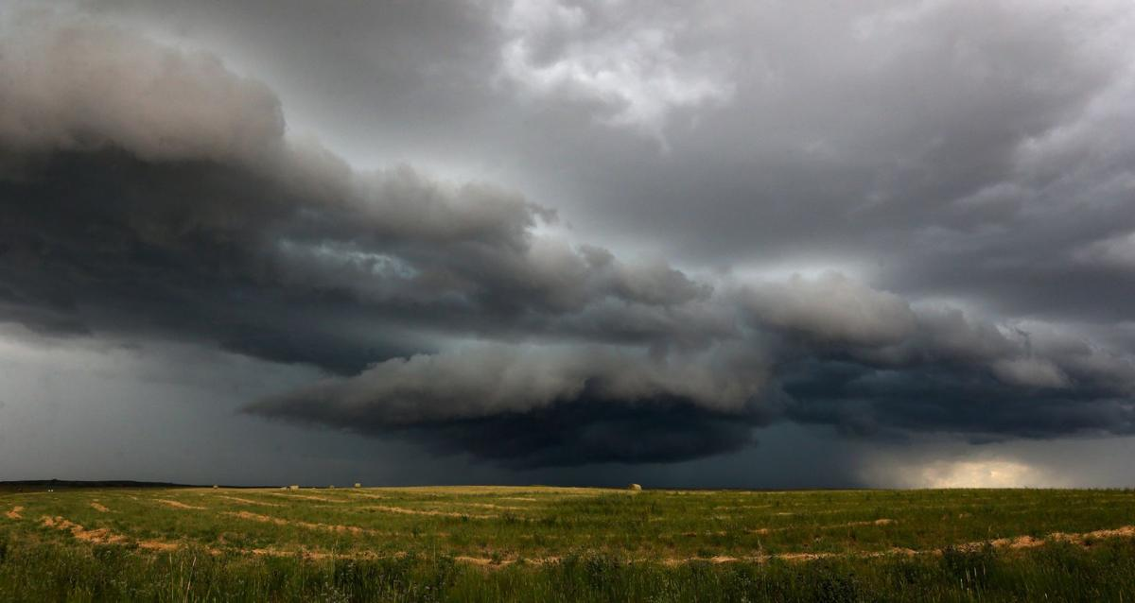
Till the Storm Passes By
Mosie Lister
In the dark of the midnight,
I have oft hid my face,
While the storm howls above me,
And there’s no hiding place.
‘Mid the crash of the thunder,
Precious Lord, hear my cry;
Keep me safe till the storm passes by.
Many times Satan whispered,
“There is no need to try,
For there’s no end of sorrow,
There’s no hope by and by.”
But I know Thou art with me,
And tomorrow I’ll rise
Where the storm never darkens the skies.
When the long night has ended
And the storms come no more,
Let me stand in Thy presence
On that bright, peaceful shore.
In that land where the tempest
Never comes, Lord, may I
Dwell with Thee when the storm passes by.
Chorus:
Till the storm passes over,
Till the thunder sounds no more,
Till the clouds roll forever from the sky,
Hold me fast, let me stand
In the hollow of Thy hand,
Keep me safe till the storm passes by.

Slide 12
Psalm 57:2
“I will cry out to God Most High, To God who performs all things for me.”
The justification for running to God is based on who He is. David describes Him in two ways:
‘Ēlyôn: “something that is higher, upper” and then of Yahweh where it is used as “a divine epithet, which occurs either by itself or as an attribute” of God, meaning God Most High.
Pagan ideas of God was that of a pantheon of Gods, some higher than the others.
But, there is none higher than Yahweh.

Slide 13
“To God Who Performs All Things for Me”
The conciseness of the Hebrew language condenses into two words what the NKJV renders as “to God who performs all things for me.”
The word gāmar means “end, come to an end, complete” and then with the sense of “God that completeth, accomplisheth, for me” (HALOT, 170).
The word is used in a negative sense to refer “to the abrupt and seemingly permanent termination of that which previously existed.”
It is used in a positive sense to refer “to how the Lord finishes or accomplishes in the life of his saints all that he undertakes” (TWOT, I:168).
The NIV and ESV translates the phrase to mean “who fulfils his purpose for me.”
The idea is that God has a purpose for the life of everyone of us and allows and providentially oversees the events in our lives to accomplish God’s purpose for our lives.

Slide 14
Other Verses
“The Lord will perfect that which concerns me; Your mercy, O Lord, endures forever; Do not forsake the works of Your hands” (Psa. 138:8).
“. . . being confident of this very thing, that He who has begun a good work in you will complete it until the day of Jesus Christ” (Phil. 1:6).

Slide 15
Psalm 57:3
“He shall send from heaven and save me; He reproaches the one who would swallow me up. Selah God shall send forth His mercy and His truth.”
David was confident in what God would do in his life:
“He shall send from heaven and save me” is not speaking of “forgiveness of sins” but deliverance from the situation described elsewhere as a calamity.
God will act from heaven to bring the deliverance for David just as He acted from heaven to save Israel at the Red Sea.
“He reproaches the one who would swallow me up.”
“Reproach” (chārap) is sometimes defined as “to confuse, to disillusion” (HALOT, 356). In this sense, God reproaches those attacking David.
Blackmore follows the NKJV rather than the KJV (“and save me [from] the reproach of him that would swallow me up.”

Slide 16
God’s Mercy and Truth
God shall send from heaven His mercy and truth.
Mercy (chesed): steadfast love, covenant loyalty.
Truth (’ĕmet): faithfulness of God. He will never leave or forsake us.

Slide 17
Psalm 57:4
“My soul is among lions; I lie among the sons of men Who are set on fire, Whose teeth are spears and arrows, And their tongue a sharp sword.”
David describes his dangerous circumstances moving him to plead for God’s mercy. His enemies are compared to:
Lions. David was in a situation figuratively such as Daniel was literally (Dan. 6).
Men who are set on fire. The verb lāhat means “to blaze up, flame” and is used here of enemies trying to destroy David, as arsonists might.
Their teeth are spears and arrows.
Their tongue a sharp sword. The last two describe the vicious verbal attacks of David’s enemies.

Slide 18
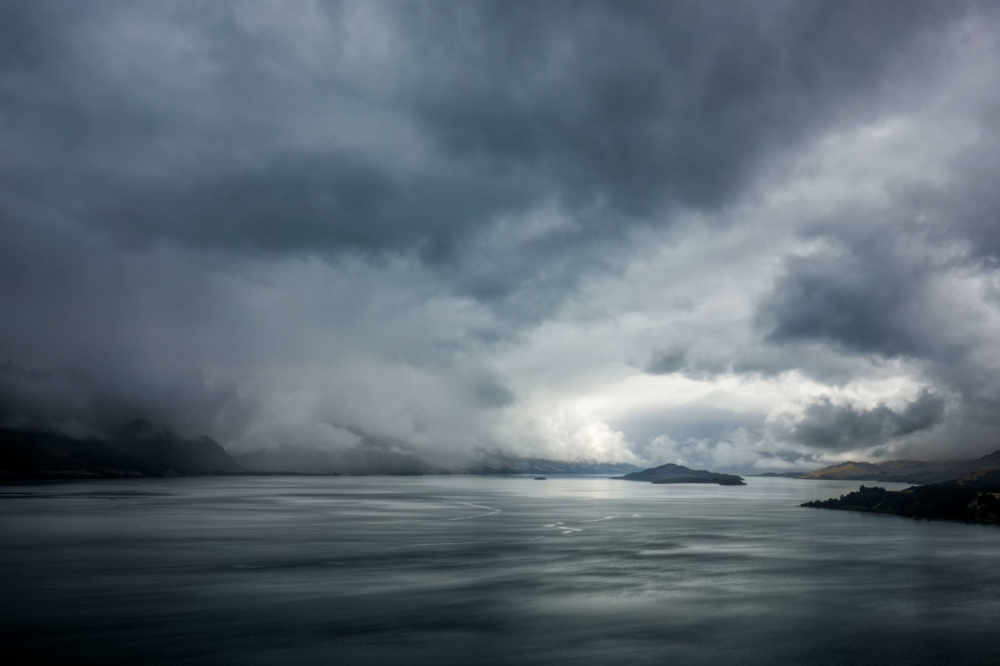
Nevertheless, David says, “I lie among the sons of men.”
The sense of šākab is “to lie down to sleep” (HALOT, 1487).
The meaning of the Hebrew construction is “a more or less emphatic statement of a fixed determination”—“I will lie down to sleep,” for the Lord is His protector.

Slide 19
First Refrain: Psalm 57:5
“Be exalted, O God, above the heavens; Let Your glory be above all the earth.”
This is the first of two refrains in the psalm (see v. 11 for the other).
It is a prayer that God’s will be exalted above the heavens and His glory above all the earth, with heavens and earth represented all creation.
The significance of this statement should not be missed. The significance that Yahweh is the Most High God is not only that He is the most powerful being, but that He also is most important. How do my lowly self interests compare to the interests of God Most High: God’s will should be exalted above my own.
Derek Kidner: “David, wonderfully, looks up from his own urgent interests to his overriding concern: that God should be exalted. In such a crisis, this equivalent to ‘hallowed be Thy name’ was both a victory in itself (cf. John 12:27f.) and a weapon against the enemy” (Psalms 1–72: An Introduction and Commentary, Tyndale Old Testament Commentaries, 224).

Slide 20
The Main Thing: God Will Be Glorified
David is not concerned about his own situation being changed, but that God will be glorified.
In this, David foreshadowed the Savior who prayed, “Now My soul is troubled, and what shall I say? ‘Father, save Me from this hour’? But for this purpose I came to this hour. Father, glorify Your name” (John 12:27-28).

Slide 21
Psalm 57:6
“They have prepared a net for my steps; My soul is bowed down; They have dug a pit before me; Into the midst of it they themselves have fallen. Selah.”
A net (rešet) is used for trapping birds an wild animals (HALOT, 1298). The trap has been “prepared” (kôn) for his steps (pa‘am) or foot.
The effect on David was that it was depressing to him. His soul (or spirit) was bowed down (kāpap, “to bend down [one’s head]”) or to “be depressed.”
David’s enemies’ intention was to entrap David, to destroy him, but David was confident that they themselves would fall into the trap (šîchāh) which they had set for him.

Slide 22
II. David’s Song of Praise
(57:7-11)

Slide 23
Psalm 57:7
“My heart is steadfast, O God, my heart is steadfast; I will sing and give praise.”
Whereas David’s enemies had “prepared” (kôn) a net to entrap David, the Lord’s anointed had set (kôn) his heart on singing praise to God.
The Niphal form of the same verb is used here in the sense of “be steadfast, be sure” (HALOT, 464).
He was determined what he would do, as shown by repeating the phrase.
He uses two verbs to express his intentions šîr and zāmar, both of which mean “to sing.” In the context of these verses, David intends to use the lute and harp in his offering of praise to God.

Slide 24
Psalm 57:8
“Awake, my glory! Awake, lute and harp! I will awaken the dawn.”
The verb “to awake” (‘ûr) is repeated three times in this verse and applied to these three things:
My glory” is David’s own soul.
The lute and the harp.
The dawn.
David’s intention was to arise early in the morning, as the dawn occurs, to offer his praise to God.

Slide 25
Psalm 57:9
“I will praise You, O Lord, among the peoples; I will sing to You among the nations.”
David resolved to praise (yādāh) and sing (zāmar) to God (’ādôn).
Two groups of people are described as those before whom David will praise the Lord:
The peoples (‘am), used of those with family kinship, the clan, the Hebrew people.
The nations (bal-’ummāh), literally the “not peoples,” the nations.

Slide 26
Psalm 57:10-11
“For Your mercy reaches unto the heavens, And Your truth unto the clouds” (Psa. 57:10).
David praises God for His mercy which reaches as high as the heavens.
On the phrase “mercy and truth” see v. 3, where both attributes also appear.
“Be exalted, O God, above the heavens; Let Your glory be above all the earth” (Psa. 57:11).
The refrain from v. 5 is repeated with the same meaning.

Slide 27
Conclusion

Slide 28
Take Away’s
God is a merciful God.
God is our source of refuge, not outward circumstances (a physical cave), military strategy, strong weapons, or anything else.
When the storms of life come, each of us should learn to turn to the Lord, to find comfort under the shadow of His wings.
God has promised to complete His plan for our lives.
God will deliver His people from their enemies.
When great deliverances come in our lives, we should praise God for them and tell others about them, without leaving the impression that our deliverances come from secondary causes (chance, medical community, our own wisdom, etc.).

