Slide 2
What Christianity Brings to the World
The world’s hatred for the gospel and its preachers defies logic. Look at the good the gospel does:
It makes men good citizens. They pay their taxes, abide by the laws of the land (even when they might dislike them), etc.
It strengthens the family unit. Typically, Christian families are strong, close-knit units.
It encourages men to relieve the suffering of the needy.

Slide 3
2 Timothy 3:12
“Yes, and all who desire to live godly in Christ Jesus will suffer persecution” (2 Tim. 3:12).
Paul wrote, “We are hard pressed on every side, yet not crushed; we are perplexed, but not in despair; persecuted, but not forsaken; struck down, but not destroyed—always carrying about in the body the dying of the Lord Jesus, that the life of Jesus also may be manifested in our body” (2 Cor. 4:8-10).
The recent court decision on abortion has unleashed a fury against the Supreme Court, the Republican Party, the Catholic Church, pro-life organizations, etc.—anyone who is opposed to abortion.

Slide 4
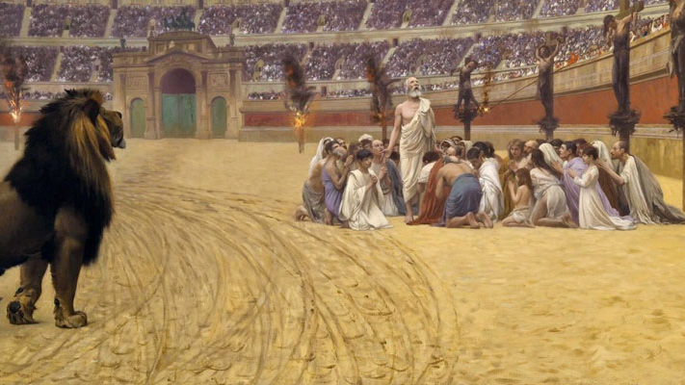
“If the world hates you, you know that it hated Me before it hated you” (John 15:18).

Slide 5
Can We Be a Christian Without Being Hated?

Slide 6
Matthew 10:16-18
“Behold, I send you out as sheep in the midst of wolves. Therefore be wise as serpents and harmless as doves. But beware of men, for they will deliver you up to councils and scourge you in their synagogues. You will be brought before governors and kings for My sake, as a testimony to them and to the Gentiles.”

Slide 7
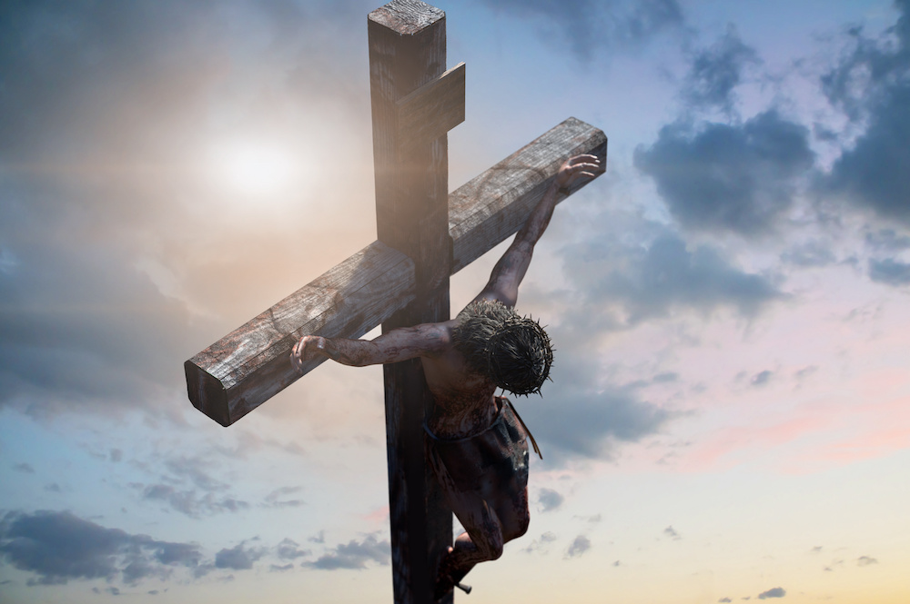
The World Hated Jesus

Slide 8
John’s Gospel
“If the world hates you, you know that it hated Me before it hated you” (John 15:18).
“He who hates Me hates My Father also” (John 15:23).
“But this happened that the word might be fulfilled which is written in their law, ‘They hated Me without a cause’” (John 15:25).

Slide 9
Hatred of Jesus
The “world” must not be understood to mean “all men.” Rather, the “world” refers to those men who have imbibed the spirit of the world, with all of its values, goals, and ideals, and have therefore hated the Lord.
The world’s hatred for Jesus was culminating that night, even as Jesus spoke. Judas had gone to the Jewish leaders to arrange for Jesus’s arrest; the next day He was crucified, at the insistence of the mob who was orchestrated by the Jewish leaders. The world hated Jesus for these reasons:
He exposed its works as evil (Jn. 7:7). As wicked men, they loved and preferred the darkness to the light.
This was in fulfillment of divine prophecy (“he was despised,” Isa. 53:3).

Slide 10
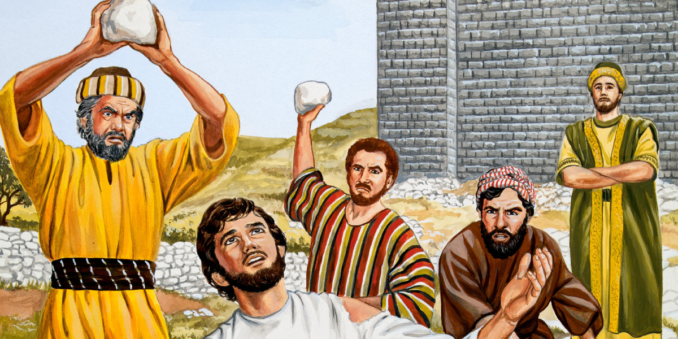
Hatred of Jesus’s Disciples

Slide 11
Persecution Will Come
Jesus foretold that persecution would come:
“And you will be hated by all for My name’s sake. But he who endures to the end will be saved” (Matt. 10:22).
The disciple cannot expect that the world will treat him better than it treated his master:
“Remember the word that I said to you, ‘A servant is not greater than his master.’ If they persecuted Me, they will also persecute you. If they kept My word, they will keep yours also” (John 15:20).

Slide 12
Disciples Were Persecuted
John was writing his gospel at a time when Roman persecution was budding. Already several of the apostles and other Christians had been put to death:
Stephen (Acts 7:54-8:1)
James (Acts 12:1-3)
Paul (2 Tim. 4:6-8)
Soon John was exiled (Rev. 1:9).
The world’s hatred toward Christians was shown:
By exclusion. Some could not be part of the labor unions and other activities of society because they refused to confess “Caesar is Lord.”
Malicious words and hatred
Physical torture and death
“Do not fear any of those things which you are about to suffer. Indeed, the devil is about to throw some of you into prison, that you may be tested, and you will have tribulation ten days. Be faithful until death, and I will give you the crown of life” (cf. Rev. 2:10).

Slide 13
Why the World Hates Jesus’s Disciples

Slide 14
The World Does Hate Jesus’s Disciples
“Behold what manner of love the Father has bestowed on us, that we should be called children of God! Therefore the world does not know us, because it did not know Him” (1 John 3:1).
“Do not marvel, my brethren, if the world hates you” (1 John 3:13).

Slide 15
1. Because we are not “of the world”
“If you were of the world, the world would love its own. Yet because you are not of the world, but I chose you out of the world, therefore the world hates you” (John 15:19).
“An unjust man is an abomination to the righteous, And he who is upright in the way is an abomination to the wicked” (Prov. 29:27).
“In regard to these, they think it strange that you do not run with them in the same flood of dissipation, speaking evil of you” (1 Pet. 4:4).

Slide 16
2. Because Christians expose their sins
“And have no fellowship with the unfruitful works of darkness, but rather expose them” (Eph. 5:11).
“For everyone practicing evil hates the light and does not come to the light, lest his deeds should be exposed” (John 3:20).

Slide 17
3. We are in a life & death struggle
“Now when the dragon saw that he had been cast to the earth, he persecuted the woman who gave birth to the male Child. But the woman was given two wings of a great eagle, that she might fly into the wilderness to her place, where she is nourished for a time and times and half a time, from the presence of the serpent. So the serpent spewed water out of his mouth like a flood after the woman, that he might cause her to be carried away by the flood. But the earth helped the woman, and the earth opened its mouth and swallowed up the flood which the dragon had spewed out of his mouth. And the dragon was enraged with the woman, and he went to make war with the rest of her offspring, who keep the commandments of God and have the testimony of Jesus Christ”(Rev. 12:13-17).

Slide 18
4. Christians threaten their financial interests
“For a certain man named Demetrius, a silversmith, who made silver shrines of Diana, brought no small profit to the craftsmen. He called them together with the workers of similar occupation, and said: ‘Men, you know that we have our prosperity by this trade. Moreover you see and hear that not only at Ephesus, but throughout almost all Asia, this Paul has persuaded and turned away many people, saying that they are not gods which are made with hands. So not only is this trade of ours in danger of falling into disrepute, but also the temple of the great goddess Diana may be despised and her magnificence destroyed, whom all Asia and the world worship’” (Acts 19:24-27).

Slide 19
Financial Interests
Pornography
Prostitution
Abortion
Gambling
Smoking
Drugs
Alcohol
Filthy movies and TV

Slide 20
False Accusations of First Century Saints
Cannibals because they ate the Lord’s supper
Atheists because they would not worship idols
Insurrectionists because they would not confess “Caesar is Lord”
Destroying the family because Christianity separated members of the family one from another

Slide 21
Contemporary Accusations
Christians hate homosexuals
Christians are unlearned bigots who oppose transgendering teens
Christians hate women because we oppose a woman’s right to an abortion
Christians are censors because we oppose pornography
Christians are described as right-wing radicals who would bring all the world in bondage to our radical ideas
Christians are called bigots because we believe there is only one way to be saved
The world’s hatred is its reluctant testimony that we are Christians!

Slide 22
Don’t Compromise with Satan
“Woke Christianity” is “Broke Christianity”!

Slide 23
Don’t Quit Exposing Sin
Recognizing that exposing the sins of the world brings hatred, some do not want the sins of the world exposed from the pulpit.
They do not want these things preached against from the pulpit: sex outside of marriage, sinful divorce and remarriage, homosexuality, transgendering, drinking intoxicating beverages, using recreational drugs, dancing, smoking, mixed swimming, etc.
They do not want denominational doctrines to be exposed.
Some object to these topics being preached in the pulpit because they run off visitors.

Slide 24
Come As You Are, Stay As Your Are
Quit preaching on hell fire!
Put out the fires of hell!
Accept universal salvation for everyone.
It will avoid the world’s persecution because it has become a part of the world!

Slide 25
Conclusion

Slide 26
Matthew 5:10-12
“Blessed are those who are persecuted for righteousness’ sake, For theirs is the kingdom of heaven. Blessed are you when they revile and persecute you, and say all kinds of evil against you falsely for My sake. Rejoice and be exceedingly glad, for great is your reward in heaven, for so they persecuted the prophets who were before you.”
Accept the Lord’s blessings by willingly accepting the world’s persecution. It is the world’s testimony that you are a Christian!

Slide 27
Focus on Christ’s Blessings
Eternal life in heaven
Forgiveness of sins
Prayer
The Father’s providential care and blessings

