Slide 2
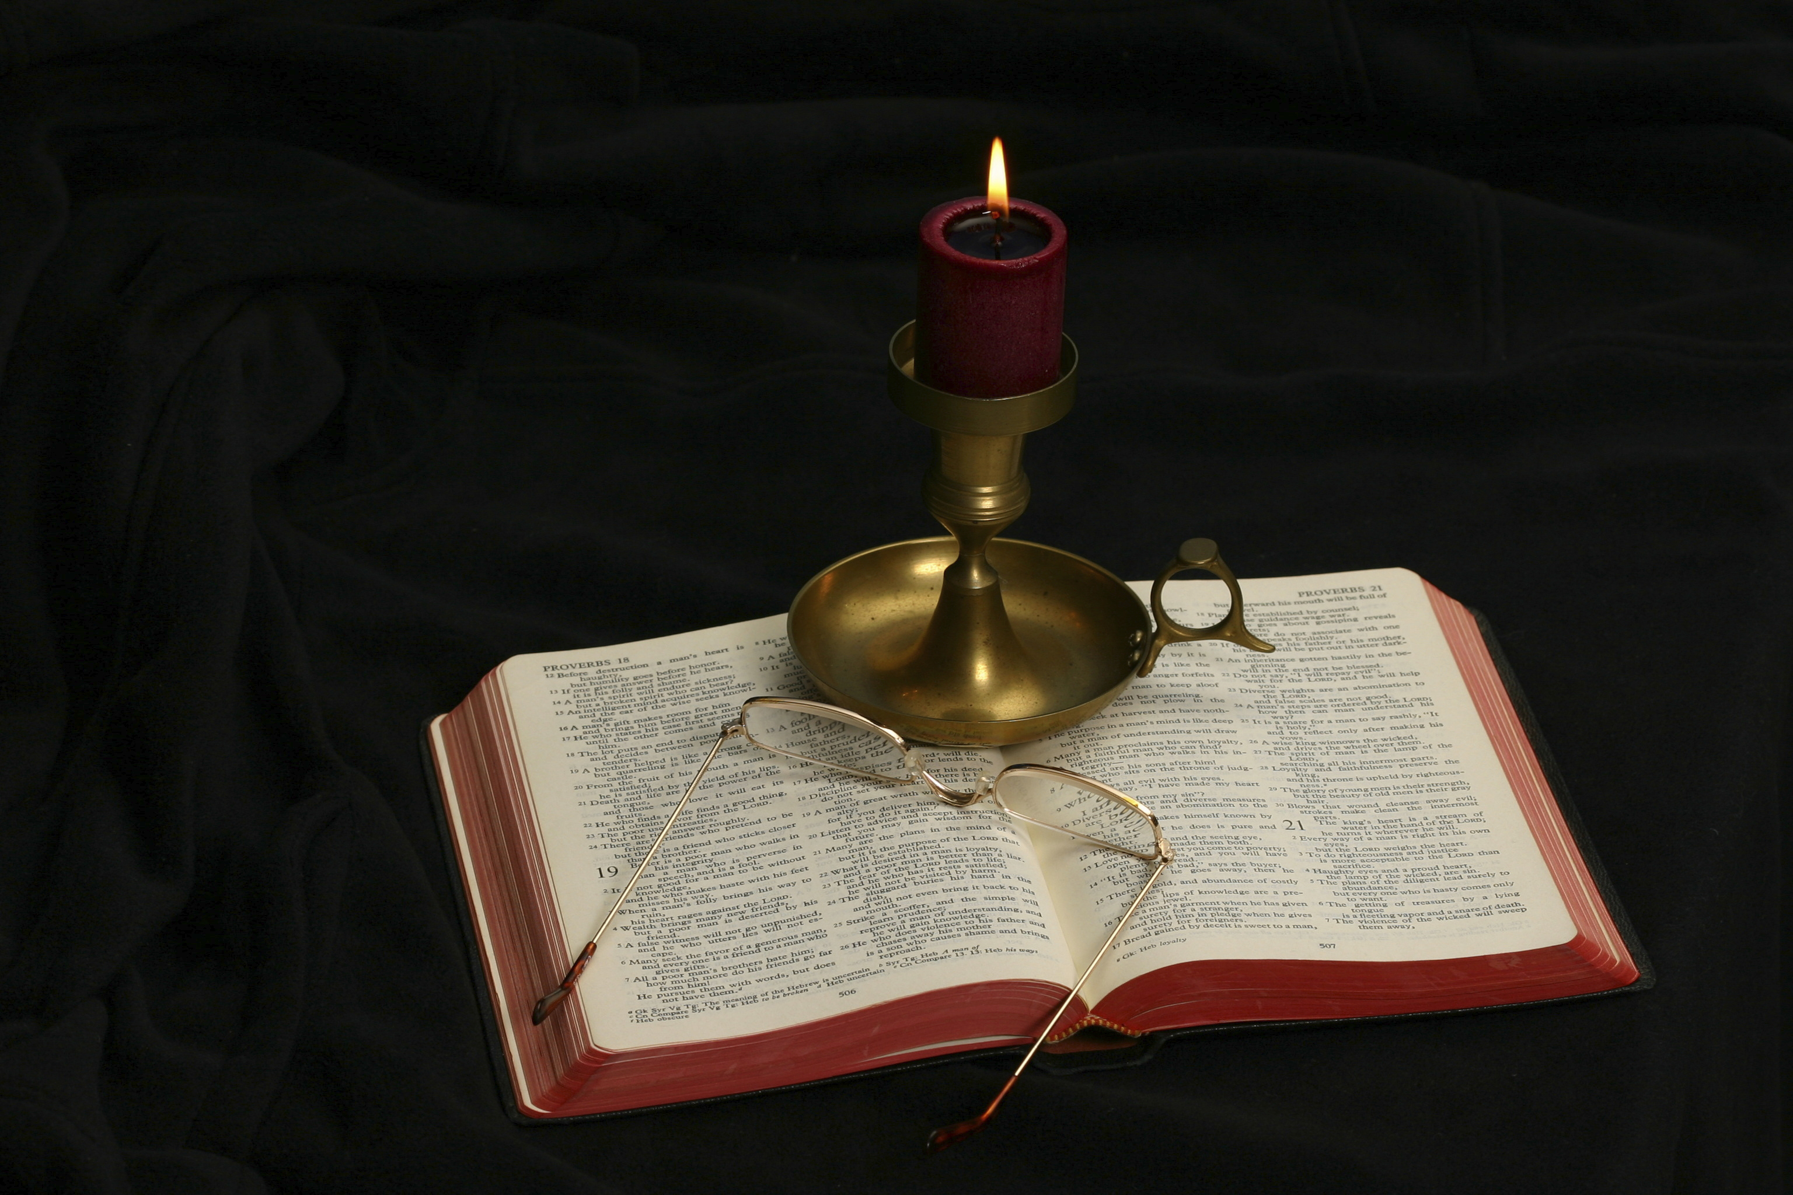
The Gospel of Matthew
Chapter 8

Slide 3
Setting the Context
Matthew 4:23— “And Jesus went about all Galilee, teaching in their synagogues, preaching the gospel of the kingdom, and healing all kinds of sickness and all kinds of disease among the people.”
Jesus’s Sermon on the Mount (chs. 5-7): Jesus’s teaching
Jesus’s miracles (chs. 8-9)

Slide 4
Jesus’s Miracles
Ten miracles divided into three groups of three:
First group: healing of leper (8:1-4), healing of centurion’s servant (8:5-13), healing of Peter’s mother-in-law (8:14-17)
First Separation: call to follow Jesus (8:18-22)
Second group: stilling of the tempest (8:23-27), healing of Gergesene demoniac (8:28-34), healing of man sick of palsy (9:1-8)
Second Separation: call of Matthew (9:9-13), question about fasting (9:14-17)
Third group: Healing of woman with issue of blood and raising of Jairus’s daughter (9:18-26), healing of two blind men (9:27-30), healing of dumb man possessed of a demon (9:31-34).
Summary statement (9:35-38)

Slide 5
Observations
Matthew is not strictly following a chronological order
The harmonies of the gospel struggle to put in chronological order the events in Matthew 8-9.
Both the Sermon on the Mount and the two chapters of miracles leave one with the impression that Matthew has grouped information together to emphasize the unparalleled authority of Jesus the Messiah.

Slide 6
Jesus Cleanses a Leper (Matt. 8:1-4) First Group: First Miracle
“When He had come down from the mountain, great multitudes followed Him. And behold, a leper came and worshiped Him, saying, ‘Lord, if You are willing, You can make me clean.’ Then Jesus put out His hand and touched him, saying, ‘I am willing; be cleansed.’ Immediately his leprosy was cleansed. And Jesus said to him, ‘See that you tell no one; but go your way, show yourself to the priest, and offer the gift that Moses commanded, as a testimony to them.’”

Slide 7
Matthew 8:1
When He had come down from the mountain, great multitudes followed Him.
The verse is joined to the Sermon on the Mount by “He came down from the mountain.”
What does this verse show us?
Did Jesus’s teaching drive people away from Him?
What do we learn about teaching hard teaching such, as “looking on a woman to lust after her,” “divorce and remarriage,” “exposing the hypocrisy of contemporary religion” (or denominations), making harsh demands on one’s members (love those who hate you, be willing to suffer persecution for Christ’s sake)?

Slide 8
Matthew 8:2
“And behold, a leper came and worshiped Him, saying, ‘Lord, if You are willing, You can make me clean.’”
This miracle appears in Mark 1:40-45 and Luke 5:12-16.
What standing did a leper have in Israel?
How do you think the crowd that followed Jesus would have reacted to the approach of the leper?
What three things demonstrated the leper’s faith?
What is the significance of using “make me clean” instead of “heal me”?

Slide 9
Matthew 8:3
“Then Jesus put out His hand and touched him, saying, ‘I am willing; be cleansed.’ Immediately his leprosy was cleansed.”
What gave Jesus’s touching the leper additional significance (see Lev. 5:3)?
Jesus’s reply consists of two words in Greek, thelō, katharisthēti.
The first word answers “if you are willing.”
The second word removes the leprosy.
What medicine did Jesus use? What surgery did He perform?
How did Jesus cleanse the leper?
What is the point of the adverb “immediately”?

Slide 10
Matthew 8:4
“And Jesus said to him, ‘See that you tell no one; but go your way, show yourself to the priest, and offer the gift that Moses commanded, as a testimony to them.’”
R.T. France: “This motif of secrecy, which is often regarded as an apologetic device of Mark to explain why so few responded to Jesus during his ministry, is better understood as reflecting a real danger that Jesus could achieve unwanted popularity merely as a wonderworker, or worse still as a nationalistic liberator, and so foster a serious misunderstanding of the true nature of his mission” (Matthew: An Introduction and Commentary, 157).
What is the significance of having a priest examine the leper and offering a gift at the Temple (Lev. 14:10, 21-22)?
In what way would doing this be a “testimony” to them?

Slide 11
Jesus Heals a Centurion’s Servant First Group: Second Miracle (8:5-13)
“Now when Jesus had entered Capernaum, a centurion came to Him, pleading with Him, saying, ‘Lord, my servant is lying at home paralyzed, dreadfully tormented.’ And Jesus said to him, ‘I will come and heal him.’ The centurion answered and said, ‘Lord, I am not worthy that You should come under my roof. But only speak a word, and my servant will be healed. For I also am a man under authority, having soldiers under me. And I say to this one, “Go,” and he goes; and to another, “Come,” and he comes; and to my servant, “Do this,” and he does it.’ When Jesus heard it, He marveled, and said to those who followed, ‘Assuredly, I say to you, I have not found such great faith, not even in Israel! And I say to you that many will come from east and west, and sit down with Abraham, Isaac, and Jacob in the kingdom of heaven. But the sons of the kingdom will be cast out into outer darkness. There will be weeping and gnashing of teeth.’ Then Jesus said to the centurion, ‘Go your way; and as you have believed, so let it be done for you.’ And his servant was healed that same hour.”

Slide 12
General Comments
Luke 7:1-10 records the same event.
In Luke’s account the conversation with Jesus occurs through intermediaries.
Matthew gives the narrative without mentioning the intermediaries.
What does Luke 7:5 tell us about this centurion?

Slide 13
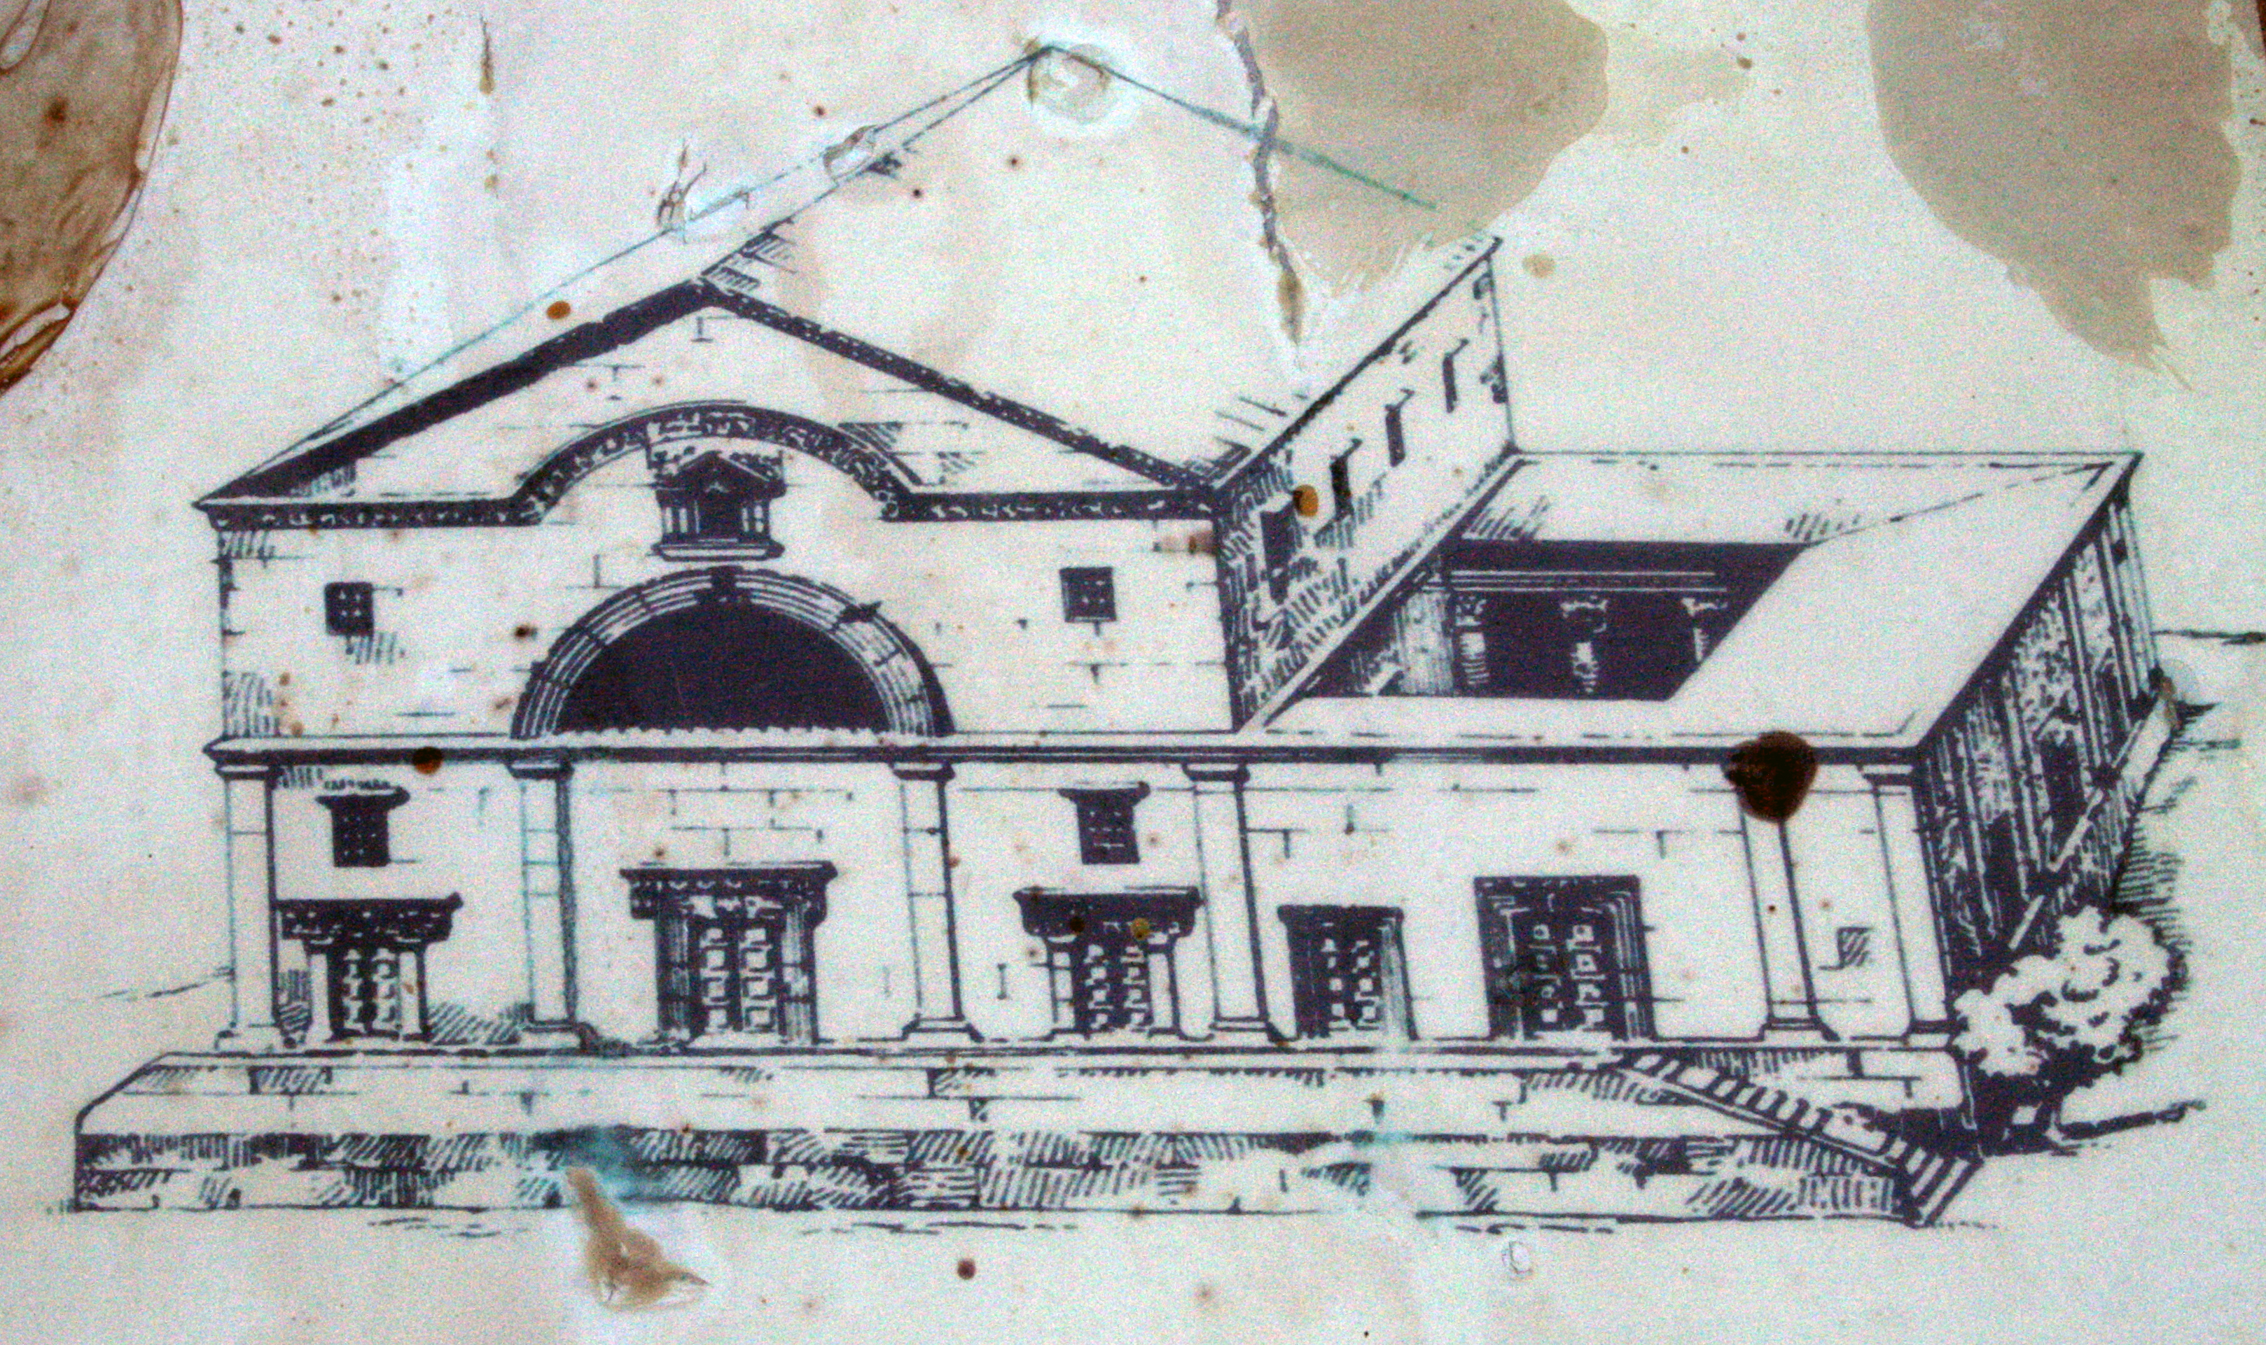

Slide 14
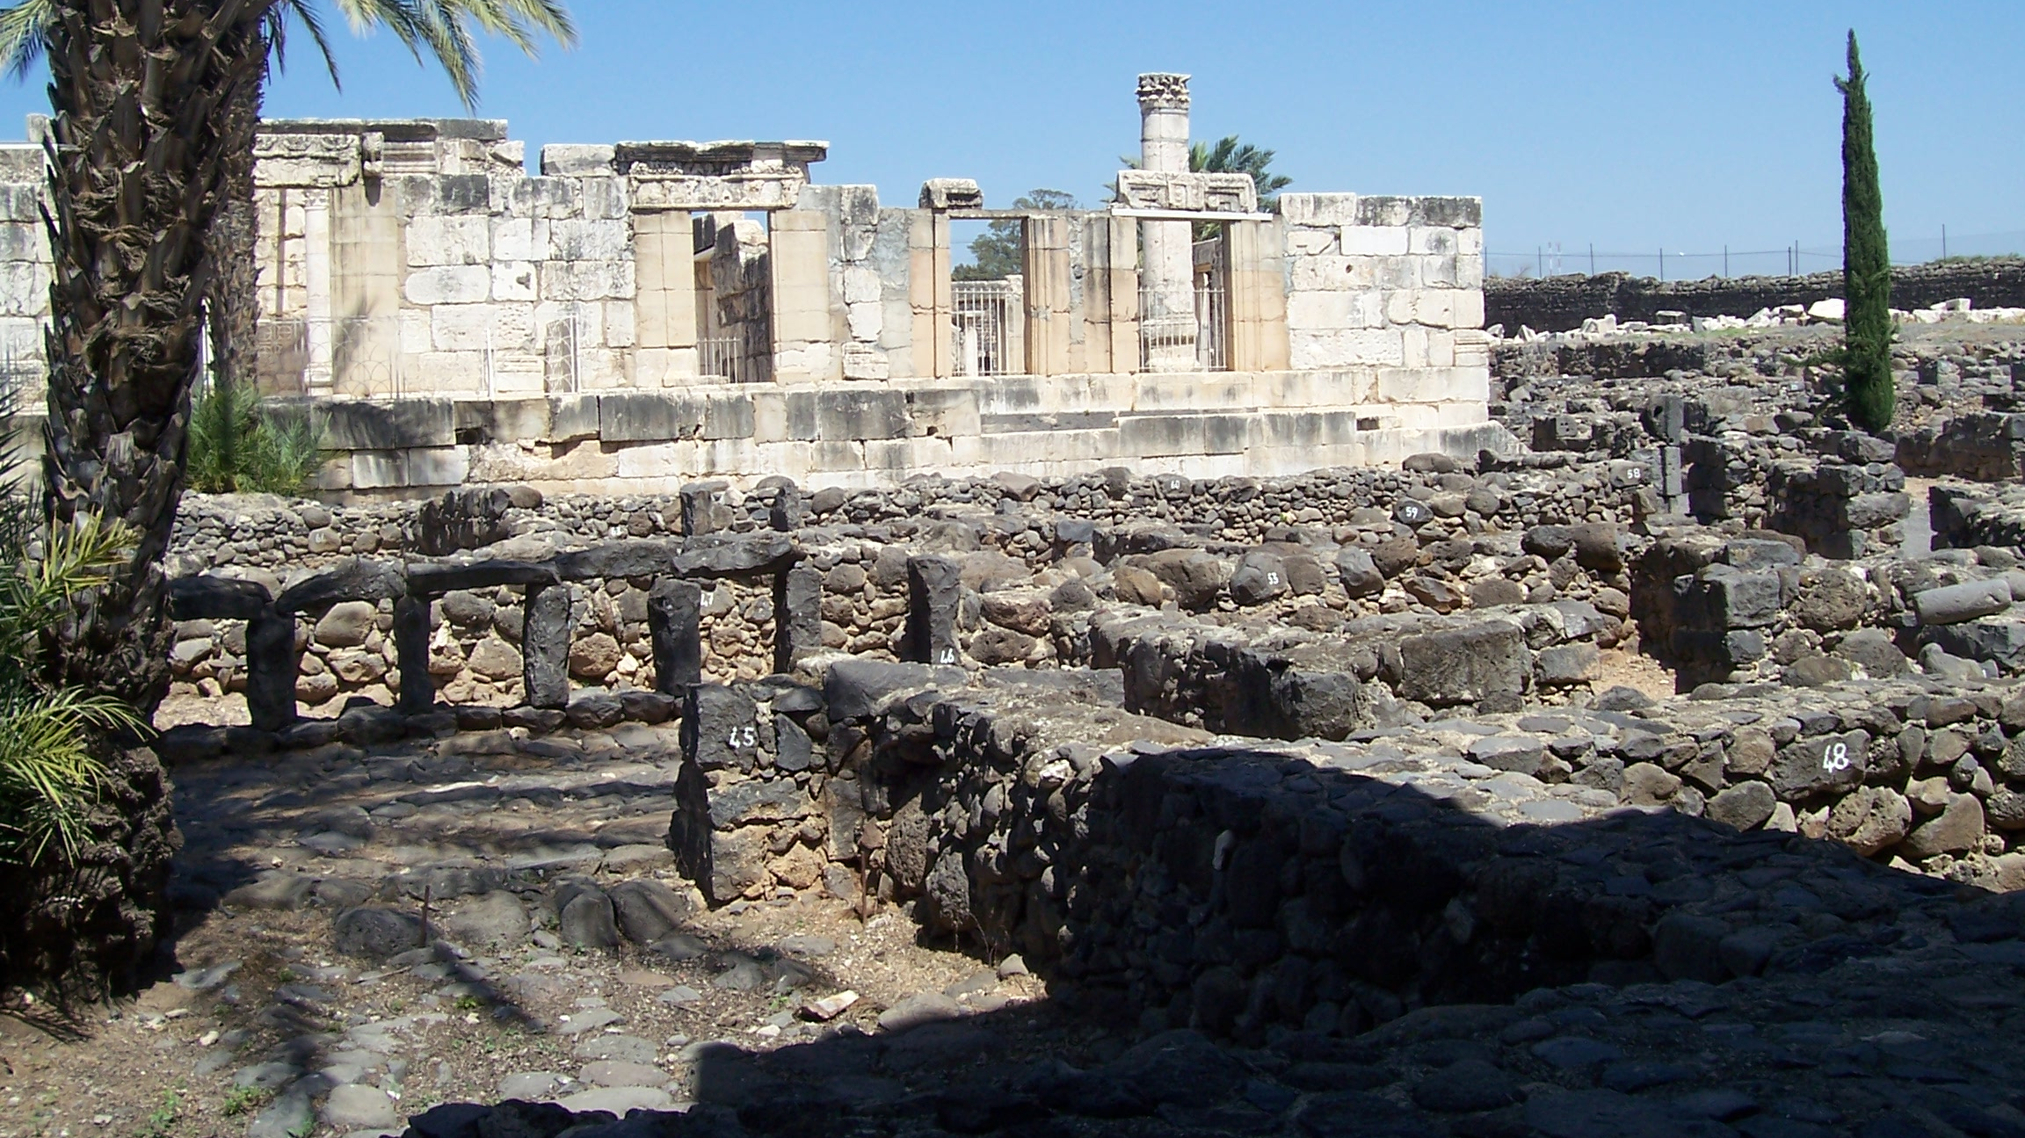
Fourth Century Synagogue Remains at Capernaum, built on foundation of first century synagogue.

Slide 15
General Comments
Luke 7:1-10 records the same event.
In Luke’s account the conversation with Jesus occurs through intermediaries.
Matthew gives the narrative without mentioning the intermediaries.
What does Luke 7:5 tell us about this centurion?
John 4:46-54 has enough similarities that some believe it records the same event; others affirm they are separate events based on where Jesus was (Cana) when the miracle occurred.
The first two miracles have a common tie: uncleanness.
The leper was unclean because of his disease.
The centurion is unclean and excluded because he is a Gentile.
This miracle highlights another Matthean theme: the gospel should be preached to Gentiles.

Slide 16
Matthew 8:5
“Now when Jesus had entered Capernaum, a centurion came to Him, pleading with Him, . . .”
The event happened in Capernaum.
The man was a centurion (hekatontarchēs), “a Roman officer commanding about a hundred men (subordinate to a tribute), centurion, captain” (BDAG, 299).
Pleading (parakaleo: “to make a strong request for something, request, implore, entreat,” BDAG, 765).
A Roman officer did not normally plead with Jewish men.

Slide 17
Matthew 8:6
. . . saying, “Lord, my servant is lying at home paralyzed, dreadfully tormented.”
The centurion addressed Jesus as Lord. The word can mean a polite “sir” or “master,” or it may reflect a perception of the deity of Jesus.
In Matthew’s account, the sick person is designated a pais, which can be a “boy, youth,” a child, or a slave or servant (BDAG, 750). In Luke’s account, he is designated a doulos, a servant (Luke 7:2).
By contrast, the sick person in John 4:46-54 is designated a huios, a son.
One can sense the affection the centurion has for his servant.
Paralyzed (paralutikos): “lame person, paralytic” (BDAG, 768).
Tormented (basanizō): the word is used of suffering brought on by diseases (BDAG, 168).
It is modified by the adverb dreadfully (deniōs), “an extreme negative point on a scale relating to values, terribly” (BDAG, 215).
Luke adds that he was “ready to die” (7:2).

Slide 18
Matthew 8:7
“And Jesus said to him, ‘I will come and heal him.’”
“I will come” has an emphatic “I.” It may be an allusion to the intermediaries through whom the request was made. Instead of sending a word through intermediaries, Jesus said that He would go directly to the Gentile’s house.
However, the NIV makes Jesus’s response a question: “Shall I come and heal him?”
The Jews thought that intermingling with Gentiles made one unclean. In treating this sentence as a question, the NIV translation is this: “Was the centurion asking Jesus to make himself unclean by coming to heal the lad?”
Heal (therapeuō): “heal, restore” (BDAG, 453).

Slide 19
Matthew 8:8
“The centurion answered and said, ‘Lord, I am not worthy that You should come under my roof. But only speak a word, and my servant will be healed.’”
The use of “Lord” again.
Worthy (hikanos): “pertaining to meeting a standard, fit, appropriate, competent, qualified, able, with the connotation worthy, good enough” (BDAG, 472). The same word appears in 3:11 (“whose shoes I am not worthy to unloose”).
In what sense did the centurion consider himself unworthy?
What is implied about the faith of the centurion by his words, “But only speak a word, and my servant will be healed”?

Slide 20
Matthew 8:9
“For I also am a man under authority, having soldiers under me. And I say to this one, ‘Go,’ and he goes; and to another, ‘Come,’ and he comes; and to my servant, ‘Do this,’ and he does it.”
The centurion considers Jesus’s authority to be similar to his own: “Just as he can command others to carry out the orders he himself has been given and can expect their instant and complete obedience, so also he believes that Jesus, under God’s authority, gives orders for illnesses to be cured instantaneously” (Craig Blomberg, Matthew, 141).
The centurion is not being arrogant, for he himself is under authority.
His idea was that there was no need for Jesus to come into contact with his house to make Himself unclean.
Jesus shows that He has the kind of authority the centurion describes when He speaks to the winds and waves and they obey Him.

Slide 21
Matthew 8:10
“When Jesus heard it, He marveled, and said to those who followed, ‘Assuredly, I say to you, I have not found such great faith, not even in Israel!’”
Why was Jesus amazed at the centurion’s faith?
To whom does Jesus speak when He says, “O ye of little faith” (6:30; 8:26; 14:31; 16:8)?
How would you compare the centurion’s faith to a Jew’s faith in regard to its theological content?
John Nolland: “The kind of faith in view is one that recognises and responds to what God has now begun to do in Jesus. As in Luke, ‘Faith … is attributed to those who act decisively on the basis of the conviction that God’s help is to be found with Jesus and gratefully receive God’s action through him’” (The Gospel of Matthew: A Commentary on the Greek Text, 356).

Slide 22
Matthew 8:11
“And I say to you that many will come from east and west, and sit down with Abraham, Isaac, and Jacob in the kingdom of heaven.”
Sit down (anaklinō) describes the Jewish practice of reclining at a table.
Who are those who come from the “east and west”?
What is the point of what Jesus said in this verse?
What is the significance of Abraham, Isaac, and Jacob?
What are some passages in the Old Testament which emphasize the Gentiles participating in the Messiah’s kingdom?
“In you all the families of the earth shall be blessed” (Gen. 12:8; 18:18; 22:18; 26:4; Gal. 3:8; Isa. 2:2; 56:3-7; Mal. 1:11).
How is “kingdom of heaven” used in this verse?

Slide 23
The Messianic Banquet
“And in this mountain The Lord of hosts will make for all people A feast of choice pieces, A feast of wines on the lees, Of fat things full of marrow, Of well-refined wines on the lees. And He will destroy on this mountain The surface of the covering cast over all people, And the veil that is spread over all nations. He will swallow up death forever, And the Lord God will wipe away tears from all faces; The rebuke of His people He will take away from all the earth; For the Lord has spoken” (Isa. 25:6-8).
Leon Morris: “One way first-century Jews had of referring to the coming bliss was to speak of the messianic banquet, an occasion of festivity in the world to come. To recline with the patriarchs was to feast in leisurely manner in the very best company. The patriarchs would undoubtedly be the recipients of God’s blessing in the coming world; therefore, to be associated with them was to share the blessing. This is what Jesus speaks of here, as his mention of leisure with the patriarchs and the reference to the kingdom of heaven (see on 3:2) clearly show” (The Gospel according to Matthew, The Pillar New Testament Commentary, 195).

Slide 24
Matthew 8:12
“But the sons of the kingdom will be cast out into outer darkness. There will be weeping and gnashing of teeth.”
Who are intended by “the sons of the kingdom”?
R. T. France quoted Joachim Jeremias as saying: “‘It was the current belief that no descendant of Abraham could be lost’” (Matthew: An Introduction and Commentary, 160).
What is meant by “outer darkness” and what does it mean?
The plague of darkness in Egypt excluded the Israelites and became a symbol of the lost condition of the Gentiles (Wisdom of Solomon 17:17, 21; Tob. 14:10; Psalms of Solomon 14:9).
The NT used darkness as a place of the lost (2 Pet. 2:17; Jude 13).
Those who are lost are forever separated from the Lord (2 Thess. 1:9), the Father of lights (Jas. 1:17).
Outer (exōteros): “farthest, extreme” (BDAG, 355).

Slide 25
Weeping and Gnashing of Teeth
This phrase appears six times in Matthew (8:12; 13:42, 50; 22:13; 24:51; 25:30) and once in Luke (Luke 13:28).
Weeping (klauthmos).
Gnashing (brugmos): “gnashing of teeth striking together. . . Grinding of teeth because of pain” (BDAG, 184).
Leon Morris: “Wailing signifies not only grief but grief loudly expressed, while the definite article ‘indicates the unique and extreme character of the action’ (BAGD); it is not any old wailing that is meant, but the wailing that is associated with final rejection. It will be accompanied by the grinding of teeth, another proverbial expression for distress and mostly used in the New Testament, as here, for grief (or possibly anger or vexation) at the final rejection” (The Gospel according to Matthew, The Pillar New Testament Commentary, 196).

Slide 26
Matthew 8:13
“Then Jesus said to the centurion, ‘Go your way; and as you have believed, so let it be done for you.’ And his servant was healed that same hour.”
What evidences of Jesus’s deity do you see in this miracle?
What part does the faith of the one who was healed play in his healing?
What part does the centurion’s faith play in his servant’s healing?
Can you think of another instance when someone else’s faith led them to bring their sick to Jesus for healing?
The man let down through the roof

Slide 27
Healing of Peter’s Mother-in-Law First Group: Third Miracle (8:14-15)
“Now when Jesus had come into Peter’s house, He saw his wife’s mother lying sick with a fever. So He touched her hand, and the fever left her. And she arose and served them. When evening had come, they brought to Him many who were demon-possessed. And He cast out the spirits with a word, and healed all who were sick, that it might be fulfilled which was spoken by Isaiah the prophet, saying: ‘He Himself took our infirmities And bore our sicknesses’” (Matt. 8:14-17).

Slide 28
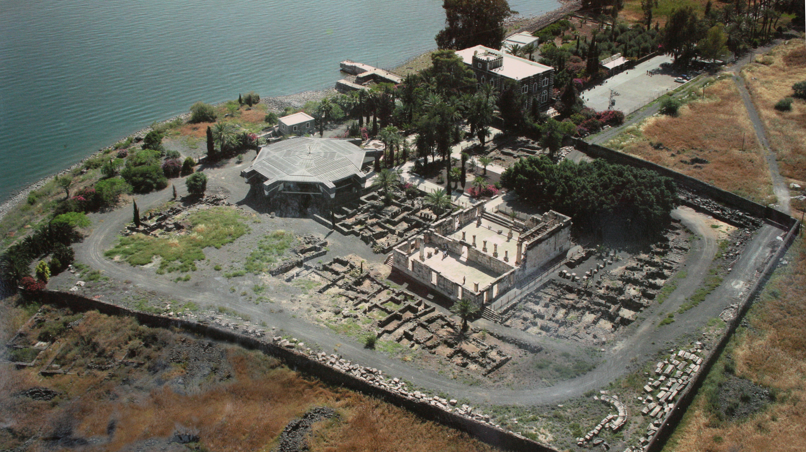
Aerial View of Capernaum

Slide 29
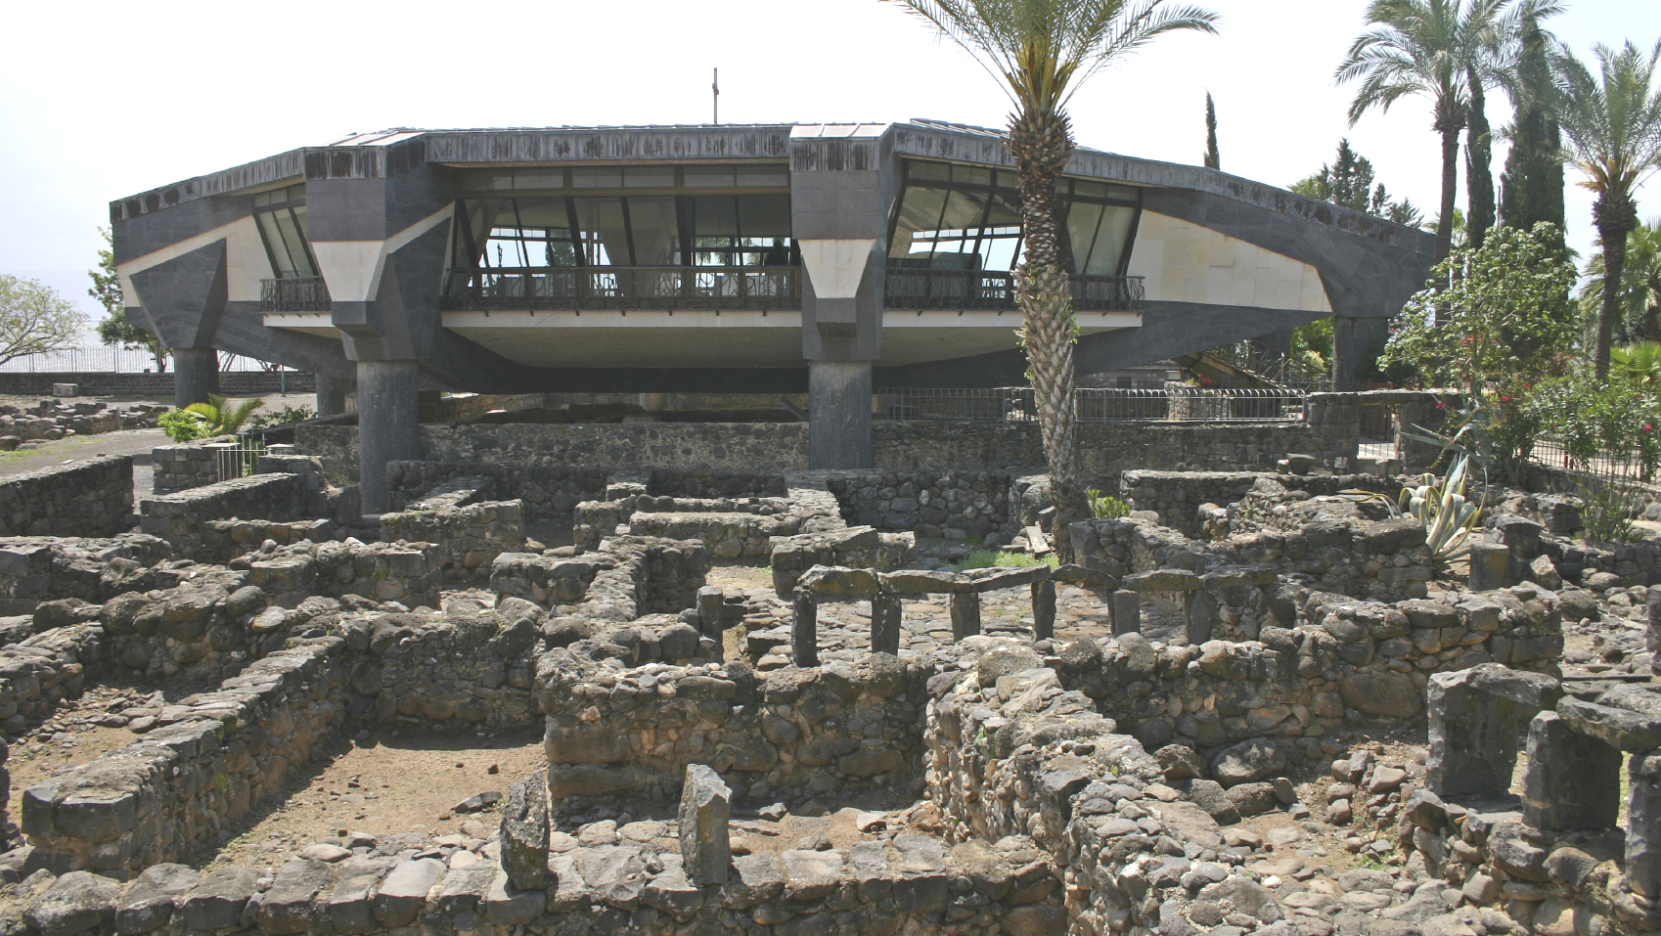
Chapel over the Ruins of Peter’s House

Slide 30
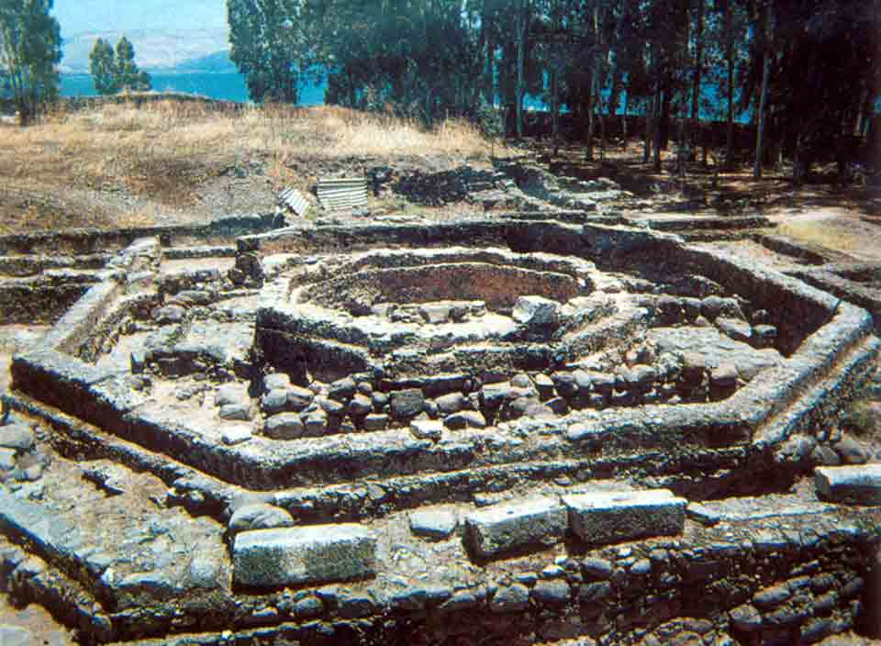
The Excavated Ruins

Slide 31
Structural Organization
Jesus’s Actions
The Result
He comes into the house
He sees Peter’s mother-in-law
He touches her hand
The fever leaves
The woman rises
The woman serves Jesus
Chart taken from Davies and Allison, Commentary on Matthew, 2:32

Slide 32
Information from the Parallel Accounts
Mark 1:29-34
Luke 4:38-41
“Now as soon as they had come out of the synagogue, they entered the house of Simon and Andrew, with James and John. But Simon’s wife’s mother lay sick with a fever, and they told Him about her at once. So He came and took her by the hand and lifted her up, and immediately the fever left her. And she served them. At evening, when the sun had set, they brought to Him all who were sick and those who were demon-possessed. And the whole city was gathered together at the door. Then He healed many who were sick with various diseases, and cast out many demons; and He did not allow the demons to speak, because they knew Him.”
“Now He arose from the synagogue and entered Simon’s house. But Simon’s wife’s mother was sick with a high fever, and they made request of Him concerning her. So He stood over her and rebuked the fever, and it left her. And immediately she arose and served them. When the sun was setting, all those who had any that were sick with various diseases brought them to Him; and He laid His hands on every one of them and healed them. And demons also came out of many, crying out and saying, ‘You are the Christ, the Son of God!’ And He, rebuking them, did not allow them to speak, for they knew that He was the Christ.”

Slide 33
Matthew 8:14
“Now when Jesus had come into Peter’s house, He saw his wife’s mother lying sick with a fever.”
The miracle is also recorded in Mark 1:29-34 and Luke 4:38-41. The miracle occurred on a Sabbath day, after coming home from the synagogue (Mark 1:21).
Lying sick is translated from the word ballō, with the meaning “of physical disability, . . . lying sick” (BDAG, 163).
Her sickness is described by the word puressō, “suffer with a fever” (BDAG, 899).
Why is it significant that Peter had a mother-in-law?

Slide 34
Matthew 8:15
“So He touched her hand, and the fever left her. And she arose and served them.”
Craig L. Blomberg: “But the only point that concerns Matthew is Jesus’ compassion for yet a third category of people who were viewed as second-class citizens within Judaism, namely, women” (Matthew, The New American Commentary, 143).
How long did it take for the woman to become well?
What is the significance of stating that the woman “arose and served them”?

Slide 35
Summary of Jesus’s Healing Ministry Matthew 8:16-17
“When evening had come, they brought to Him many who were demon-possessed. And He cast out the spirits with a word, and healed all who were sick, that it might be fulfilled which was spoken by Isaiah the prophet, saying: ‘He Himself took our infirmities And bore our sicknesses.’”

Slide 36
Matthew 8:16
When evening had come, they brought to Him many who were demon-possessed. And He cast out the spirits with a word, and healed all who were sick, . . .”
Why is the phrase “when evening had come” important?
See Luke 4:31, which ties the miracles to the Sabbath.
Which diseases was Jesus able to heal?
How did Jesus cast out demons?
How did contemporary and modern exorcists attempt to cast out demons?
Jesus healed “all who were sick.”

Slide 37
Matthew 8:17
“. . . that it might be fulfilled which was spoken by Isaiah the prophet, saying: ‘He Himself took our infirmities And bore our sicknesses.’”
In light of Matthew’s use of the OT prophecies to confirm that Jesus is the Messiah, it is surprising that this is his only quotation from Isaiah 53.
This is the sixth prophecy cited in Matthew’s “that it might be fulfilled” proofs that Jesus is the Messiah.
Charismatics have used this verse to argue that healing from physical maladies is a present blessing of the atonement.
John Peter Lange and Philip Schaff: “Christ takes away disease, in token of His removing its root, sin, by taking upon Himself death as the full wages and the full burden of sin” (A Commentary on the Holy Scriptures: Matthew, 158).
Sin is sometimes pictured as a disease (Isa. 1:5-6).
Only in the world to come will physical sufferings end (Rev. 21:4).

Slide 38
First Separation: Call to Follow Jesus (Matthew 8:18-22)
“And when Jesus saw great multitudes about Him, He gave a command to depart to the other side. Then a certain scribe came and said to Him, ‘Teacher, I will follow You wherever You go.’ And Jesus said to him, ‘Foxes have holes and birds of the air have nests, but the Son of Man has nowhere to lay His head.’ Then another of His disciples said to Him, ‘Lord, let me first go and bury my father.’ But Jesus said to him, ‘Follow Me, and let the dead bury their own dead.’”
Parallel passage: Luke 9:57-62
The emphasis: Jesus demands wholehearted commitment!

Slide 39
Matthew 8:18
“And when Jesus saw great multitudes about Him, He gave a command to depart to the other side.”
Gave a command (keleuō): “to give a command, ordinarily of an official nature, command, order, urge” (BDAG, 538).
To whom was the command given?
Not likely to the multitudes, for He seems to be wanting to have some private time.
To the other side (eis to peran): this phrase shifts in meaning depending upon one’s geographical perspective.
The miracles of the first group are in and around Capernaum.
The miracles of the second group involve crossing the Sea of Galilee and arriving in the area of the Gergesenes/Gadarenes, on the east side of the Sea of Galilee.

Slide 40
Matthew 8:19
“Then a certain scribe came and said to Him, ‘Teacher, I will follow You wherever You go.’”
Scribe (grammateus): “specialists in the law of Moses: experts in the law, scholars versed in the law, scribes” (BDAG, 206).
Teacher (didaskalos): this term is “used in addressing Jesus (corresponding to the title rab, rabbi)” (BDAG, 241). Jesus is a teacher, but that is an inadequate description of who He is.
What this scribe expresses is what a disciple’s obligations are.

Slide 41
Matthew 8:20
“And Jesus said to him, ‘Foxes have holes and birds of the air have nests, but the Son of Man has nowhere to lay His head.’”
“Foxes have holes and birds have nests” contrasts with the conditions under which the Messiah worked with those of wild animals, emphasizing the sacrifices He made to redeem mankind.
Leon Morris: “To be the disciple of such a man might well be interesting, but it would be far from comfortable. The scribe’s reaction is not given, but certainly the cost of discipleship is brought clearly before him” (The Gospel according to Matthew, The Pillar New Testament Commentary, 201).

Slide 42
“Son of Man”
This is the first occurrence of the phrase “Son of Man” in Matthew. The phrase occurs in 30 verses.
The phrase ben ’ādām appears 108 in the Old Testament in most passages to express the human nature of the person so described.
However, Daniel 7:13-14 describes the Messiah’s ascension to heaven: “I was watching in the night visions, And behold, One like the Son of Man, Coming with the clouds of heaven! He came to the Ancient of Days, And they brought Him near before Him. Then to Him was given dominion and glory and a kingdom, That all peoples, nations, and languages should serve Him. His dominion is an everlasting dominion, Which shall not pass away, And His kingdom the one Which shall not be destroyed.” This meaning is Matthew’s meaning in all 30 uses.

Slide 43
Matthew 8:21
“Then another of His disciples said to Him, ‘Lord, let me first go and bury my father.’”
A second person, designated a disciple of Jesus, petitioned that he be allowed to go and bury his father.
R. T. France: “If his father was already dead, his request was a natural, even essential, one. The dead must be buried within 24 hours (though the subsequent ceremonies could last a week), and this duty was incumbent on the son. . . . It has been suggested, however, that the father was not yet dead, so that what was requested was an indefinite postponement” (Matthew: An Introduction and Commentary, 164).

Slide 44
Matthew 8:22
“But Jesus said to him, ‘Follow Me, and let the dead bury their own dead.’”
Jesus’s reply is this: “Following Jesus takes precedence over even family obligations.”
Dead is used in two senses in this verse: “. . . Let the (spiritually) dead bury their own (physically) dead.”
D. A. Carson: “Little has done more to harm the witness of the Christian church than the practice of filling its ranks with every volunteer who is willing to make a little profession, talk fluently of experience, but display little of perseverance” (quote from Craig Blomberg, Matthew, 148).

Slide 45
Jesus’s Miracles
Ten miracles divided into three groups of three:
First group: healing of leper (8:1-4), healing of centurion’s servant (8:5-13), healing of Peter’s mother-in-law (8:14-17)
First Separation: call to follow Jesus (8:18-22)
Second group: stilling of the tempest (8:23-27), healing of Gergesene demoniac (8:28-34), healing of man sick of palsy (9:1-8)
Second Separation: call of Matthew (9:9-13), question about fasting (9:14-17)
Third group: Healing of woman with issue of blood and raising of Jairus’s daughter (9:18-26), healing of two blind men (9:27-30), healing of dumb man possessed of a demon (9:31-34).
Summary statement (9:35-38)

Slide 46
Stilling of the Tempest Second Group: First Miracle (8:23-27)
“Now when He got into a boat, His disciples followed Him. And suddenly a great tempest arose on the sea, so that the boat was covered with the waves. But He was asleep. Then His disciples came to Him and awoke Him, saying, ‘Lord, save us! We are perishing!’ But He said to them, ‘Why are you fearful, O you of little faith?’ Then He arose and rebuked the winds and the sea, and there was a great calm. So the men marveled, saying, ‘Who can this be, that even the winds and the sea obey Him?’”

Slide 47
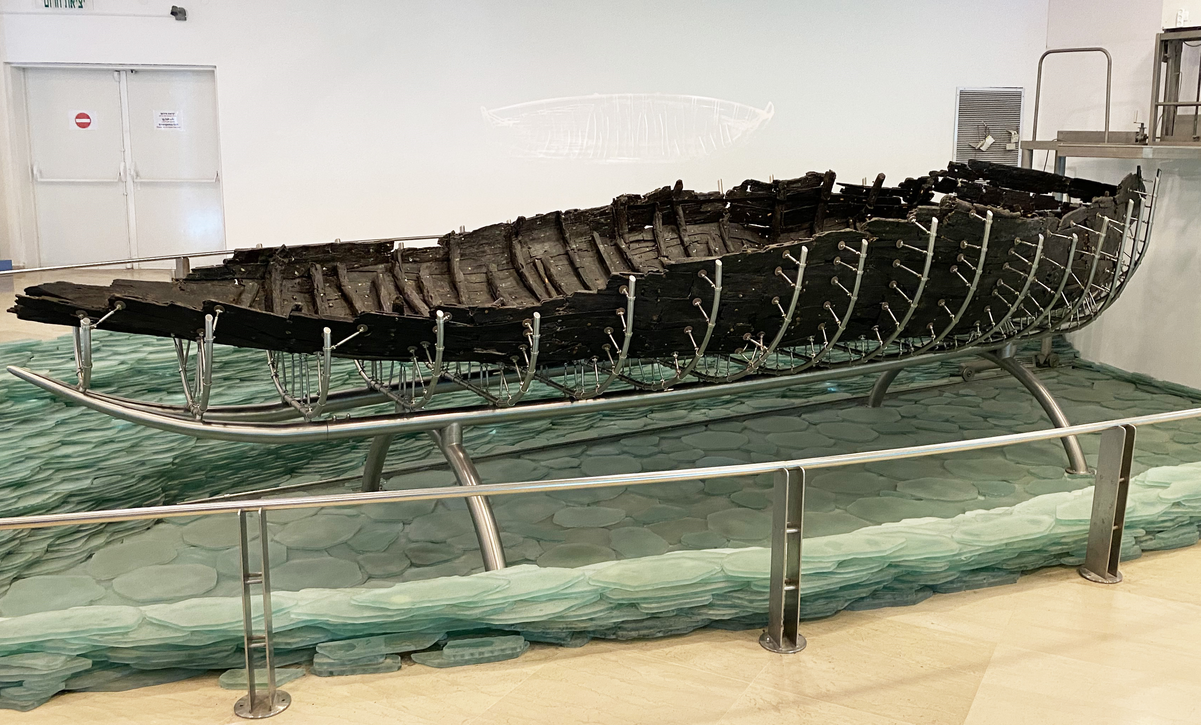
First Century AD Boat Recovered from the Sea of Galilee

Slide 48
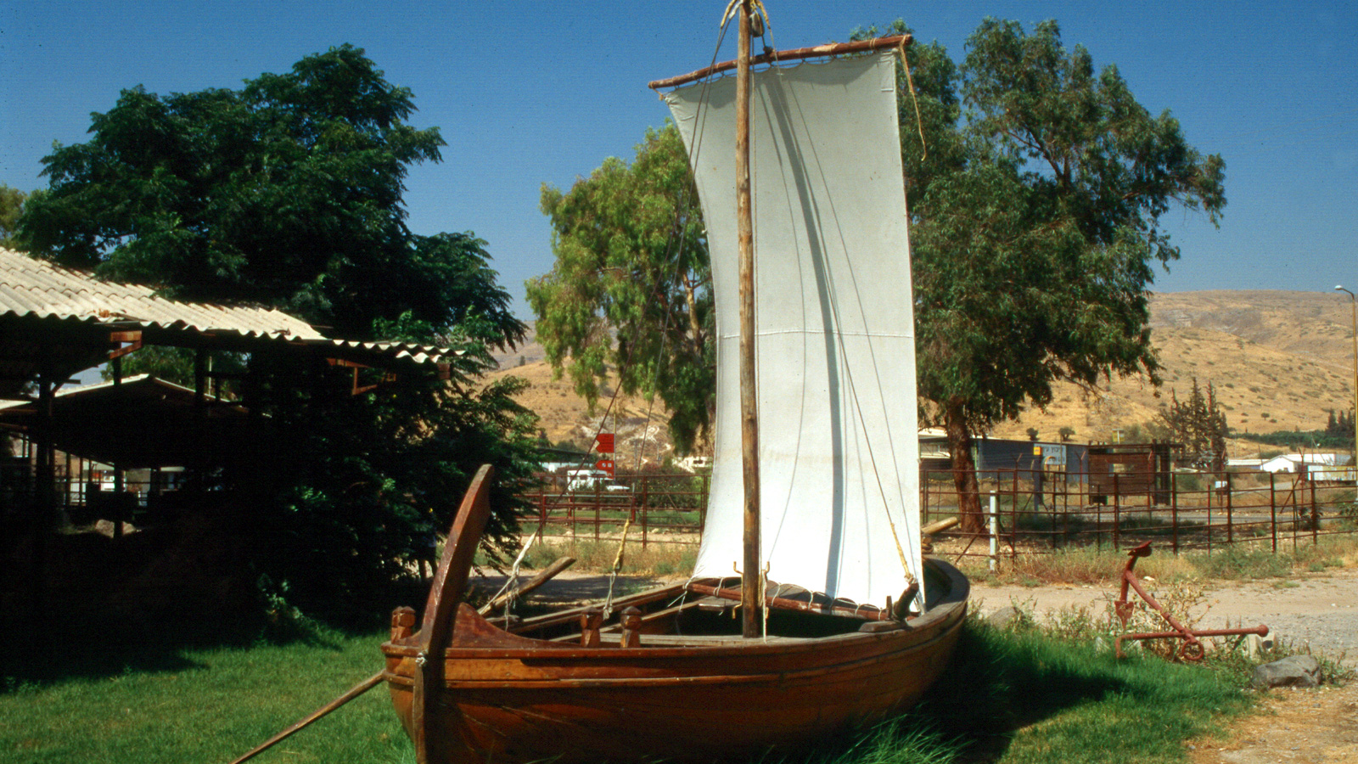
Full-Scaled Model of the Boat Recovered

Slide 49
Matthew 8:23-24
“Now when He got into a boat, His disciples followed Him. And suddenly a great tempest arose on the sea, so that the boat was covered with the waves. But He was asleep.”
The withdrawal from Capernaum to cross to the other side of the Sea (8:18) continues following the discussion about discipleship.
Jesus’s disciples did as Jesus commanded them.
Keep in mind that our author, Matthew, was one of the Twelve!

Slide 50
What Kind of Storm?
Matthew describes the tempest as a seismos: this is the word normally used for an earthquake, “a violent sharking or commotion, shock, agitation”; here it is used of “storm on a body of water, with waves caused by high winds” (BDAG, 918). This word is modified by the adjective great, to show its intensity and strength.
Mark (4:37) and Luke (8:23) use the word lailaps to describe the storm: “whirlwind, hurricane” (BDAG, 581).

Slide 51
Other Details
The effect of the storm was serious: “the boat was covered with the waves.”
Without question, the professional fishermen on the boat were doing their best of keep the boat afloat.
However, the boat was filling with water and the situation was becoming desperate (Mark 4:37; Luke 8:23).
Mark 4:36 includes an important additional fact: “And other little boats were also with Him.”
As all of this commotion is going on, Jesus is asleep on a pillow/cushion in the stern of the boat (Mark 4:38).
What can we learn about Jesus from this sentence?

Slide 52
Matthew 8:25
“Then His disciples came to Him and awoke Him, saying, ‘Lord, save us! We are perishing!’”
Why is this response unusual and astounding?
How is “save us” used in this context?
How is “perishing” used in this context?

Slide 53
Matthew 8:26
“But He said to them, ‘Why are you fearful, O you of little faith?’ Then He arose and rebuked the winds and the sea, and there was a great calm.”
Fearful (deilos): “cowardly, timid. . . Of a person lacking confidence” (BDAG, 215).
Would you and I have fit the description of little faith (oligopistos)?
Rebuked (epitimaō): “to express strong disapproval of someone, rebuke, reprove, censure also speak seriously, warn in order to prevent an action or bring one to an end” (BDAG, 384).
Have you ever heard of any charismatic claiming to duplicate this miracle by Jesus?

Slide 54
A Great Calm
Calm (galēnē): “an unruffled surface on a body of water, a calm, on a lake” (BDAG, 187). Like the “tempest,” the “calm” is modify by the adjective “great” to emphasize its stillness and quietness.
Leon Morris: “Matthew does not describe a gradual diminution of the force of the winds and the waves, but a sudden cessation of all the storm’s activity, so that everything was peaceful” (The Gospel according to Matthew, The Pillar New Testament Commentary, 206.

Slide 55
God Controls the Winds and Waves
“By awesome deeds in righteousness You will answer us, O God of our salvation, You who are the confidence of all the ends of the earth, And of the far-off seas; Who established the mountains by His strength, Being clothed with power; You who still the noise of the seas, The noise of their waves, And the tumult of the peoples. They also who dwell in the farthest parts are afraid of Your signs; You make the outgoings of the morning and evening rejoice” (Psa. 65:5-8).
“O Lord God of hosts, Who is mighty like You, O Lord? Your faithfulness also surrounds You. You rule the raging of the sea; When its waves rise, You still them” (Psa. 89:8-9).

Slide 56
Matthew 8:27
“So the men marveled, saying, ‘Who can this be, that even the winds and the sea obey Him?’”
Marveled (thaumazō): “wonder, marvel, be astonished” (BDAG, 444).
Notice the contrast between “the men” and the one whom “even the winds and the sea obey.”
What implications did the disciples draw from this miracle?
What powers did they perceive to be under Jesus’s control?
This kind of miracle is called a “nature miracle.”
One may try to explain miracles of healing as “the power of suggestion,” but he cannot explain raising the dead, commanding the winds and waves and they obey Him, in this manner!
What is the answer to the disciples’ unanswered question?

Slide 57
Not A Lesson About the Storms of Life
Craig L. Blomberg: “Matthew did not likely have such an application in mind. There are implications for discipleship here, to be sure; we must turn to Jesus as the one to trust in all circumstances of life. But the focus of this passage remains squarely Christological—on who Christ is, not on what he will do for us. One who has this kind of power can be no less than God himself, worthy of worship, irrespective of when and how he chooses to use that power in our lives. Sometimes he leaves storms unstilled for good and godly ends (cf. 2 Cor 12:7–8)” (Matthew, The New American Commentary, 150).

Slide 58
Healing of Gergesene Demoniac Second Group: Second Miracle (8:28-34)
“When He had come to the other side, to the country of the Gergesenes, there met Him two demon-possessed men, coming out of the tombs, exceedingly fierce, so that no one could pass that way. And suddenly they cried out, saying, ‘What have we to do with You, Jesus, You Son of God? Have You come here to torment us before the time?’ Now a good way off from them there was a herd of many swine feeding. So the demons begged Him, saying, ‘If You cast us out, permit us to go away into the herd of swine.’ And He said to them, ‘Go.’ So when they had come out, they went into the herd of swine. And suddenly the whole herd of swine ran violently down the steep place into the sea, and perished in the water. Then those who kept them fled; and they went away into the city and told everything, including what had happened to the demon-possessed men. And behold, the whole city came out to meet Jesus. And when they saw Him, they begged Him to depart from their region.”

Slide 59
Mark’s Account Has More
“. . . who had his dwelling among the tombs; and no one could bind him, not even with chains, because he had often been bound with shackles and chains. And the chains had been pulled apart by him, and the shackles broken in pieces; neither could anyone tame him. And always, night and day, he was in the mountains and in the tombs, crying out and cutting himself with stones. When he saw Jesus from afar, he ran and worshiped Him” (Mark 5:3-6).
“So those who fed the swine fled, and they told it in the city and in the country. And they went out to see what it was that had happened. Then they came to Jesus, and saw the one who had been demon-possessed and had the legion, sitting and clothed and in his right mind. And they were afraid. And those who saw it told them how it happened to him who had been demon-possessed, and about the swine. Then they began to plead with Him to depart from their region. And when He got into the boat, he who had been demon-possessed begged Him that he might be with Him. However, Jesus did not permit him, but said to him, ‘Go home to your friends, and tell them what great things the Lord has done for you, and how He has had compassion on you.’ And he departed and began to proclaim in Decapolis all that Jesus had done for him; and all marveled” (Mark 5:14-20).

Slide 60
Luke’s Account Has More
“For He had commanded the unclean spirit to come out of the man. For it had often seized him, and he was kept under guard, bound with chains and shackles; and he broke the bonds and was driven by the demon into the wilderness. Jesus asked him, saying, ‘What is your name?’ And he said, ‘Legion,’ because many demons had entered him. And they begged Him that He would not command them to go out into the abyss” (Luke 8:29-31).
“Then they went out to see what had happened, and came to Jesus, and found the man from whom the demons had departed, sitting at the feet of Jesus, clothed and in his right mind. And they were afraid. They also who had seen it told them by what means he who had been demon-possessed was healed. Then the whole multitude of the surrounding region of the Gadarenes asked Him to depart from them, for they were seized with great fear. And He got into the boat and returned. Now the man from whom the demons had departed begged Him that he might be with Him. But Jesus sent him away, saying, ‘Return to your own house, and tell what great things God has done for you.’ And he went his way and proclaimed throughout the whole city what great things Jesus had done for him” (Luke 8:35-39).

Slide 61
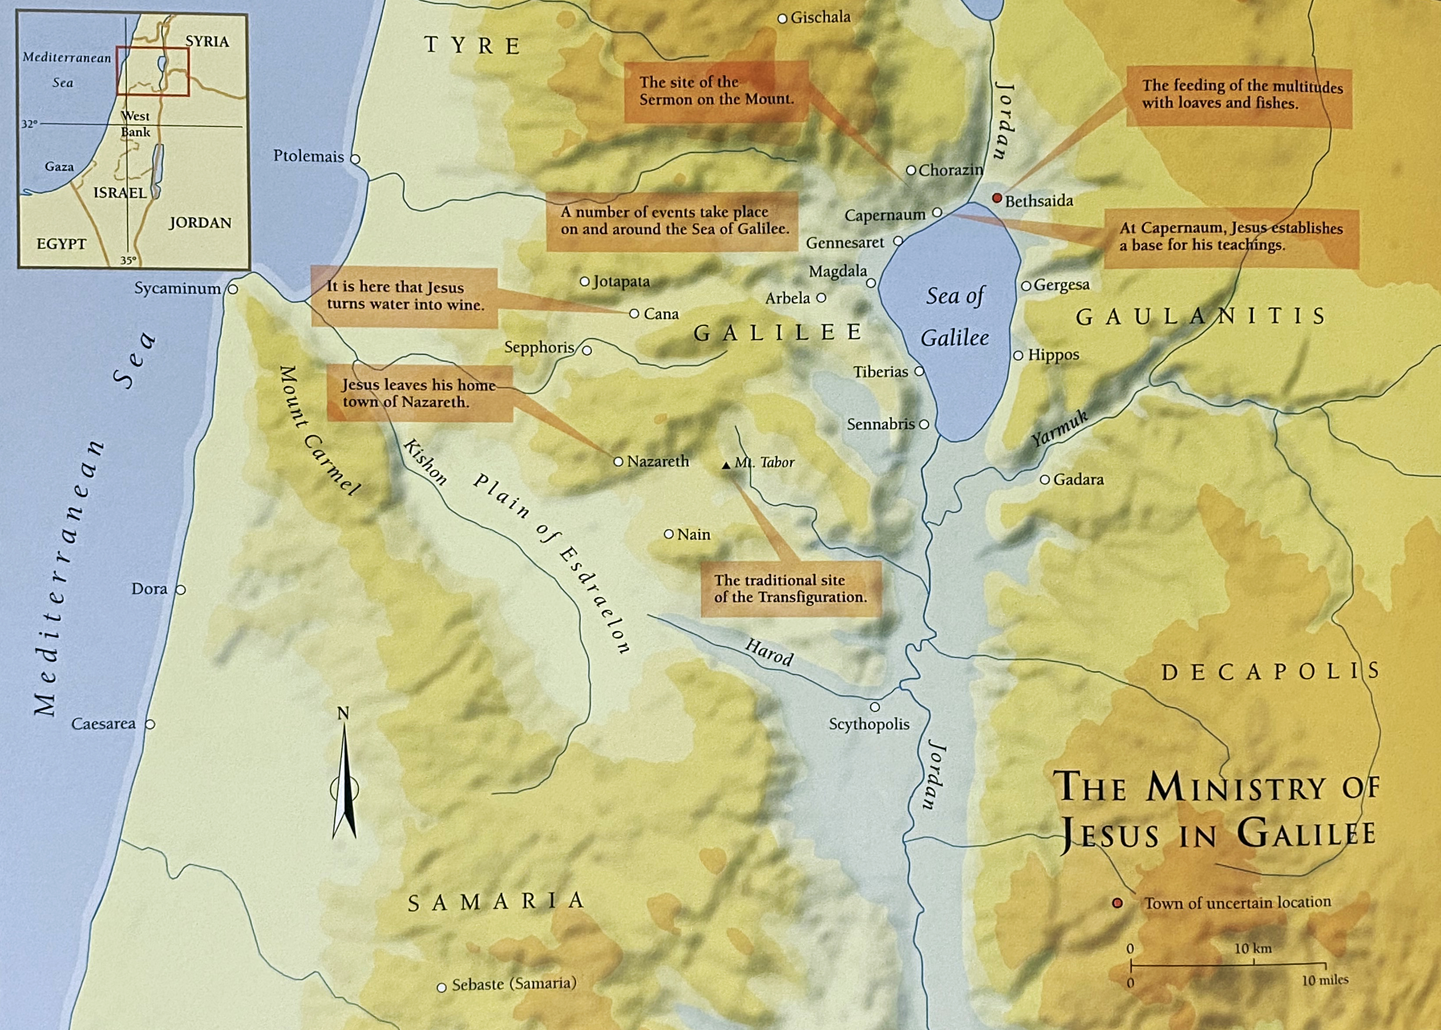
Modern Kersha, labeled Gergesa
Gadara: about 6 miles SE from Sea of Galilee
Jerash, Jordan: about 30+ miles SE of Sea of Galilee

Slide 62
Textual Variants
Matthew calls the demoniac a Gadarene (8:28); Mark (5:1) and Luke (8:26) call him a Gerasene.
Biblica says, “The incident takes place in Gentile territory insofar as the expelled demons are sent by Jesus into pigs who rush over a cliff to be drowned in the sea. The episode is said to take place in Gadara. Some manuscripts say instead it is in the land of the Gerasenes and yet others have the land of the Gergesenes. The reason for this textual uncertainty is that the place must fit the requirements of the story that the locality is near the Sea of Galilee. Gerasa and Gadara are too far away, so Gergesa was proposed.”

Slide 63
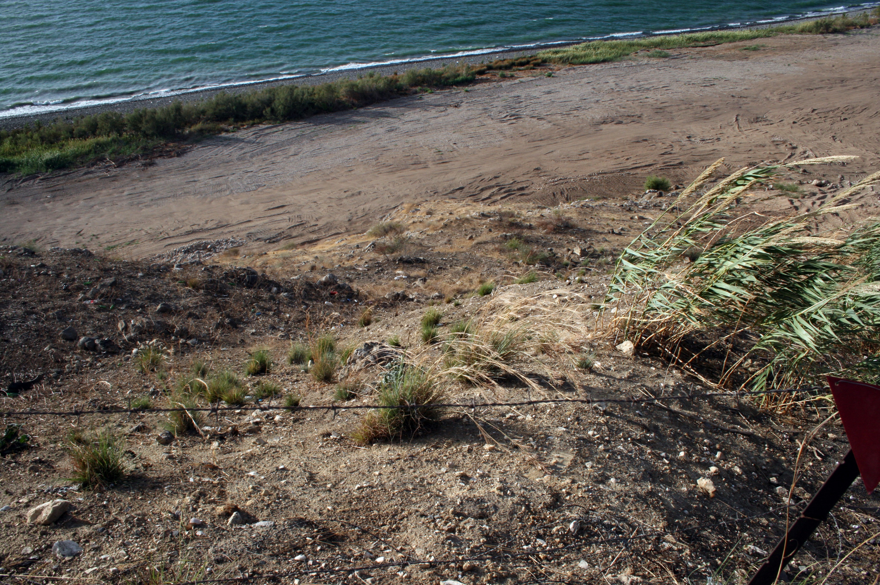
Precipice Near Kursi, Suggested Site for This Event

Slide 64
Matthew 8:28
When He had come to the other side, to the country of the Gergesenes, there met Him two demon-possessed men, coming out of the tombs, exceedingly fierce, so that no one could pass that way.
Both Mark 1:2 and Luke 8:27 mention a single man.
The two men are demon possessed.
How would you describe/define “demon possession”?
Daimonizomai: “be possessed by a hostile spirit” (BDAG, 209).
Fierce (chalepos): “pertaining to being troublesome, hard, difficult” (BDAG, 1075.
It is modified by lian, an adverb of degree meaning “to a high degree, very (much), exceedingly” (BDAG, 594).
What effect did the dwelling place of these two men have on them?
Why did people avoid passing where these two men were?

Slide 65
Demon Possession
Craig L. Blomberg: “Demonization (a more literal rendering of daimonizomenos) involves the indwelling of unseen evil spirits in a way that prevents an individual from fully controlling his or her own actions (Matthew, The New American Commentary, 151).
Leon Morris: “We should notice that demon possession is rare if it occurs at all in the Old Testament, and there are very few examples after the Gospels. In the Bible demon possession is part of the upsurge of evil opposing Jesus in the time of his incarnation” (The Gospel according to Matthew, The Pillar New Testament Commentary, 208).

Slide 66
Matthew 8:29
“And suddenly they cried out, saying, ‘What have we to do with You, Jesus, You Son of God? Have You come here to torment us before the time?’”
Who is speaking and what evidence do you have to support your answer?
What answers does this verse give to the following questions:
How did they know Jesus?
Who did they think He is?
Whose future is destined for “torment” (basanizō: “to subject to severe distress, torment, harass,” BDAG, 168)? See Rev. 20:10.
What immediate future did they fear?
What is implied in “before the time”?

Slide 67
Matthew 8:30-31
“Now a good way off from them there was a herd of many swine feeding. So the demons begged Him, saying, ‘If You cast us out, permit us to go away into the herd of swine.’”
What is significant about a herd of swine being nearby?
Verse 31 answers some of the questions posed on v. 29. It is not the two men who were speaking, but the demons speaking through them.
Can this same kind of demon possession occur today? Why or why not?
How does James 4:7 (“Resist the devil, and he will flee from you.”)provide an answer for us?
What does the word “permit”?

Slide 68
Matthew 8:32
“And He said to them, ‘Go.’ So when they had come out, they went into the herd of swine. And suddenly the whole herd of swine ran violently down the steep place into the sea, and perished in the water.”
What is the grammatical form of “go” and why is that important?
What does v. 32 state about the demons?
Ran violently (hormaō): “to make a rapid movement from one place to another, rush (headlong),” (BDAG, 724).
Steep place (krēmnos): “steep slope or bank, cliff” (BDAG, 566).
Who or what perished (apothnēskō, to die) in the water?

Slide 69
Save Men, Not Pigs
Craig L. Blomberg: “Readers concerned about the destruction of animal life and the loss of the farmers’ livelihood exhibit a contemporary sentimentality not shared by a Jewish audience who knew these pig farmers should not have been raising animals whose meat was forbidden to eat. Human sanity and salvation, moreover, must always take priority over financial prosperity” (Matthew, The New American Commentary, 152).

Slide 70
Matthew 8:33
“Then those who kept them fled; and they went away into the city and told everything, including what had happened to the demon-possessed men.”
What does “those who kept them” show about the historicity of this narrative?
Why did those caring for the pigs go and tell what had happened?
What did they report to the city—about the pigs or men?
What had happened to the demon-possessed men, according to Matthew? According to Mark 5:1-20 and Luke 8:26-39?
How do you react to this assessment of the narrative: “All down the ages the world has been refusing Jesus because it prefers its pigs” (P.P. Levertoff, St. Matthew, p. 26)?

Slide 71
Matthew 8:34
“And behold, the whole city came out to meet Jesus. And when they saw Him, they begged Him to depart from their region.”
What effect did the miracle have on the community?
Why?
What do Mark and Luke add to Matthew’s narrative?
What should one learn about Jesus from this exorcism?

Slide 72
Take Aways from the Miracle
Jesus’s authority:
Shown by His teaching (Sermon on the Mount)
Shown by His miracles
Shown by His power over the demonic forces/Devil

