Slide 2
Philippians
The book of Philippians is a short book of four chapters that can be read in 15 minutes.
The book contains several texts that are favorites to most Bible students:
“. . .according to my earnest expectation and hope that in nothing I shall be ashamed, but with all boldness, as always, so now also Christ will be magnified in my body, whether by life or by death. For to me, to live is Christ, and to die is gain. But if I live on in the flesh, this will mean fruit from my labor; yet what I shall choose I cannot tell. For I am hard pressed between the two, having a desire to depart and be with Christ, which is far better” (1:20-23).

Slide 3
Philippians 2:5-11
“Let this mind be in you which was also in Christ Jesus, who, being in the form of God, did not consider it robbery to be equal with God, but made Himself of no reputation, taking the form of a bondservant, and coming in the likeness of men. And being found in appearance as a man, He humbled Himself and became obedient to the point of death, even the death of the cross. Therefore God also has highly exalted Him and given Him the name which is above every name, that at the name of Jesus every knee should bow, of those in heaven, and of those on earth, and of those under the earth, and that every tongue should confess that Jesus Christ is Lord, to the glory of God the Father.”

Slide 4
Other Verses
“Therefore, my beloved, as you have always obeyed, not as in my presence only, but now much more in my absence, work out your own salvation with fear and trembling; for it is God who works in you both to will and to do for His good pleasure” (2:12-13).
“But what things were gain to me, these I have counted loss for Christ. Yet indeed I also count all things loss for the excellence of the knowledge of Christ Jesus my Lord, for whom I have suffered the loss of all things, and count them as rubbish, that I may gain Christ and be found in Him, not having my own righteousness, which is from the law, but that which is through faith in Christ, the righteousness which is from God by faith” (3:7-9).
“Not that I have already attained, or am already perfected; but I press on, that I may lay hold of that for which Christ Jesus has also laid hold of me. Brethren, I do not count myself to have apprehended; but one thing I do, forgetting those things which are behind and reaching forward to those things which are ahead, I press toward the goal for the prize of the upward call of God in Christ Jesus” (3:12-14).

Slide 5
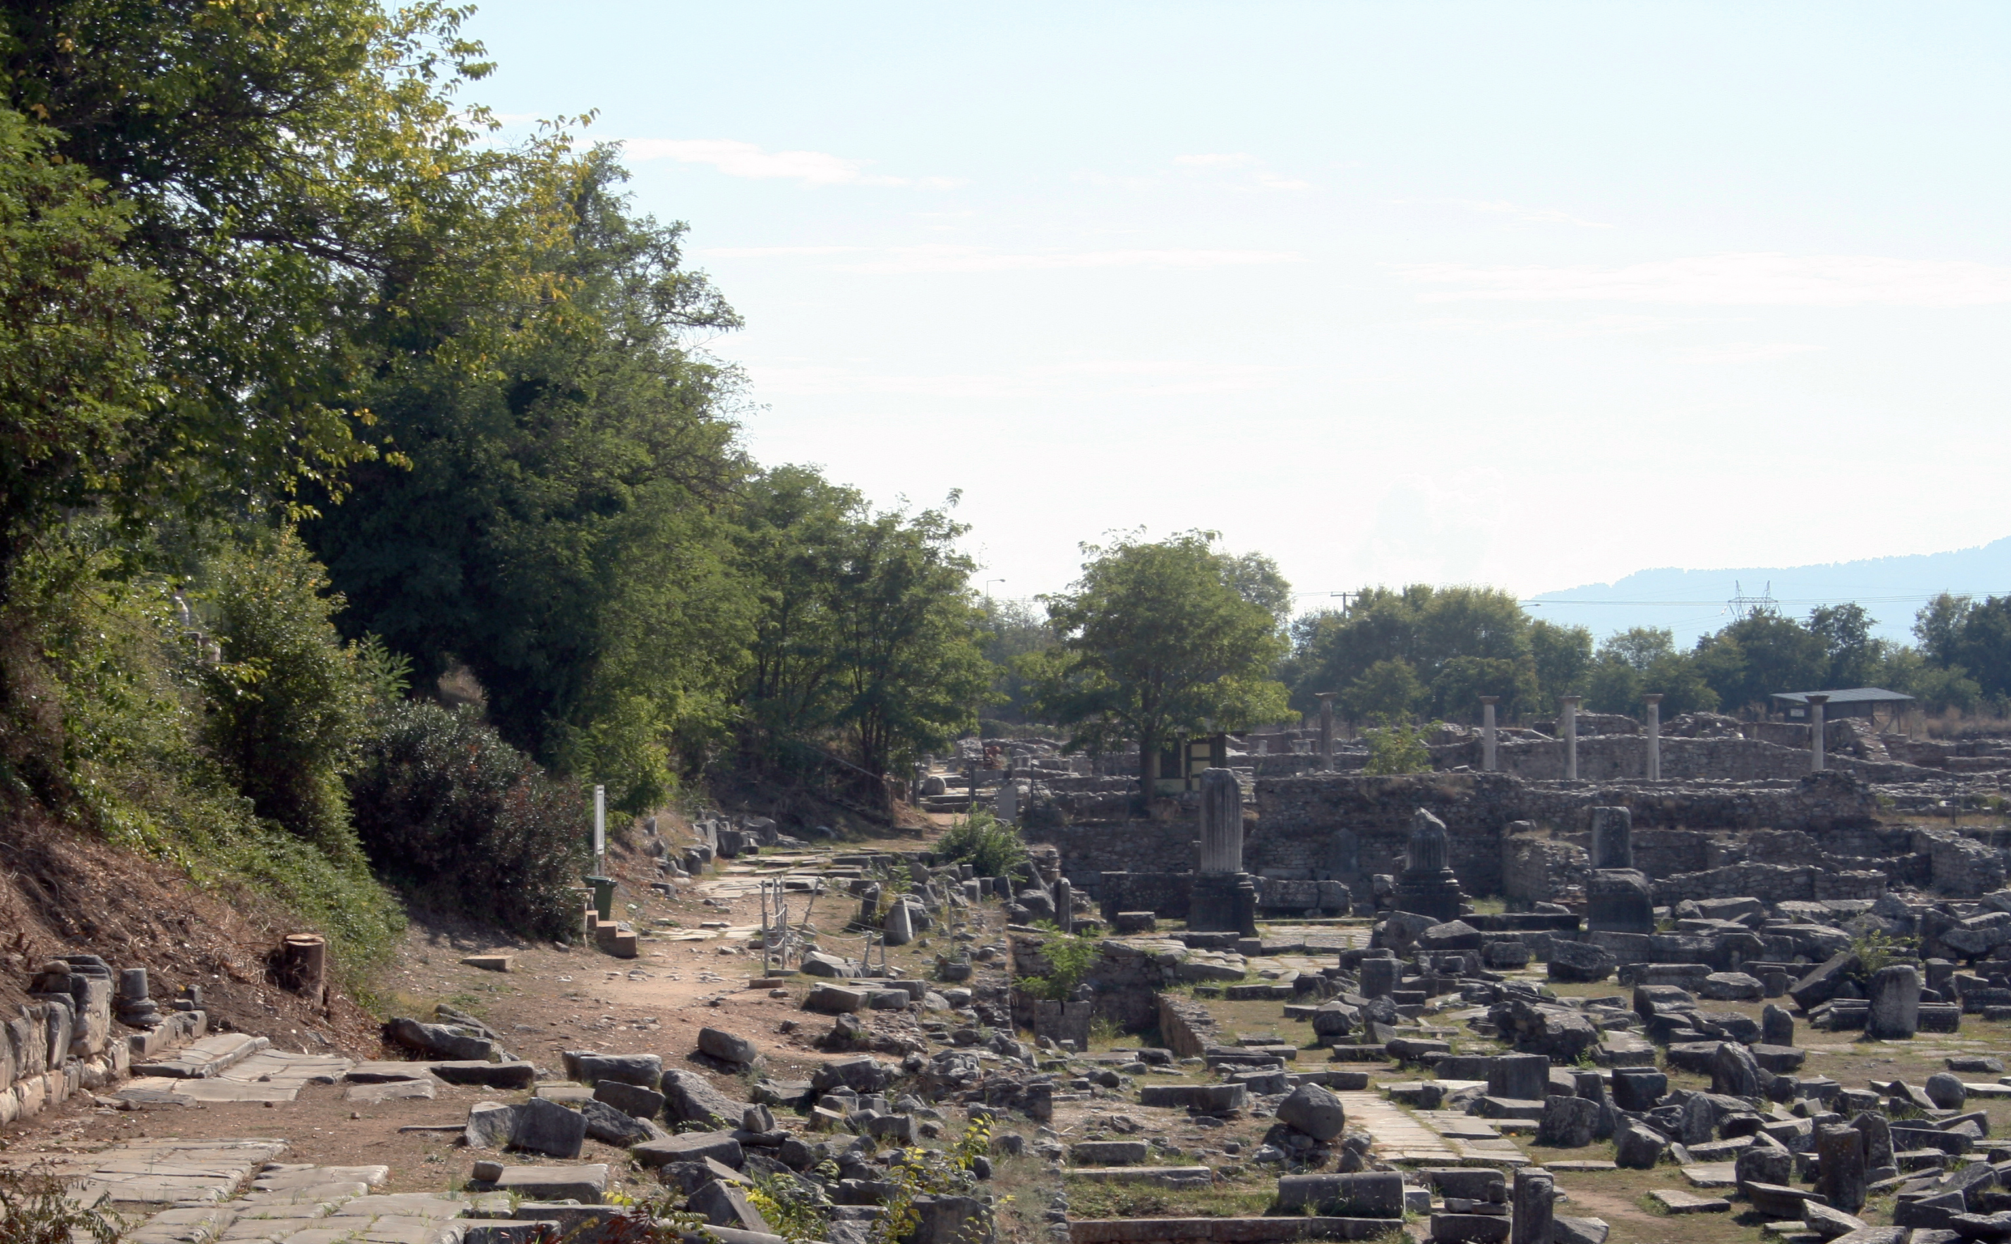
Lessons from the Letter to the Philippians

Slide 6
Introductory Material
The letter to the church at Philippi is undeniably written by Paul, the Apostle of Jesus Christ, as admitted by scholars of all backgrounds.
The date when Paul wrote the book is determined by what is said about Paul in the book. Consider these Scriptures:
“. . . just as it is right for me to think this of you all, because I have you in my heart, inasmuch as both in my chains and in the defense and confirmation of the gospel, you all are partakers with me of grace” (Phil.1:7).
“and most of the brethren in the Lord, having become confident by my chains, are much more bold to speak the word without fear” (Phil. 1:14).
“But I trust in the Lord that I myself shall also come shortly” (Phil. 2:24).

Slide 7
Philippians Allusions
“. . . so that it has become evident to the whole palace guard, and to all the rest, that my chains are in Christ” (Phil. 1:13).
“All the saints greet you, but especially those who are of Caesar’s household” (Phil. 4:22).

Slide 8
Paul’s Imprisonments
Philippi overnight (Acts 16:19-24).
Caesarea for more than two years(Acts 24:26-27).
Rome for more than two years (Acts 28:30-31).
Paul anticipated being released (Phil. 2:24).
Some of the later writings of Paul refer to travels not included in Acts, which leads scholars to the conclusion that Paul was released soon after writing this letter and traveled around the Mediterranean preaching the gospel.
Scholars also generally agree that Paul wrote the letter to the Philippians from Rome based on the reference to the guards (Phil. 1:13) and Caesar’s household (Phil. 4:22).

Slide 9
The Date
Based on these pieces of information, scholars generally agree that Philippians should be dated about AD 61.
The significance of the date lies in how recently Jesus had lived and died.
The death of Jesus is to AD 29.
This documents tells us what disciples believed about Jesus within 32 years of His death, burial, and resurrection.
This is much too soon after these events for myths and legends to have risen about Jesus.

Slide 10
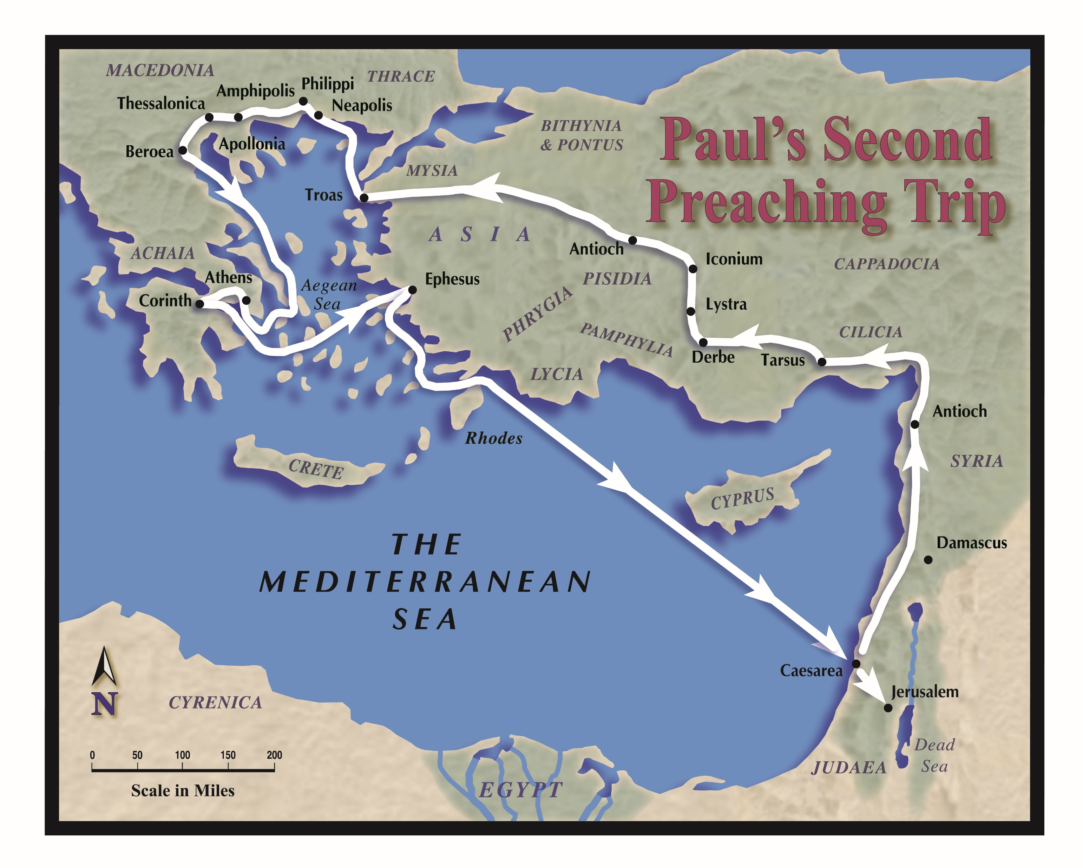
The Macedonian Call

Slide 11
The Macedonian Call
Those present: Paul, Silas, and Timothy
They came to Troas, a few miles south of ancient Troy, where Paul had a vision at night in which a man from Macedonia was saying, “Come over to Macedonia and help us” (Acts 16:9).
At this point Luke joined their group as evidenced by the “we” pronouns in Acts 16:10—“Now after he had seen the vision, immediately we sought to go to Macedonia, concluding that the Lord had called us to preach the gospel to them.”
They sailed a “straight course” from Troas to Samothrace and from there to Neapolis, arriving in two days.
On a later trip from Philippi to Troas, the same voyage took five days (Acts 20:6).

Slide 12
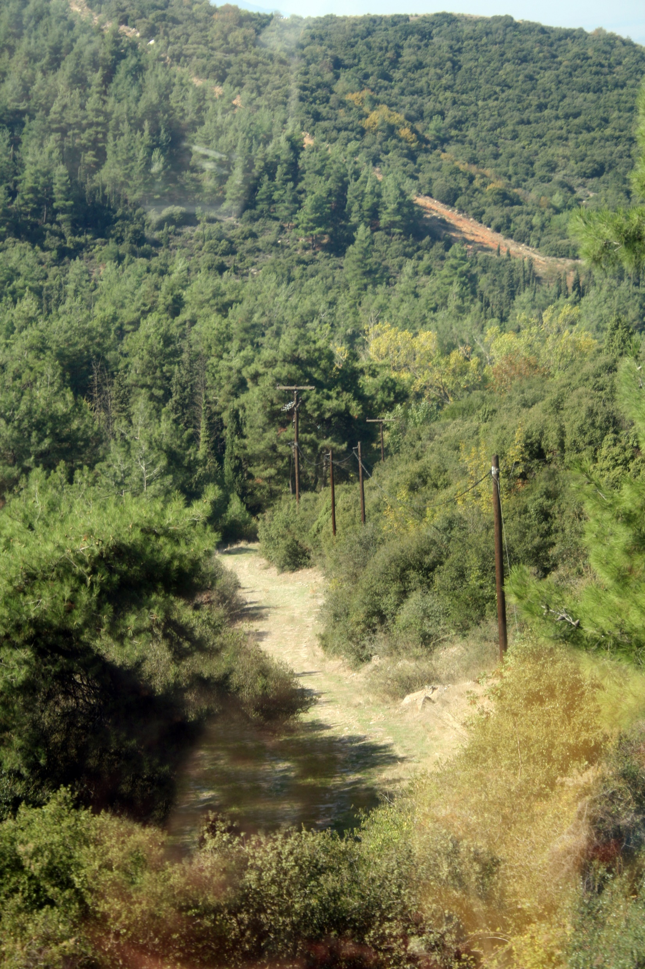
Traveling on the Egnatian Way

Slide 13
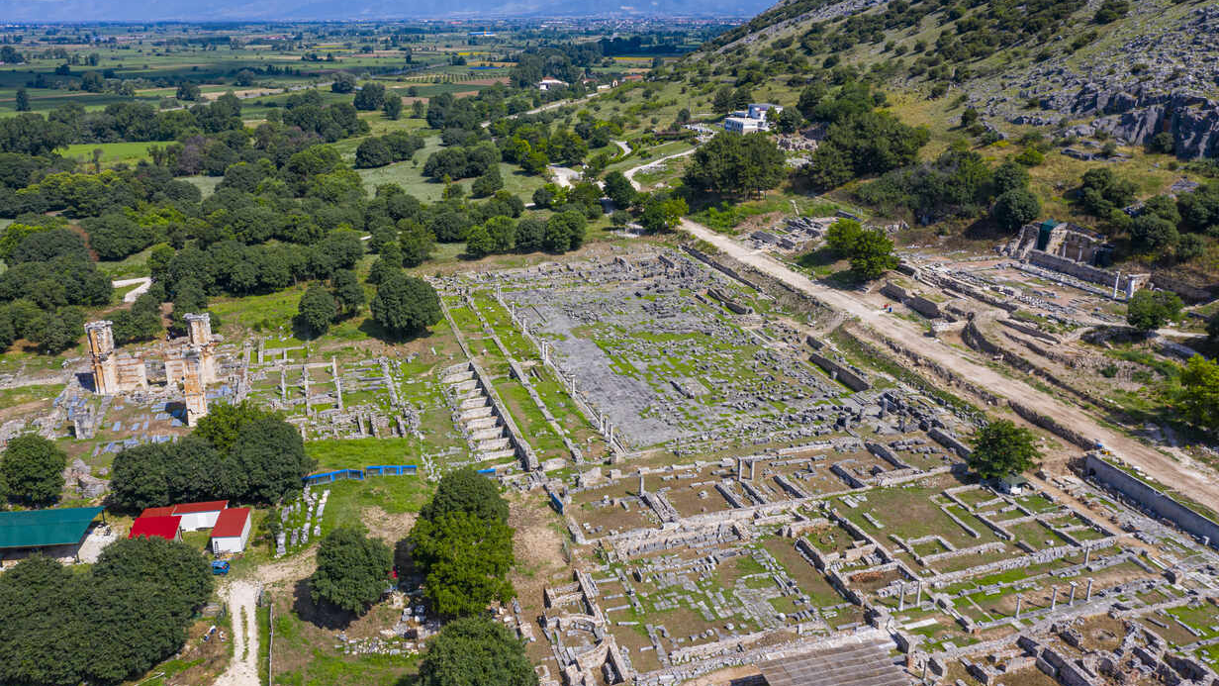
Aerial View of the Ruins at Philippi

Slide 14
Philippi
They arrived in Philippi which was “the foremost city of that part of Macedonia, a colony” (Acts 16:12).
The city was positioned on one of the main East-West trade routes, the Via Egnatia, between the East and Rome. It was also near Mt. Pangaion where precious metals were mined (Holland L. Hendrix, Anchor Bible Dictionary, “Philippi (Place),” 5:314).

Slide 15
Philippi: A Colony
“Philippi served as a provincial outpost on the Via Egnatia, the main overland artery linking Rome to the East. Two battles fought near the city in 42 B.C.E. resulted in the defeat of the ‘liberators’ Cassius and Brutus who had been instrumental in the assassination of Julius Caesar. The victors at Philippi, Octavian (later titled Augustus) and Antony, emerged as the dominant powers of the Roman Mediterranean basin. Following the battles, Philippi became a Roman colony and discharged veterans receiving land allotments settled permanently in the area. Within a few years after Augustus’ defeat of Antony at the battle of Actium (30 B.C.E.), as many as 500 more Roman soldiers—mostly veterans of Antony’s praetorian guard who had lost their claims to land in Italy—received allotments and accompanying privileges in Philippi” (ibid.).
A colony had special status because its citizens had all of the rights and privileges as a city in Italy (Louw-Nida, 1.90, p. 17; BDAG, 557).

Slide 16
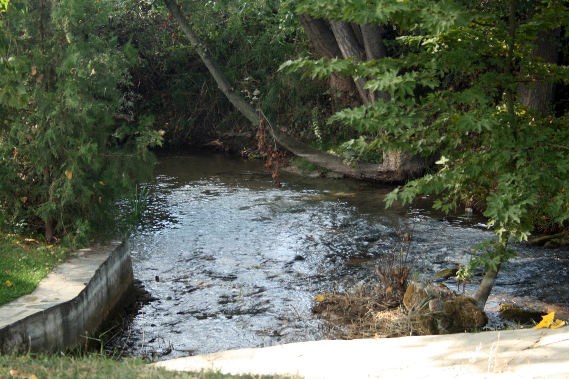
The Conversion of Lydia
“Now a certain woman named Lydia heard us. She was a seller of purple from the city of Thyatira, who worshiped God. The Lord opened her heart to heed the things spoken by Paul. And when she and her household were baptized, she begged us, saying, ‘If you have judged me to be faithful to the Lord, come to my house and stay.’ So she persuaded us” (Acts 16:14-15).

Slide 17
Lydia, A Business Woman
There was a Jewish synagogue in Thyatira, the city from which Lydia had migrated. When Lydia came to Philippi, she found no synagogue so she assembled outside the city by a riverside where prayer was generally offered (Acts 16:12).
Lydia was a seller of purple, an expensive cloth used primarily by royalty. Ben Witherington III wrote, “This means that Lydia was probably a financially independent woman, since material dyed royal purple was a luxury item that only royalty and the wealthy could normally afford, and since she has a house which will accommodate not only herself but also both her household (servants?) and guests” (“Lydia (Person),” The Anchor Yale Bible Dictionary, 4:423).

Slide 18
Lydia, A Spiritual Woman
Lydia worshiped God, not the pagan deities of the Macedonian province.
The Lord opened the heart of Lydia the same way he does for everyone else, through the preaching of the gospel (Rom. 10:17).
Lydia heard and obeyed the gospel by being baptized (Acts 16:15).
Lydia was a hospitable woman, so she persuaded Paul, Silas, Timothy, and Luke (four hungry men) to reside with her while they preached in the city.

Slide 19
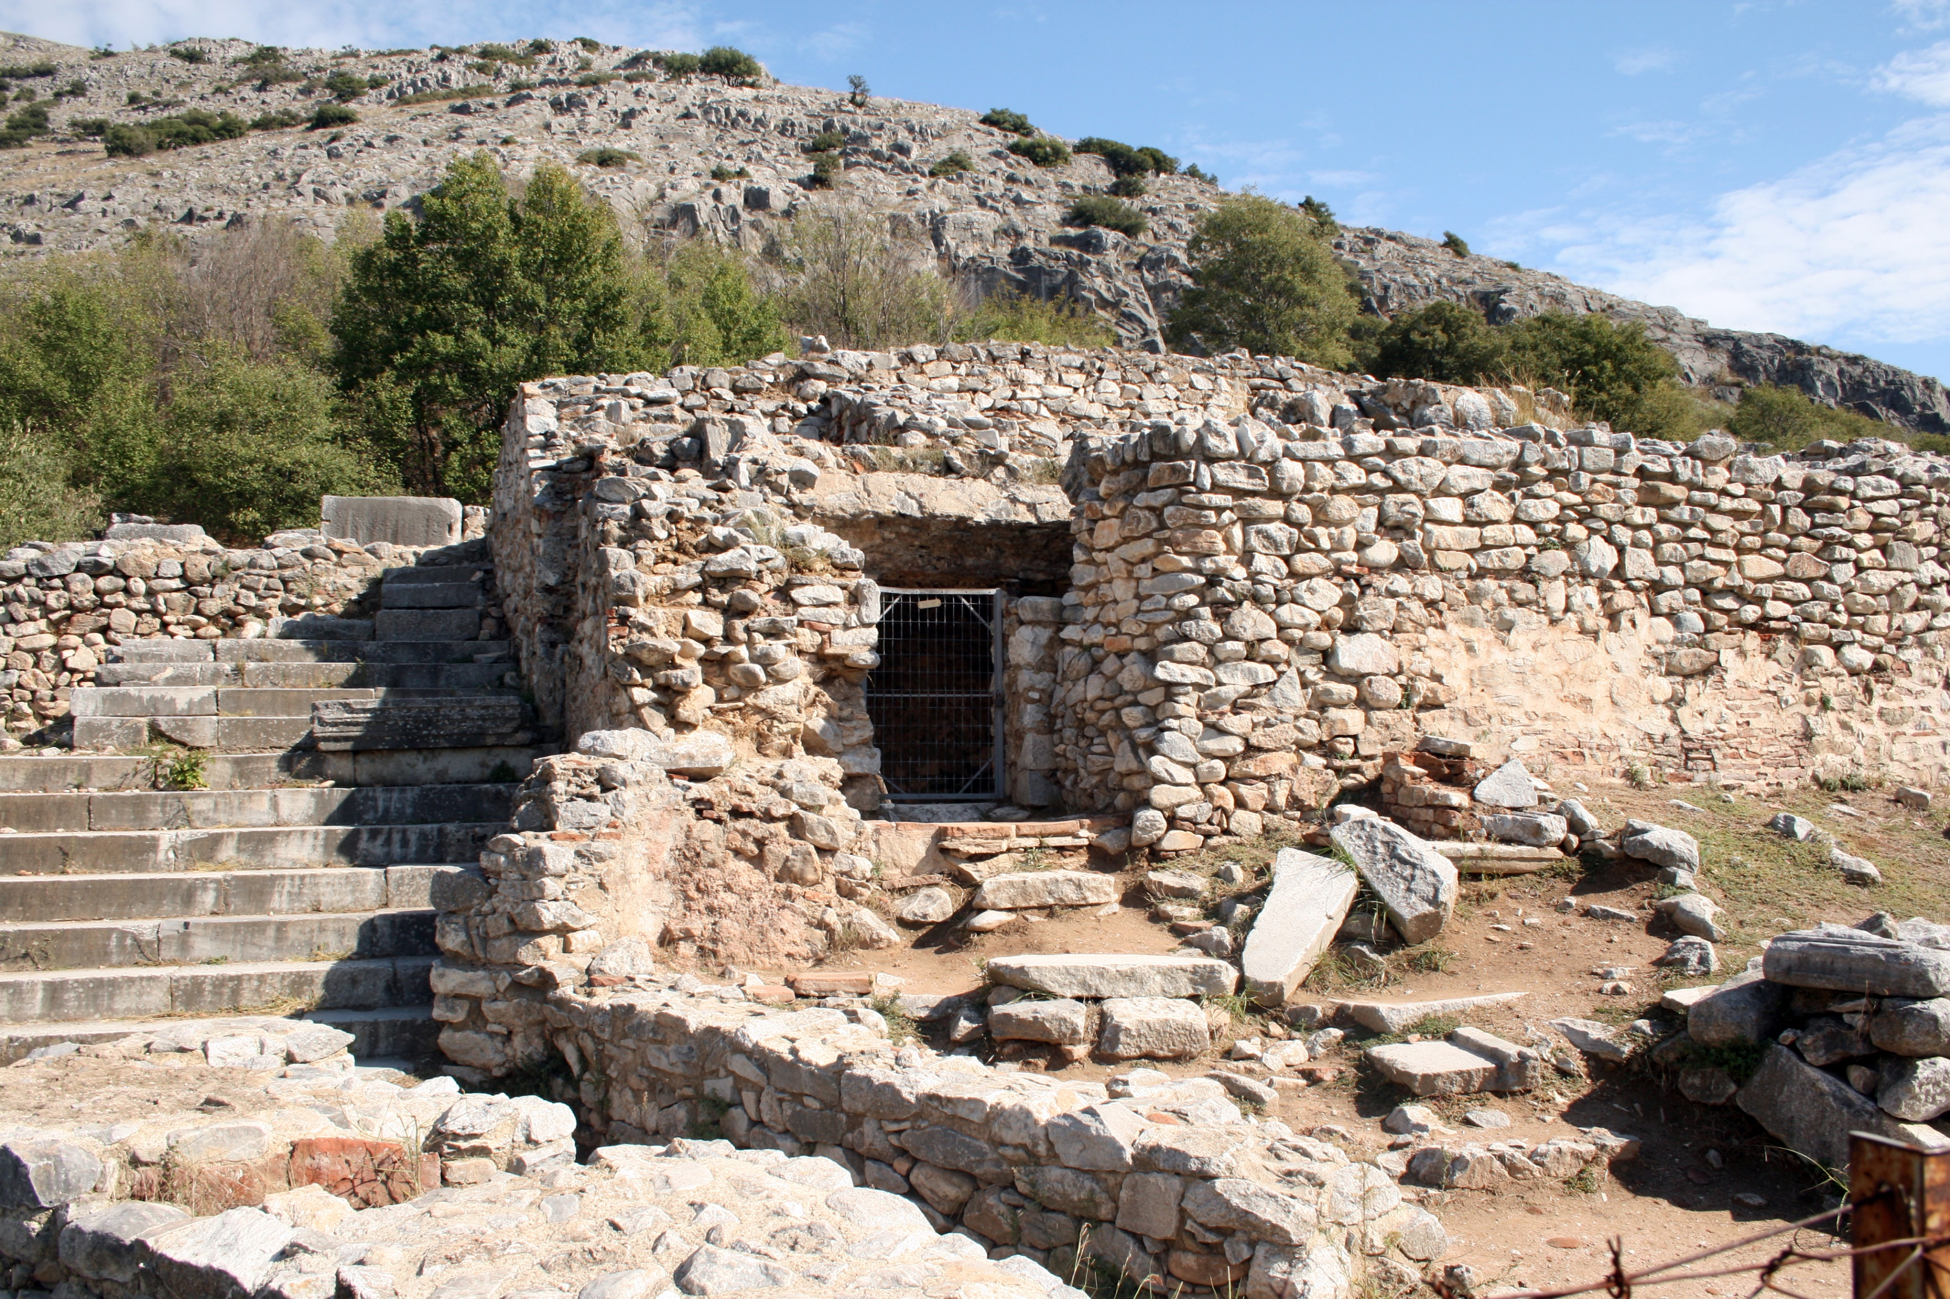
Conflict Leading to Imprisonment
Restored Ruins of Jail at Philippi

Slide 20
A Miracle
A slave girl with a spirit of divination was used by her master to make much money through her divination. She became convinced that Paul and his companions were preachers of God’s salvation.
She followed Paul and his companions for several days saying, “These men are servants of the Most High God, who proclaim to you the way of salvation” (Acts 16:17). This went on for several days.
Paul became annoyed by her and cast out her spirit of divination in the name of Jesus Christ (Acts 16:18).

Slide 21
Upset the Owners
Her owners realized that their means of making money was gone, so they seized Paul and Silas and dragged them into the market place (agora) and brought charges against them saying, “These men are Jews and they are disturbing our city. They advocate customs which it is not lawful for us Romans to accept or practice” (Acts 16:20-21).
Their charges were a pretense; they were not what caused charges to be brought out against them.
These men stirred up a multitude against Paul and Silas saying, “These men are Jews” (Acts 16:20). They used hostility toward the Jews as a pretense for their charges against Paul and Silas (cf. Acts 18:2).

Slide 22
A Beating
Charges were brought before “magistrates” (stratēgos), “the highest official in a Greek-Roman city, praetor, chief magistrate. . . . Plural of the highest officials of the Roman colony of Philippi” (BDAG, 947-948).
The magistrates commanded that Paul and Silas be beaten with rods. They received “many stripes” and were thrown into prison, putting them in charge of the jailer to keep them securely (Acts 16:23).
The jailer (desmophulax) put Paul and Silas in the inner prison and fastened their feet in the stocks (Acts 16:24).
When Paul wrote to the brethren at Thessalonica, he alluded to his experience at Philippi: “But even after we had suffered before and were spitefully treated at Philippi, as you know, we were bold in our God to speak to you the gospel of God in much conflict” (1 Thess. 2:2).

Slide 23
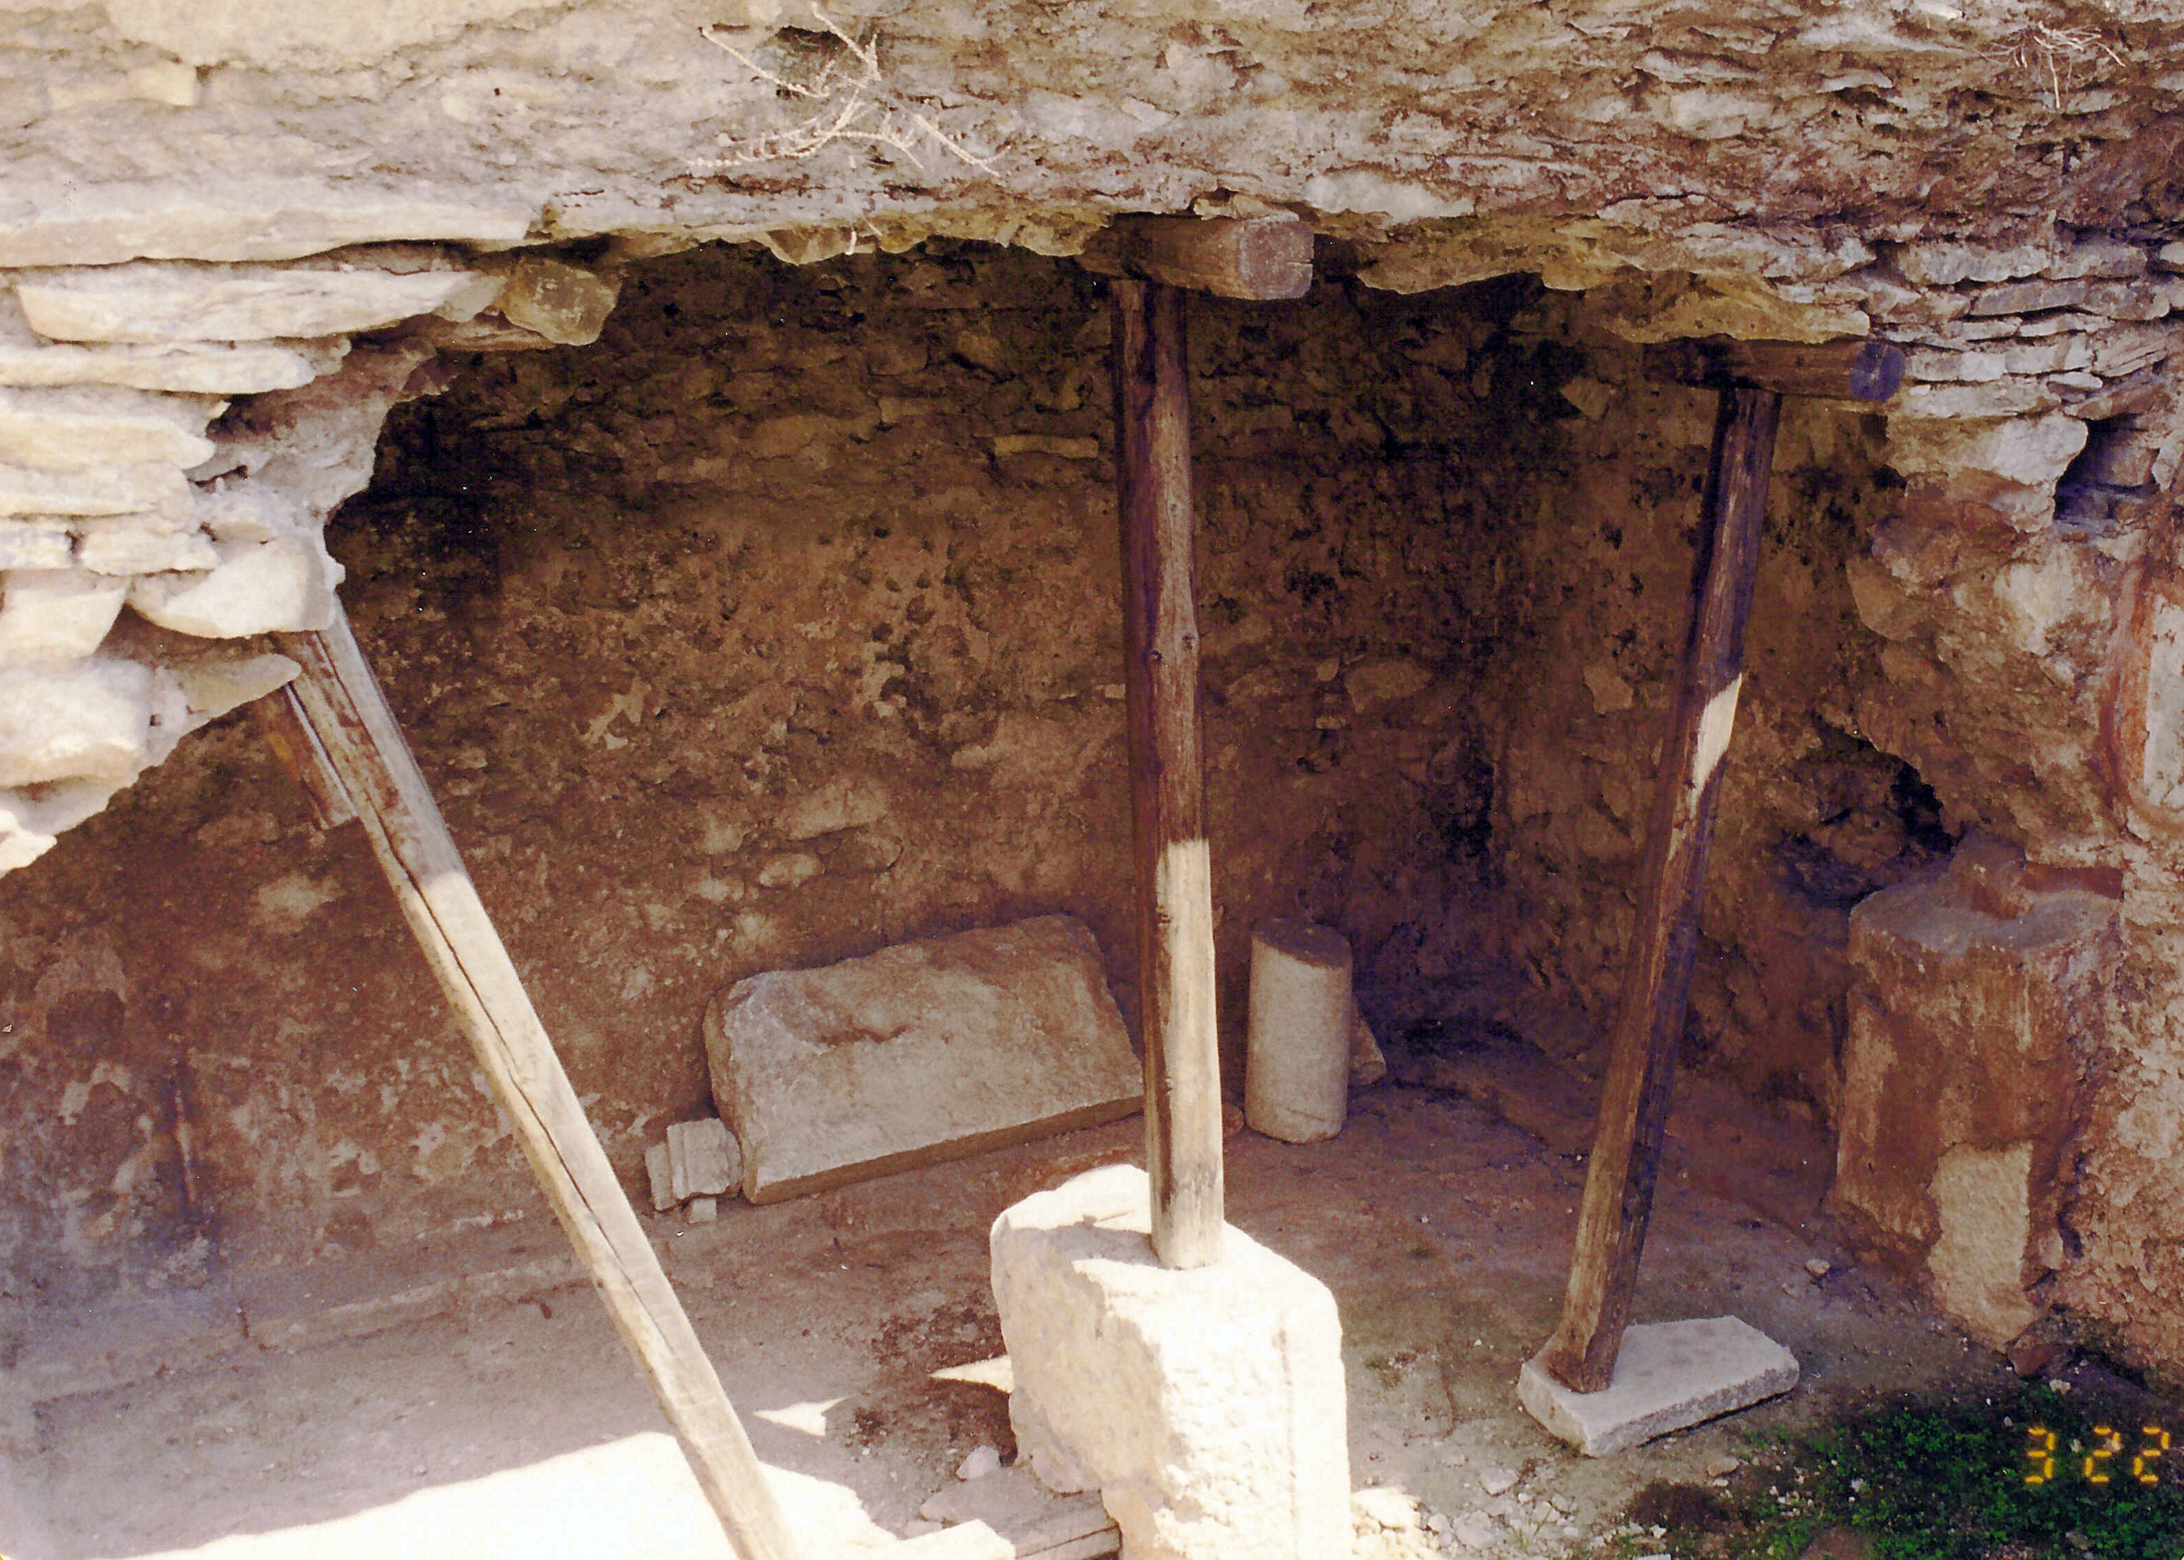
A Miraculous Release
Paul’s Prison Before Restoration

Slide 24
A Captive Audience
Paul and Silas prayed and sang praises to God while in prison and the prisoners heard them (Acts 16:25).
A great earthquake occurred that shook the foundations of the prison, opened the doors, and loosened everyone’s hand shackles.
The jailer was awakened by the earthquake. When he saw the prison doors opened, he assumed the prisoners had escaped. Therefore, he drew out his sword to kill himself, since he was responsible with his life for keeping the prisoners.
Paul cried to the jailer not to harm himself because all of the prisoners were still there (Acts 16:28).
The jailer called for a light and rushed into the prison and fell down trembling before Paul and Silas (Acts 16:29).

Slide 25
Saving the Jailer from Suicide
The jailer led Paul and Silas out of prison and asked them, “Sirs, what must I do to be saved?” (Acts 16:31).
Paul and Silas responded, “Believe on the Lord Jesus Christ, and you will be saved, you and your household” (Acts 16:32).
This is a summary statement that would require teaching him who Jesus was and what it meant to be Lord and Christ.
“Then they spoke the word of the Lord to him and to all who were in his house” (Acts 16:32).

Slide 26
The Jailer Was Saved from His Sins
The jailer’s change of attitude toward Paul and Silas, of whom he had previously supervised the giving of a beating, is seen by his washing their stripes (Acts 16:33).
The jailer and his household chose to become Christians: “And immediately he and all his family were baptized” (Acts 16:34).
Why did they need to be baptized immediately?
“Now when he had brought them into his house, he set food before them; and he rejoiced, having believed in God with all his household” (Acts 16:34).

Slide 27
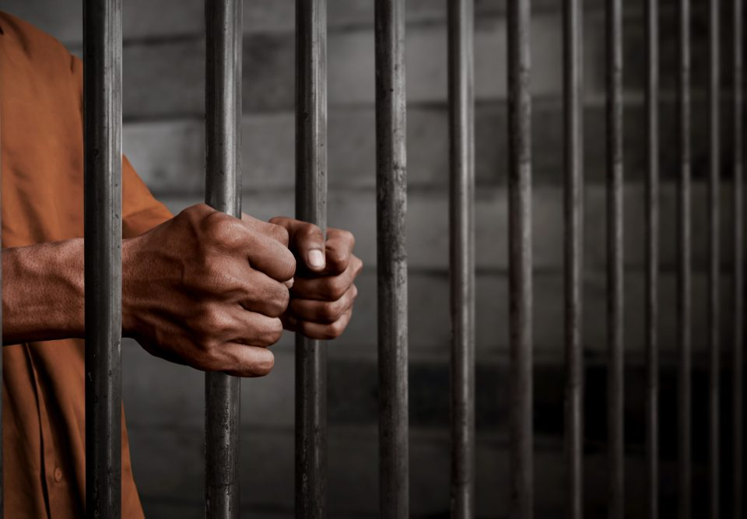
A Public Release

Slide 28
Not A Private Release
The next morning the magistrates gave order to the “officers” (rabdouchous: “constable, police officers,” BDAG, 902) that Paul and Silas be released. “The stratēgoi (q.v.) of Philippi had two lictors in attendance on them” (ibid.).
The “keeper of the prison” (jailer) reported the message to Paul saying, “The magistrates have sent to let you go. Now therefore depart, and go in peace” (Acts 16:36).
Paul and Silas refused to be released saying instead, “They have beaten us openly, uncondemned Romans, and have thrown us into prison. And now do they put us out secretly? No indeed! Let them come themselves and get us out” (Acts 16:37).

Slide 29
I. Howard Marshall
“For Paul and Silas to have departed in this way, however, could have set a dangerous precedent for the future treatment of missionaries and also could have left the Christians in Philippi exposed to arbitrary treatment from the magistrates. The magistrates had erred. They had not only beaten and imprisoned the missionaries without checking up properly on the accusations against them, but they had also not considered whether they might be Roman citizens. Roman citizens were expressly exempted from the penalty of beating, although there was little to stop a local magistrate, far from supervision, from exceeding his powers” (Acts: An Introduction and Commentary, Tyndale New Testament Commentaries, 291).

Slide 30
A Public Release
The magistrates (stratēgoi) were now afraid that they might have to answer to Rome from their crime.
“Then they came and pleaded with them and brought them out, and asked them to depart from the city” (Acts 16:39).
“So they went out of the prison and entered the house of Lydia; and when they had seen the brethren, they encouraged them and departed” (Acts 16:40).

Slide 31
Conclusion

Slide 32
Ready for the Series
This lesson has provided for you a brief description of Philippi, a short statement of who wrote the letter and when it was written. It concludes with an account of the establishment of the church at Philippi as recorded by Luke in Acts 16.
Having this information before us will provide context for looking at the foremost texts from which we will draw lessons from this letter to the Philippian church.

