Slide 2
Christians Face Tribulations
All Christians face times of temptation, trial, discouragement, and doubt.
Luke records that Paul strengthened the souls of the disciples, “exhorting them to continue in the faith, and saying, ‘We must through many tribulations enter the kingdom of God’” (Acts 14:22).

Slide 3
Facing Our Temptations
“My brethren, count it all joy when you fall into various trials, knowing that the testing of your faith produces patience. But let patience have its perfect work, that you may be perfect and complete, lacking nothing” (James 1:2-4).
“No temptation has overtaken you except such as is common to man; but God is faithful, who will not allow you to be tempted beyond what you are able, but with the temptation will also make the way of escape, that you may be able to bear it” (1 Cor. 10:13).

Slide 4
Sometimes Our Faith Wanes
Sometimes one loses his first love for Christ:
“Nevertheless I have this against you, that you have left your first love. Remember therefore from where you have fallen; repent and do the first works, or else I will come to you quickly and remove your lampstand from its place—unless you repent” (Rev. 2:4-5).
What can a person do when he has lost desire to pray and serve God?

Slide 5
Have You Left Your First Love?

Slide 6
Losing Our Love for Christ

Slide 7
The Image
Jesus as the Bridegroom:
“For the husband is head of the wife, as also Christ is head of the church; and He is the Savior of the body. Therefore, just as the church is subject to Christ, so let the wives be to their own husbands in everything” (Eph. 5:23-24).
“For we are members of His body, of His flesh and of His bones. ‘For this reason a man shall leave his father and mother and be joined to his wife, and the two shall become one flesh.’ This is a great mystery, but I speak concerning Christ and the church” (Eph. 5:30-32).
Losing one’s first love is like losing one’s mate!

Slide 8
How Could This Happen to Ephesus?
There were many commendable things at the church at Ephesus.
“I know your works, your labor, your patience, and that you cannot bear those who are evil. And you have tested those who say they are apostles and are not, and have found them liars; and you have persevered and have patience, and have labored for My name’s sake and have not become weary” (Rev. 2:2-3).
Somewhere along the line, the church’s chief motivation for these good works, their love for Christ, faded.
“Nevertheless I have this against you, that you have left your first love” (Rev. 2:4).
“If you love Me, keep My commandments” (John 14:15).
Without love for Christ, one’s faith will die!

Slide 9
Could This Happen to the Decatur Township Church of Christ?

Slide 10
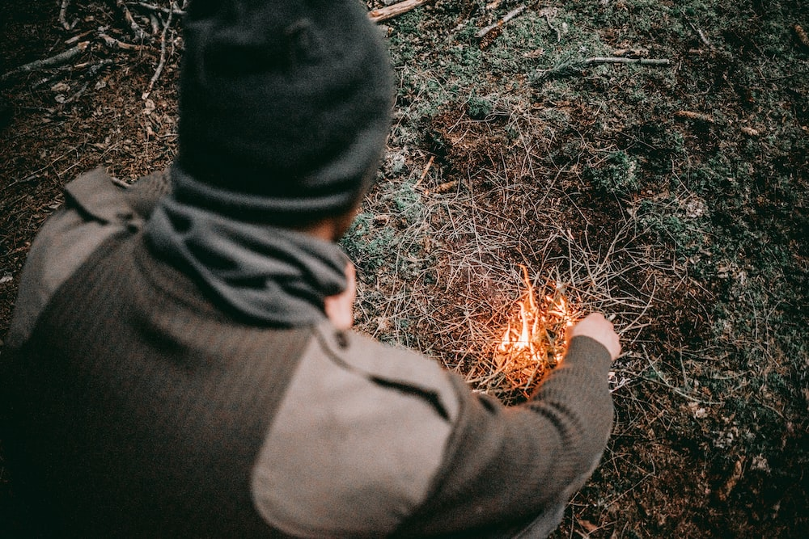
Rekindling Our First Love

Slide 11
1. Remember
Jesus told them to remember from where they had fallen” “Remember therefore from where you have fallen; repent and do the first works, or else I will come to you quickly and remove your lampstand from its place—unless you repent” (Rev. 2:5).
A similar instruction was given to the Hebrew Christians:
“But recall the former days in which, after you were illuminated, you endured a great struggle with sufferings” (Heb. 10:32).
Paul reminded the Galatian brethren who were receiving Judaizers, “You ran well. Who hindered you from obeying the truth? (Gal. 5:7).
Remember how you felt when you were baptized?

Slide 12
2. Repent Toward God
“Remember therefore from where you have fallen; repent and do the first works, or else I will come to you quickly and remove your lampstand from its place—unless you repent” (Rev. 2:5).
Notice what the prodigal son needed to do to be restored to his father (Luke 15:17).
In the parable of the lost sheep and lost coin, efforts were made to find that which is lost.
In the parable of the prodigal son, the Father did not go after the son, begging him to come back, coaxing him to do what he did not want to do.

Slide 13
Godly Sorrow Leads to Repentance
“Now I rejoice, not that you were made sorry, but that your sorrow led to repentance. For you were made sorry in a godly manner, that you might suffer loss from us in nothing. For godly sorrow produces repentance leading to salvation, not to be regretted; but the sorrow of the world produces death” (2 Cor. 7:9-10).

Slide 14
God Wants a Contrite Heart
“For thus says the High and Lofty One Who inhabits eternity, whose name is Holy: ‘I dwell in the high and holy place, With him who has a contrite and humble spirit, To revive the spirit of the humble, And to revive the heart of the contrite ones’” (Isa. 57:15).
“‘For all those things My hand has made, And all those things exist,’ Says the Lord. ‘But on this one will I look: On him who is poor and of a contrite spirit, And who trembles at My word’” (Isa. 66:2).

Slide 15
An Attitude Adjustment
Ephesian Christians who had lost their first love had to change their mind toward sin.
“But in accordance with your hardness and your impenitent heart you are treasuring up for yourself wrath in the day of wrath and revelation of the righteous judgment of God” (Rom. 2:5).
“Do not love the world or the things in the world. If anyone loves the world, the love of the Father is not in him” (1 John 2:15).

Slide 16
3. Return to Their First Works
“Remember therefore from where you have fallen; repent and do the first works, or else. . .” (Rev. 2:5).
Compare what John the Baptist said to the Jews: “Therefore bear fruits worthy of repentance. . .” (Luke 3:8).
One must return to faithful service of God.

Slide 17
What God Wants
“I beseech you therefore, brethren, by the mercies of God, that you present your bodies a living sacrifice, holy, acceptable to God, which is your reasonable service” (Rom. 12:1).
“Then Samuel spoke to all the house of Israel, saying, ‘If you return to the Lord with all your hearts, then put away the foreign gods and the Ashtoreths from among you, and prepare your hearts for the Lord, and serve Him only; and He will deliver you from the hand of the Philistines’” (1 Sam. 7:3).

Slide 18
4. Grow Your Works of Faith
To Thyatira, Jesus aid, “I know your works, love, service, faith, and your patience; and as for your works, the last are more than the first” (Rev. 2:19).
“For though by this time you ought to be teachers, you need someone to teach you again the first principles of the oracles of God; and you have come to need milk and not solid food” (Heb. 5:12).

Slide 19
5. Persevere
Christians are required to endure.
“Therefore do not cast away your confidence, which has great reward. For you have need of endurance, so that after you have done the will of God, you may receive the promise: (Heb. 10:35-36).

Slide 20
What Should I Do?
Wake Up!
“And do this, knowing the time, that now it is high time to awake out of sleep; for now our salvation is nearer than when we first believed” (Rom. 13:11).
“Awake, you who sleep, Arise from the dead, And Christ will give you light” (Eph. 5:14).

Slide 21
What Should I Do?
Wake Up:
Clean Up!
“The night is far spent, the day is at hand. Therefore let us cast off the works of darkness, and let us put on the armor of light. Let us walk properly, as in the day, not in revelry and drunkenness, not in lewdness and lust, not in strife and envy” (Rom. 13:12-13).

Slide 22
What Should I Do?
Wake Up!
Clean Up!
Grow Up!
“But put on the Lord Jesus Christ, and make no provision for the flesh, to fulfill its lusts” (Rom. 13:14).
“. . .that we should no longer be children, tossed to and fro and carried about with every wind of doctrine, by the trickery of men, in the cunning craftiness of deceitful plotting, but, speaking the truth in love, may grow up in all things into Him who is the head—Christ—from whom the whole body, joined and knit together by what every joint supplies, according to the effective working by which every part does its share, causes growth of the body for the edifying of itself in love” (Eph. 4:14-16).

Slide 23
Renew Your Spiritual Priorities
“But seek first the kingdom of God and His righteousness, and all these things shall be added to you” (Matt. 6:33).
“I have been crucified with Christ; it is no longer I who live, but Christ lives in me; and the life which I now live in the flesh I live by faith in the Son of God, who loved me and gave Himself for me” (Gal. 2:20).
A religion that says, “I will go to church when I want to” forgets who has Lordship over one’s life! Is it God or is it Me?

Slide 24
Look to Jesus, For Your Example
We must put away the self-reliant, self-sufficient, arrogant view of life, and look to Jesus:
“Therefore we also, since we are surrounded by so great a cloud of witnesses, let us lay aside every weight, and the sin which so easily ensnares us, and let us run with endurance the race that is set before us, looking unto Jesus, the author and finisher of our faith, who for the joy that was set before Him endured the cross, despising the shame, and has sat down at the right hand of the throne of God. For consider Him who endured such hostility from sinners against Himself, lest you become weary and discouraged in your souls” (Heb. 12:1-3).

Slide 25
Humble Oneself Before God
“Therefore humble yourselves under the mighty hand of God, that He may exalt you in due time, casting all your care upon Him, for He cares for you” (1 Pet. 5:6-7).
Who is doing the driving for your life?

Slide 26
If You Wish for Your First Love to Be Rekindled
Worship regularly (Heb. 10:24-25) and pray always (Eph. 6:18).
Renounce shameful things (2 Cor. 4:1-2).
Accept encouragement from others (Gal. 6:2; Isa. 35:3-4; Heb. 12:12). Accept loving concern from brethren and be loving to others.
Read your Bible daily (Psa. 119:14-16).
Bear others’ burdens (Gal. 6:2, 9-10; 1 Cor. 15:57-58).

Slide 27
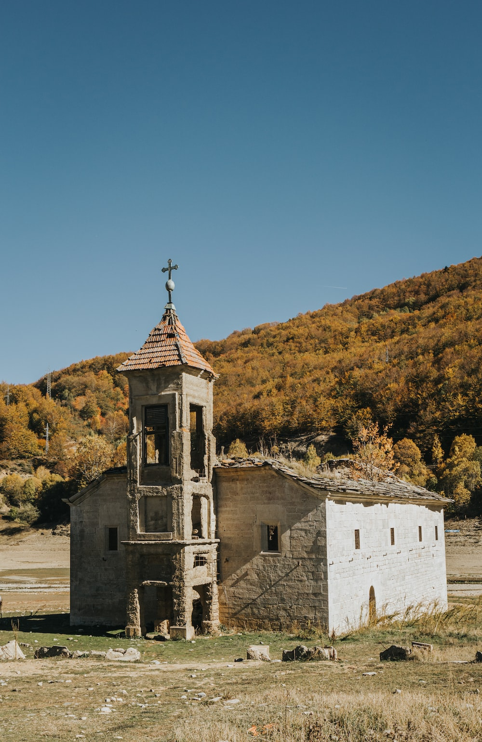
Churches Die
Some die by apostasy, departing from the truth.
Some die because their children lose their faith and faithful old folks pass away.
Some die because of lack of commitment—no one cares enough to make the commitments necessary to keep it alive!
What will happen to Decatur Township?

Slide 28
Or Else!
What happens if Ephesus (or any other church that has lost its first love) does not repent?
“Remember therefore from where you have fallen; repent and do the first works, or else I will come to you quickly and remove your lampstand from its place—unless you repent” (Rev. 2:5).
The removal of the lampstand (used to illuminate, provide light) signifies the removal of one’s classification as God’s church.

Slide 29
Conclusion

Slide 30
Final Exhortation
God can and will restore to you the joy of your salvation: “Restore to me the joy of Your salvation, And uphold me by Your generous Spirit” (Psa. 51:12).”
“Remember therefore from where you have fallen; repent and do the first works, or else I will come to you quickly and remove your lampstand from its place—unless you repent” (Rev. 2:5).

