Slide 2
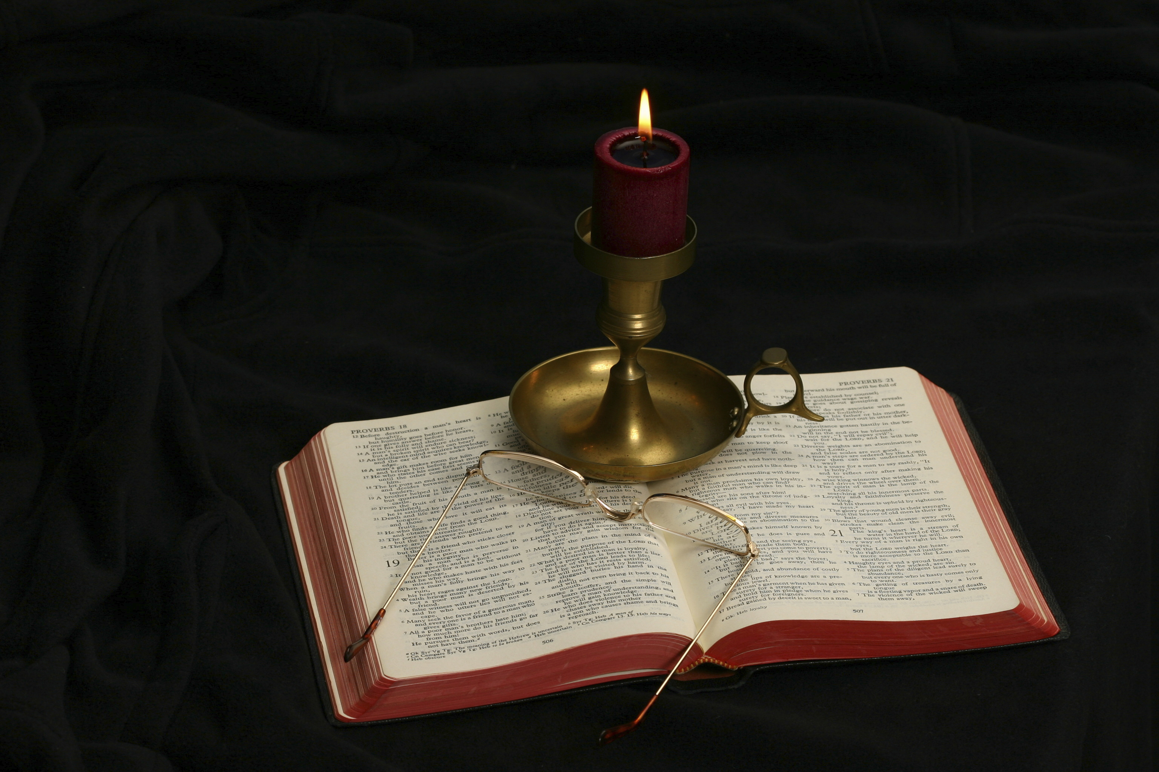
The Gospel of Matthew
Chapter 10

Slide 3
Outlining the Section
Listing what happens in this chapter:
9:35-28
Summary statement parallel to 4:23
Sheep without a shepherd
Pray for Lord of harvest to send laborers
10:1-4—The calling of the Twelve
Chapter 10 is the second sermon Matthew presents: The Missionary Discourse (10:5-42)

Slide 4
The Missionary Discourse (10:5-42)
Instructions to missionaries and their reception (10:5-15)
Tribulation and familial division (10:16-23)
Jesus and His disciples are called Beelzebul (10:24-25)
Consolation and encouragement (10:26-31)
Jesus and His disciples confess/deny each other (10:32-33)
Tribulation and family division (10:34-39)
Reception of missionaries and its reward (10:40-42)
Conclusion (11:1)

Slide 5
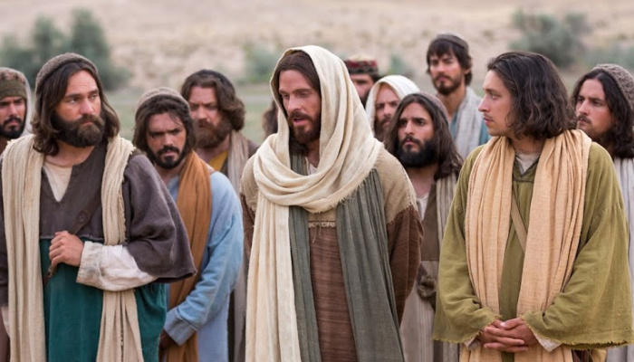
The Calling of the Twelve Matthew 10:1-4

Slide 6
Matthew 10:1-4
And when He had called His twelve disciples to Him, He gave them power over unclean spirits, to cast them out, and to heal all kinds of sickness and all kinds of disease. Now the names of the twelve apostles are these: first, Simon, who is called Peter, and Andrew his brother; James the son of Zebedee, and John his brother; Philip and Bartholomew; Thomas and Matthew the tax collector; James the son of Alphaeus, and Lebbaeus, whose surname was Thaddaeus; Simon the Canaanite, and Judas Iscariot, who also betrayed Him.

Slide 7
Matthew 10:1
And when He had called His twelve disciples to Him, He gave them power over unclean spirits, to cast them out, and to heal all kinds of sickness and all kinds of disease.
What is the significance of “He gave them power”?
What did healing the man let down through the roof (9:6-8) illustrate about authority?
Power (exousia): “the right to control or command, authority, absolute power, warrant” (BDAG, 353).
What were the disciples allowed to do to unclean spirits?
Could they use them such as occurred in Acts 16:16, when men used a demon possessed woman to soothsay/for divination?
Why did Jesus not give power to heal all kinds of sickness and disease to every missionary, preacher, and evangelist?
Cf. 10:7-8 to see the close parallel between the work of the Twelve and Jesus.

Slide 8
Matthew 10:2-4
Now the names of the twelve apostles are these: first, Simon, who is called Peter, and Andrew his brother; James the son of Zebedee, and John his brother; Philip and Bartholomew; Thomas and Matthew the tax collector; James the son of Alphaeus, and Lebbaeus, whose surname was Thaddaeus; Simon the Canaanite, and Judas Iscariot, who also betrayed Him.
What do you see from this list?
What was the advantage of sending the disciples out in pairs?
Why did Jesus send them out instead of keeping them with Him?

Slide 9
Comparative List of the Twelve Apostles
Matthew | Mark | Luke | Acts
Peter Andrew James John | Peter James, son of Zebedee John, son of Zebedee Andrew | Peter Andrew James John | Peter James John Andrew
Philip Bartholomew Thomas Matthew | Philip Bartholomew Matthew Thomas | Philip Bartholomew Matthew Thomas | Philip Thomas Bartholomew Matthew
James, son of Alphaeus Thaddeus Simon the Canaanite Judas Iscariot | James, son of Alphaeus Thaddeus Simon the Canaanite Judas Iscariot | James, son of Alphaeus Simon, the Zealot Judas, son of James Judas Iscariot | James, son of Alphaeus Simon Zelotes Judas, son of James Judas Iscariot

Slide 10
General Comments on the Apostles
This is the only time Matthew uses the word “apostle” (10:2).
The word refers to ambassadors sent out to represent Jesus (see BDAG, 122).
Leon Morris: “It will be seen that most of these have left very little mark on the history of the church, and it may well be that that was because they were not outstanding people (“They were very ordinary men,” Barclay, I, p. 358; “men of obscurity, and of no repute,” Calvin, I, p. 290). When Jesus chose his Twelve he did not choose supermen; God does not need outstanding people to do his work, and it seems that, while some of the Twelve were very able men, others were very ordinary” (The Gospel according to Matthew, The Pillar New Testament Commentary, 244).

Slide 11
The Missionary Discourse (10:5-42)
Instructions to missionaries and their reception (10:5-15)
Tribulation and familial division (10:16-23)
Jesus and His disciples are called Beelzebul (10:24-25)
Consolation and encouragement (10:26-31)
Jesus and His disciples confess/deny each other (10:32-33)
Tribulation and family division (10:34-39)
Reception of missionaries and its reward (10:40-42)
Conclusion (11:1)

Slide 12
Instructions to Missionaries and Their Recipients (Matthew 10:5-15)
These twelve Jesus sent out and commanded them, saying: “Do not go into the way of the Gentiles, and do not enter a city of the Samaritans. But go rather to the lost sheep of the house of Israel. And as you go, preach, saying, ‘The kingdom of heaven is at hand.’ Heal the sick, cleanse the lepers, raise the dead, cast out demons. Freely you have received, freely give. Provide neither gold nor silver nor copper in your money belts, nor bag for your journey, nor two tunics, nor sandals, nor staffs; for a worker is worthy of his food. Now whatever city or town you enter, inquire who in it is worthy, and stay there till you go out. And when you go into a household, greet it. If the household is worthy, let your peace come upon it. But if it is not worthy, let your peace return to you. And whoever will not receive you nor hear your words, when you depart from that house or city, shake off the dust from your feet. Assuredly, I say to you, it will be more tolerable for the land of Sodom and Gomorrah in the day of judgment than for that city!”

Slide 13
Matthew 10:5-6
“These twelve Jesus sent out and commanded them, saying: ‘Do not go into the way of the Gentiles, and do not enter a city of the Samaritans. But go rather to the lost sheep of the house of Israel.”
What are the implications of “sent out” and “commanded”?
The reader may be surprised to see the restriction placed on the Twelve, forbidding them to go to Gentiles and Samaritans.
Because of this restriction, this commission is called The Limited Commission in contrast to the Great Commission (28:18-20).
One can see that a distinct difference exists between these two commissions, demanding that the apostles work among the Jews, much as Paul would go first to the Jews and then to the Gentiles (Rom. 1:16).
The “lost sheep of the house of Israel” applies to all of Israel, not a restricted part of Israel. All of Israel were sheep gone astray.

Slide 14
Matthew 10:7
“And as you go, preach, saying, ‘The kingdom of heaven is at hand.’”
The message preached is the same as John the Baptist preached (Matt. 3:2) and that Jesus preached (Matt. 4:17).
Is at hand (engizō) means “to draw near in a temporal sense, draw near, come near, approach” (BDAG, 270).
The kingdom had not already come, but was soon to be established.
This fact precludes the possibility that Jesus is returning at the end of the age to establish an earthly kingdom (as in premillennial thought).
Preach (kērussō): “to make public declarations, proclaim aloud” (BDAG, 543). The present tense emphasizes continuous action.

Slide 15
Matthew 10:8
“Heal the sick, cleanse the lepers, raise the dead, cast out demons. Freely you have received, freely give.”
“Heal the sick, cleanse the lepers, raise the dead, cast out demons” is a fair summary of what Jesus’s mission in chapters 8-9 looked like.
Isaiah prophesied about the Messiah: “Then the eyes of the blind shall be opened, And the ears of the deaf shall be unstopped. Then the lame shall leap like a deer, And the tongue of the dumb sing. For waters shall burst forth in the wilderness, And streams in the desert” (Isa. 35:5-6).
The Apostles’ work was to be an extenuation of the work of Jesus Himself, since He authorized them to act on His behalf.
“Freely you have received, freely give” forbids the Apostles from taking money for the healings and resurrections they might perform.

Slide 16
Matthew 10:9-10
“Provide neither gold nor silver nor copper in your money belts, nor bag for your journey, nor two tunics, nor sandals, nor staffs; for a worker is worthy of his food.”
These are temporary commandments for the Limited Commission and not permanent commandments for all of God’s evangelists.
This is confirmed by Jesus’s statement shortly before His death:
“And He said to them, ‘When I sent you without money bag, knapsack, and sandals, did you lack anything?’ So they said, ‘Nothing.’ Then He said to them, ‘But now, he who has a money bag, let him take it, and likewise a knapsack; and he who has no sword, let him sell his garment and buy one’” (Luke 22:35-36).
Jesus’s point is that you are not to make plans for providing for yourself on a long trip to another part of the world.

Slide 17
What Not to Do and Take
Do not take money (gold, silver, copper) in your money belt (zōnē).
Do not take. . .
Lunch basket (pēra): a leather pouch used by travelers, knapsack, traveler’s bag” (BDAG, 811). Think of a kid’s lunch pack.
Two tunics (chitōn): the garment warn next to the skin; we may say, don’t take a change of clothes
Sandals. This implies that they were expected to go barefooted.
Staff (rabdos): a stick that could be used as a walking stick or an instrument for protection against wild animals or people.
Luke 10:4 forbids “greetings” that might consume too much time.

Slide 18
The Workman Is Worthy of His Meat
This principle is expressed also in the following Scriptures:
“Even so the Lord has commanded that those who preach the gospel should live from the gospel” (1 Cor. 9:14).
“Let the elders who rule well be counted worthy of double honor, especially those who labor in the word and doctrine. For the Scripture says, ‘You shall not muzzle an ox while it treads out the grain,’ and, ‘The laborer is worthy of his wages’” (1 Tim. 5:17-18).
In this context, the Apostles would receive a place to stay and food for their work. These men were working for God so God would provide.
Later, Jesus and His Apostles were supported by generous benefactors (Luke 8:1-3), from which monetary contributions Judas stole (John 12:6).
Jesus words in Luke 22:35-36 also show that these special arrangements were to build faith in God’s providential provisions for His disciples.

Slide 19
Matthew 10:11
“Now whatever city or town you enter, inquire who in it is worthy, and stay there till you go out.”
Inquire (exetazō): “try to find out by use of careful methods, which may include personal inquiry, scrutinize, examine, inquire” (BDAG, 349).
R. T. France: They are to look for someone able and willing to accommodate them, and this would normally be someone open to their message, though not necessarily already committed to their cause” (Matthew: An Introduction and Commentary, 184).
The point is that one should not be moving around from lesser provisions to better provisions.

Slide 20
Matthew 10:12-13
“And when you go into a household, greet it. If the household is worthy, let your peace come upon it. But if it is not worthy, let your peace return to you.”
Craig Blomberg: “To give or return ‘peace’ meant to bless or retract a blessing from an individual or a household” (Matthew, The New American Commentary, 173).
Leon Morris: “If the household really is worthy, then their greeting of peace will be effective; there really will be peace to these people. But this will not be the case if the household be not worthy; it is unrealistic to think that the peace of God would rest on such people” (The Gospel according to Matthew, The Pillar New Testament Commentary, 250).

Slide 21
Matthew 10:14
“And whoever will not receive you nor hear your words, when you depart from that house or city, shake off the dust from your feet.”
Craig Blomberg: “Shaking the dust off one’s feet was a ritual of renunciation used by Jews when they returned to Israel from Gentile territories (cf. Paul’s Christian modification of this practice in Acts 13:51)” (Matthew, 173).
The point is that rejection of the Christian message is a serious offense.
“Anyone who has rejected Moses’ law dies without mercy on the testimony of two or three witnesses. Of how much worse punishment, do you suppose, will he be thought worthy who has trampled the Son of God underfoot, counted the blood of the covenant by which he was sanctified a common thing, and insulted the Spirit of grace?” (Heb. 10:28-29).

Slide 22
Matthew 10:15
“Assuredly, I say to you, it will be more tolerable for the land of Sodom and Gomorrah in the day of judgment than for that city!”
John Nolland: “The saying is not designed to hold out hope for Sodom [and Gomorrah] but rather to suggest that the present situation created by the coming of Jesus means that what is involved in rejecting his messengers is much more serious than had been the wickedness of Sodom [and Gomorrah]” (The Gospel of Matthew: A Commentary on the Greek Text, New International Greek Testament Commentary, 420).
This heightens the seriousness of rejection of Jesus’s invitation. It is not a small thing to reject the Lord of all creation!

Slide 23
Tribulation and Familial Division (10:16-23)
“Behold, I send you out as sheep in the midst of wolves. Therefore be wise as serpents and harmless as doves. But beware of men, for they will deliver you up to councils and scourge you in their synagogues. You will be brought before governors and kings for My sake, as a testimony to them and to the Gentiles. But when they deliver you up, do not worry about how or what you should speak. For it will be given to you in that hour what you should speak; for it is not you who speak, but the Spirit of your Father who speaks in you. Now brother will deliver up brother to death, and a father his child; and children will rise up against parents and cause them to be put to death. And you will be hated by all for My name’s sake. But he who endures to the end will be saved. When they persecute you in this city, flee to another. For assuredly, I say to you, you will not have gone through the cities of Israel before the Son of Man comes.”

Slide 24
General Comments
The focus of the instruction shifts to persecution and how to deal with negative responses to the preaching of the gospel.
The material had its initial meaning in the Limited Commission, but the material seems also to speak of conditions not present in the pre-crucifixion era and speaks of conditions after Pentecost.
Leon Morris: “Matthew has gathered here teachings of Jesus that would be of importance to the Christian preachers of his own day. He seems to have liked to put together sayings that related to similar topics” (The Gospel according to Matthew, The Pillar New Testament Commentary, 252).
Note that persecution of Jesus’s apostles is predicted.
The material in this section has strong parallels in Matt. 24:9-14 and parallel passages in Mark and Luke.

Slide 25
Matthew 10:16
“Behold, I send you out as sheep in the midst of wolves. Therefore be wise as serpents and harmless as doves.”
I is important because the significance of the message depends upon its origin.
The image of sheep in the midst of wolves is that of animals with no means of self-defense (cf. Matt. 7:15, depicting false teachers as wolves) except that of their shepherd (cf. John 10:12-15). There is serious danger ahead!
At the beginning mission, the wolves were the Jewish establishment, both Pharisees and Sadducees.
Wise (phronimos): “pertaining to understanding associated with insight and wisdom, sensible, prudent, wise” (BDAG, 1066).
As serpents recalls “Now the serpent was more subtle than any other wild creature” (Gen. 3:1).
Harmless (akeraios): “pertaining to being without a mixture of evil and hence to being pure—‘pure, untainted” (Louw-Nida, 745); irreproachable honesty.

Slide 26
John Nolland
“The wisdom called for from the disciples will involve anticipating danger and avoiding it wherever possible, but not in such a way as to undercut their mission priorities. The innocence called for will involve a consistent integrity that is prepared to suffer rather than compromise and which is careful to give no grounds for legitimate legal objection to the action of the disciples” (The Gospel of Matthew: A Commentary on the Greek Text, 423).
Leon Morris quoted Bruner to say: “If we are to be sheep among wolves—and this is Jesus’ intention—then we should at least be smart sheep, sheep who use our heads, sheep who don’t overestimate the benevolence of wolves” (op. cit., 253).

Slide 27
Matthew 10:17
“But beware of men, for they will deliver you up to councils and scourge you in their synagogues.”
Beware (prosechō): “to be in a state of alert, be concerned about, care for, take care” (BDAG, 879).
Deliver (paradidōmi) is used to describe what Judas did (Matt. 26:15, 16, 21, 24).
Councils (sunedrion): Note the plural form. Each local synagogue had its governing board in the various cities, usually consisting of 23 members.
Scourge (mastigoō), “to beat with a whip or lash, whip, flog, scourge” (BDAG, 620).
Synagogues had authority to scourge (cf. 2 Cor. 11:24, Paul received 39 stripes on five occasions).
Morris comments: “Synagogues were places of worship, but they were also places of instruction and, as we see here, places where local justice was administered. The court would sit in the synagogue and punishment be inflicted” (The Gospel according to Matthew, 253).

Slide 28
Matthew 10:18
“You will be brought before governors and kings for My sake, as a testimony to them and to the Gentiles.”
Here is evidence of the post-Pentecost sufferings that are predicted; note “to the Gentiles” and the officers before whom they would be tried.
Governors (hēgemōn): “head imperial provincial administrator, governor in the provinces” (BDAG, 433). Think of Pilate, Felix, Festus, Gallio, etc.
Kings (basileus): “one who rules as possessor of the highest office in a political realm, king” (BDAG, 169). Think of Caesar and puppet kings such as Herod the Great, Herod Agrippa I and II, and others.
For my sake indicates the purpose for being examined (cf. Matt. 5:11; 1 Pet. 4:14-16).

Slide 29
As a Testimony to Them
The same phrase appears in Matt. 8:4 for the cleansed leper being pronounced clean by the priests.
Compare the two trials of Paul before Felix (Acts 24) and Festus (Acts 26) for how both occasions gave opportunity for Paul to give testimony to them concerning Jesus.
Leon Morris: “The sufferings of the disciples would be the means of bringing the essential Christian message to Gentiles, people outside the ancient people of God but within the scope of the Christian message” (The Gospel according to Matthew, 254).

Slide 30
Matthew 10:19-20
“But when they deliver you up, do not worry about how or what you should speak. For it will be given to you in that hour what you should speak; for it is not you who speak, but the Spirit of your Father who speaks in you.”
Do not worry (merimnaō): “to be apprehensive, have anxiety, be anxious, be (unduly) concerned” (BDAG, 632). It has previously appeared in 6:28.
It would be natural for untrained disciples to be anxious about going on trial for their lives (Acts 24:1-8). However, God promises to supply their needs in this passage just as he did in chapter 6.
The twelve apostles are the audience addressed by Jesus in this passage. This help falls under the promises given to the apostles in John 14:16-17; 15:26-27; 16:13. For examples of their inspired defenses, see Acts 4:1-22, 33; 7:1-53. It would be a mistake to apply this promise to every Christian.
These verses are a good explanation of what “inspiration” entails.

Slide 31
Matthew 10:21
“Now brother will deliver up brother to death, and a father his child; and children will rise up against parents and cause them to be put to death.”
This passage emphasizes that faith in Jesus created tensions and broke familial bonds (see also vv. 35-36).
It makes one recall Jesus’s words in the Sermon on the Mount (5:10-12).
The most intimate bonds (brother/brother, father/child, children/parents) will be broken.
People will die because of their faith!

Slide 32
Matthew 10:22
“And you will be hated by all for My name’s sake. But he who endures to the end will be saved.”
The persecution that Jesus foretold is already apparent in 1 Peter 1:6-9; 2:19-25; 3:14-18; 4:13-16; 5:10.
For my name’s sake is reason for the suffering (cf. 5:10-12).
He who endures to the end will be saved is repeated in other texts (24:13; Mark 13:13).
Endure (hupomenō): “to maintain a belief or course of action in the face of opposition, stand one’s ground, hold out, endure” (BDAG, 1039).
This is not a promise of escaping physical death. It is a promise of standing in the presence of one’s Lord forever.

Slide 33
Willingness to Endure
John Nolland: “In part the information about coming persecution is provided to forewarn the disciples in order to prepare them for the path of perseverance along which they must make their way through the period of escalating difficulty. If the disciples can hold on long enough, the period of threat will be over and rescue will come (cf. related uses of the verb ‘save’ in 24:13, 22). Something far better lies beyond. . . . Where practical wisdom might suggest that to abandon one’s profession in the time of persecution is the way to secure one’s future, quite the opposite is insisted on here” (The Gospel of Matthew: A Commentary on the Greek Text, New International Greek Testament Commentary, 426).

Slide 34
Matthew 10:23
“When they persecute you in this city, flee to another. For assuredly, I say to you, you will not have gone through the cities of Israel before the Son of Man comes.”
Jesus is not teaching a fatalistic approach to suffering. If one has the ability to flee from persecution, he should do so (cf. Matt. 24:15-17 and examples of some who fled [Matt. 2:13; 4:12; 12:15; 14:6; 16:28; Acts 8:1-4; 9:25; 14:6, 16]).
Jesus calls His disciples to bravery, not foolishness! One must not provoke persecution by unnecessary controversy.
The reference to finishing the mission to the cities of Israel before the son of Man comes points to His coming in His kingdom at Pentecost (Acts 2).

Slide 35
Jesus and His Disciples Are Called Beelzebul (10:24-25)
“A disciple is not above his teacher, nor a servant above his master. It is enough for a disciple that he be like his teacher, and a servant like his master. If they have called the master of the house Beelzebub, how much more will they call those of his household!” (Matt. 10:24-25).

Slide 36
Similar Statements
“A disciple is not above his teacher, but everyone who is perfectly trained will be like his teacher” (Luke 6:40).
“Most assuredly, I say to you, a servant is not greater than his master; nor is he who is sent greater than he who sent him” (John 13:16).
“Remember the word that I said to you, ‘A servant is not greater than his master.’ If they persecuted Me, they will also persecute you. If they kept My word, they will keep yours also” (John 15:20).

Slide 37
Ready to Suffer
Jesus is explaining to His disciples what following Him may cost them—their own lives!
The saying includes accepted relationships:
Disciple/teacher
Master/slave
If the world hates the teacher, it will also hate those being taught by that teacher. It is, therefore, likely that the world will attack Jesus’s disciples.

Slide 38
Beelzebul
The name “Beelzeboul” is the transliteration into Greek of an old Canaanite god, meaning “Baal, the Prince.”
Leon Morris: “The god of Ekron was called ‘Baal-zebub’ (2 Kings 1:2, 3, 6, 16; the name does not occur in the LXX text), a term that means ‘lord of flies’ and that apparently was a Hebrew pun on the name of a Philistine god. The Jews may have further corrupted this into ‘Baal-zebul,’ ‘lord of dung,’ which would be a way of further insulting the heathen deity. . . .Taking all this into consideration, it seems likely that the Hebrews took the name of a heathen deity that they could interpret contemptuously as ‘lord of flies’ or ‘lord of dung’ and that they applied to evil beings” (The Gospel according to Matthew, 259).
John Nolland: “‘Beelzeboul’ had become in time simply an alternative name for Satan” (The Gospel of Matthew: A Commentary on the Greek Text, New International Greek Testament Commentary, 435).

Slide 39
Consolation and Encouragement (10:26-31)
“Therefore do not fear them. For there is nothing covered that will not be revealed, and hidden that will not be known. Whatever I tell you in the dark, speak in the light; and what you hear in the ear, preach on the housetops. And do not fear those who kill the body but cannot kill the soul. But rather fear Him who is able to destroy both soul and body in hell. Are not two sparrows sold for a copper coin? And not one of them falls to the ground apart from your Father’s will. But the very hairs of your head are all numbered. Do not fear therefore; you are of more value than many sparrows.”

Slide 40
Therefore. . .
What things written in 10:16-25 might be the reason for what follows?
Sent forth a sheep in the midst of wolves (10:16)
Punishment coming from synagogue leaders and Roman officials (10:17-18)
Alienation within one’s own family (10:21-22)
Persecution (10:23)

Slide 41
Consolation and Encouragement (10:26-31)
“Therefore do not fear them. For there is nothing covered that will not be revealed, and hidden that will not be known. Whatever I tell you in the dark, speak in the light; and what you hear in the ear, preach on the housetops. And do not fear those who kill the body but cannot kill the soul. But rather fear Him who is able to destroy both soul and body in hell. Are not two sparrows sold for a copper coin? And not one of them falls to the ground apart from your Father’s will. But the very hairs of your head are all numbered. Do not fear therefore; you are of more value than many sparrows.”
A threefold warning against being afraid.

Slide 42
Matthew 10:26 – First Interpretation
“Therefore do not fear them. For there is nothing covered that will not be revealed, and hidden that will not be known.”
Jesus’s enemies were in positions of power, with the ability to inflict pain, suffering, and even death.
For (gar) begins to give reasons why not to fear. None of them guarantees that one will not suffer!
The machinations (scheming, crafty actions) of the wicked were done behind closed doors and hidden from the general public (e.g., Judas’s agreement to betray Jesus).
Jesus promised that those hidden things of darkness would be widely known, a promise fulfilled, as we know them even to this day.
In fact the secret sins of everyone will be made known on Judgment Day.

Slide 43
Matthew 10:26– Second Interpretation
“Therefore do not fear them. For there is nothing covered that will not be revealed, and hidden that will not be known.”
What Jesus reveals to them in secret should be proclaimed as widely as they are able to proclaim it.
Both interpretations offer explanations compatible with the truth. This interpretation has the advantage of what follows in v. 27.

Slide 44
Matthew 10:27
“Whatever I tell you in the dark, speak in the light; and what you hear in the ear, preach on the housetops.”
The flat rooftops of the houses in first century Palestine made good platforms to make announcements.
What temptation made it important that the Apostles heed what Jesus said?
Jesus’s private teaching to the Apostles should be publicly proclaimed!
That would require boldness in the face of legitimate dangers.
How is this verse applicable to our situation in the 21st century?

Slide 45
Matthew 10:28
“And do not fear those who kill the body but cannot kill the soul. But rather fear Him who is able to destroy both soul and body in hell.”
What two kinds of fear are mentioned in this verse?
What reason is given not to fear in this verse?
What is missing from reasons not to fear?
God will build a wall around you to protect you from physical suffering!
What is the meaning of “body” and “soul” in this verse? What do you learn from this verse about each?
What is this verse teaching?
What does “destroy both body and soul in hell” imply about the bodies of the wicked?

Slide 46
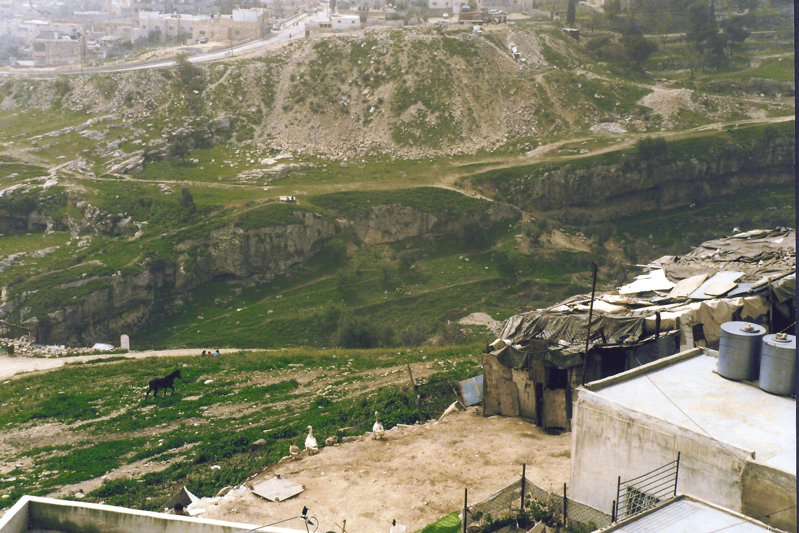
The Hinnom Valley Running North to South Through Jerusalem

Slide 47
Hell
The Greek word Gehenna means the “Valley of the Sons of Hinnom, a ravine south of Jerusalem. There, according to later Jewish popular belief, God’s final judgment was to take place (cp. Just., A I, 19, 8). In the gospels it is the place of punishment in the next life, hell” (BDAG, 191).
The word appears 12 times in the Bible (7 times is Matthew: 5:22, 29, 30; 10:28; 18:9; 23:15, 33). All but one (James 3:6) of the uses appear in the gospels, coming from the mouth of Jesus.
We will pay attention to what Jesus said about Hell in these verses.
What can you learn from the three previous uses—5:22, 29, 30?
What do you learn from 10:28?

Slide 48
Matthew 10:29-30
“Are not two sparrows sold for a copper coin? And not one of them falls to the ground apart from your Father’s will. But the very hairs of your head are all numbered.”
Sparrows were the cheapest of the birds sold for food, according to a third century AD decree (A. Deissmann, Light from the Ancient East [1927], pp. 272–275).
The copper coin (assariou) is 1/16 of a denarius (a day’s wages for the common laborer). In an economy where $100 is a day’s wages, it is $6.25.
Numbered (arithmeō).
What is Jesus teaching in these two verses?

Slide 49
God Cares for His Disciples
The first Greek word of the sentence in v. 30 is “your”; it is placed first for emphasis: “But the very hairs of your head are all numbered.”
What is the significance of this sentence?
R.T. France: “This saying does not promise escape from suffering or even death, but the knowledge that the time of its coming is in the hands of your Father, whose intimate knowledge of and concern for his children is spelt out in vv. 30 and 31” (Matthew: An Introduction and Commentary, 191).

Slide 50
Matthew 10:31
“Do not fear therefore; you are of more value than many sparrows.”
Therefore (oun) introduces the consequence of Jesus’s argument.
What is the consequence of Jesus’s argument for why the apostles (and all of God’s disciples) should not fear?
Put yourself in the place of Paul in a Roman jail, knowing that the “time of my departure is at hand.” How should/would you handle that situation?

Slide 51
Tribulation and Family Division (10:34-39)
“O not think that I came to bring peace on earth. I did not come to bring peace but a sword. For I have come to ‘set a man against his father, a daughter against her mother, and a daughter-in-law against her mother-in-law’; and ‘a man’s enemies will be those of his own household.’ He who loves father or mother more than Me is not worthy of Me. And he who loves son or daughter more than Me is not worthy of Me. And he who does not take his cross and follow after Me is not worthy of Me. He who finds his life will lose it, and he who loses his life for My sake will find it.”

Slide 52
Matthew 10:32
“Therefore whoever confesses Me before men, him I will also confess before My Father who is in heaven.”
Confess (homologeō): “of profession of allegiance . . . . Especially of confessing Christ, or the teaching of his community/church” (BDAG, 708).
It is used of man’s acknowledgment of his allegiance to Jesus, the Christ.
It is used of Jesus’s acknowledgment of one as His disciples on Judgment day.
A man’s standing before God in Judgment depends explicitly upon what He believes and does with Jesus.
What is the significance of Jesus referring to God as “My Father who is heaven”?

Slide 53
Matthew 10:33
“But whoever denies Me before men, him I will also deny before My Father who is in heaven.”
Deny (arneomai): “deny, disown” (BDAG, 244).
The parallels between vv. 32 and 33 are exact.
Note that Jesus offers no middle ground between “confessing Him” and “denying Him,” because there is none.
Vv. 32-33 describe a situation that may have happened while Jesus actually lived, but more nearly fits the situation after His resurrection.

Slide 54
Matthew 10:34
“Do not think that I came to bring peace on earth. I did not come to bring peace but a sword.”
What does “I came” imply about Jesus?
Jesus is called the Prince of Peace (Isa. 9:6). What kind of peace did He bring?
What kind of peace did Jesus state that He would not bring?
How is “sword” used in this passage?
Jesus did not call for His disciples to make physical war with anyone.
R.T. France: “But the peace the Messiah brings is much more than the absence of fighting, which men dignify with the name of ‘peace’, it is a restored relationship with God. And in the bringing of such ‘peace’, paradoxically, conflict is inevitable, as not all will accept it” (Matthew: An Introduction and Commentary, 192).

Slide 55
Matthew 10:35-36
“For I have come to ‘set a man against his father, a daughter against her mother, and a daughter-in-law against her mother-in-law’; and ‘a man’s enemies will be those of his own household.’”
Note again: “I have come.” What does it imply?
Cf. Micah 7:6—“For son dishonors father, Daughter rises against her mother, Daughter-in-law against her mother-in-law; A man’s enemies are the men of his own household.”
It was not Jesus’s mission to create hostility within the family. Christian families are usually the most peaceable of any.
However, sometimes becoming a Christian creates family conflict.

Slide 56
Matthew 10:37
“He who loves father or mother more than Me is not worthy of Me. And he who loves son or daughter more than Me is not worthy of Me.”
What is this verse teaching?
When might one have to choose Jesus above one’s family members?
Just who did Jesus think He is, if He demands a loyalty higher than the loyalty one owes his family?
What did Jesus’s family think about Him (Mark 3:21)?
Worthy (axios): no one can ever earn his salvation; it is a gift of grace; having acknowledged that, this word is used with the meaning “does not deserve to belong to me” (BDAG, 94).

Slide 57
Matthew 10:38
“And he who does not take his cross and follow after Me is not worthy of Me.”
The metaphor that Jesus uses is that of a prisoner condemned to death by crucifixion who was required to carry the cross bar to the place of execution.
Though Jesus had not yet been crucified, all Palestinians would have understood its meaning.
Leon Morris explains the meaning of the metaphor: “. . . taking up the cross stood for the utmost in renunciation of the claims of self. The person who took up a cross had died to a whole way of life; Jesus demands from everyone who follows him nothing less than a death to self” (The Gospel according to Matthew, 268).
How would our complaints about what we have sacrificed for the Lord sound on the day of Judgment, when we hear what others have endured for Jesus?

Slide 58
Matthew 10:39
“He who finds his life will lose it, and he who loses his life for My sake will find it.”
This verse appears in five other places (Matt. 16:25; Mark 8:35; Luke 9:24; 17:33; John 12:25).
How is “life” used in both halves of this verse?
What is this verse teaching?
How is “for My sake” used in this sentence? What does it imply about who Jesus thought He is?
What does this verse imply about life after death?

Slide 59
Reception of Missionaries and Its Reward (10:40-42)
“He who receives you receives Me, and he who receives Me receives Him who sent Me. He who receives a prophet in the name of a prophet shall receive a prophet's reward. And he who receives a righteous man in the name of a righteous man shall receive a righteous man's reward. And whoever gives one of these little ones only a cup of cold water in the name of a disciple, assuredly, I say to you, he shall by no means lose his reward.”

Slide 60
Note the Ones to Be Received
“You” = the Apostles
Prophet
Righteous man
Little ones

Slide 61
Matthew 10:40
“He who receives you receives Me, and he who receives Me receives Him who sent Me.”
This verse might be illustrated by David’s effort to send ambassadors to Ammon upon the death of their king. The new king Hanun treated them as spies and disgraced them by shaving off half of their beard, cutting off their garments at their hips, and sending them away (2 Sam. 10:4-5).
Their humiliation of David’s men led to war.
Think of how the U.S. would react to mistreatment of their ambassadors?
Think how Jesus will react to someone not receiving the Apostles whom He sent out.
Cf. the Parable of the Separation of the Sheep and Goats (25:39-40).
Look at 3 John 3-8 and 2 John 9-11.
How might persecution affect obedience to this commandment?

Slide 62
Matthew 10:41
“He who receives a prophet in the name of a prophet shall receive a prophet’s reward. And he who receives a righteous man in the name of a righteous man shall receive a righteous man’s reward.”
One can think of how some of the prophets sent out by Yahweh were rejected, persecuted, and put to death.
What meaning does the phrase “ in the name of prophet” convey?
What is the difference between a prophet and a righteous man?

Slide 63
Matthew 10:42
“And whoever gives one of these little ones only a cup of cold water in the name of a disciple, assuredly, I say to you, he shall by no means lose his reward.”
The “little ones” reminds me of the “least of these my brethren” in 25:40.
Leon Morris: “Notice that Jesus is speaking of the smallest conceivable gift to the most insignificant of people” (The Gospel according to Matthew, 271).
What is the significance of “in the name of a disciple”?
The word “assuredly” (amēn) and the double negative (ou mē) make the statement an emphatic one.

