Slide 2
We All Live to Regret Some Things We Have Done in Life!

Slide 3
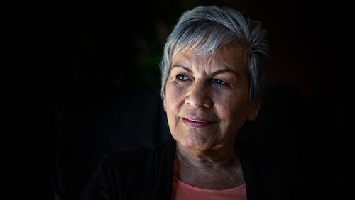
7
Things You Will Never Regret

Slide 4
Choices We Make
Life is made by choices; some good, some bad.
It is exciting when one can make a good choice, and positively influences another to be a child of God, and to improve his way of living.
Some choices, attitudes and actions are sinful action that results in regret and remorse filling the heart over the problems we have caused.
Here are seven (out of a possible thousand) things that one will never regret!

Slide 5
1. Being Kind to the Elderly

Slide 6
Quotations About Kindness
Kindness:
“Kindness is the golden chain by which society is bound together” (Goethe).
Mark Twain said, “Kindness is a language which the deaf can hear and the blind can read.”
Elderly: Benard Baruch said, “To me, old age is 15 years older than I am.”
Let kindness rule in our heart, especially toward the senior citizens!

Slide 7
Scripture Says . . .
“Thou shalt rise up before the hoary head, and honor the face of the old man, and fear thy God: I am the Lord” (Lev. 19:32).
“With the ancient is wisdom; and in length of days understanding” (Job 12:12; cf. Job. 32:6-9).
“Hearken unto thy father that begat thee, and despise not thy mother when she is old” (Prov. 23:22).
“The eye that mocks his father, And scorns obedience to his mother, The ravens of the valley will pick it out, And the young eagles will eat it” (Prov. 30:17).

Slide 8
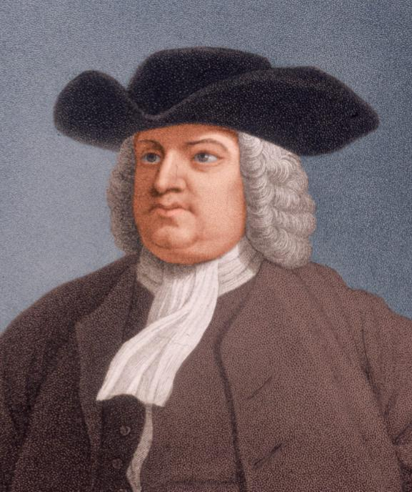
William Penn (1644-1718):
“I expect to pass through life but once. If therefore, there be any kindness I can show, or any good thing I can do to any fellow being, let me do it now, and not defer or neglect it, as I shall not pass this way again.”

Slide 9
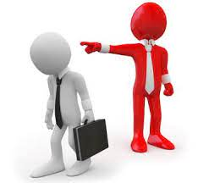
2. Not Retaliating When Angry

Slide 10
Quotations
Seneca: “The greatest remedy for anger is delay.”
Thomas Jefferson: “When angry, count to ten before you speak; if very angry, count to an hundred.”
A Dutch Proverb: “A little pot boils easily!

Slide 11
What Anger Does
Writes vicious letters or immediately posts an angry reply on Facebook, Twitter, etc.
Says mean things
Lashes out verbally or physically at others
Takes revenge

Slide 12
Scripture Says . . .
“Be ye angry, and sin not; let not the sun go down upon your wrath. . . .Let all bitterness, and wrath, and anger, and clamour, and evil speaking, be put away from you, with all malice; and be ye kind one to another, tenderhearted, forgiving one another, even as God for Christ’s sake hath forgiven you” (Eph. 4:26, 31-32).
“A wrathful man stiffeth up strife; but he that is slow to anger appeaseth strife” (Prov. 15:18).
“A soft answer turneth away wrath: but grievous words stir up anger” (Prov. 15:1).

Slide 13
3. Working to Save a Friendship

Slide 14
Scripture: What Makes a Friendship Valuable
“A friend loves at all times, And a brother is born for adversity” (Prov. 17:17).
“A man who has friends must himself be friendly, But there is a friend who sticks closer than a brother” (Prov. 18:24).
“Ointment and perfume delight the heart, And the sweetness of a man’s friend gives delight by hearty counsel” (Prov. 27:9).

Slide 15
What Friends Will Do
Rebuke you. “Open rebuke is better Than love carefully concealed. Faithful are the wounds of a friend, But the kisses of an enemy are deceitful” (Prov. 27:5-6).
Comfort you: “To him who is afflicted, kindness should be shown by his friend, Even though he forsakes the fear of the Almighty” (Job 6:14).
Support you through adversity: “Two are better than one, Because they have a good reward for their labor. For if they fall, one will lift up his companion. But woe to him who is alone when he falls, For he has no one to help him up. Again, if two lie down together, they will keep warm; But how can one be warm alone? Though one may be overpowered by another, two can withstand him. And a threefold cord is not quickly broken” (Eccl. 4:9-12).

Slide 16
Work to Keep Your Friends
“Therefore if thou bring thy gift to the altar, and there rememberest that thy brother hath ought against thee; Leave there thy gift before the altar, and go thy way; first be reconciled to thy brother, and then come and offer thy gift” (Matt. 5:23-25).
The certainty of our happiness and the purity of our lives depends on our making a wise choice of our companions and friends.
Make effort to preserve friendships!
Cicero said friends are “the most valuable and fairest furniture of life!”

Slide 17
Go That Extra Mile
“You have heard that it was said, ‘An eye for an eye and a tooth for a tooth.’ But I tell you not to resist an evil person. But whoever slaps you on your right cheek, turn the other to him also. If anyone wants to sue you and take away your tunic, let him have your cloak also. And whoever compels you to go one mile, go with him two. Give to him who asks you, and from him who wants to borrow from you do not turn away” (Matt. 5:38-42).

Slide 18
4. Not Repeating Gossip!

Slide 19
Scripture Says . . .
“A perverse man stirs up dissension, and a gossip separates close friends” (Prov. 16:28).
“A prudent man concealeth knowledge; but the heart of fools proclaimeth foolishness” (Prov. 12:23).
“He that covereth a transgression seeketh love; but he that repeateth a matter separateth very friends” (Prov. 17:9).
“An hypocrite with his mouth destroyeth his neighbor” (Prov. 11:9).

Slide 20
Quotes on Reputation
Socrates: “The way to gain a good reputation is to endeavor to be what you desire to appear.”
Henry Ford: “You can not build a reputation on what you are going to do!”

Slide 21
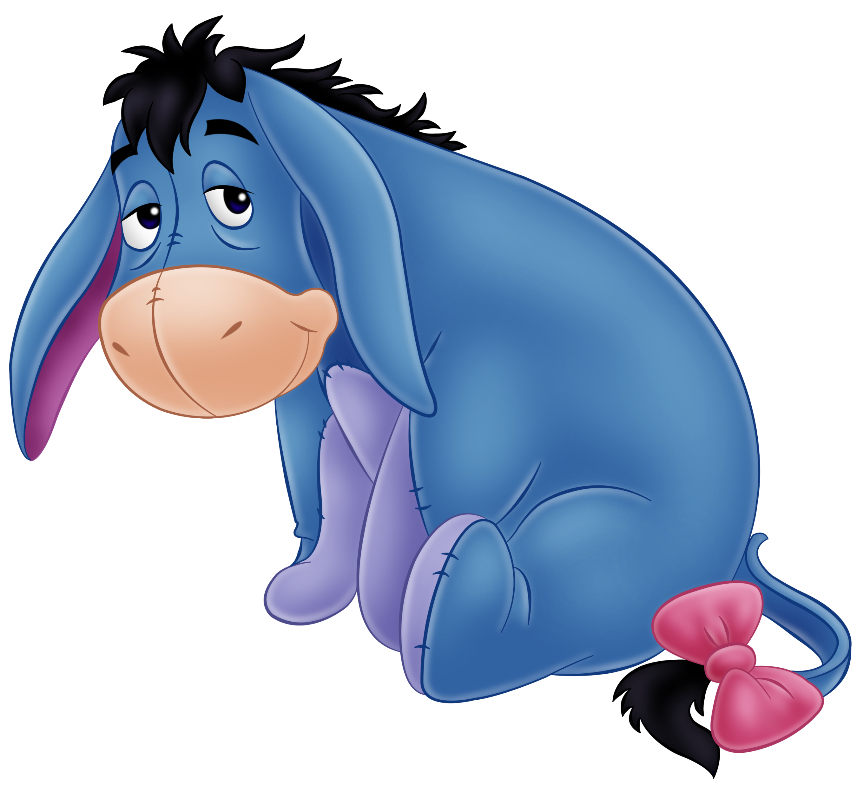
5. Show Consideration for Others, Especially Your Family!
“A little consideration, a little thought for others, makes all the difference.”
Eeyore

Slide 22
Scripture Says . . .
“Therefore, whatever you want men to do to you, do also to them, for this is the Law and the Prophets” (Matt. 7:12).
“My son, hear the instruction of thy father, and forsake not the law of thy mother; For they shall be an ornament of grace unto thy head, and chains about thy neck” (Prov. 1:8-9).
“But if any provide not for his own, and specially for those of his own house, he hath denied the faith, and is worse than an infidel” (1 Tim. 5:8).
“Honor thy father and mother; which is the first commandment with promise; that it may be well with thee, and thou mayest live long on the earth” (Eph. 6:2-3).
Our loved ones care more about us than any other person on the earth! Respect them!

Slide 23
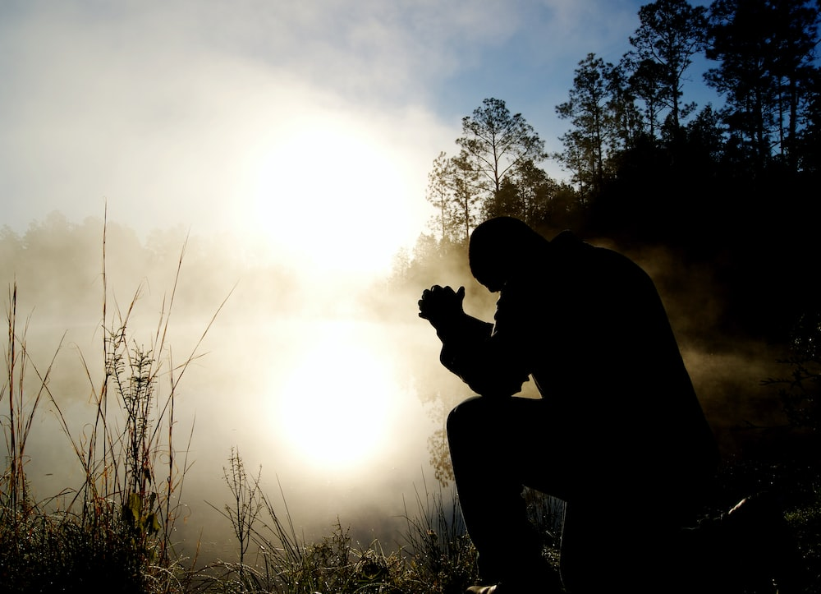
6. Show Reverence for Your Maker

Slide 24
Scripture Says . . .
“The fear of the Lord is the beginning of knowledge” (Prov. 1:7).
“Trust in the Lord with all thine heart; and lean not unto thine own understanding. In all thy ways acknowledge him, and he shall direct thy paths. Be not wise in thine own eyes;fear the Lord, and depart from evil” (Prov. 3:5-7).
“Let us hear the conclusion of the whole matter: Fear God, and keep his commandments: for this is the whole duty of man” (Eccl. 12:13).

Slide 25
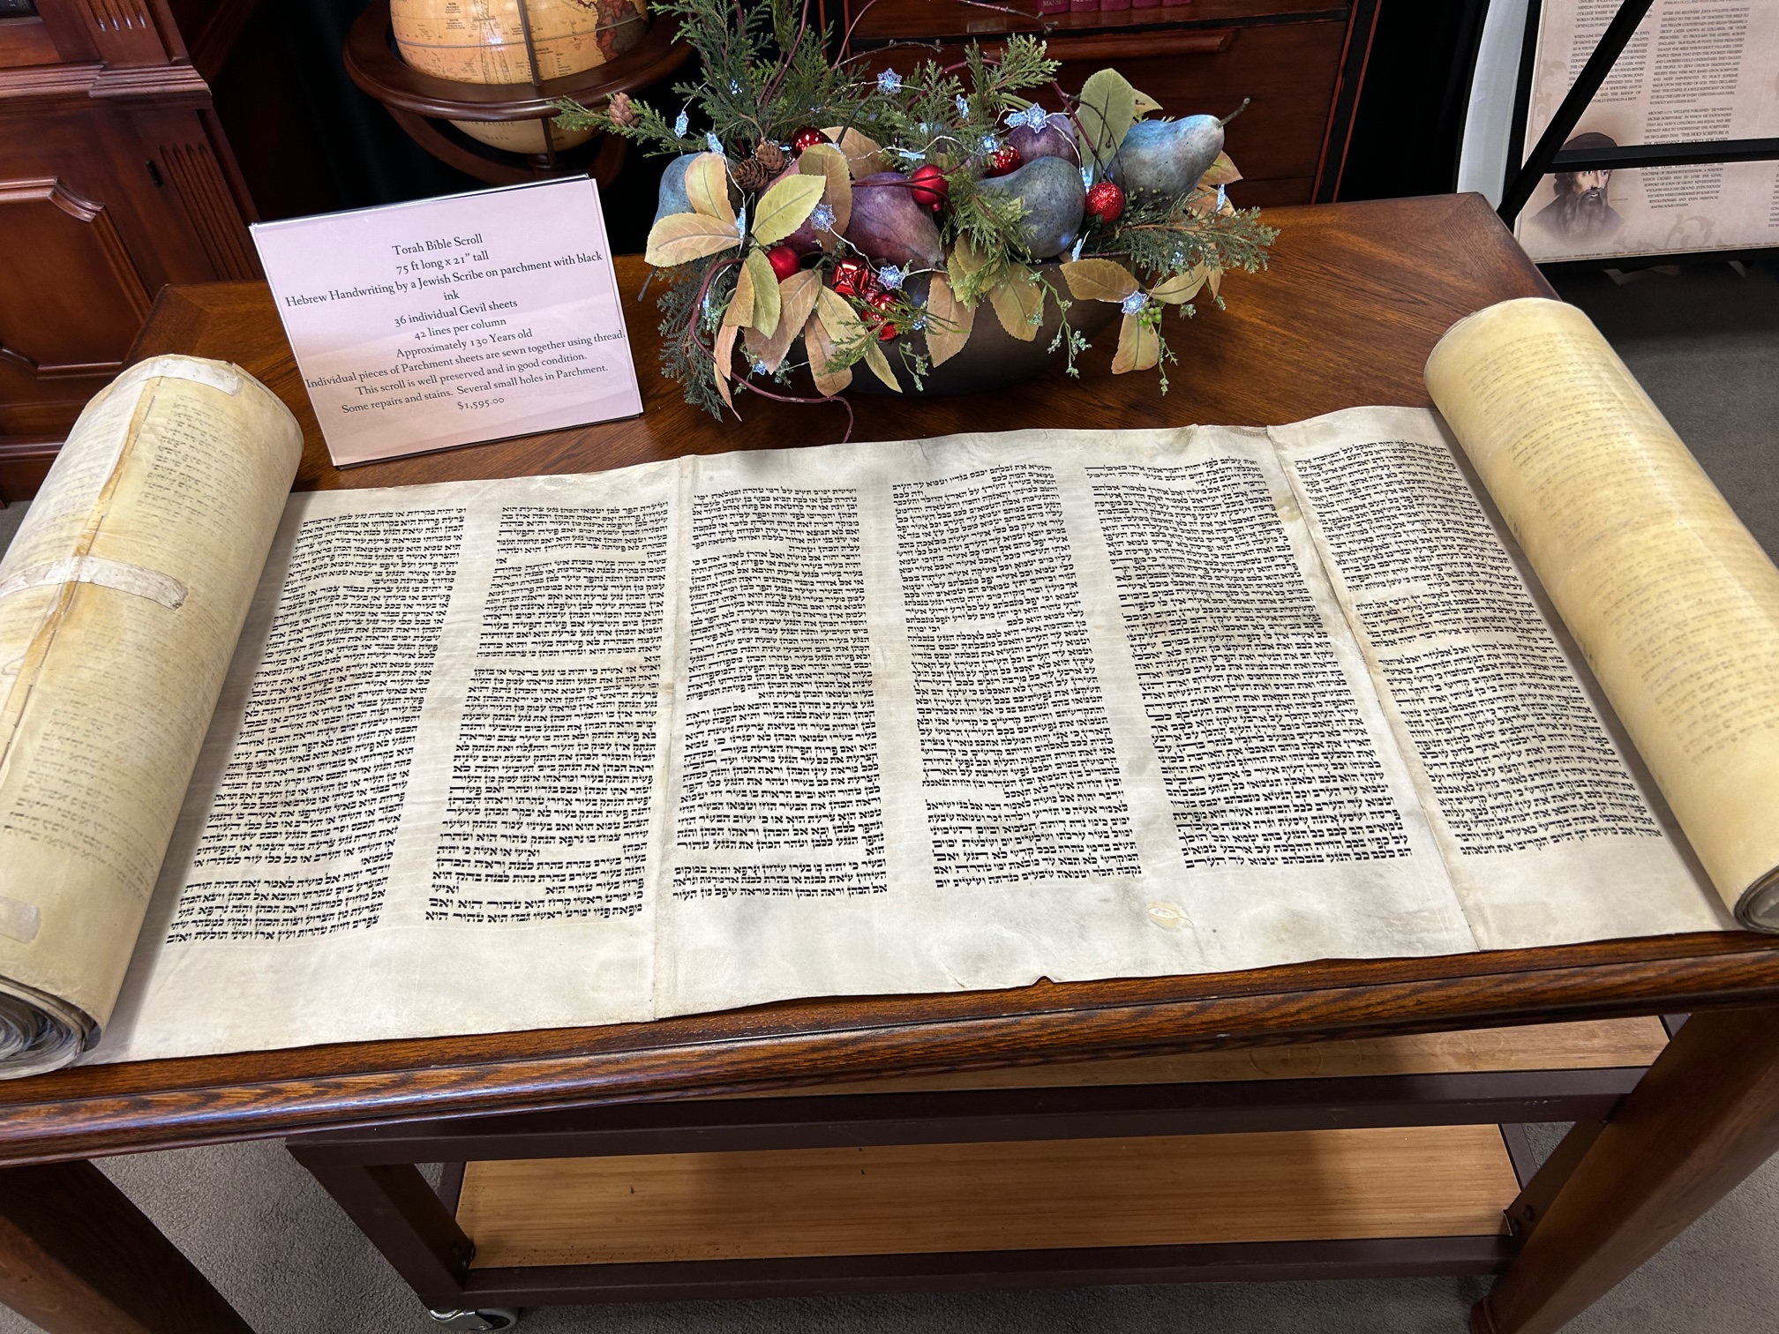
7. Respect God’s Laws

Slide 26
Scripture Says . . .
“And whatsoever ye do in word or deed, do all in the name of the Lord Jesus, giving thanks to God and the Father by him” (Col. 3:17).
“For therein (the gospel) is the righteousness of God revealed from faith to faith: as it is written, The just shall live by faith” (Rom. 1:17).
“For I say unto you, That except your righteousness shall exceed the righteousness of the scribes and Pharisees, ye shall in no case enter into the kingdom of heaven” (Matt. 5:20).
“But in every nation he that feareth him, and worketh righteousness, is accepted with him” (Acts 10:35).

Slide 27
Scripture Says . . .
“Awake to righteousness, and sin not; for some have not the knowledge of God: I speak this to your shame” (1 Cor. 15:34).
“Being filled with the fruits of righteousness, which are by Jesus Christ, unto the glory and praise of God” (Phil. 1:11).
“And the fruit of righteousness is sown in peace of them that make peace” (James 3:18).

Slide 28
We are only supposing, but if it were real,
Had you invoiced your life from your birth,
If you figured the profits made from Life’s deal.
How much would YOU find you were worth?
Don’t count as possessions your silver and gold
For tomorrow you leave them behind.
And all that is yours to have and to hold
Are the blessings you’ve given mankind.
Just what did you do as you journeyed along
That was really and truly worthwhile?
Are you sure that the good deeds will satisfy the wrong,
Can you look back over life with a smile?
Suppose that today was your last day on earth,
And the last weary mile you had trod;
After all of your struggles, how much are you worth. . .
How much can you take home to God?
Just Suppose . . .

Slide 29
Conclusion

Slide 30
So What?
Rectify past wrongs within our life, and as we affect others.
“Because he hath appointed a day, in the which he will judge the world in righteousness by that man whom he hath ordained; whereof he hath given assurance unto all men, in that he hath raised him from the dead” (Acts 17:31).
“Henceforth there is laid up for me a crown of righteousness, which the Lord, the righteous judge, shall give me at that day: and not to me only, but unto all them also that love His appearing” (2 Tim. 4:7-8).

