Slide 2
Paul Is Wrapping Up
Paul is coming to the end of his letter to the Philippians.
He adds another exhortation to his closing thoughts—“think about these things.”

Slide 3
Philippians 4:8
“Finally, brothers, whatever is true, whatever is honorable, whatever is just, whatever is pure, whatever is lovely, whatever is commendable, if there is any excellence, if there is anything worthy of praise, think about these things.”

Slide 4
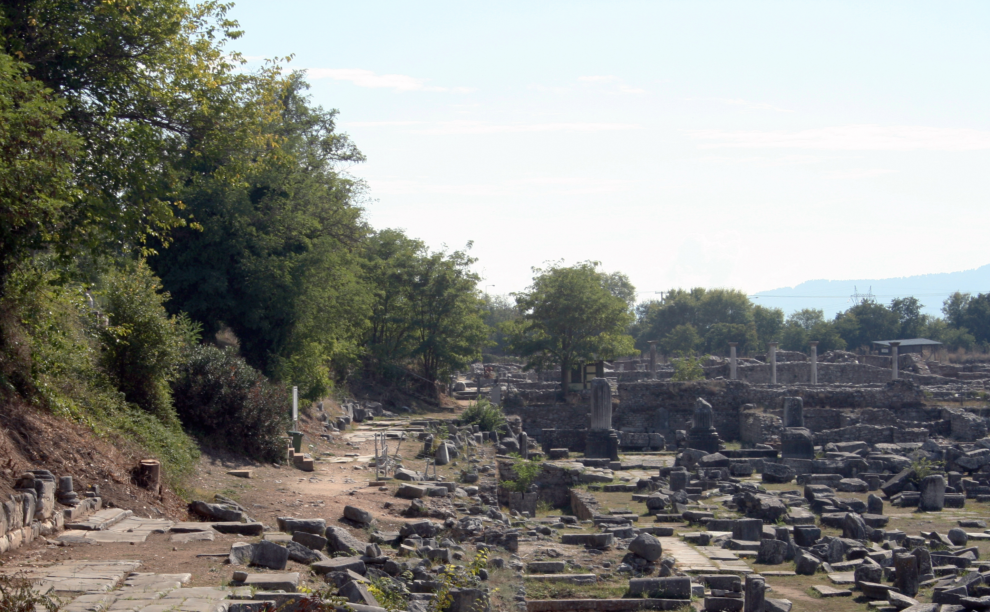
Favorite Texts from Philippians

Slide 5
Attached to Its Context
This verse should be joined to verse 7. “And the peace of God, which surpasses all understanding, will guard your hearts and your minds in Christ Jesus.”
Ralph P. Martin wrote, “This gives a good sense to the apostle’s admonition. If inner tranquility is to be enjoyed continually and its influence shed abroad certain steps must be taken” (Philippians: An Introduction and Commentary, 177).
Whether or not we follow the pattern given for inner peace will be determined by how much we want it.

Slide 6
Jesus Emphasized Man’s Heart

Slide 7
The Heart Above Rituals
The Pharisees rebuked Jesus’s disciples for eating bread with unwashed hands (Mark 7:2).
The Lord rebuked the Pharisees from giving too much emphasis to the ceremonial washings for prevention of defilement saying, “‘There is nothing outside a person that by going into him can defile him, but the things that come out of a person are what defile him.’ And when he had entered the house and left the people, his disciples asked him about the parable. And he said to them, ‘Then are you also without understanding? Do you not see that whatever goes into a person from outside cannot defile him, since it enters not his heart but his stomach, and is expelled?’” (Mark 7:15-19).
He then explained, “What comes out of a person is what defiles him. For from within, out of the heart of man, come evil thoughts, sexual immorality, theft, murder, adultery, coveting, wickedness, deceit, sensuality, envy, slander, pride, foolishness. All these evil things come from within, and they defile a person” (Mark 7:20-23).

Slide 8
From the Sermon on the Mount
“Do not lay up for yourselves treasures on earth, where moth and rust destroy and where thieves break in and steal, but lay up for yourselves treasures in heaven, where neither moth nor rust destroys and where thieves do not break in and steal. For where your treasure is, there your heart will be also” (Matt. 6:19-21).
He then added that the heart must be single focused: “The eye is the lamp of the body. So, if your eye is healthy, your whole body will be full of light, but if your eye is bad, your whole body will be full of darkness. If then the light in you is darkness, how great is the darkness! No one can serve two masters, for either he will hate the one and love the other, or he will be devoted to the one and despise the other. You cannot serve God and money” (Matt. 6:22-24).

Slide 9
From Confrontations with the Pharisees
In His confrontation with the Pharisees when they charged that Jesus cast out demons by the power of Beelzebul, the Lord said, “Either make the tree good and its fruit good, or make the tree bad and its fruit bad, for the tree is known by its fruit. You brood of vipers! How can you speak good, when you are evil? For out of the abundance of the heart the mouth speaks. The good person out of his good treasure brings forth good, and the evil person out of his evil treasure brings forth evil” (Matt. 12:33-35).

Slide 10
Grounded in the Old Testament
What Jesus taught is grounded in truths taught previously in the Old Testament.
“My son, be attentive to my words; incline your ear to my sayings. Let them not escape from your sight; keep them within your heart. For they are life to those who find them, and healing to all their flesh. Keep your heart with all vigilance, for from it flow the springs of life” (Prov. 4:20-23).
No wonder Jesus pronounced a blessing on those who are “pure in heart” (Matt. 5:8).

Slide 11
Jesus Emphasized the Greatest Commandment

Slide 12
The Shema‘
Moses commanded, “Hear, O Israel: The Lord our God, the Lord is one. You shall love the Lord your God with all your heart and with all your soul and with all your might. And these words that I command you today shall be on your heart” (Deut. 6:4–6).
Jesus described it as the first and greatest commandment: “You shall love the Lord your God with all your heart and with all your soul and with all your mind. This is the great and first commandment” (Matt. 22:37-38).

Slide 13
The Foundation Rock
The decision to believe in God with all of one’s heart is the foundation rock on which everything else is based.
“The fear of the Lord is the beginning of knowledge; fools despise wisdom and instruction” (Prov. 1:7).
“Trust in the Lord with all your heart, and do not lean on your own understanding. In all your ways acknowledge him, and he will make straight your paths. Be not wise in your own eyes; fear the Lord , and turn away from evil” (Prov. 3:5-7).

Slide 14
Think about These Things

Slide 15
Things That Are True
The Greek word alēthēs is used in several ways:
“Pertaining to being truthful, honest, truthful, righteous, honest.”
“Pertaining to being in accordance with fact, true” (BDAG, 43). This is the meaning assigned to this passage.
The sense can either be letting one’s mind dwell on those things which are true and factual, as defined by God’s word or considering it as a character trait of “truthfulness, dependability” (think of “true friend”).

Slide 16
Things That Are Noble
The Greek word semnos is used as a qualification of elders who are to be “worthy of respect/honor, noble, dignified, serious” and then “of characteristics, states of being, and things honorable, worthy, venerable, holy, above reproach” (BDAG, 919).
One can fill his mind with things that are dishonorable, unworthy, and disrespectful or noble things.

Slide 17
Things That Are Just
The Greek word dikaios is a favorite word for Paul, usually used in the sense of moral justification, being declared justified. In this context BDAG suggest that the meaning is “that which is obligatory in view of certain requirements of justice, right, fair, equitable” (247).
One must remember that what is “right” is grounded in God, not humanity’s opinion about what is right. Contrast the present attitude about such things as sex outside the bonds of marriage, homosexuality, abortion, etc.

Slide 18
Things That Are Pure
Pure, from hagnos, is a cultic word, originally an attribute of divinity and everything belonging to it. Later the word included a moral sense.
Gordon Fee said that “Here it has to do with whatever is not besmirched or tainted in some way by evil” (Philippians, 179).

Slide 19
Things That Are Lovely
The Greek word prosphilēs means “pertaining to causing pleasure or delight, pleasing, agreeable, lovely, amiable” (BDAG, 887).
Ralph P. Martin said that the word “is found only here in the New Testament and, when used of things, carries the meaning ‘pleasing, attractive’; but as I. H. Marshall says, since ‘we may perversely find evil things attractive, the rendering “beautiful” is to be preferred’” (Philippians: An Introduction and Commentary, 178).

Slide 20
Things of Good Report
The Greek word euphēmos bears the meaning of “praiseworthy, commendable” (BDAG, 414). Gordon Fee said that this word “represents the kind of conduct that is worth considering because it is well spoken of by people in general” (179).
There are things in our society that have a bad report (think of the movie ratings). When the immoral world tells you something is R or X you need to believe them.

Slide 21
Things of Virtue and Praiseworthy
Virtue:
I was first introduced to the Greek word aretē as a student at Florida College. It was the name of one of the societies.
The word had a long history of honorable meaning in Greek society, especially among the Greek Stoics.
It means “uncommon character worthy of praise, excellence of character, exceptional civic virtue” (BDAG, 130).
Praiseworthy.
The Greek word epainos is used in this context of “a thing worthy of praise” (BDAG, 357), so the English translation is very literal.

Slide 22
Guard Your Mind

Slide 23
Pornography
Pornography addictions affect both men and women:
40 million U.S. adults regularly visit internet pornography websites
10% of U.S. adults admit to having an addiction to internet pornography
17% of all women struggle with porn addiction
20% of men and 13% of women admit to accessing porn while at work
70% of women admit to keeping their cyber activities secret
1 of 3 visitors of all adult websites is a woman
Women favor chat rooms twice as much as men
(https://www.therecoveryvillage.com/process-addiction/porn-addiction/pornography-statistics/#:~:text=Today%2C%20porn%20 addiction% 2C%20or%20problematic, 6%25%20of%20the%20adult%20population.).

Slide 24
Protect Yourself
It is extremely difficult to “unsee” or “unhear” things that are emblazoned on your mind.
Some very strong men have come home from war traumatized by what they saw and heard. I knew one of these men who came home from WWII and suffered his entire life from emotional problems created by that war.
Young minds exposed to pornographic images frequently become addicted to them and find those images difficult to erase from their minds.
Filthy movies
TV programs
With filthy language.
Programs that undermine Christian values (approving conduct that the Bible declares to be sinful).
Filthy music

Slide 25
Conclusion

