Slide 2
Paul Is Wrapping Up
Paul is coming to the end of his letter to the Philippians.
He adds another exhortation to his closing thoughts which will be our last lesson in this series.

Slide 3
Philippians 4:10-13
“I rejoiced in the Lord greatly that now at length you have revived your concern for me. You were indeed concerned for me, but you had no opportunity. Not that I am speaking of being in need, for I have learned in whatever situation I am to be content. I know how to be brought low, and I know how to abound. In any and every circumstance, I have learned the secret of facing plenty and hunger, abundance and need. I can do all things through him who strengthens me.”

Slide 4
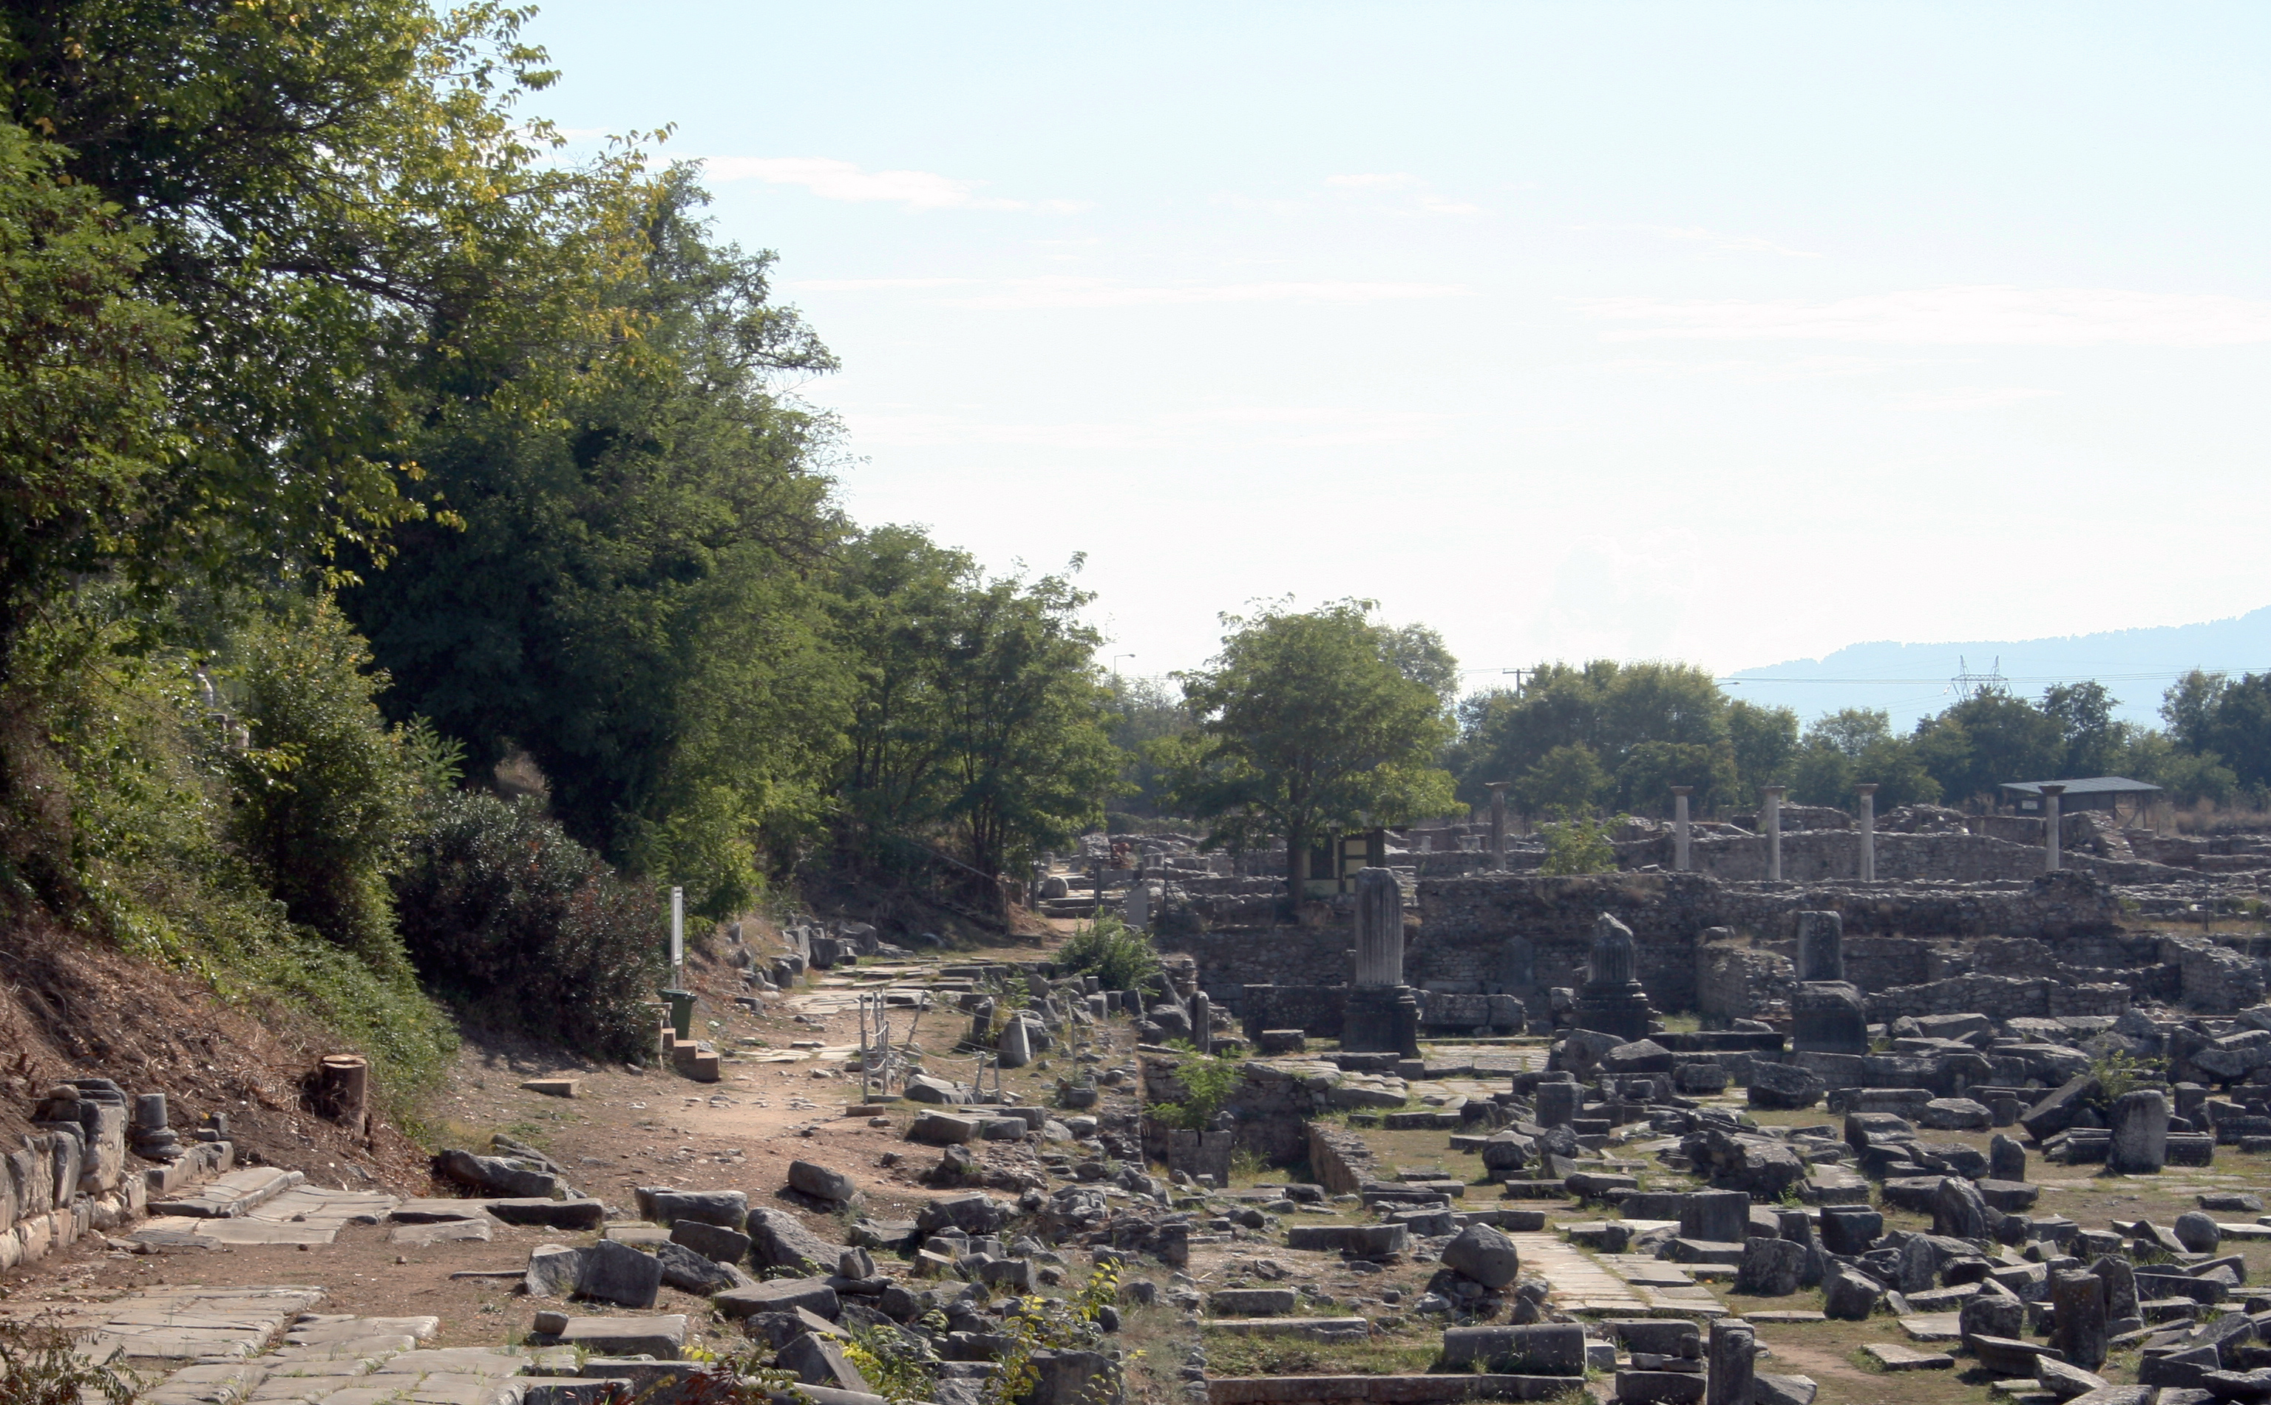
Favorite Texts from Philippians

Slide 5
Paul’s Circumstances
He is in a Roman jail, expecting to be released soon, but not positive about the outcome (2:24).
As a person in jail, he was dependent upon his colleagues and friends for food. Gordon Fee explains that Paul was “in a prison system where prisoners must secure their own food supply” and in that situation Paul “had plenty of opportunity to go hungry” (Philippians, 186).
Epaphroditus had recently come to Paul with help supplied by the church at Philippi (2:25; 4:10).
The Philippians had been a generous group that provided for Paul’s needs from the beginning of their association with one another.
Lydia opened her home to Paul and his companions after she was converted (Acts 16:15).
They provided Paul help while he worked at Thessalonica (Phil. 4:15) and Corinth (2 Cor. 11:9).
One reason for his letter to the Philippians was to thank them for their help.

Slide 6
Roman Patronage
His thanks are written to a body of people quite familiar with a system that was called “patronage.”
The patron was the protector, sponsor, and benefactor of the client. Although typically the client was of inferior social class, a patron and client might even hold the same social rank, but the former would possess greater wealth, power, or prestige that enabled him to help or do favors for the client.
Benefits a client may be granted include legal representation in court, loans of money, influencing business deals or marriages, and supporting a client’s candidacy for political office or a priesthood. Arranging marriages for their daughters, clients were often able to secure new patrons and extend their influence in the political arena. In return for these services, the clients were expected to offer their services to their patron as needed.
The nearest thing I can compare this system to is one accepting a “gift” from a mafia godfather. It always came with strings attached.
If he ever needed your help, you could not turn him down.

Slide 7
Paul Took No Support from Corinth
At Corinth, Paul refused to accept financial support from the church, perhaps because of these attitudes toward patronage. He wrote,
“In the same way, the Lord commanded that those who proclaim the gospel should get their living by the gospel. But I have made no use of any of these rights, nor am I writing these things to secure any such provision. For I would rather die than have anyone deprive me of my ground for boasting. For if I preach the gospel, that gives me no ground for boasting. For necessity is laid upon me. Woe to me if I do not preach the gospel! For if I do this of my own will, I have a reward, but if not of my own will, I am still entrusted with a stewardship. What then is my reward? That in my preaching I may present the gospel free of charge, so as not to make full use of my right in the gospel” (1 Cor. 9:14-18).
In the letter to the Philippians, Paul was being very careful to express appreciation for their gifts in such a way as to let them know he was not indebted to them, but was sufficient.

Slide 8
Thanks to the Philippians Church
“I rejoiced in the Lord greatly that now at length you have revived your concern for me. You were indeed concerned for me, but you had no opportunity” (4:10).
By “now at length,” one might think he was saying, “Why did it take so long for you to get around to helping me?”
Not wishing to leave that impression, he quickly added, “You were indeed concerned for me, but you had no opportunity” (4:10).
In what follows, Paul describes how he lived with his painful circumstances and this provides for us a pattern of how we also should accept our own situations in life.

Slide 9
Paul Had Learned to Be Content

Slide 10
A Difficult Lesson
This is a difficult and yet important lesson to learn and, I am confident that no one here would dare state that he has completely mastered this attitude.
Job’s comment following the loss of his wealth and his children are noble words of a strong man: “Then Job arose and tore his robe and shaved his head and fell on the ground and worshiped. And he said, ‘Naked I came from my mother’s womb, and naked shall I return. The Lord gave, and the Lord has taken away; blessed be the name of the Lord.’ In all this Job did not sin or charge God with wrong” (Job 1:20-22).

Slide 11
1 Corinthians 10:13
“No temptation has overtaken you that is not common to man. God is faithful, and he will not let you be tempted beyond your ability, but with the temptation he will also provide the way of escape, that you may be able to endure it.”
Illnesses
Deaths in one’s family
Financial losses
Old age
Conflicts within a marriage
A Divorce
Rebellious children
The fact is that there are situations which come to each of us over which we have no control.

Slide 12
Self-Sufficiency
Paul uses the word autarkēs to describe his attitude. The word is defined as to be “content, self-sufficient” (BDAG, 152).
He does not use the word in a stoical sense that hides one’s emotions.
The Stoic would have said that he was “sick and yet happy, in peril and yet happy, dying and yet happy, in exile and happy, in disgrace and happy.”
The stoic would explain that he could do this because of the strength of his inner will to contain, restrain, and control his emotions.

Slide 13
Sufficiency Because of God
The person who is a Christian learns his sufficiency does not reside within himself but in his dependence upon God.
He recognizes the existence of an omniscient and Almighty God.
The revelation of God shows His nature: “The Lord passed before him and proclaimed, ‘The Lord, the Lord, a God merciful and gracious, slow to anger, and abounding in steadfast love and faithfulness, keeping steadfast love for thousands, forgiving iniquity and transgression and sin, but who will by no means clear the guilty, visiting the iniquity of the fathers on the children and the children’s children, to the third and the fourth generation’” (Exod. 34:6-7).

Slide 14
Things We Know About God
He recognizes that one God as the Creator and Sustainer of the universe.
God provides the needs to sustain the wild animals (Matt. 6:26).
Man is more valuable to God than animals (Matt. 6:26; 12:12).
He has a Father/son relationship with this God.
God knows the needs of His children (Matt. 6:8, 32).
God will provide for the needs of mankind (Matt. 7:7-11).
Therefore, God will provide for His saints (Matt. 6:33).

Slide 15
Philippians 4:11-12
“Not that I am speaking of being in need, for I have learned in whatever situation I am to be content. I know how to be brought low, and I know how to abound. In any and every circumstance, I have learned the secret of facing plenty and hunger, abundance and need.”
Paul knew about being brought low.

Slide 16
1 Corinthians 4:11-13
“To the present hour we hunger and thirst, we are poorly dressed and buffeted and homeless, and we labor, working with our own hands. When reviled, we bless; when persecuted, we endure; when slandered, we entreat. We have become, and are still, like the scum of the world, the refuse of all things.”

Slide 17
2 Corinthians 6:4-10
“. . . but as servants of God we commend ourselves in every way: by great endurance, in afflictions, hardships, calamities, beatings, imprisonments, riots, labors, sleepless nights, hunger; by purity, knowledge, patience, kindness, the Holy Spirit, genuine love; by truthful speech, and the power of God; with the weapons of righteousness for the right hand and for the left; through honor and dishonor, through slander and praise. We are treated as impostors, and yet are true; as unknown, and yet well known; as dying, and behold, we live; as punished, and yet not killed; as sorrowful, yet always rejoicing; as poor, yet making many rich; as having nothing, yet possessing everything.”

Slide 18
2 Corinthians 11:23-29
Are they servants of Christ? I am a better one—I am talking like a madman—with far greater labors, far more imprisonments, with countless beatings, and often near death. Five times I received at the hands of the Jews the forty lashes less one. Three times I was beaten with rods. Once I was stoned. Three times I was shipwrecked; a night and a day I was adrift at sea; on frequent journeys, in danger from rivers, danger from robbers, danger from my own people, danger from Gentiles, danger in the city, danger in the wilderness, danger at sea, danger from false brothers; in toil and hardship, through many a sleepless night, in hunger and thirst, often without food, in cold and exposure. And, apart from other things, there is the daily pressure on me of my anxiety for all the churches. Who is weak, and I am not weak? Who is made to fall, and I am not indignant?”

Slide 19
Paul’s Attitude During Suffering
“So to keep me from becoming conceited because of the surpassing greatness of the revelations, a thorn was given me in the flesh, a messenger of Satan to harass me, to keep me from becoming conceited. Three times I pleaded with the Lord about this, that it should leave me. But he said to me, ‘My grace is sufficient for you, for my power is made perfect in weakness.’ Therefore I will boast all the more gladly of my weaknesses, so that the power of Christ may rest upon me. For the sake of Christ, then, I am content with weaknesses, insults, hardships, persecutions, and calamities. For when I am weak, then I am strong” (2 Cor. 12:7-10).
Who can deny that he prays more frequently and fervently when we have suffering in our lives that we cannot control?
Our sufferings puts us on our knees in the presence of God.

Slide 20
I Know How to Abound!
Richard R. Melick wrote, “It may be more difficult to triumph in the good times than in the bad. A Christian’s victory comes from a conscious dependence on the Lord and his power, and that is easier understood when times get hard!” (Philippians, Colossians, Philemon, 155).
The wisdom of Solomon must have guided Paul:
“He who loves money will not be satisfied with money, nor he who loves wealth with his income; this also is vanity. When goods increase, they increase who eat them, and what advantage has their owner but to see them with his eyes? Sweet is the sleep of a laborer, whether he eats little or much, but the full stomach of the rich will not let him sleep. There is a grievous evil that I have seen under the sun: riches were kept by their owner to his hurt, and those riches were lost in a bad venture. And he is father of a son, but he has nothing in his hand. As he came from his mother’s womb he shall go again, naked as he came, and shall take nothing for his toil that he may carry away in his hand” (Eccl. 5:10-15).

Slide 21
Abundance Enables Us to Do Good
“. . .Each one must give as he has decided in his heart, not reluctantly or under compulsion, for God loves a cheerful giver. And God is able to make all grace abound to you, so that having all sufficiency in all things at all times, you may abound in every good work. As it is written, ‘He has distributed freely, he has given to the poor; his righteousness endures forever.’ He who supplies seed to the sower and bread for food will supply and multiply your seed for sowing and increase the harvest of your righteousness. You will be enriched in every way to be generous in every way, which through us will produce thanksgiving to God” (2 Cor. 9:7-11).
“And let us not grow weary of doing good, for in due season we will reap, if we do not give up. So then, as we have opportunity, let us do good to everyone, and especially to those who are of the household of faith” (Gal. 6:9-10).

Slide 22
Learning to Live with Abundance
We must overcome the temptations to selfish living and accept the responsibility for using God’s good gifts to us. Look at some rich men who lost their souls:
The rich young ruler (Matt. 19:16-22).
The rich man who did nothing to help Lazarus (Luke 16:19-31).

Slide 23
Strength Through Christ

Slide 24
Not Boasting in Our Own Strength
This verse is not glorying in one’s own personal spiritual strength. Ours is not a self-sufficiency, but a Christ-sufficiency!
With God’s help, young David defeated the Philistine giant Goliath (1 Sam. 17).
With 300 men (Judg. 7:7), Gideon defeated 135,000 Midianites (Judg. 8:10).
“At my first defense no one came to stand by me, but all deserted me. May it not be charged against them! But the Lord stood by me and strengthened me, so that through me the message might be fully proclaimed and all the Gentiles might hear it. So I was rescued from the lion’s mouth. The Lord will rescue me from every evil deed and bring me safely into his heavenly kingdom. To him be the glory forever and ever. Amen” (2 Tim. 4:16-18).
Our strength is not within ourselves but in Him who strengthens me!

Slide 25
Conclusion

Slide 26
Do Not Be Deceived
It is obvious from Paul’s own life experience and what he taught the Philippians that the “health and wealth gospel” is a distortion of the Christian message.
This doctrine teaches that faith in the Lord will result in good health (even miraculous healing of horrible diseases) and prosperity.
For Paul, the gospel resulted in anything but health and prosperity in the temporal sense.
What the gospel message does for us is:
Give us remission of our sins.
Gives us the promise of resurrection to eternal life.
Provides hope in the face of the most difficult life circumstances.
Provides the best life for mankind on earth.

