Slide 2
Christian Behavior:
Exhortations for On the Job Conduct

Slide 3
Titus 2:1-10
Paul gives Titus instructions for teaching various categories of believers. There are five groups addressed:
Older men
Older women
Younger women
Young men
Slaves
The categories of instruction in Titus 2:1-10 include all Christians, whatever their gender, age, or station in life might be.

Slide 4
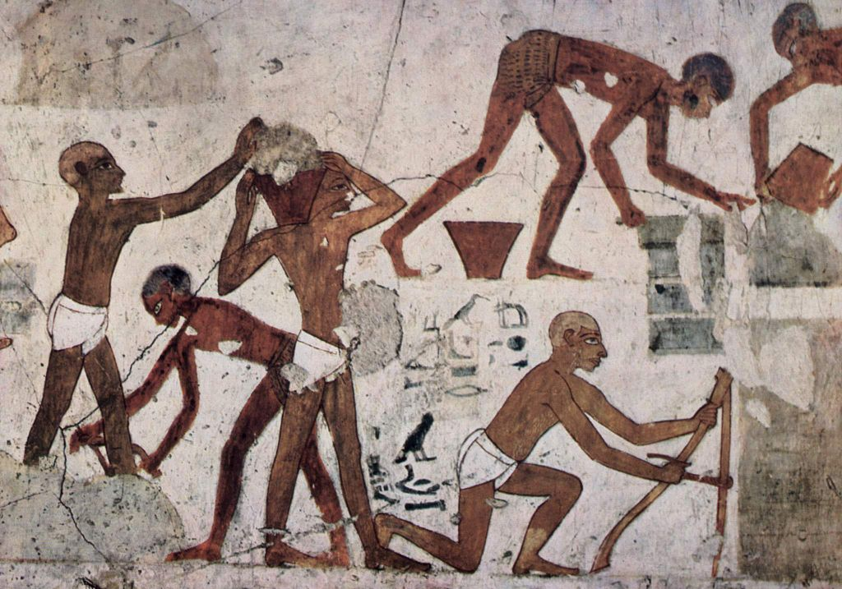
Brief Comments on Slavery

Slide 5
Interpreting Ancient Slavery
Most of us view slavery through the lens of the slavery that was practiced in 17-19th century America.
In American practice, slavery involved racial distinctions.
But race was not a factor for biblical slavery.

Slide 6
Comments About Slavery
“Central features that distinguish 1st century slavery from that later practiced in the New World are the following: racial factors played no role; education was greatly encouraged (some slaves were better educated than their owners) and enhanced a slave’s value; many slaves carried out sensitive and highly responsible social functions; slaves could own property (including other slaves!); their religious and cultural traditions were the same as those of the freeborn; no laws prohibited public assembly of slaves; and (perhaps above all) the majority of urban and domestic slaves could legitimately anticipate being emancipated by the age of 30” (S. Scott Bartchy, “Slavery: New Testament,” ed. David Noel Freedman, The Anchor Yale Bible Dictionary, 6:66).

Slide 7
Prisoners of War as Slaves
“And all the army of the Chaldeans, who were with the captain of the guard, broke down the walls around Jerusalem. And the rest of the people who were left in the city and the deserters who had deserted to the king of Babylon, together with the rest of the multitude, Nebuzaradan the captain of the guard carried into exile. But the captain of the guard left some of the poorest of the land to be vinedressers and plowmen” (2 Kings 25:10-12).

Slide 8
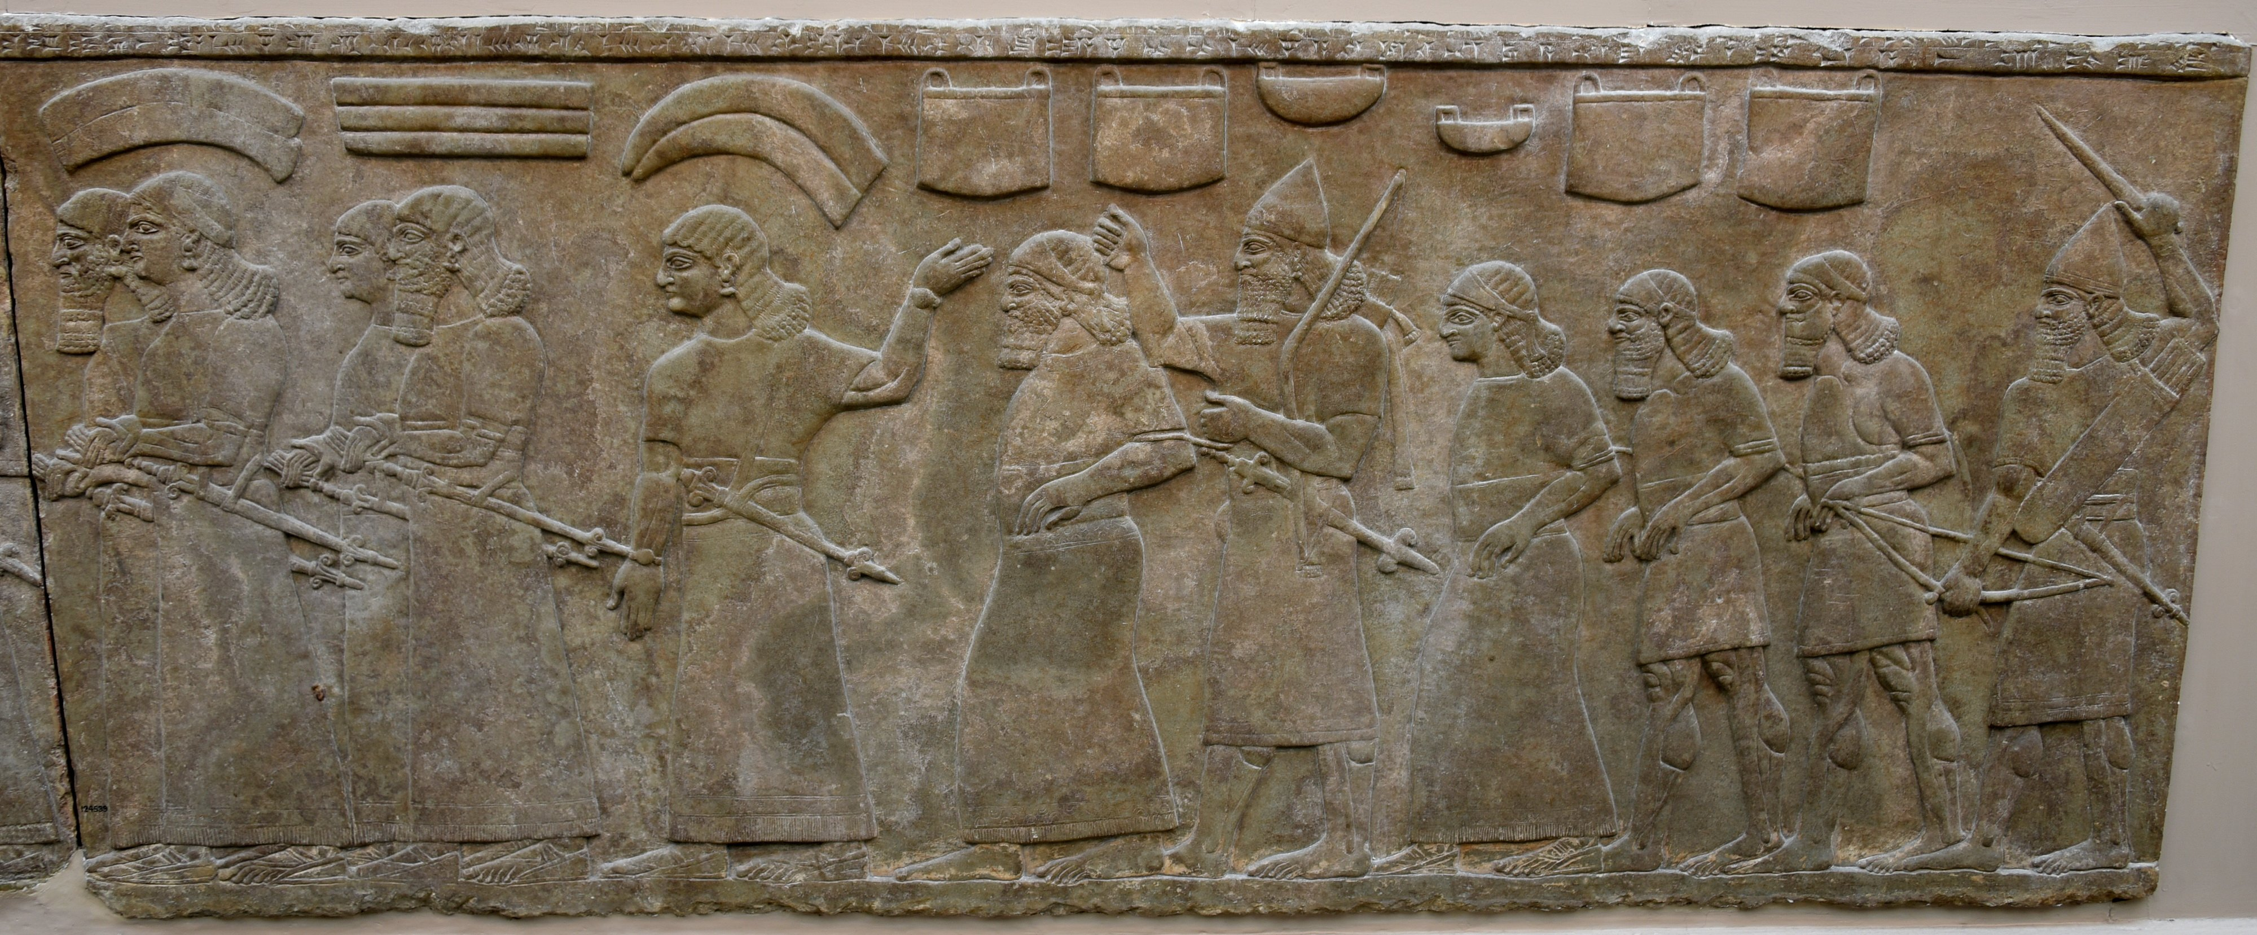
Prisoners of war taken into slavery. Neo-Assyrian Period, 865-860 BCE. Detail of Panel 17 (bottom), Room B, the North-Palace Palace, Nimrud, modern-day Iraq (The British Museum, London).

Slide 9
Sources for Slaves
Primarily males who were prisoners of war, carried away by conquerors in large masses.
The people most desired as slaves were those most skilled.
Consequently, many slaves were better educated and more skilled than their masters.
Debt slavery. Sometimes parents sold themselves and/or their children into slavery.
Abandoned children might be left on the streets and picked up by whomever was willing to raise them. They frequently became slaves.
Sometimes free persons were enslaved as punishment for violation of laws (ABD, VI:59).

Slide 10
The Social Status of a Slave
While no one wished to be a slave, the fact is that the status of slaves were largely dependent upon the status of one’s owner. It was far preferable to be Caesar’s slave than to be a poor freeman.
“Large numbers of people sold themselves into slavery for various reasons, e.g., to pay debts, to climb socially (Roman citizenship was conventionally bestowed on a slave released by a Roman owner), to obtain special jobs, and above all to enter a life that was more secure and less strenuous than existence as a poor, freeborn person” (ibid., 6:67).
Other New Testament passages address the issue of the master/slave relationship (Eph. 6:5-8; Col. 3:22-25; 1 Tim. 6:1-2; 1 Pet. 2:18-25).

Slide 11
Note the Rise in Joseph’s Status
“Now Joseph had been brought down to Egypt, and Potiphar, an officer of Pharaoh, the captain of the guard, an Egyptian, had bought him from the Ishmaelites who had brought him down there. The Lord was with Joseph, and he became a successful man, and he was in the house of his Egyptian master. His master saw that the Lord was with him and that the Lord caused all that he did to succeed in his hands. So Joseph found favor in his sight and attended him, and he made him overseer of his house and put him in charge of all that he had. From the time that he made him overseer in his house and over all that he had, the Lord blessed the Egyptian’s house for Joseph’s sake; the blessing of the Lord was on all that he had, in house and field. So he left all that he had in Joseph’s charge, and because of him he had no concern about anything but the food he ate. Now Joseph was handsome in form and appearance” (Gen. 39:1-6).

Slide 12
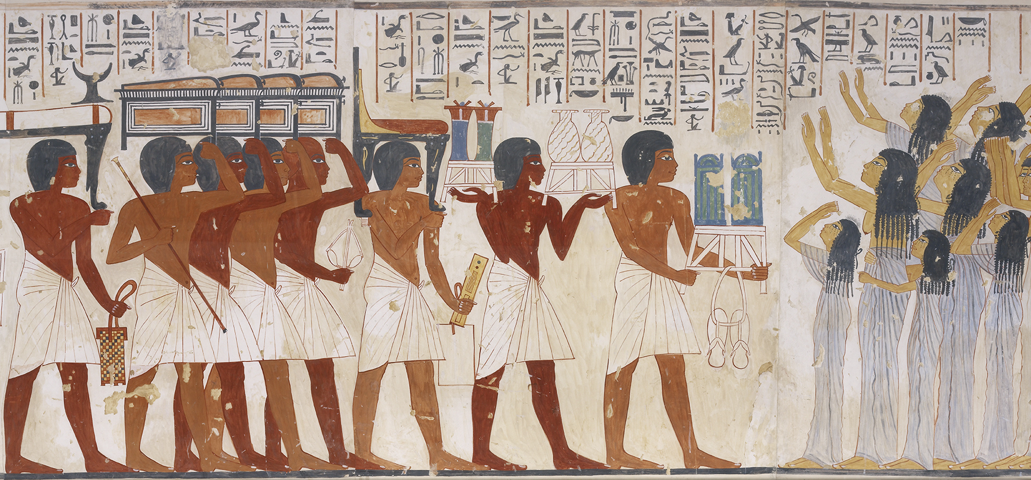
Paul’s Exhortations to Bondservants

Slide 13
How Do We Apply These Verses to Ourselves?
Slavery does not exist in our society.
Every person has the freedom to quit a job and look for something else without asking anyone’s approval.
The nearest thing in our society that fits these verses is how one acts toward his employer, manager, and overseer.

Slide 14
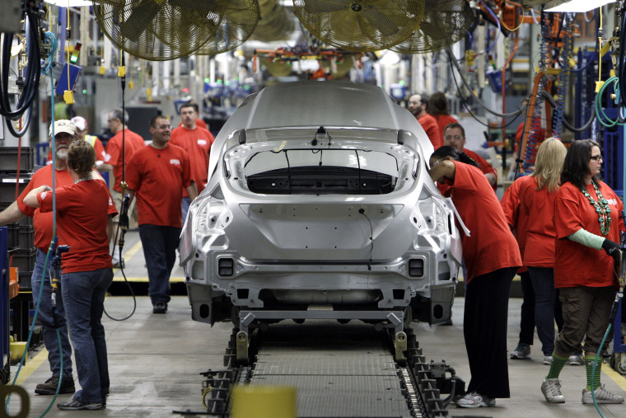

Slide 15
A. Be Submissive to your Masters
Paul uses the same word for the servant’s obligation to be submissive to his master as the wife is to have to her husband (hupotassō).
However, the word used for master is not the usual word “lord” (kurios; Eph. 6:5), but despotēs (used of slaveowners in two other passages [1 Tim. 6:1; 1 Pet. 2:18]). More frequently, the word is used of God (Luke 2:24; Acts 4:24; Rev. 6:10) or Christ (Luke 13:25; 2 Pet. 2:1; Jude 4).
Some Christians owned slaves.
Philemon was the master of the runaway slave Onesimus (Phile. 8-16).
“Let all who are under a yoke as bondservants regard their own masters as worthy of all honor, so that the name of God and the teaching may not be reviled. Those who have believing masters must not be disrespectful on the ground that they are brothers; rather they must serve all the better since those who benefit by their good service are believers and beloved. Teach and urge these things” (1 Tim. 6:1-2).

Slide 16
Submissive in Everything
Presumably, these masters were Christians for there is nothing said to take into consideration a master commanding a servant to do something sinful.
But “in everything” does not justify one in practicing sin because the boss commanded him to sin.
“But Peter and John answered them, ‘Whether it is right in the sight of God to listen to you rather than to God, you must judge, for we cannot but speak of what we have seen and heard’” (Acts 4:19-20).
“But Peter and the apostles answered, ‘We must obey God rather than men’” (Acts 5:29).

Slide 17
Obedient Slaves
Therefore, the general principle was to be an obedient slave. “New Testament writers encouraged the Christian slaves to serve their masters obediently, whether or not the master was a Christian” (Thomas D. Lea and Hayne P. Griffin, 1, 2 Timothy, Titus, The New American Commentary, 306).
One should not misunderstand “the truth shall make you free” (John 3:32) to mean that it freed one from his obligations to his master.
Applying this to the modern work environment, employees are expected to obey the owner of the company or its representatives.

Slide 18
B. Be Well Pleasing
The Greek word euarestos is defined as “pleasing, acceptable” and then explained for this passage as “give satisfaction to their masters” (BDAG, 403).
The sense is “to try to please their masters.”
The same should be said of employees.
When one’s salary is being paid by another, one should make it his aim to do his job in such a way as to please his boss.
I don’t know an honest owner of a company who wants his employees to produce shoddy material.

Slide 19
3. Do Not Talk Back
The significance of antilegō is “contradicting and arguing with their masters,” which would only aggravate and create tension.
The idea is not to be mouthing at or about your master.
First of all, it would be self-defeating, bringing upon oneself swift punishment.
Secondly, it would be unbecoming of someone who was trying to live as a Christian.
When one talks back, he is generally showing disrespect to the one ordering him to do a certain job.

Slide 20
4. Not Pilfering
The Greek word nosphizō is defined as “to put aside for one self, keep back, of engagement in a type of skimming operation” (BDAG, 679).
Men working as slaves would have opportunity to take for oneself things that belonged to their master.
Christian slaves should not behave in such a way.
“Stealing would be a temptation to slaves, who could have access to many things that might not be missed in small quantities and who might justify their actions by saying either that the item did not count and would not be missed or that what they stole was justly owed to them anyway” (George W. Knight, The Pastoral Epistles: A Commentary on the Greek Text, New International Greek Testament Commentary, 314–315).

Slide 21
5. But Showing All Good Faith
This requirement is combined with “not pilfering.” The combination of “not pilfering, but showing all good faith” has the significance that one should be honest with his master.
“Showing all good faith” presents the positive side of honesty.
A master or employer soon learns which slaves/employees can be trusted and which cannot. One will be advanced; the other will be punished or fired, as the case may require.

Slide 22
Ephesians 6:5-8
Bondservants, obey your earthly masters with fear and trembling, with a sincere heart, as you would Christ, not by the way of eye-service, as people-pleasers, but as bondservants of Christ, doing the will of God from the heart, rendering service with a good will as to the Lord and not to man, knowing that whatever good anyone does, this he will receive back from the Lord, whether he is a bondservant or is free.

Slide 23
Colossians 3:22-25
Bondservants, obey in everything those who are your earthly masters, not by way of eye-service, as people-pleasers, but with sincerity of heart, fearing the Lord. Whatever you do, work heartily, as for the Lord and not for men, knowing that from the Lord you will receive the inheritance as your reward. You are serving the Lord Christ. For the wrongdoer will be paid back for the wrong he has done, and there is no partiality.

Slide 24
The Guiding Light

Slide 25
The Same Light for All
“So that in everything they may adorn the doctrine of God our Savior” expresses the purpose for showing good conduct.
The same kind of principle was expressed with reference to younger women: “that the word of God may not be reviled” (2:5).
A similar reason was given for the young men: “so that an opponent may be put to shame, having nothing evil to say about us” (2:8).

Slide 26
Christianity Is Judged By Its Adherents
One of the points of this passage may be lost by applying it to employees of a company.
How the gospel was able to change the lives of those living in the bleakest of circumstances, to give them hope, to see their wickedness changed into godliness, was a testimony to their masters and others in the society.
“Inevitably, unbelievers judge the gospel message by the lives of those who embrace it. As we live and identify ourselves as Christians, we can make the gospel message attractive and credible by our godly attitudes and behavior” (Thomas D. Lea and Hayne P. Griffin, 1, 2 Timothy, Titus, The New American Commentary, 308).

Slide 27
Matthew 5:16 at Work
How we act on the job reflects the Christian message we profess to believe.
If there is inconsistency, you are not only disrespected, but the image of your life hides the gospel from the lost.
This is exactly the opposite of what Jesus wants from us:
“In the same way, let your light shine before others, so that they may see your good works and give glory to your Father who is in heaven” (Matt. 5:16).

Slide 28
Conclusion

Slide 29
The Brass Tacks
What does your boss and fellow employees think of you and the gospel based on your conduct at work?

