Slide 2
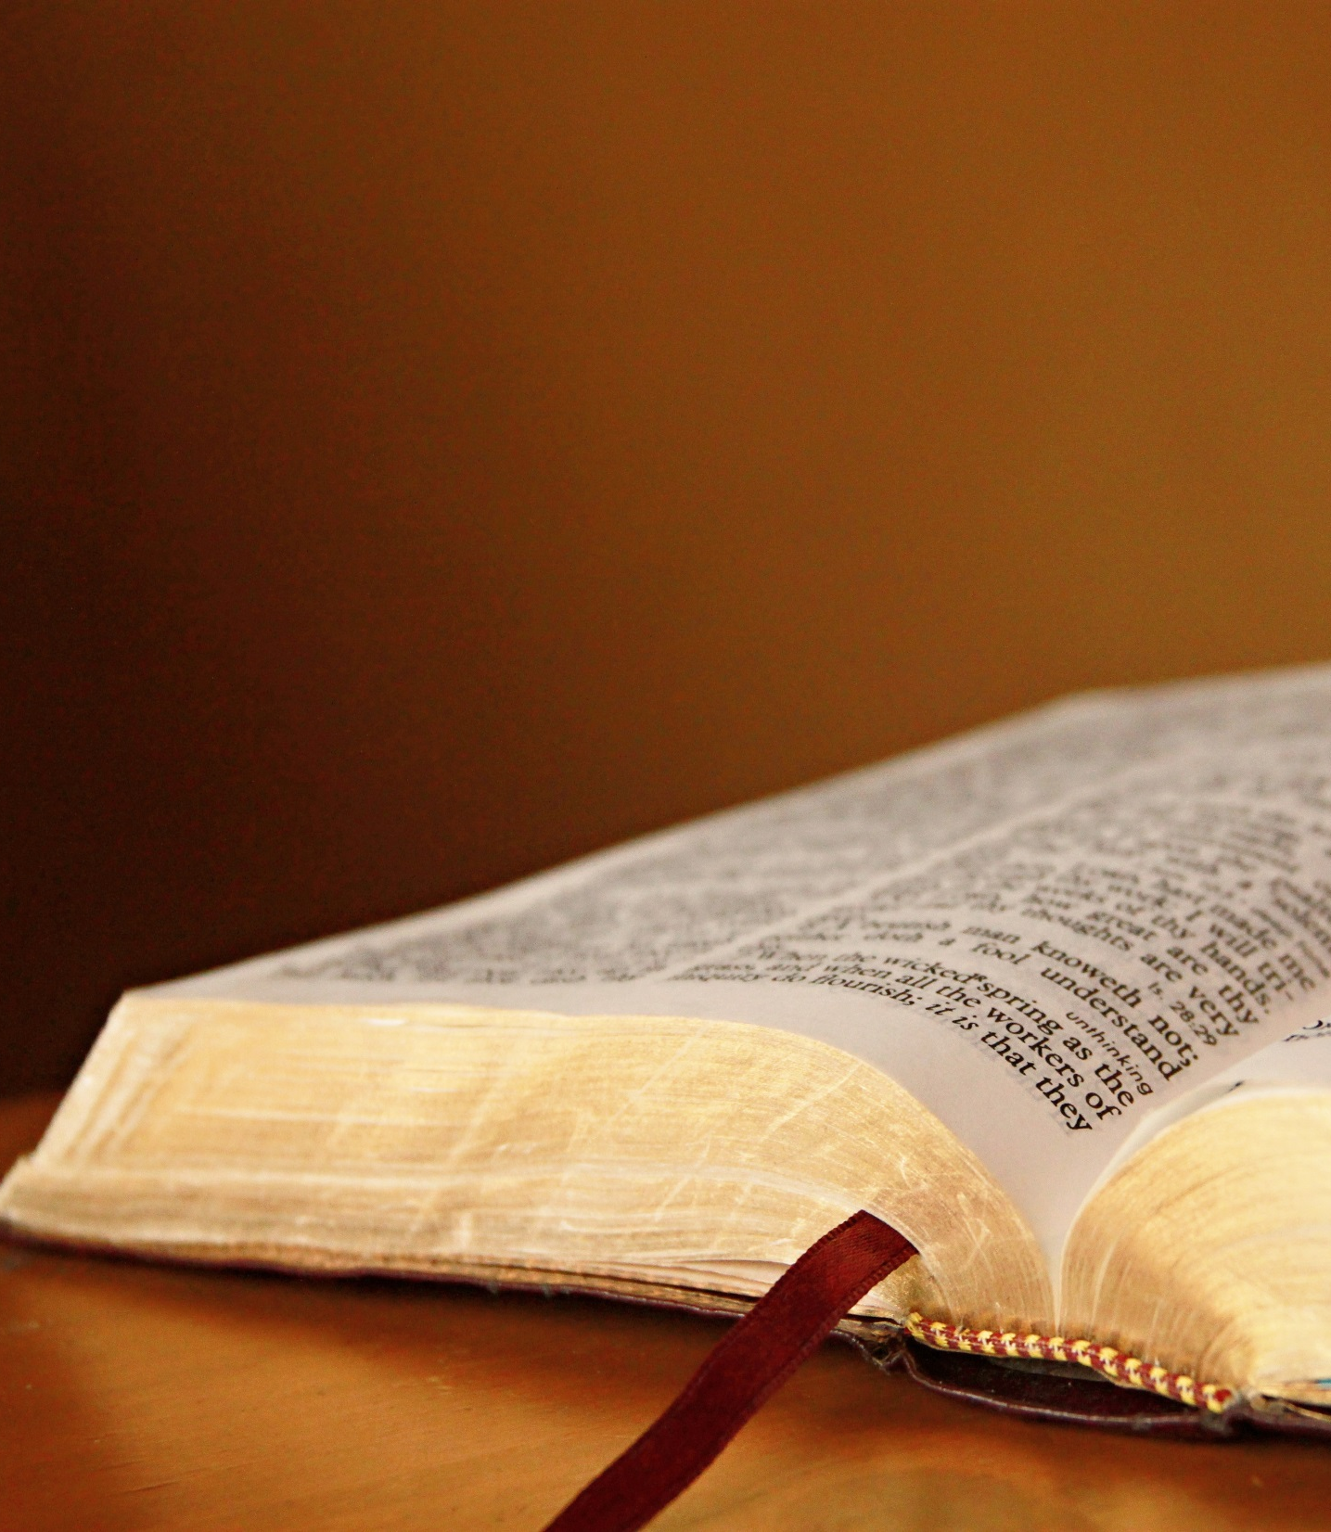
As a deer pants for flowing streams, so pants my soul for you, O God. My soul thirsts for God, for the living God. When shall I come and appear before God?
(Psa. 42:1-2)

Slide 4
God Desires Passionate Believers!
Titus 2:14
Rom. 12:11
Enthusiastic devotion; tireless diligence; eager desire; fervor for a person, cause, or object.

Slide 5
1st step to accomplishment!
We accomplish what motivates us!
Changes people!
Protects me from sin!

Slide 6
How do we regain
our zeal for God?
Be filled with God’s word!
Prayer!
Return to our 1st love!
Associate with passionate people!
Make it a priority!

Slide 7
Peter – Man Full of Zeal for the Lord!
On Mount of Transfiguration,
Peter wanted to build “tents”.
Peter said he would die,
rather than deny Jesus.
Peter drew sword in Garden.
Peter ran to empty tomb.
Peter left boat to go to Lord.

Slide 9
ZEALOUS TO BE WITH THE LORD
Peter’s
He knew that Jesus alone could calm the storms of life.
Live in the midst of storms
Mat. 11:28-30
He knew Jesus was in control of his creation.
Knew Jesus was “God with us”
Knew Jesus controlled wind & waves
Knew Jesus was Lord over ALL
Matthew 14:22-33

Slide 10
ZEALOUS TO BE WITH THE LORD
Peter’s
He knew that Jesus alone could save his soul.
Took eyes off Jesus-then began to sink.
“Lord, save me!”
Faith did not change because sinking.
Lord when he left boat & Lord when began to sink.
Knew Jesus alone could save.
Matthew 14:22-33

Slide 11
ZEALOUS TO BE WITH THE LORD
Peter’s
After these events, Jesus taught a large crowd. (John 6:66-69)
Crowd had hard time accepting the message of Jesus.
Many turned away – would disciples leave?
Peter- “You alone have words of life.”
Jesus alone could save!
Matthew 14:22-33

Slide 12
His Zeal Lead to Excitement and Service
Peter’s
Peter longed for opportunity to be used by Jesus.
We who have truth should be excited and eager.
Will we turn words into actions?
Matthew 14:22-33

Slide 13
Zeal of Peter
Peter’s
Sometimes Peter missed the point.
Sometimes messed up.
Sometimes overzealous.
Zeal led to service & effectiveness.
Not a hearer ONLY but a doer!
Matthew 14:22-33

