Slide 2
The Gospel of Matthew
Chapter 13

Slide 3
A Shift to the ESV
At this point, I am changing the translation I am using for these lessons. I have been using the NKJV; I am going to be using the ESV from now on.

Slide 4
Introduction to Chapter 13
The word “parable” has not yet occurred in Matthew’s gospel, although several short sayings would qualify as parables (5:25-26; 11:16-19; 12:43-45). In this chapter the word “parable” is used 12 times in 11 verses.
This chapter needs to be studied in the context of chs. 11-12.
Both chapters contain narratives that show resistance to Jesus’s gospel (from John the Baptist’s disciples to the woes on impenitent cities, conflict over the Sabbath, Jesus heals by the power of Beelzebul, etc.).
These parables provide explanation for the rejection of Jesus: the problem is not in the seed but the soil, weeds among the wheat, etc.
One perceives a growing division among the Jews about Jesus.
One purpose of a parable was to conceal new truths from those whose hearts were hardened while revealing those same truths to those who were receptive, as indicated by Jesus’s explanations to the disciples of the meaning of some parables.
The 13th chapter is also divided into sections delivered to the crowds and sections of private instruction that explained the parables to His disciples.

Slide 5
What Is a Parable?
Parable (parabolē): “a narrative or saying of varying length, designed to illustrate a truth especially through comparison or simile, comparison, illustration, parable, proverb, maxim” (BDAG, 759).
A homespun definition: “an earthly story with a heavenly meaning.”
Any first century Jew would have been familiar with the images being used to convey spiritual truths.

Slide 6
Outline of the Chapter
Matthew has eight of Jesus’s parables that create a block of Jesus’s teachings (v. 53 indicates this was one sermon).
The sower (13:1-9)
Interlude: the purpose of parables (13:10-17)
Explanation of the parable of the sower (13:18-23)
Three parables of growth:
Weeds in the field (13:24-30)
The mustard seed (13:31-32)
The yeast (13:33)
Interlude: the purpose of parables (13:34-35)
Explanation of the parable of the weeds (13:36-43)
Three further parables:
The hidden treasure (13:44)
The pearl of great price (13:45-46)
The parable of the net (13:47-50)
Concluding parable: new and old treasures (13:51-52)
Jesus rejected at Nazareth (13:53-58)

Slide 7
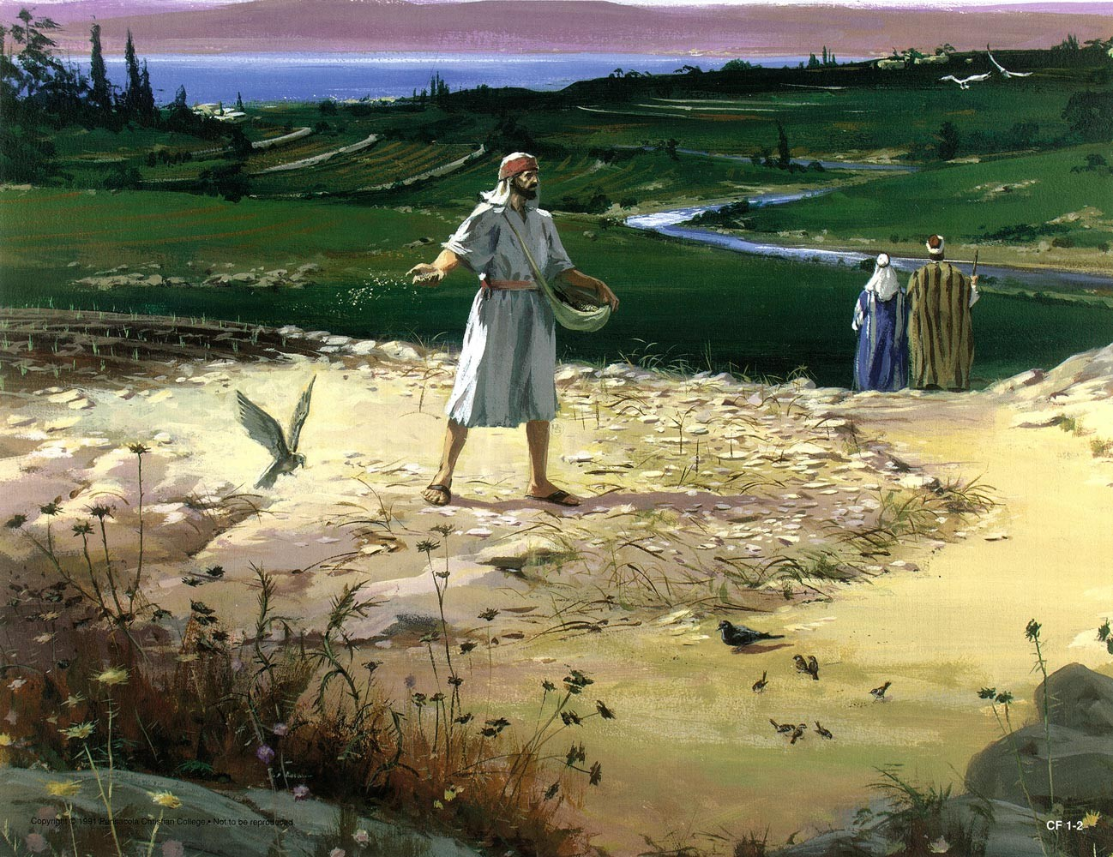
The Parable of the Sower Matt. 13:1-23

Slide 8
The Parable of the Sower
Setting the stage (13:1-2)
Telling the parable (13:3-9)
The Purpose of the Parables (13:10-16)
Explanation of the Parable (13:17-23)

Slide 9
Matthew 13:1-2
“That same day Jesus went out of the house and sat beside the sea. And great crowds gathered about him, so that he got into a boat and sat down. And the whole crowd stood on the beach.”
That same day means that the narrative follows the conflict in which Jesus was charged with working miracles by the power of Beelzebul followed by His family coming to care for Him.
What indicates a difference in audience between chapters 12 and 13?
The crowds were so numerous that Jesus had to use a boat for His pulpit so that all could see and hear His words.

Slide 10
The Parable
“And he told them many things in parables, saying: ‘a sower went out to sow. And as he sowed, some seeds fell along the path, and the birds came and devoured them. Other seeds fell on rocky ground, where they did not have much soil, and immediately they sprang up, since they had no depth of soil, but when the sun rose they were scorched. And since they had no root, they withered away. Other seeds fell among thorns, and the thorns grew up and choked them. Other seeds fell on good soil and produced grain, some a hundredfold, some sixty, some thirty. He who has ears, let him hear’” (13:3-9).

Slide 11
The Parable
Depicts broadcast sowing, instead of planting in rows.
In broadcast sowing, the one sowing does not have much control over where the seed lands.
The kinds of ground:
A pathway: birds devour the seed
Stony ground:
The ground has a thin top layer of soil over a layer of stone.
The seed sprouts, but because the roots cannot penetrate the stone, the plant dies.
Thorny ground is ground with thorns which choke out the seed.
Good ground is soil that produces a bountiful harvest.
The difference in outcome depends, not upon the seed, but the difference in the soils.

Slide 12
Interlude: The Purpose of Parables Matthew 13:10-17
“Then the disciples came and said to him, ‘Why do you speak to them in parables?’ And he answered them, ‘To you it has been given to know the secrets of the kingdom of heaven, but to them it has not been given. For to the one who has, more will be given, and he will have an abundance, but from the one who has not, even what he has will be taken away. This is why I speak to them in parables, because seeing they do not see, and hearing they do not hear, nor do they understand. Indeed, in their case the prophecy of Isaiah is fulfilled that says: “You will indeed hear but never understand, and you will indeed see but never perceive.” For this people’s heart has grown dull, and with their ears they can barely hear, and their eyes they have closed, lest they should see with their eyes and hear with their ears and understand with their heart and turn, and I would heal them.’ But blessed are your eyes, for they see, and your ears, for they hear. For truly, I say to you, many prophets and righteous people longed to see what you see, and did not see it, and to hear what you hear, and did not hear it.”

Slide 13
Matthew 13:10
“Then the disciples came and said to him, ‘Why do you speak to them in parables?’”
At some point, whether after or in the middle of the presentation is not known, the disciples asked why Jesus was speaking parables to the crowd.
Jesus’s explanation is a private conversation (Mark 4:10) to show the dual purpose of his parables—to conceal His teaching from those who were antagonists and to reveal His teaching to those who were followers.
Since Jesus was teaching from a boat, “the disciples came and said” likely points to a time after the giving of the parable.
He also relates this to Isaiah 6:9-10, not as a prediction fulfilled but another example of the same kind of situation.

Slide 14
Matthew 13:11
“And he answered them, ‘To you it has been given to know the secrets of the kingdom of heaven, but to them it has not been given.’”
Secrets (mustēria): “the unmanifested or private counsel of God, (God’s) secret, the secret thoughts, plans, and dispensations of God . . . .which are hidden from human reason, as well as from all other comprehension below the divine level, and await either fulfillment or revelation to those for whom they are intended” (BDAG, 662). Cf. Paul’s use of the term in Eph. 3:1-5.
Cf. Matt. 11:25-26.
Having accepted that Jesus is the Lord’s Messiah, the disciples understood the mysteries that those who rejected Jesus (“he casts out demons by the power of Beelzebul”) could not.

Slide 15
Matthew 13:12
“For to the one who has, more will be given, and he will have an abundance, but from the one who has not, even what he has will be taken away.”
The whole of God’s revelation is centered on Jesus. Those who reject Jesus (“he works miracles through the power of Beelzebul”) will lose understanding of the revelation that had previously been given to them.
The Jews who rejected Jesus had the kingdom taken from them and given to another who would bring forth its fruits (Matt. 21:43).
Those who accept that Jesus was the Christ see clearly the unfolding of God’s divine plan through the fulfillment of Old Testament prophecies and thus, their understanding of the divine purpose expands.

Slide 16
Matthew 13:13
“This is why I speak to them in parables, because seeing they do not see, and hearing they do not hear, nor do they understand.”
The latter part of this verse is an allusion to Isaiah 6:9-10, which describes Israel’s rejection of Isaiah’s words in the seventh century BC.
Jesus views Himself in the same position as Isaiah—communicating divine revelation that is being rejected.
“‘Seeing’ and ‘hearing’ are each used in two different senses here, once for simple sensory perception and then for the kind of insight that leads to acceptance of the gospel and discipleship” (Craig Blomberg, Matthew, 216–217).

Slide 17
Matthew 13:14-15
“Indeed, in their case the prophecy of Isaiah is fulfilled that says:
‘You will indeed hear but never understand,
and you will indeed see but never perceive.”
For this people’s heart has grown dull,
and with their ears they can barely hear,
and their eyes they have closed,
lest they should see with their eyes
and hear with their ears
and understand with their heart
and turn, and I would heal them.’”

Slide 18
Isaiah’s Prophecy
Usually “that it might be fulfilled” is used in the sense of predictive prophecy, in which divine omniscience foretells an event to happen in the future.
Here it is used in a different sense. Isaiah 6:9–10 was not in fact a prediction for the distant future but rather for Isaiah’s own experience in the seventh century BC. The people who heard Jesus’s divine revelation were reacting in the same way as those who heard Isaiah’s prophecy. The pattern of behavior was repeated.
Therefore, Matthew does not intend that this passage be a part of the set of examples where predictive prophecy has been fulfilled in Jesus.

Slide 19
The Purpose of Preaching
The wording of Isaiah describes what should happen when one hears God’s word:
Hear with their ears
See with their eyes
Understand with their heart
Turn (from sin)
God would heal them!
The process will not work when men refuse to hear what the message from God affirms!

Slide 20
Matthew 13:16
“But blessed are your eyes, for they see, and your ears, for they hear.”
This has the form of a beatitude.
“See” and “hear” are not used in the sense of physical perception, but in the more comprehensive sense of seeing and hearing with understanding of the meaning of what they are witnessing.
There is a strong contrast between “them” of vv. 14-15 and “you” of vv. 16-17.
What Jesus is saying is that His work in their presence is the fulfillment of God’s eternal purpose foretold in the Old Testament prophecies.

Slide 21
Matthew 13:17
“For truly, I say to you, many prophets and righteous people longed to see what you see, and did not see it, and to hear what you hear, and did not hear it.”
The blessing experienced by the first century disciples is emphasized by describing how those generations before them wished to know its meaning.
Daniel: “I heard, but I did not understand. Then I said, ‘O my lord, what shall be the outcome of these things?’ He said, ‘Go your way, Daniel, for the words are shut up and sealed until the time of the end’” (12:8-9).
“Concerning this salvation, the prophets who prophesied about the grace that was to be yours searched and inquired carefully, inquiring what person or time the Spirit of Christ in them was indicating when he predicted the sufferings of Christ and the subsequent glories. It was revealed to them that they were serving not themselves but you, in the things that have now been announced to you through those who preached the good news to you by the Holy Spirit sent from heaven, things into which angels long to look” (1 Pet. 1:10-12).

Slide 22
The Parable
“And he told them many things in parables, saying: ‘a sower went out to sow. And as he sowed, some seeds fell along the path, and the birds came and devoured them. Other seeds fell on rocky ground, where they did not have much soil, and immediately they sprang up, since they had no depth of soil, but when the sun rose they were scorched. And since they had no root, they withered away. Other seeds fell among thorns, and the thorns grew up and choked them. Other seeds fell on good soil and produced grain, some a hundredfold, some sixty, some thirty. He who has ears, let him hear’” (13:3-9).

Slide 23
Explanation of the Parable of the Sower Matthew 13:18-23
“Hear then the parable of the sower: When anyone hears the word of the kingdom and does not understand it, the evil one comes and snatches away what has been sown in his heart. This is what was sown along the path. As for what was sown on rocky ground, this is the one who hears the word and immediately receives it with joy, yet he has no root in himself, but endures for a while, and when tribulation or persecution arises on account of the word, immediately he falls away. As for what was sown among thorns, this is the one who hears the word, but the cares of the world and the deceitfulness of riches choke the word, and it proves unfruitful. As for what was sown on good soil, this is the one who hears the word and understands it. He indeed bears fruit and yields, in one case a hundredfold, in another sixty, and in another thirty.”

Slide 24
Matthew 13:18-19
“Hear then the parable of the sower: When anyone hears the word of the kingdom and does not understand it, the evil one comes and snatches away what has been sown in his heart. This is what was sown along the path.”
The Seed is the word of the kingdom (“of God,” Luke 8:11). The same seed is planted in each kind of ground. There is no problem with the seed!
The hearer: one who hears without understanding. The lack of understanding is that described above, like that of Isaiah 6:9-10.
The birds that devour the seed: the evil one (Devil) snatches away the seed.
Luke’s account: “The ones along the path are those who have heard; then the devil comes and takes away the word from their hearts, so that they may not believe and be saved” (8:12).

Slide 25
Matthew 13:20-21
“As for what was sown on rocky ground, this is the one who hears the word and immediately receives it with joy, yet he has no root in himself, but endures for a while, and when tribulation or persecution arises on account of the word, immediately he falls away.”
Rocky ground: a quick starter but one who does not finish.
Represents a hearer who obeys the gospel when he first hears it, but does not persevere.
He is described as “having no root in himself.” What does that mean?
In the face of tribulation (thlipsis: “trouble that inflicts distress, oppression, affliction, tribulation,” BDAG, 457) or persecution (diōgmos: “a program or process designed to harass and oppress someone, persecution,” BDAG, 253), he falls away which describes quitting to serve Jesus, or apostasy.
This shows the fallacy of “once saved, always saved.”

Slide 26
Matthew 13:22
“As for what was sown among thorns, this is the one who hears the word, but the cares of the world and the deceitfulness of riches choke the word, and it proves unfruitful.”
The hearer: one who hears the word but allows the cares of this world to choke out the word.
Cares of the world. How do these choke out the word?
Deceitfulness of riches: How does this choke out the word?
Why is this hearer unfruitful?

Slide 27
Matthew 13:23
“As for what was sown on good soil, this is the one who hears the word and understands it. He indeed bears fruit and yields, in one case a hundredfold, in another sixty, and in another thirty.”
What makes this ground good?
“As for that in the good soil, they are those who, hearing the word, hold it fast in an honest and good heart, and bear fruit with patience” (Luke 8:11).
What does good seed in good ground produce?
Why are there different amounts of produce?

Slide 28
Observations
The importance of the seed: the word of God. No good fruit will come apart from good seed.
The effect of the seed is not predetermined. God’s seed falls on various hearts and has different effects. Yet, He does not force His word on anyone.
There is no blame placed on the sower of the seed.
The result depends upon the ground on which it falls—what kind of heart this person has.

Slide 29
Three Parables
Three parables of growth:
Weeds in the field (13:24-30)
The mustard seed (13:31-32)
The yeast (13:33)
Interlude: the purpose of parables (13:34-35)
Explanation of the parable of the weeds (13:36-43)

Slide 30
The Parable of the Weeds Matthew 13:24-30
“He put another parable before them, saying, ‘The kingdom of heaven may be compared to a man who sowed good seed in his field, but while his men were sleeping, his enemy came and sowed weeds among the wheat and went away. So when the plants came up and bore grain, then the weeds appeared also. And the servants of the master of the house came and said to him, “Master, did you not sow good seed in your field? How then does it have weeds?” He said to them, “An enemy has done this.” So the servants said to him, “Then do you want us to go and gather them?” But he said, “No, lest in gathering the weeds you root up the wheat along with them. Let both grow together until the harvest, and at harvest time I will tell the reapers, ‘Gather the weeds first and bind them in bundles to be burned, but gather the wheat into my barn.’”’”

Slide 31
The Parable
What is the purpose for this parable?
What was the purpose of planting weeds in a field?
The Israelites threw rocks in the fields of Moab for the same reason.
“‘This is a light thing in the sight of the Lord. He will also give the Moabites into your hand, and you shall attack every fortified city and every choice city, and shall fell every good tree and stop up all springs of water and ruin every good piece of land with stones.’ The next morning, about the time of offering the sacrifice, behold, water came from the direction of Edom, till the country was filled with water. . . . And they overthrew the cities, and on every good piece of land every man threw a stone until it was covered. They stopped every spring of water and felled all the good trees, till only its stones were left in Kir-hareseth, and the slingers surrounded and attacked it” (2 Kings 3:19, 25).
“To sow darnel among wheat as an act of revenge was punishable in Roman law, which suggests that the parable depicts a real-life situation” (R. T. France, Matthew: An Introduction and Commentary, 229).
We will discuss the meaning of the parable when we study vv. 36-43.

Slide 32
The Mustard Seed Matthew 24:31-32
“He put another parable before them, saying, ‘The kingdom of heaven is like a grain of mustard seed that a man took and sowed in his field. It is the smallest of all seeds, but when it has grown it is larger than all the garden plants and becomes a tree, so that the birds of the air come and make nests in its branches.’”

Slide 33
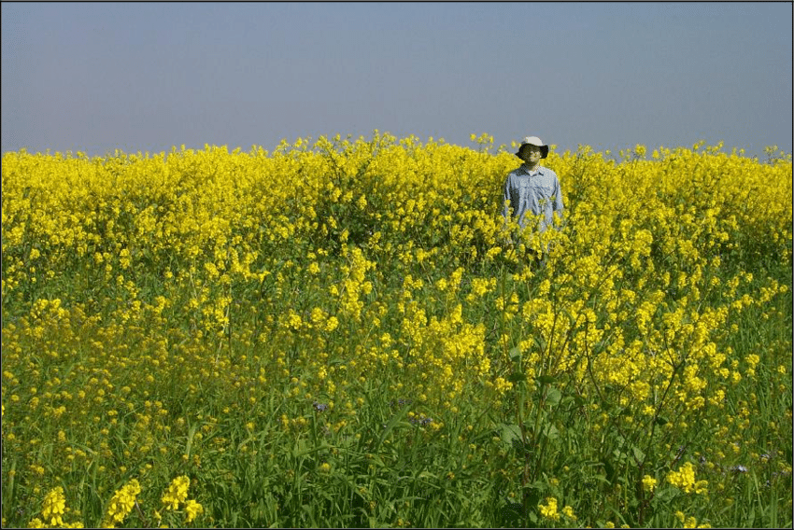
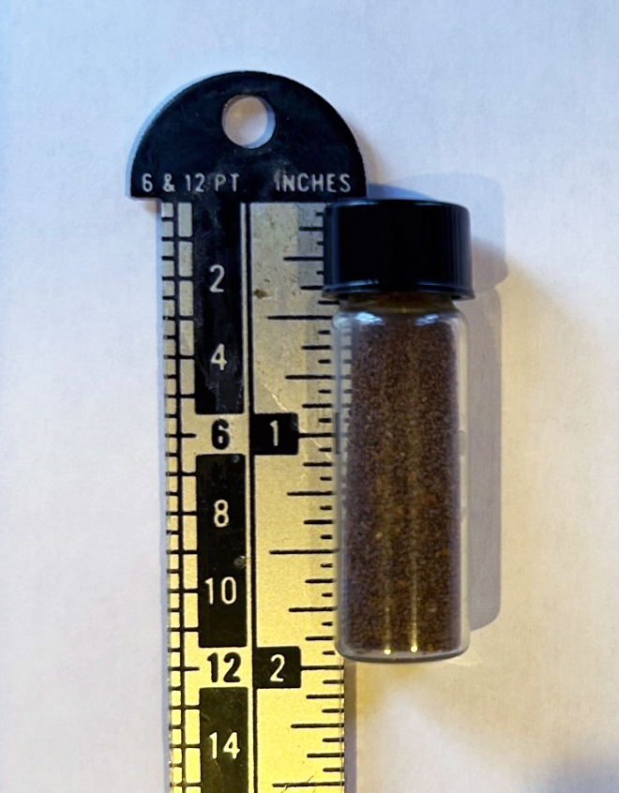
Mustard plants (brassica nigra) sometimes grow taller than a man and birds sometimes nest in their branches (Fauna and Flora of the Bible, [New York: United Bible Societies], 145-146).

Slide 34
Matthew 12:30-32
Technically, there are seeds smaller than mustard seed, but this is probably the smallest seed to which those living in Palestine would have been exposed.
The comparison is not to trees, but to garden plants (lachanon).
The idea of birds dwelling in its branches may come from the dream of Nebuchadnezzar (Dan. 4:12) or Ezekiel 31:6.
What is the point of the parable?
How does it apply to Jesus’s ministry?
What is represented by the seed?
What is represented the mustard plant?

Slide 35
The Parable of the Leaven Matthew 12:33
“He told them another parable. ‘The kingdom of heaven is like leaven that a woman took and hid in three measures of flour, till it was all leavened.’”
Leaven (zumē) would have been sour dough that is used to make the dough rise.
The surprising part of this parable is three measures of flour—about 35 liters or about a bushel of flour, enough to feed about 100 people!
Hid (enkruptō) may have been used because of the inconspicuous way the kingdom of heaven was developing among them.
What is this parable teaching?

Slide 36
Interlude: Purpose of Parables Matthew 13:34-35
“All these things Jesus said to the crowds in parables; indeed, he said nothing to them without a parable. This was to fulfill what was spoken by the prophet: ‘I will open my mouth in parables; I will utter what has been hidden since the foundation of the world.’”
This is the 8th in the series “this happened that it might be fulfilled. . .” arguments to show that Jesus is the Messiah.
In this second interlude, Jesus explains the purpose of the parables: to utter what has been hidden since the foundation of the world—to provide a revelation of God’s divine plan through His parables.
Jesus quoted this statement from Psalm 78:2, perhaps because it contains the word “parable” (māšāl: a wisdom saying, HALOT, 648). The psalmist used Israel’s history on which to base his appeal to Israel, so that it could be easily understood by his audience. Jesus uses parables to explain divine mysteries.

Slide 37
Explanation of the Parable of the Weeds Matthew 13:36-43
“Then he left the crowds and went into the house. And his disciples came to him, saying, ‘Explain to us the parable of the weeds of the field.’ He answered, ‘The one who sows the good seed is the Son of Man. The field is the world, and the good seed is the sons of the kingdom. The weeds are the sons of the evil one, and the enemy who sowed them is the devil. The harvest is the end of the age, and the reapers are angels. Just as the weeds are gathered and burned with fire, so will it be at the end of the age. The Son of Man will send his angels, and they will gather out of his kingdom all causes of sin and all law-breakers, and throw them into the fiery furnace. In that place there will be weeping and gnashing of teeth. Then the righteous will shine like the sun in the kingdom of their Father. He who has ears, let him hear.’”

Slide 38
Matthew 13:36
“Then he left the crowds and went into the house. And his disciples came to him, saying, ‘Explain to us the parable of the weeds of the field.’”
Jesus reserves the explanation of the parable for the disciples alone in a house.
The disciples ask their questions because they do not understand, demonstrating how the same parable can be both concealing and revealing.

Slide 39
Matthew 13:37-39
“He answered, ‘The one who sows the good seed is the Son of Man. The field is the world, and the good seed is the sons of the kingdom. The weeds are the sons of the evil one, and the enemy who sowed them is the devil. The harvest is the end of the age, and the reapers are angels.’”
The one sowing good seed: The Son of Man, one of Jesus’s favorites phrases to describe Himself as the Christ. Later He is depicted as the harvester and owner of the kingdom.
The one sowing bad seed: The enemy, the Devil.
The field: The world and not the church.
The good seed: The seed is defined by what it produces—sons of the kingdom
The weeds: The weeds are what the bad seed produced—sons of the Devil
The harvest: The end of this age, judgment day.
The reapers: Angels who participate in gathering the harvest

Slide 40
Matthew 13:40-42
“Just as the weeds are gathered and burned with fire, so will it be at the end of the age. The Son of Man will send his angels, and they will gather out of his kingdom all causes of sin and all law-breakers, and throw them into the fiery furnace. In that place there will be weeping and gnashing of teeth.”
Jesus uses the separation of the wheat from the weeds as an illustration of the judgment (cf. Matt. 25:31-46).
The righteous and the wicked grow together in the world throughout the ages, but at the judgment the Lord will separate the wheat from the weeds.
What is the role of the Son of Man at the end of this age?
Who will be removed and cast into the fiery furnace?
The fiery furnace reminds us of the three Hebrew children (Dan. 3:5), but here it is used as a depiction of Hell.
What is the significance of “there will be weeping and gnashing of teeth”?

Slide 41
Matthew 13:43
“Then the righteous will shine like the sun in the kingdom of their Father. He who has ears, let him hear.”
The righteous are those who are saved.
Shining like the sun is the picture of glorification.
The concluding exhortation, “He who has ears, let him hear,” calls upon men to make a decision about what they will do with Jesus.

Slide 42
Three More Parables
The next section is a set of three parables as marked by their titles, “The Kingdom of Heaven is like . . .”
The hidden treasure (13:44)
The pearl of great price (13:45-46)
The parable of the net (13:47-50)
Leon Morris: “The first two stress the value of the kingdom, and the third the finality of the separation that will take place at the end of this age” (The Gospel according to Matthew, 358).
All three of these parables only appear in Matthew’s gospel.

Slide 43
A Hidden Treasure Matthew 13:44
“The kingdom of heaven is like treasure hidden in a field, which a man found and covered up. Then in his joy he goes and sells all that he has and buys that field.”
In the days before banks, treasures were frequently hidden to protect oneself from thieves (cf. the one-talent man in Matt. 25:25). This treasure was hidden in a field.
The circumstances of how the treasure was left in a field is not explained.
Morris suggests the following: “If anyone did this before going off on a journey and failed to return, the possessions remained there and might be found later through a chance discovery like that in this parable. So too, in frequent wars, people would hide valuables to keep them from looting soldiers, and sometimes the owners would not survive” (359).
The point of the parable is this: “the kingdom is so valuable that it is worth sacrificing anything to gain it” (Craig Blomberg, Matthew, 223).
The man’s attitude toward his sacrifice to obtain the treasure is “his joy.” He does not feel imposed upon to have to give up everything for something so valuable.

Slide 44
A Goodly Pearl Matthew 13:45-46
“Again, the kingdom of heaven is like a merchant in search of fine pearls, who, on finding one pearl of great value, went and sold all that he had and bought it.”
Pearls were considered extremely valuable in ancient times, much like diamonds today.
What did the pearl merchant have to do to obtain the high quality pearl?
What is the difference between the one who found the treasure in a field and the merchant who found a goodly pearl?

Slide 45
The Fishing Net Matthew 13:47-50
“Again, the kingdom of heaven is like a net that was thrown into the sea and gathered fish of every kind. When it was full, men drew it ashore and sat down and sorted the good into containers but threw away the bad. So it will be at the end of the age. The angels will come out and separate the evil from the righteous and throw them into the fiery furnace. In that place there will be weeping and gnashing of teeth.”
This parable is different because it contains an interpretation.
Sometimes one does not know the kinds of “fish” that are attracted by the gospel, and we do not have the ability to separate them.
Most of the explanation is a verbatim repetition of vv. 40-42, which indicates how closely joined in meaning are the parables of the fishing net and the tares among the wheat.

Slide 46
Events of the End of the Age
The world will have an end (Matt. 13:39, 49; 28:20)! This universe is not eternal, as some men think.
Some of Jesus’s pictures of judgment:
Separation of tares from the wheat (13:36-43)
Separation of good fish from worthless fish (13:47-50)
Separation of wise and foolish virgins (25:1-13)
Separation of the men who used their talents (25:14-30)
Separation of sheep and goats (25:31-46)
Pictures of eternal damnation (13:42, 50)

Slide 47
Concluding Parable: New and Old Treasures Matthew 13:51-52
“‘Have you understood all these things?’ They said to him, ‘Yes.’ And he said to them, ‘Therefore every scribe who has been trained for the kingdom of heaven is like a master of a house, who brings out of his treasure what is new and what is old.’”
Jesus has been “discipling” the Twelve who accompany Him.
He asked them if they understood what He was teaching and they respond that they did, even though other texts show evidence that they did not understand all things.
The treasures of “old and new” may be the rich treasures of both testaments.
Only those who understand the NT fulfillment of OT prophecies can fully appreciate the treasures of the OT.

Slide 48
Jesus Rejected at Nazareth Matthew 13:53-58
“And when Jesus had finished these parables, he went away from there, and coming to his hometown he taught them in their synagogue, so that they were astonished, and said, ‘Where did this man get this wisdom and these mighty works? Is not this the carpenter’s son? Is not his mother called Mary? And are not his brothers James and Joseph and Simon and Judas? And are not all his sisters with us? Where then did this man get all these things?’ And they took offense at him. But Jesus said to them, ‘A prophet is not without honor except in his hometown and in his own household.’ And he did not do many mighty works there, because of their unbelief.”

Slide 49
Structure of Matthew’s Gospel
At this point in Matthew’s gospel (13:53–16:20), the author begins to follow the order of Mark’s gospel (6:1–9:50).
He will do so again in 19:1–23:39 and 26:1–28:20.
Matthew 13:54-58 is pretty much identical to Mark 6:1-6. Luke’s account of the same incident is much more detailed (4:16-30).
Some scholars think that Luke 4:16-30 is an earlier incident in Jesus’s life.
The section begins with rejection of Jesus:
Rejection by Jesus’s home town (13:54-58)
Rejection by Herod Antipas (14:1-12)

Slide 50
Matthew 13:53-54
“And when Jesus had finished these parables, he went away from there, and coming to his hometown he taught them in their synagogue, so that they were astonished, and said, ‘Where did this man get this wisdom and these mighty works?’”
The two incidents about Jesus’s family in 12:46-50 and 13:54-58 frame the parables of Jesus (13:1-53). When viewed by itself 13:54-58 is both a conclusion to a previous section and a transitional paragraph to a fresh section of the gospel.
Jesus’s hometown (patris) is Nazareth, where Mary and Joseph had raised Him.
What reaction did His teaching have on the crowd?
The word “astonished” (ekplēssō) appears 12 times in the gospels, always to describe the effect of Jesus’s teaching and miracles.
Why are the people amazed?

Slide 51
Matthew 13:55-56
“Is not this the carpenter’s son? Is not his mother called Mary? And are not his brothers James and Joseph and Simon and Judas? And are not all his sisters with us? Where then did this man get all these things?”
The word tektōn (carpenter) is used in two places, here and in Mark 6:3. Mark says that Jesus was a carpenter and Matthew that Jesus was a carpenter’s son. It is natural to assume that a son followed the trade of his father.
A tektōn is “one who constructs, builder, carpenter” but can include masonry (BDAG, 995).
Jesus’s brothers: James, Joseph, Simon, Judas.
James became a leader in the Jerusalem church, wrote the book of James, and was put to death by being thrown over the wall of the Temple.
Judas was the author of Jude.
None of Jesus’s sisters are identified by name. They are only mentioned in Matthew.
What is this verse saying?

Slide 52
Matthew 13:57
“And they took offense at him. But Jesus said to them, ‘A prophet is not without honor except in his hometown and in his own household.’”
Took offense (skandalizō): “to cause to be brought to a downfall, cause to sin. . . Be led into sin, be repelled by someone” (BDAG, 926). It is the opposite of believing in Jesus.
Jesus did not fit their picture of what the Messiah/Christ should be and was rejected by His own family and home town.
That Jesus refers to Himself as a prophet is significant. Israel had not known any prophets since Malachi. However, Jesus is more than a prophet!

Slide 53
Matthew 13:58
“And he did not do many mighty works there, because of their unbelief.”
Mark said, “And he could do no mighty work there, except that he laid his hands on a few sick people and healed them” (6:5).
“Their unbelief” does not limit the power of Jesus! It limited the benefits they received from Jesus. We should understand this to be saying that their unbelief resulted in their not bringing their sick ones to Him to be healed!

