Slide 2
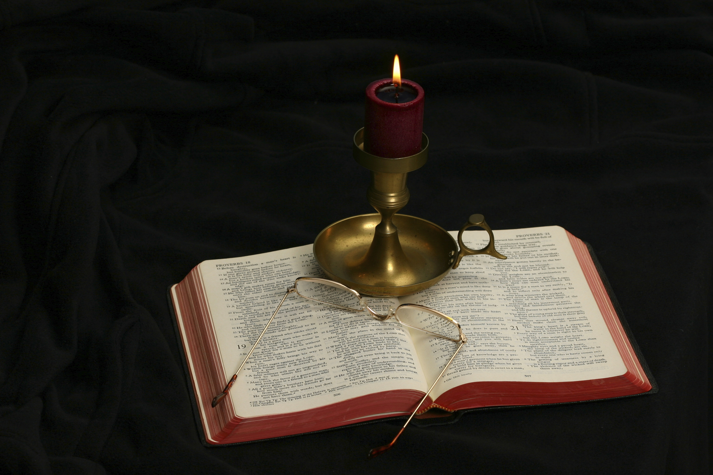
The Gospel of Matthew
Chapter 14

Slide 3
Outline of the Chapter
Herod Antipas’s opinion of Jesus and beheading of John the Baptist (14:1-12)
The feeding of the 5000 (14:13-21)
Jesus walks on water (14:22-33)
The popularity of Jesus as a healer (14:34-36)

Slide 4
The Connection with 13:53-58
Matthew 13:53-58 presents the misunderstanding that Jesus’s home town and family had about Jesus.
Matthew 14:1-12 presents Herod Antipas’s misunderstanding about Jesus, followed by the account of Antipas’s beheading of John the Baptist.

Slide 5
Matthew 14:1-12
At that time Herod the tetrarch heard about the fame of Jesus, and he said to his servants, “This is John the Baptist. He has been raised from the dead; that is why these miraculous powers are at work in him.” For Herod had seized John and bound him and put him in prison for the sake of Herodias, his brother Philip’s wife, because John had been saying to him, “It is not lawful for you to have her.” And though he wanted to put him to death, he feared the people, because they held him to be a prophet. But when Herod’s birthday came, the daughter of Herodias danced before the company and pleased Herod, so that he promised with an oath to give her whatever she might ask. Prompted by her mother, she said, “Give me the head of John the Baptist here on a platter.” And the king was sorry, but because of his oaths and his guests he commanded it to be given. He sent and had John beheaded in the prison, and his head was brought on a platter and given to the girl, and she brought it to her mother. And his disciples came and took the body and buried it, and they went and told Jesus.

Slide 6
Matthew 14:1-2
“At that time Herod the tetrarch heard about the fame of Jesus, and he said to his servants, ‘This is John the Baptist. He has been raised from the dead; that is why these miraculous powers are at work in him.’”
At that time connects either thematically with the account of Herod Antipas’s assessment of Jesus tied to Nazareth’s assessment of Him, or chronologically (but not precisely) with John’s death.
Tetrarch (Tetraarchēs) is “a petty prince dependent on Rome and with rank and authority lower than those of a king” (BDAG, 1000).
Herod governed Galilee and Perea from 4 BC to 39 AD.
He governed almost all of Jesus’s life.
Pilate sent Jesus to Herod Antipas, when trying to avoid making a judgment about Jesus.

Slide 7
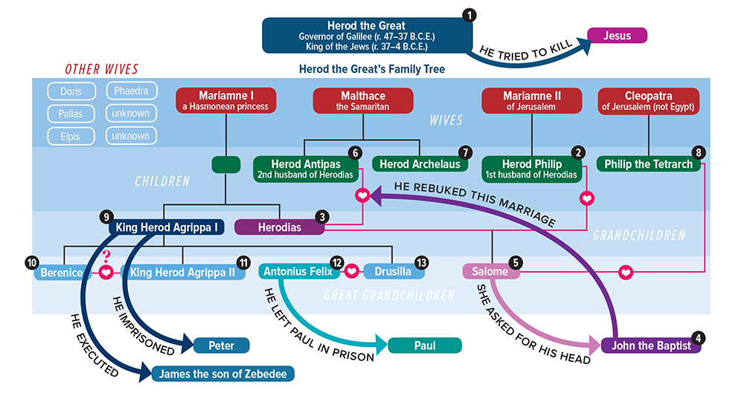
https://www.biblicalarchaeology.org/wp-content/uploads/2017/09/herodian-family-tree.jpg

Slide 8
Matthew 14:1-2
The scripture says that Herod Antipas heard of the fame of Jesus.
Fame (akoē): “that which is heard, fame, report, rumor” (BDAG, 36).
Why did Herod think Jesus was John the Baptist risen from the dead?
John 10:41 indicates that John never worked miracles while he was alive.

Slide 9
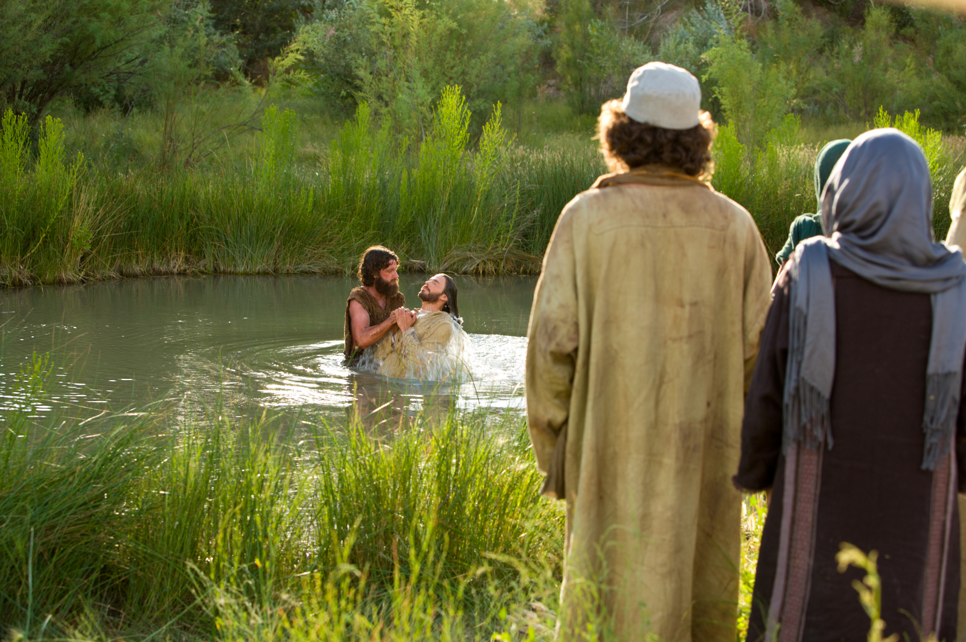
The Death of John the Baptist

Slide 10
Matthew 14:3-4
“For Herod had seized John and bound him and put him in prison for the sake of Herodias, his brother Philip’s wife, because John had been saying to him, ‘It is not lawful for you to have her.’”
Had seized: Indicates that this is a flashback in the story to give background information.
Herod Antipas (Herod the Great’s son with Malthace) divorced his first wife (which divorce provoked a war with her father, Aretas, the king of Petra).
Herodias was the daughter of Herod the Great and Mariamne I, making her his half sister.
More seriously, Antipas married Herodias, his niece and half-brother’s wife, which would have been viewed as incestuous and a violation of the Law.
“You shall not uncover the nakedness of your brother’s wife; it is your brother’s nakedness” (Lev. 18:16).
“If a man takes his brother’s wife, it is impurity. He has uncovered his brother’s nakedness; they shall be childless” (Lev. 20:21).
Had been saying: John the Baptist kept preaching against this marriage.

Slide 11
Matthew 14:5
“And though he wanted to put him to death, he feared the people, because they held him to be a prophet.”
Mark wrote, “for Herod feared John, knowing that he was a righteous and holy man, and he kept him safe. When he heard him, he was greatly perplexed, and yet he heard him gladly” (6:20).
Herod’s conflicted feelings about John the Baptist are evident from 14:9.
Herod’s political approach to John the Baptist is similar to the political approach the Jewish leaders later had toward Jesus (21:46).

Slide 12
Matthew 14:6
“But when Herod’s birthday came, the daughter of Herodias danced before the company and pleased Herod, . . .”
The occasion: a birthday (genesia) party for Herod Antipas.
Danced (orcheomai): “a licentious oriental court” (R. T. France, 238). There is “no need to question the immodest and provocative dance of the daughter” (Leon Morris, 372, n. 17).
Daughter of Herodias (by Herod Philip), identified by Josephus as Salome (Josephus, Antiquities 18.136). She is called a korasion (girl), “a term which can be used of those of marriageable age; she was at least a teenager” (R. T. France, 238).
Before the company emphasizes the public nature of the dance.
Given the nature of the dance and the general immorality of Herod, the sense of “pleased” includes sexually stimulating dancing.

Slide 13
Matthew 14:7
“. . . so that he promised with an oath to give her whatever she might ask.”
Mark explains the oath in more detail: “And he vowed to her, ‘Whatever you ask me, I will give you, up to half of my kingdom’” (6:23).
An oath made in the presence of others could not be retracted without significant embarrassment. Herod’s oath reminds one of Jephthah’s oath (Judg. 11:30).

Slide 14
Matthew 14:8
“Prompted by her mother, she said, ‘Give me the head of John the Baptist here on a platter.’”
Prompted (probibazō): “cause to come forward. . . But she, pushed forward by her mother” (BDAG, 866).
We learn the morals of Herodias by her participation in a sinful marriage and her using her teenaged daughter as a weapon to get her way. Her barbarity in asking for John’s head on a platter is shocking!
The request that this be done here (hōde) carries the sense of “here and now,” leaving Herod no room to give it to her later (and perhaps renege on his promise). It presumes that Herod was at Machaerus when this happened.

Slide 15
Matthew 14:9
And the king was sorry, but because of his oaths and his guests he commanded it to be given.
Matthew uses the term “king” which was not the office which the tetrarch held, but which was sometimes used of one holding that office, at the exact moment he acts least kingly!
Was sorry (lupeō): “to become sad, sorrowful, distressed” (BDAG, 604).
To save face, Herod Antipas showed no concern about righteousness and justice, but chose to put an innocent man to death to please his miffed wife.
He was compelled by his guests to fulfill what he had promised.
Herod issued the order for John to be put to death.

Slide 16
Matthew 14:10-11
“He sent and had John beheaded in the prison, and his head was brought on a platter and given to the girl, and she brought it to her mother.”
Herod’s conduct shows him to be a despotic, tyrannical ruler, not bound by the common laws of having a trial and judgment.
Beheading was not a recognized Jewish form of punishment.
Josephus says that John the Baptist was beheaded at Machaerus, which indicates that this is likely where the birthday celebration occurred.

Slide 17
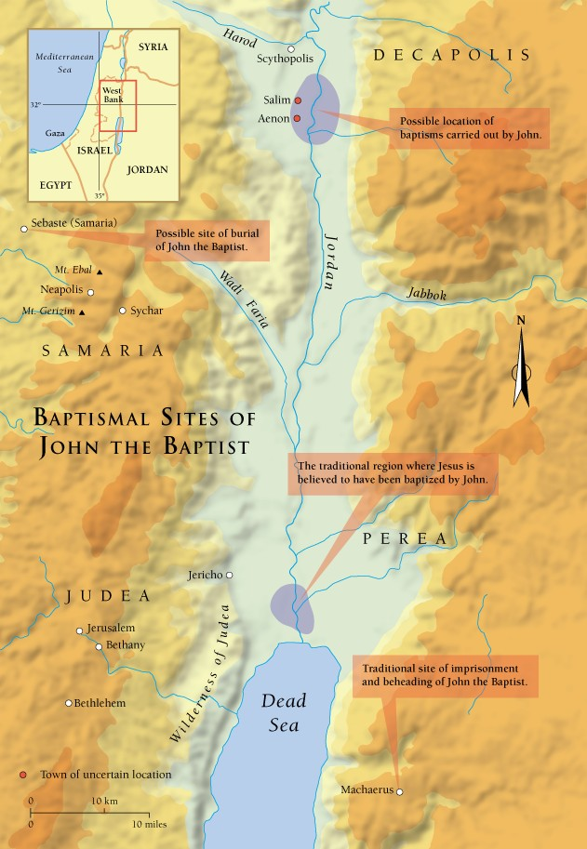

Slide 18
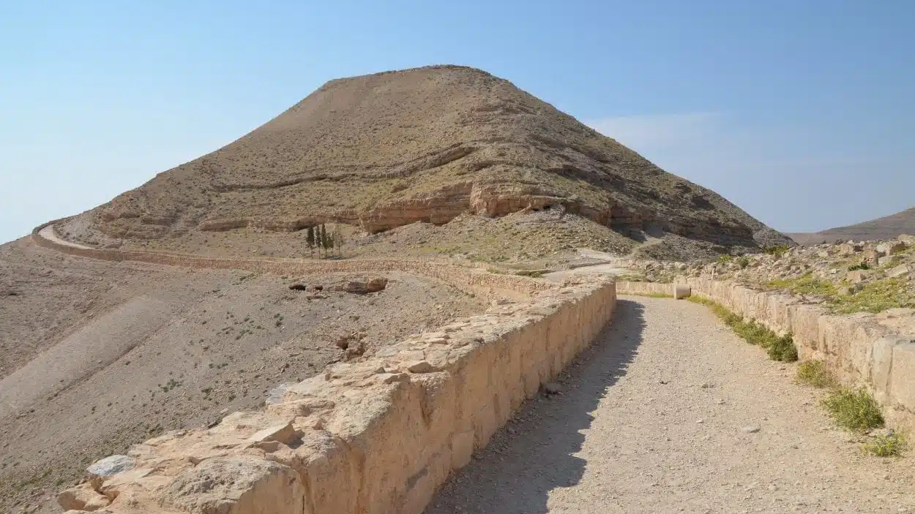
Approach to Herod’s Palace at Machaerus

Slide 19
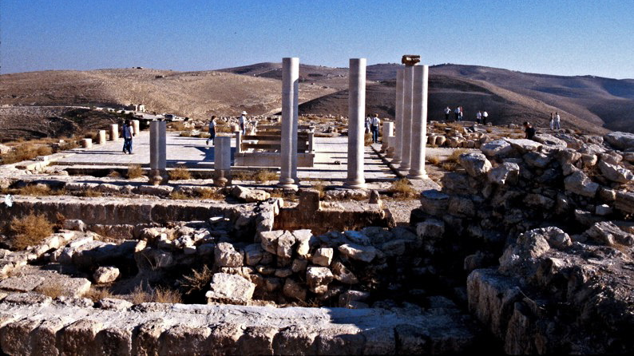
Remains of the Palace

Slide 20
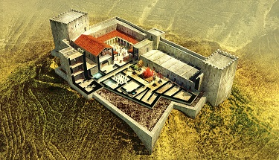
Drawing of what Herod’s palace at Machaerus looked like.

Slide 21
Matthew 14:12
“And his disciples came and took the body and buried it, and they went and told Jesus.”
In 11:2-19 John had sent his disciples to Jesus to inquire if He was the Christ. In this text, the disciples of John report to Jesus the death of John the Baptist.

Slide 22
John’s Death Foreshadowed the Death of Jesus
John | Jesus
Herod the tetrarch was responsible for John’s death | Pilate the governor was responsible for Jesus’s death
John was seized (krateō) (14:3) | Jesus was seized (krateō) (21:46)
John was bound (deō) (14:3) | Jesus was bound (deō) (27:2)
Herod feared the crowds because they held John to be a prophet (14:5) | The chief priests and Pharisees feared the crowds because they held Jesus to be a prophet (21:46)
Herod was asked by another to execute John and grieved so to do (14:6-11) | Pilate was asked by others to execute Jesus and was reluctant so to do (27:11-26)
John was buried by his disciples (14:12) | Jesus was buried by a disciple (27:57-61)
Table copied from W.D. Davies and D.C. Allison, Matthew, ICC, 2:476.

Slide 23
The Feeding of the 5000 Matthew 14:13-21
“Now when Jesus heard this, he withdrew from there in a boat to a desolate place by himself. But when the crowds heard it, they followed him on foot from the towns. When he went ashore he saw a great crowd, and he had compassion on them and healed their sick. Now when it was evening, the disciples came to him and said, ‘This is a desolate place, and the day is now over; send the crowds away to go into the villages and buy food for themselves.’ But Jesus said, ‘They need not go away; you give them something to eat.’ They said to him, ‘We have only five loaves here and two fish.’ And he said, ‘Bring them here to me.’ Then he ordered the crowds to sit down on the grass, and taking the five loaves and the two fish, he looked up to heaven and said a blessing. Then he broke the loaves and gave them to the disciples, and the disciples gave them to the crowds. And they all ate and were satisfied. And they took up twelve baskets full of the broken pieces left over. And those who ate were about five thousand men, besides women and children.”

Slide 24
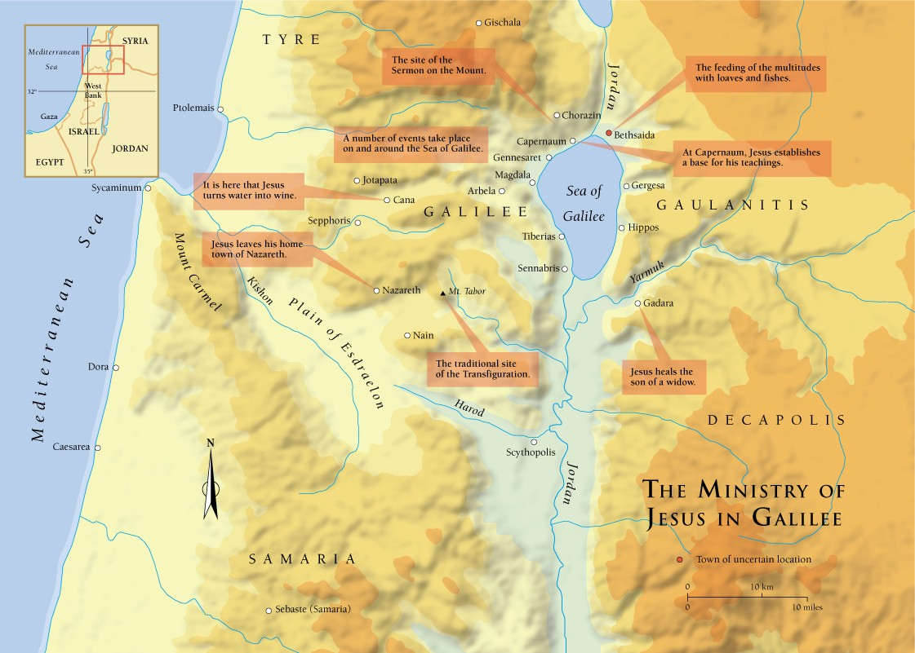

Slide 25
Overview
This miracle is recorded in all four gospels (Matt. 14:13-21; Mark 6:32-44; Luke 9:10-17; John 6:1-15). It is the only miracle (other than the resurrection) that is found in all four accounts.
There are details specific to each of the accounts.
Because of the number of people present, this miracle is one of the best attested miracles that Jesus performed.
John 6:4 says that this miracle occurred near the Passover, which makes it about one year before Jesus’s crucifixion.

Slide 26
Similar Gift Miracles
God provided manna for Israel during the 40 years of Wilderness wandering.
The author of 1 Kings tells how Elijah fed the widow of Zarephath by multiplying her flour for many days (1 Kings 17:8-16).
Elisha multiplied the oil of the widow of a prophet to enable her to pay her debts (2 Kings 4:1-7).
Jesus enabled the disciples to have miraculous draughts of fish on two occasions (Luke 5:1-11; John 21:5).
Jesus turned water into wine (John 2:1-11).

Slide 27
Elisha’s Multiplying of the Loaves
Elisha fed the prophets of 2 Kings 4:42-44: “A man came from Baal-shalishah, bringing the man of God bread of the firstfruits, twenty loaves of barley and fresh ears of grain in his sack. And Elisha said, ‘Give to the men, that they may eat.’ But his servant said, ‘How can I set this before a hundred men?’ So he repeated, ‘Give them to the men, that they may eat, for thus says the Lord, “They shall eat and have some left.”’ So he set it before them. And they ate and had some left, according to the word of the Lord.”

Slide 28
Modernist Explanations
Those who reject God and the miraculous are forced to explain what happened. Here are some of their ideas:
Jesus took the little boy’s lunch and shared it, which convinced the others to share their own lunches and there was plenty for everyone, with leftovers.
Jesus broke off tiny portions of the boy’s lunch and distributed them to the people.
Matthew’s account is intended to describe a miracle.

Slide 29
Matthew 14:13
“Now when Jesus heard this, he withdrew from there in a boat to a desolate place by himself. But when the crowds heard it, they followed him on foot from the towns.”
Matthew’s account ties the miracle to hearing the news of the death of John the Baptist; Mark’s account ties it to the return of the Twelve from the Limited Commission, providing an opportunity for rest (Mark 6:30-31). This leaves the impression that both events occurred about the same time, shortly before the Passover of the year before Jesus’s death.
The last event in Matthew 13 is Jesus being rejected by His home town of Nazareth. In this narrative Jesus leaves on a boat, indicating that He is back on the Sea of Galilee.
The place to which Jesus withdrew is a solitary place, not a desert in the sense we think of it (they sit on grass, v. 19), but an unpopulated region.
The crowd could see which direction their boat was sailing and went to where Jesus was.

Slide 30
Matthew 14:14
“When he went ashore he saw a great crowd, and he had compassion on them and healed their sick.”
Note the “great crowd,” indicating that it was unusually large.
Had compassion (splangchnizomai): “have pity, feel sympathy” (BDAG, 938). The word appears 12 times, all of them in the gospels (Matt. 5x, Mark 4x, and Luke 3x).
The word is derived from splangchnon, “the inward parts of the body, especially the viscera, inward parts, entrails.” It is used “mostly as the seat and source of love, sympathy, and mercy” (BDAG, 938).
Jesus was deeply moved at the sight of the afflicted.
Jesus healed those among the crowd who were sick (arrōstos).
Mark attributes Jesus’s compassion on the crowd as stemming from them being as sheep without a shepherd (6:34).

Slide 31
Matthew 14:15
“Now when it was evening, the disciples came to him and said, ‘This is a desolate place, and the day is now over; send the crowds away to go into the villages and buy food for themselves.’”
Evening (opsios): “the period between late afternoon and darkness, evening” (BDAG, 746).
The compassion shown by the disciples (dismiss them so they can get food) is different from that of Jesus (healing and feeding them).

Slide 32
Matthew 14:16
“But Jesus said, ‘They need not go away; you give them something to eat.’”
The physical need is not a great issue since the people have been with him part of one day. Missing a meal is not life threatening. Its spiritual significance is more important than satisfying a physical need.
Capernaum and Bethsaida were not far away should they need to go away to buy food.
Jesus’s command is to the disciples, “you give them. . . .” echoes the words of Elisha and makes the differences in the two narratives significant.
Five loves and two fish vs. twenty loaves of barley and fresh ears of grain
5000 men plus women and children vs. 100 men
12 baskets of leftovers vs. leftovers

Slide 33
Matthew 14:17
“They said to him, ‘We have only five loaves here and two fish.’”
Matthew has abbreviated what Mark says: “But he answered them, ‘You give them something to eat.’ And they said to him, ‘Shall we go and buy two hundred denarii worth of bread and give it to them to eat?’ And he said to them, ‘How many loaves do you have? Go and see.’ And when they had found out, they said, ‘Five, and two fish’” (6:37-38).
A denarius was a day’s wage for a common laborer (Matt. 20:2).
John mentions that it was a young lad’s lunch (John 6:9).
The word he uses for “fish” is not the same as in Matthew. The synoptics use the word ichthus (fish) and John uses opsarion (“As food eaten with bread, opsarion can mean ‘tidbit’ in general . . . or specifically fish. . . preserved fish” (BDAG, 747) or “dried or preserved fish, the standard condiment of bread” (Davies and Allison, 2:489).

Slide 34
Matthew 14:17-18
“They said to him, ‘We have only five loaves here and two fish.’ And he said, ‘Bring them here to me.’”
Bread and fish would have been a common diet for those living in the vicinity of the Sea of Galilee.
John mentioned that the loaves were “barley loaves” (John 6:9), the grain used by poorer people.
The disciples see the small amount of food as a reason for doing nothing; Jesus uses it as a basis for action.

Slide 35
Matthew 14:19
“Then he ordered the crowds to sit down on the grass, and taking the five loaves and the two fish, he looked up to heaven and said a blessing. Then he broke the loaves and gave them to the disciples, and the disciples gave them to the crowds.”
Jesus assumes the role of the one providing a banquet.
He ordered (keleuō) the crowd to sit down (anaklinō: “to cause to recline at a meal,” BDAG, 65).
The notice of the green grass (Mark 6:39) and John’s account that it was near Passover (6:4) is an undesigned coincidence.
Note the posture of prayer in this case: “he looked up to heaven.”
Blessing (eulogeō): “to ask for bestowal of special favor, especially of calling down God’s gracious power, bless” (BDAG, 408). Leon Morris said, “It is a way of referring to a prayer of thanksgiving” (379, n. 44).
The disciples distributed the food to the crowds.

Slide 36
The Parallel Language
Matthew 14:19 | Luke 24:30 | The Lord’s Supper
“Then he ordered the crowds to sit down on the grass, and taking the five loaves and the two fish, he looked up to heaven and said a blessing. Then he broke the loaves and gave them to the disciples, and the disciples gave them to the crowds.” | “When he was at table with them, he took the bread and blessed and broke it and gave it to them.” | “Now as they were eating, Jesus took bread, and after blessing it broke it and gave it to the disciples, and said, “Take, eat; this is my body. . . .” (Matt. 26:26; cf. Mark 14:22; Luke 22:19; 1 Cor. 11:23-24).

Slide 37
Matthew 14:20
“And they all ate and were satisfied. And they took up twelve baskets full of the broken pieces left over.”
“They all ate” includes not only the men, but also the women and children.
Were satisfied (chortazō) indicates that everyone ate as much as he wanted or needed.
Baskets (kophinos): there are two different words used to designate the “baskets” in the feeding of the 5000 and the 4000. I was formerly taught that the baskets used in the feeding of the 4000 were larger than those of the feeding of the 5000. Louw-Nida comments, “Unfortunately, there is no way of determining from the Greek text precisely the size or type of baskets involved in references to σπυρίς and κόφινος” (Greek-English Lexicon of the New Testament: Based on Semantic Domains,71).
Is using the leftovers Bible authority for a “doggy-bag” at the restaurants? ☺

Slide 38
Matthew 14:21
“And those who ate were about five thousand men, besides women and children.”
Mark’s account tells how they were able to ascertain how many were present: “Then he commanded them all to sit down in groups on the green grass. So they sat down in groups, by hundreds and by fifties” (6:39-40).
“Besides women and children” expands the number above 5000, but how much more is impossible to know.

Slide 39
Take Aways
What should we learn from Jesus’s feeding 5000 from five loaves and two fish?
What message did John 6 draw from this miracle (6:26-59)?
What does this miracle teach us about who Jesus is?

Slide 40
Jesus Walks on Water Matthew 14:22-33
Immediately he made the disciples get into the boat and go before him to the other side, while he dismissed the crowds. And after he had dismissed the crowds, he went up on the mountain by himself to pray. When evening came, he was there alone, but the boat by this time was a long way from the land, beaten by the waves, for the wind was against them. And in the fourth watch of the night he came to them, walking on the sea. But when the disciples saw him walking on the sea, they were terrified, and said, “It is a ghost!” and they cried out in fear. But immediately Jesus spoke to them, saying, “Take heart; it is I. Do not be afraid.” And Peter answered him, “Lord, if it is you, command me to come to you on the water.” He said, “Come.” So Peter got out of the boat and walked on the water and came to Jesus. But when he saw the wind, he was afraid, and beginning to sink he cried out, “Lord, save me.” Jesus immediately reached out his hand and took hold of him, saying to him, “O you of little faith, why did you doubt?” And when they got into the boat, the wind ceased. And those in the boat worshiped him, saying, “Truly you are the Son of God.”

Slide 41
Matthew 14:22-23
“Immediately he made the disciples get into the boat and go before him to the other side, while he dismissed the crowds. And after he had dismissed the crowds, he went up on the mountain by himself to pray. When evening came, he was there alone. . . .”
What is the significance of the word immediately (eutheōs)?
What does go before Him imply?
What is the significance of by Himself and alone?
Why did Jesus want to be alone?
Jesus taught about private prayer (Matt. 6:6).
Luke records more of Jesus’s prayer life than the other gospels (Luke 5:16; 9:18, 28-29; 11:1).

Slide 42
Context for the Miracle
The miracle of Jesus walking on water closely follows the miracle of feeding the 5000.
The miracle also appears in Mark 6:45-52 and John 6:16-21.
John’s gospel gives the details.
“Perceiving then that they were about to come and take him by force to make him king, Jesus withdrew again to the mountain by himself. When evening came, his disciples went down to the sea, got into a boat, and started across the sea to Capernaum. It was now dark, and Jesus had not yet come to them” (John 6:15-17).
When was the last time Jesus was tempted to be made a king?
Why did He think it necessary that the disciples get in a boat and leave?

Slide 43
Matthew 14:24
“. . . but the boat by this time was a long way from the land, beaten by the waves, for the wind was against them.”
The statement that the boat is a long way from land, excludes as possible some of the rationalist explanations that Jesus was wading in shallow water or walking along the edge of the lake and was mistakenly thought to be walking on water.
John 6:19 indicates that they were 25-30 stadia from where they departed. A stadium is 600 feet: 3-4 miles out in the Sea of Galilee. At its widest width, the Sea of Galilee is about 7 miles. Their journey across the north part of the sea would have been shorter.
A storm or strong contrary wind was beating against the boat. The word basanizō (beaten) means “to subject to punitive judicial procedure, torture,” BDAG, 168); in this context it means “to harass.” Matthew is saying the waves were “torturing” the sailors.
The wind makes it difficult to make progress in crossing the Sea.

Slide 44
Matthew 14:25
“And in the fourth watch of the night he came to them, walking on the sea.”
The night (6pm to 6am) was divided four sections of three hours each; the fourth watch is 3-6 am. It reminds us of how long the disciples had been trying to oar across the Sea of Galilee.
One notices how little hyperbole is used in explaining what they saw.
“And he saw that they were making headway painfully, for the wind was against them. And about the fourth watch of the night he came to them, walking on the sea. He meant to pass by them” (Mark 6:48).
However, Jesus saw the need of the Twelve and reacted to help them.

Slide 45
Matthew 14:26
“But when the disciples saw him walking on the sea, they were terrified, and said, ‘It is a ghost!’ and they cried out in fear.”
Jesus walking on water was a surprise to the disciples; they were not expecting it.
Both terrified (tarassō is used in the passive form to mean “be troubled, frightened, terrified,” BDAG, 990) and cried out in fear express the emotional reaction to what the disciples saw.
The disciples could not imagine any man being able to do what they saw happening—a man walking on water!
They thought they were seeking a ghost (phantasma: “apparition, ghost,” BDAG, 1049; the word only appears here and in Mark’s account of the same miracle, 6:49), perhaps thinking like Saul when he saw Samuel at the house of the witch of Endor (1 Sam. 28).

Slide 46
Matthew 14:27
“But immediately Jesus spoke to them, saying, ‘Take heart; it is I. Do not be afraid.’”
Immediately (euthus) shows Jesus responding quickly to ease their mind.
Jesus spoke three statements to calm their hearts:
Take heart (tharseō): “to be firm or resolute in the face of danger or adverse circumstances, be enheartened, be courageous” (BDAG, 444).
Do not be afraid.
It is I. The Greek phrase egō eimi is more literally “I am!” This is the Greek equivalent for the divine name given in Exodus 3:14—Yahweh!
This may be Jesus’s clearest revelation of His divinity to date.

Slide 47
OT Concept of Who Controls the Seas
Who separated the waters of the Red Sea (Exod. 14:10-15)?
Read what the Psalmist wrote in 107:23-32.
“Your way was through the sea, your path through the great waters; yet your footprints were unseen” (Psa. 77:19).
Who controlled the storm when Jonah was thrown overboard (Jon. 1:1-16)?
“. . .who alone stretched out the heavens and trampled the waves of the sea” (Job 9:8).
“You trampled the sea with your horses, the surging of mighty waters” (Hab. 3:15).
Jesus’s control of the contrary winds, the waves, and His walking on the Sea were tangible evidence of His Deity, showing that He was “God with us” (Immanuel), Yahweh!

Slide 48
Matthew 14:28
“And Peter answered him, ‘Lord, if it is you, command me to come to you on the water.’”
The incident in 14:28-33 only appears in Matthew’s gospel.
What does this verse reveal about Peter’s character?
How is “Lord” used in this passage?
Command (keleuō): “to give a command, ordinarily of an official nature, command, order, urge” (BDAG, 538).
Peter waits for the Lord’s command before he steps outside the boat.

Slide 49
Matthew 14:29
“He said, ‘Come.’ So Peter got out of the boat and walked on the water and came to Jesus.”
What enabled Peter to walk on water?
Would you (or I) have had enough faith to get out of the boat and start toward Jesus?
There is no indication of how far Peter walked before he began to sink, but he was near enough to Jesus that He could take hold of Peter’s hand to save him.

Slide 50
Matthew 14:30
“But when he saw the wind, he was afraid, and beginning to sink he cried out, ‘Lord, save me.’”
What caused Peter to begin to sink?
To sink is from katapontizō, “plunge, sink in the sea. . . then generally drown” (BDAG, 525).
Why did Peter not turn for help to those in the boat, but instead turned to Jesus who was outside the boat?
What does “save me” mean in this context?

Slide 51
Matthew 14:31
“Jesus immediately reached out his hand and took hold of him, saying to him, ‘O you of little faith, why did you doubt?’”
Immediately conveys the urgency of the situation.
Why does Jesus describe Peter as one “of little faith”?
Other uses of the word oligopistos: Matt. 6:30; 8:26; 16:8; Luke 12:28
Doubt (distazō): “to be uncertain, to have second thoughts about a matter. . . To have doubts concerning something, doubt, waver” (BDAG, 252).
What should we learn about how to handle crises in our life from this instance?

Slide 52
Matthew 14:32
“And when they got into the boat, the wind ceased.”
Why did the wind cease when Jesus and Peter got in the boat?

Slide 53
Matthew 14:33
“And those in the boat worshiped him, saying, ‘Truly you are the Son of God.’”
Is it scriptural to offer worship to Jesus, to sing His praises, and to pray to Him (Matt. 2:2)?
What conclusion should one draw from the miracle of Jesus walking on water?

Slide 54
The Popularity of Jesus as a Healer Matthew 14:34-36
And when they had crossed over, they came to land at Gennesaret. And when the men of that place recognized him, they sent around to all that region and brought to him all who were sick and implored him that they might only touch the fringe of his garment. And as many as touched it were made well.

Slide 55
Matthew 14:34
“And when they had crossed over, they came to land at Gennesaret.”
John 6:17 states, “When evening came, his disciples went down to the sea, got into a boat, and started across the sea to Capernaum.”
John then records the sermon that Jesus preached to those who followed Him from the miracle of feeding the 5000 to Capernaum.
Matthew does not mention that incident. However, because of that sermon, many turned away from following Jesus.
Gennesaret is “a plain thirty stadia long and 20 stadia wide (3.5 × 1.5 miles) on the NW side of the Sea of Galilee between ancient Tiberias and Capernaum” (Douglas R. Edwards, The Anchor Yale Bible Dictionary, 2: 963). Note that the village of Capernaum may be considered part of Gennesaret.

Slide 57
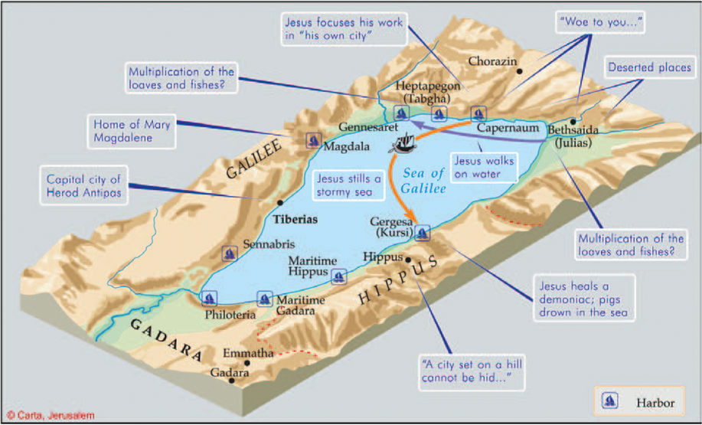

Slide 58
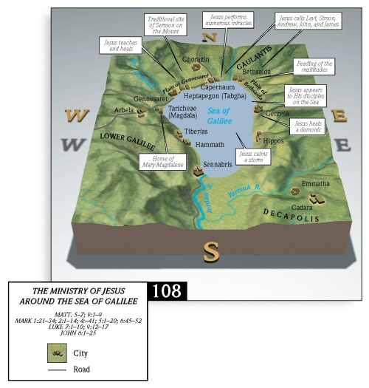

Slide 59
Matthew 14:35-36
And when the men of that place recognized him, they sent around to all that region and brought to him all who were sick and implored him that they might only touch the fringe of his garment. And as many as touched it were made well.
Matthew gives a short summary of many people being healed in the region.
The request to just touch the “fringe” of Jesus’s garment recalls the healing of the woman with an issue of blood (Matt. 9:20).
Matthew adds that those who touched His garment’s fringe were healed.

