Slide 1
IN SUFFERING

Slide 2
THE MESSAGE OF THE GOSPEL
2 Cor. 1:3-11
One Of Healing, Hope, & Comfort
God is the only certainty in life!
My God Is So BIG!

Slide 3
Our temporary nature clarified. V.5-6
James 4:14
Psalm 90:3-12
For a thousand years in your sight are but as yesterday when it is past, or as a watch in the night. V.4
2 Peter 3:8
“I have heard your prayer; I have seen your tears.” 2 Kings 20:5

Slide 4
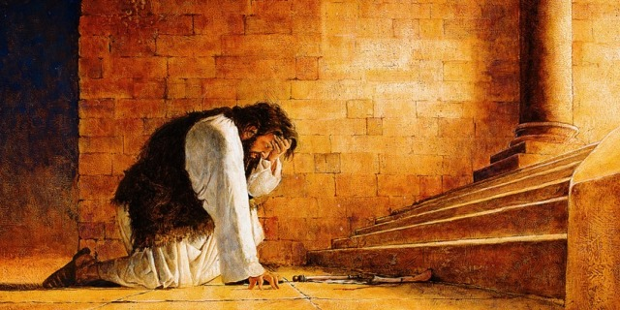
“Now, O LORD, please remember how I have walked before you in faithfulness and with a whole heart, and have done what is good in your sight.”
“I have heard your prayer; I have seen your tears.” 2 Kings 20:5
2 Kings 20:3

Slide 6
“…and if children, then heirs—heirs of God and fellow heirs with Christ, provided we suffer with him in order that we may also be glorified with him. For I consider that the sufferings of this present time are not worth comparing with the glory that is to be revealed to us.”
Romans 8:17-18

Slide 7
“In this you rejoice, though now for a little while, if necessary, you have been grieved by various trials, so that the tested genuineness of your faith—more precious than gold that perishes though it is tested by fire—may be found to result in praise and glory and honor at the revelation of Jesus Christ.”
1 Peter 1:6-7

Slide 9
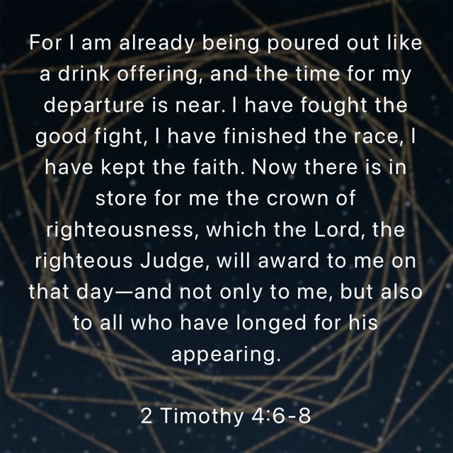

Slide 10
V.8

Slide 12
IN SUFFERING

Slide 13
But thanks be to God, who gives us the victory through our Lord Jesus Christ. Therefore, my beloved brothers, be steadfast, immovable, always abounding in the work of the Lord, knowing that in the Lord your labor is not in vain. 1 Corinthians 15:57-58

Slide 14
God’s Plan for Your Salvation
Based on God’s GRACE-- Eph. 2:8
Hear the Word of God --John 20:30-31
Believe In Your Heart -- Acts 8:37
Repent Of Your Sins --Luke 13:3, 5
Confess faith in Jesus -- Matt. 10:32-33
Be Baptized Into Christ -- Acts 22:16
Be Faithful Until Death --Rev. 2:10

