Slide 2
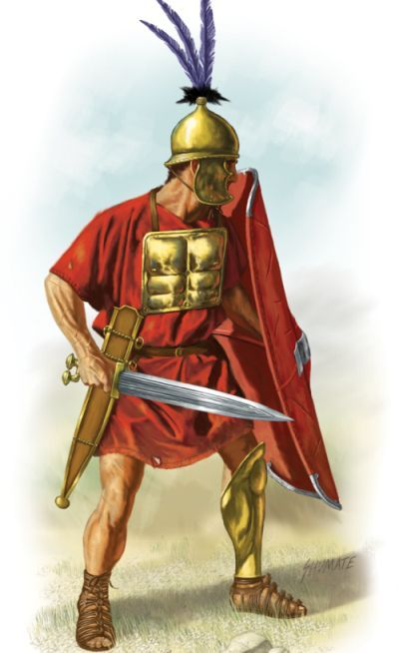
“For I am not ashamed of the gospel, for it is the power of God for salvation to everyone who believes, to the Jew first and also to the Greek. For in it the righteousness of God is revealed from faith for faith, as it is written, ‘The righteous shall live by faith’” (Romans 1:16-17).

Slide 3
Mark 8:38
“For whoever is ashamed of me and of my words in this adulterous and sinful generation, of him will the Son of Man also be ashamed when he comes in the glory of his Father with the holy angels” (Mark 8:38; cf. Luke 9:26).

Slide 4
I Am Not Ashamed
What reason does one have to be ashamed?
Though Paul had reason, he was resolved to stand
Most gospel preachers have had no reason to be ashamed
Things are a changing

Slide 5
I Am Not Ashamed
What reason does one have to be ashamed?
I am not ashamed of Bible morals

Slide 6
I Am Not Ashamed
What reason does one have to be ashamed?
I am not ashamed of Bible morals
I am not ashamed to talk to people about Jesus

Slide 7
I Am Not Ashamed
What reason does one have to be ashamed?
I am not ashamed of Bible morals
I am not ashamed to talk to people about Jesus
I am not ashamed of Jesus’s church
Its worship
Its oneness
Its mission

Slide 8
I Am Not Ashamed
What reason does one have to be ashamed?
I am not ashamed of Bible morals
I am not ashamed to talk to people about Jesus
I am not ashamed of Jesus’s church
I am not ashamed to suffer persecution for Jesus

Slide 9
Stand up, stand up for Jesus,
Ye soldiers of the cross;
Lift high his royal banner,
It must not suffer loss.
From victory unto victory
His army shall he lead,
Till every foe is vanquished,
And Christ is Lord indeed.
Stand up, stand up for Jesus,
Stand in his strength alone;
The arm of flesh will fail you,
Ye dare not trust your own.
Put on the gospel armor,
Each piece put on with prayer;
Where duty calls or danger,
Be never wanting there.
“Stand Up, Stand Up for Jesus”
Bart Millard
Stand up, stand up for Jesus,
The strife will not be long;
This day the noise of battle,
The next the victor’s song.
To those who vanquish evil
A crown of life shall be;
They with the King of Glory
Shall reign eternally.

