Slide 2
Timothy
Paul wrote two letters to Timothy that are included in the New Testament.
Paul included Timothy’s name in his opening greetings of six other letters (1 Thess. 1:1; 2 Cor. 1:1; Phil. 1:1; Phile. 1; 2 Thess. 1:1; Col. 1:1).
Timothy was a native of Lystra (Acts 16:1, 2).
He was the son of a Jewish woman and a Greek father (Acts 16:1).
He joined Paul’s missionary group on his second missionary journey and is mentioned six times in Acts (16:1; 17:14, 15; 18:5; 19:22; 20:4).

Slide 3
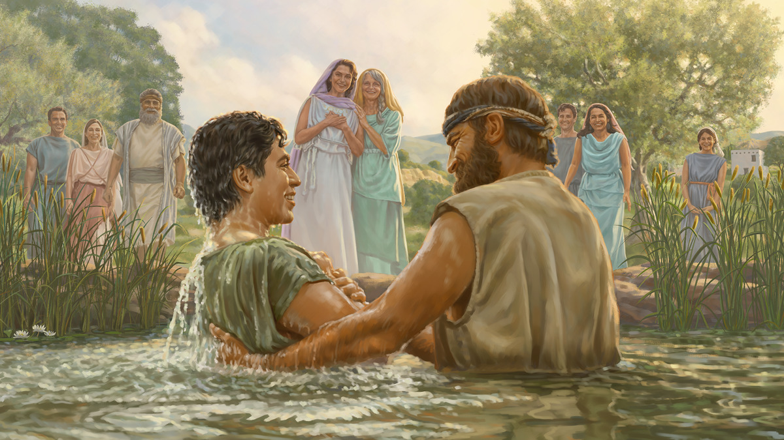
Timothy’s Family
https://www.jw.org/en/library/magazines/watchtower-study-april-2022/Mothers-Learn-From-the-Example-of-Eunice/

Slide 4
Timothy’s Family
Grandmother: Lois
Mother: Eunice
“I am reminded of your sincere faith, a faith that dwelt first in your grandmother Lois and your mother Eunice and now, I am sure, dwells in you as well” (2 Tim. 1:5).
Timothy was a third generation Christian!

Slide 5
Godly Parents
“A good man leaves an inheritance to his children’s children. . .” (Prov. 13:22).

Slide 6
Children Taught to Respect Their Parents
“You shall stand up before the gray head and honor the face of an old man, and you shall fear your God: I am the Lord” (Lev. 19:32).
Solomon wrote, “If one curses his father or his mother, his lamp will be put out in utter darkness” (Prov. 20:20).
“My son, keep your father’s commandment, and forsake not your mother’s teaching. Bind them on your heart always; tie them around your neck. When you walk, they will lead you; when you lie down, they will watch over you; and when you awake, they will talk with you” (Prov. 6:20-22).
“A fool despises his father’s instruction, but whoever heeds reproof is prudent” (Prov. 15:5).

Slide 7
Blessings from Godly Parents
“A good man leaves an inheritance to his children’s children. . .” (Prov. 13:22).

Slide 8
Blessings from Godly Parents
A stable environment
An atmosphere of love
Inheriting an honorable name
Prepared to face life
Religious Training
A good example

Slide 9
Mistakes Some Parents Make
Threatening children into obedience
Teaching children that other things take priority over Christ
Smothering children

Slide 10
Teach Your Children God’s Word
“But as for you, continue in what you have learned and have firmly believed, knowing from whom you learned it and how from childhood you have been acquainted with the sacred writings, which are able to make you wise for salvation through faith in Christ Jesus” (2 Tim. 3:14, 15).
“Fathers, do not provoke your children to anger, but bring them up in the discipline and instruction of the Lord” (Eph. 6:4).
Teach them what it says and then make application appropriate to their learning level.

Slide 11
Provide a Good Example
Show a sincere faith
Give them a good example
Set the right priorities
Talk to your children
Lead them to Christ
Apologize and forgive

Slide 12
Psalm 127:3-5
“Behold, children are a heritage from the Lord,
the fruit of the womb a reward.
Like arrows in the hand of a warrior
are the children of one’s youth.
Blessed is the man
who fills his quiver with them!
He shall not be put to shame
when he speaks with his enemies in the gate.”

