Slide 2
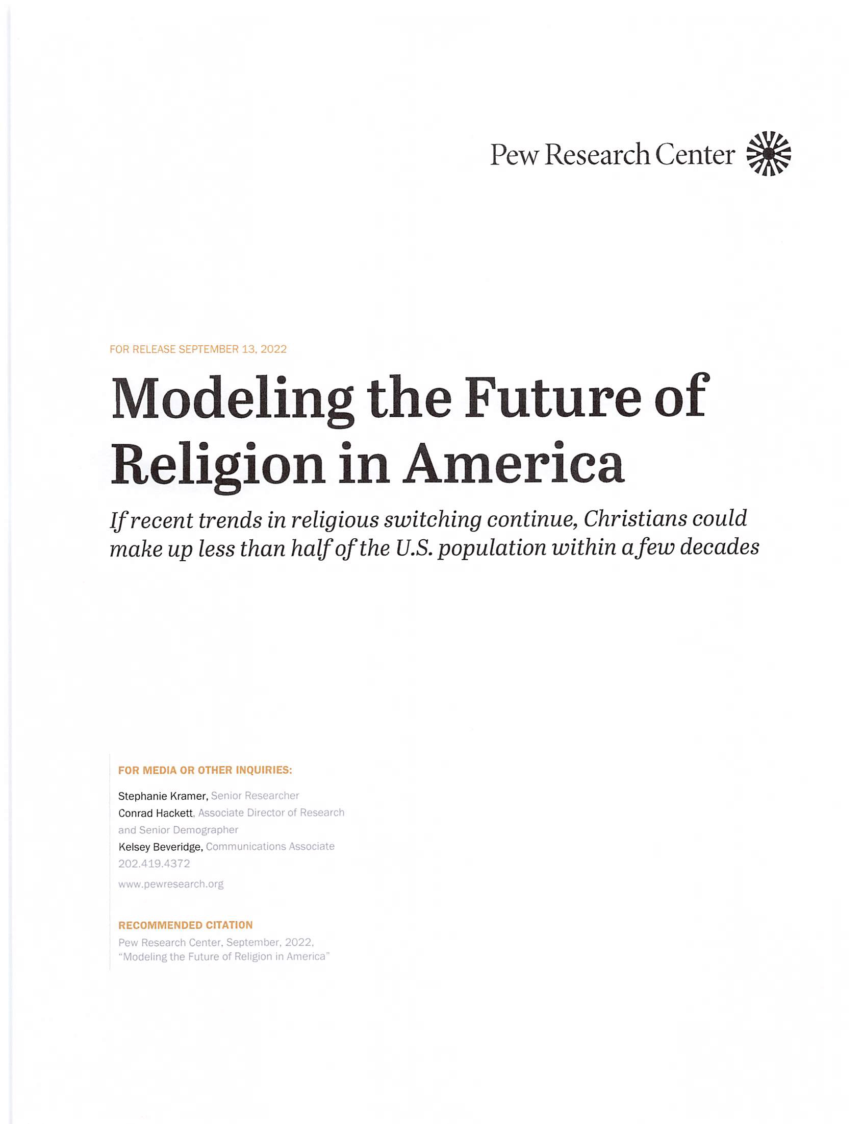
“If recent trends in religious switching continue, Christians could make up less than half of the U.S. population within a few decades.”
September 13, 2022
Pew Research Center

Slide 3
Basis for the Forecast
The largest percentage of Christians falls into the elderly age group and are dying.
The largest percentage of those who are defining themselves as “nones” are the younger people.
Low fertility rates among Americans.
The effect of large numbers of Asian and Muslim people immigrating into the U.S.

Slide 4
A Secular America
Secularism is already the dominant religion in Europe.
This includes Italy, France, Germany, United Kingdom, etc.
Canada is much more secular than the U.S.
Already the Soviet/China block of nations is atheistic.
Now the United States is dominated by secularism in its legislation and culture.

Slide 5
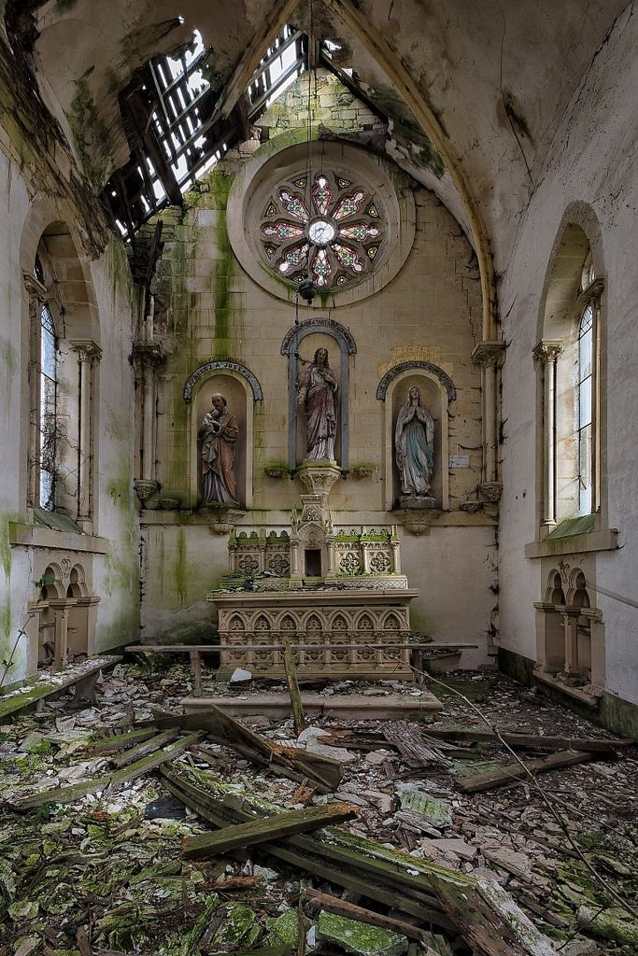
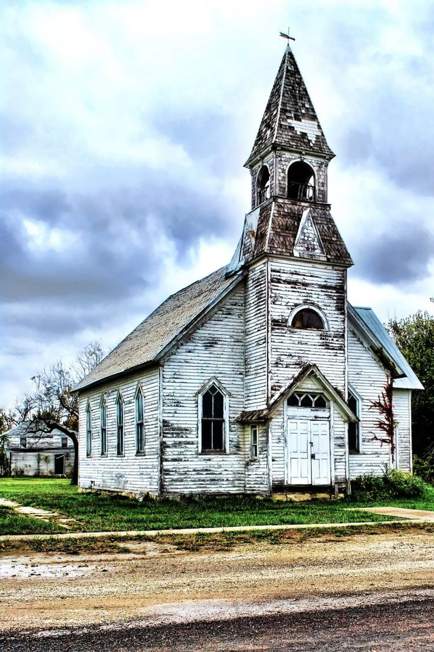
Living as a Christian Minority
European
American

Slide 6
Remember the Words of Jesus
“Enter by the narrow gate. For the gate is wide and the way is easy that leads to destruction, and those who enter by it are many. For the gate is narrow and the way is hard that leads to life, and those who find it are few” (Matt. 7:13-14).
“And someone said to him, ‘Lord, will those who are saved be few?’ And he said to them, ‘Strive to enter through the narrow door. For many, I tell you, will seek to enter and will not be able’” (Luke 13:23-24).

Slide 7
1st Century Christianity Was a Minority Religion
This was so from the day Christianity was born—in Jerusalem, Judea and Samaria, and in the uttermost pasts of the world (Acts 1:8).
During the reigns of Nero (AD 54-68) and Domitian (AD 81-96), Christians were persecuted.
Christianity was an illegal religion until the reign of Constantine (306-337).
In 313, Constantine issued the Edict of Milan which declared tolerance for the Christian religion in the Roman Empire.
Even then, many heresies had already arisen in Christianity and many Christian sects would have been considered apostates at the time and even today.

Slide 8
Already A Minority
Look what is included in today’s Christian majority:
Roman Catholicism
Protestant denominations both mainline and Evangelical
New Testament Christians do not consider either of these as part of the body of Christ.
They teach a different plan of salvation
They follow humanly written creeds
Many of these denominations have denied the deity of Christ and the inspiration of the Scriptures
They are loose in their moral principles

Slide 9
New Testament Christians Are A Super Minority
In 2022, the total membership of Churches of Christ is estimated to be between 1,700,000 and 2,000,000, with over 40,000 individual congregations worldwide.
In the United States, there are approximately 1,087,559 members and 11,776 congregations.
The population of the United States in 2022 was 334,233,854. The church (including institutional, non-institutional, one-cup, no Bible class, etc.) is .3% (3/10 of 1%) of the total population!
The first message of this study is this: We always have been the minority religion in the world and always will be.

Slide 10
It’s Not All Bad News!

Slide 11
Let’s Define Words
Christendom: “the part of the world in which Christianity prevails”
Christianity: “the religion derived from Jesus Christ, based on the Bible as sacred scripture”
Most of what is in Christendom is not Christianity!

Slide 12
What Many Oppose
Catholicism
Mainline Protestantism
Churches that have accommodated themselves to relativity in ethics
The Religious Right with churches married to politicians or political parties
Faith healers
Mega-churches
Division in the Lord’s church
Would Christianity Be Hurt If Any or All of These Passed Away?

Slide 13
Is the Lord Purging and Uprooting?
The call of Jeremiah: “Then the Lord put out his hand and touched my mouth. And the Lord said to me, “Behold, I have put my words in your mouth. See, I have set you this day over nations and over kingdoms, to pluck up and to break down, to destroy and to overthrow, to build and to plant” (Jer. 1:10).
The ground had to be cleared before God could replant.
F. B. Huey: “Judah’s idols and immoral practices had to be purged before God could bless the nation. Erroneous beliefs and practices must be destroyed before reconstruction can take place (Eccl 3:3). A new building cannot be constructed until the old structure it will replace has been demolished. ‘God can speak his yes only after he has spoken a no’” (Jeremiah, Lamentations, The New American Commentary, 52).

Slide 14
One Should Remember That . . .
The Protestant Reformation of the 14-15th centuries occurred because of the apostasies within Roman Catholicism.
The American Restoration Movement was a rejection of the denominational divisions of the nineteenth century.
Perhaps the Lord is rooting out the weeds to make room for us to plant good seed. Is God purging the church to prepare for another wave of evangelism?

Slide 15
America ≠ Israel
God had a covenant with Israel that He did not make with all nations. His covenant was not with . . .
Egypt
Syria
Assyria
Babylon
Persia
Macedonia/Greece
Rome
Nor does God have a covenant with the United States!

Slide 16
God Controls the Nations
“And he made from one man every nation of mankind to live on all the face of the earth, having determined allotted periods and the boundaries of their dwelling place” (Acts 17:27).
“He makes nations great, and he destroys them; he enlarges nations, and leads them away” (Job 12:23).
“They will fall by the edge of the sword and be led captive among all nations, and Jerusalem will be trampled underfoot by the Gentiles, until the times of the Gentiles are fulfilled” (Luke 21:24).
Remember Nebuchadnezzar’s dream (Dan. 2:36-45).

Slide 17
Lessons for Nebuchadnezzar (Daniel 4)
“The sentence is by the decree of the watchers, the decision by the word of the holy ones, to the end that the living may know that the Most High rules the kingdom of men and gives it to whom he will and sets over it the lowliest of men’” (4:17).
“While the words were still in the king’s mouth, there fell a voice from heaven, ‘O King Nebuchadnezzar, to you it is spoken: The kingdom has departed from you, and you shall be driven from among men, and your dwelling shall be with the beasts of the field. And you shall be made to eat grass like an ox, and seven periods of time shall pass over you, until you know that the Most High rules the kingdom of men and gives it to whom he will’” (4:31-32).
America needs to remember what Nebuchadnezzar had to learn!

Slide 18
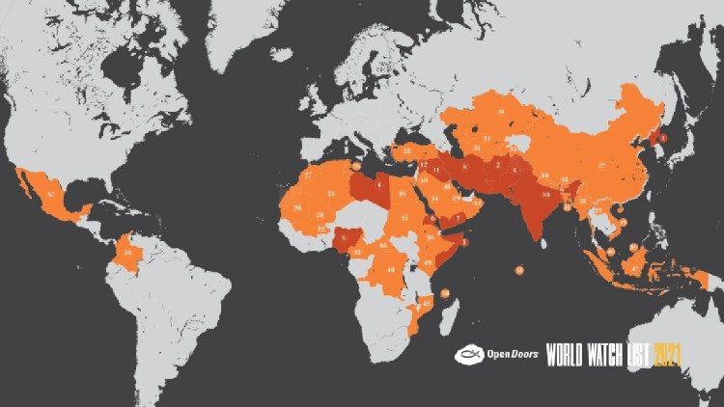
Will We Keep the Faith?
Persecution Against Christians: 2022 World Watch List released by Vatican News (01/20/2022)

Slide 19
Keep the Faith
“Fear not, therefore; you are of more value than many sparrows. So everyone who acknowledges me before men, I also will acknowledge before my Father who is in heaven, but whoever denies me before men, I also will deny before my Father who is in heaven” (Matt. 10:32-33).
“But Peter and the apostles answered, ‘We must obey God rather than men’” (Acts 5:29).
“In this you rejoice, though now for a little while, if necessary, you have been grieved by various trials, so that the tested genuineness of your faith—more precious than gold that perishes though it is tested by fire—may be found to result in praise and glory and honor at the revelation of Jesus Christ. Though you have not seen him, you love him. Though you do not now see him, you believe in him and rejoice with joy that is inexpressible and filled with glory, obtaining the outcome of your faith, the salvation of your souls” (1 Pet. 1:6-9).

Slide 20
Ominous Predictions
In 2017, Ron Dreher wrote The Benedict Option, advertised on its cover as “The most discussed and most important religious book of the decade.” Dreher calls for Americans to recognize that the light of Christianity is flickering out all over the West and “barring a dramatic reversal of current trends, it will all but disappear entirely from Europe and North America” (8).
In 2020, he followed up with another book entitled Live Not By Lies, Dreher predicts, “A time of painful testing, even persecution, is coming. Lukewarm or shallow Christian will not come through with their faith intact” (162).

Slide 21
Dreher: Admirers or Followers?
Dreher’s answer to his rhetorical question is as follows: “We will know when we act—or fail to act—as Christians when to be faithful costs us something. It may be a small thing at first—a place on a sports team because we won’t play on Sunday mornings, or the respect of our peers when we will not march in a parade for a political cause. But the demands made on us will grow greater, and the consequences for failing to submit to the world’s demands will grow more severe” (ibid.).
It may mean losing a job.
It may mean you have to accept a lesser paying and less fulfilling job to provide for your family.
You may be “cancelled” by the WOKE crowd.
You may be fined or arrested for your faith.

Slide 22
The Times They Are A-Changin’ Song by Bob Dylan
I am not trying to scare you or discourage you in any way. But it would be unwise not to be aware of the evolving culture around us and its potential to do Christians harm.
Already, some small business owners have been sued to force them to provide photography and cake for homosexual weddings.
Teachers have been fired for not teaching critical race theory and refusing to present transgender materials to elementary children.
It would be unwise not to prepare ourselves for the eventuality that persecution may come upon us, just as it did the first century church.
May God help us to be spiritually strong enough to endure whatever may lie before us.

