Slide 1
The Suffering Of Jesus
Luke 22:39-46

Slide 2
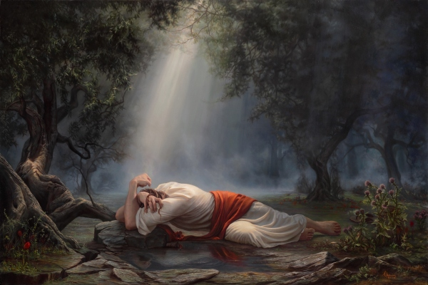
The Suffering Of Jesus
Jesus began to be sorrowful. Matt. 26:37
He was sorrowful unto death. Matt. 26:38
He was in agony. Luke 22:44

Slide 3
Life Is Hard!
"Man who is born of woman Is of few days and full of trouble. 2 He comes forth like a flower and fades away; He flees like a shadow and does not continue.” Job 14:1-2

Slide 4
We Will Experience Grief!
“But I do not want you to be ignorant, brethren, concerning those who have fallen asleep, lest you sorrow as others who have no hope.” 1 Thess. 4:13

Slide 5
Illness Is All Around Us!
Life Is Hard!
We Will Experience Grief!
2 Kings 20:1-6

Slide 6
For to this you have been called, because Christ also suffered for you, leaving you an example, so that you might follow in his steps. 1 Peter 2:21

Slide 7
Jesus, Our Example In Suffering
He was concerned about others. Matt. 26:41
He prayed to God. Luke 22:44
He looked to His friends. Matt. 26:37-38
He accepted God’s will. Luke 22:42

Slide 8
John 12:27
"Now My soul is troubled, and what shall I say? 'Father, save Me from this hour'? But for this purpose I came to this hour.”

Slide 9
John 10:18
"No one takes it from Me, but I lay it down of Myself. I have power to lay it down, and I have power to take it again. This command I have received from My Father."

Slide 10
Heb. 5:8-9
“though He was a Son, yet He learned obedience by the things which He suffered. 9 And having been perfected, He became the author of eternal salvation to all who obey Him,”

Slide 11
Our Example In Suffering
Think of others.
Pray to God.
Look to friends.
Accept God’s will.

Slide 12
God’s Plan for Your Salvation
Based on God’s GRACE-- Eph. 2:8
Hear the Word of God --John 20:30-31
Believe In Your Heart -- Acts 8:37
Repent Of Your Sins --Luke 13:3, 5
Confess faith in Jesus -- Matt. 10:32-33
Be Baptized Into Christ -- Acts 22:16
Be Faithful Until Death --Rev. 2:10

