Slide 1
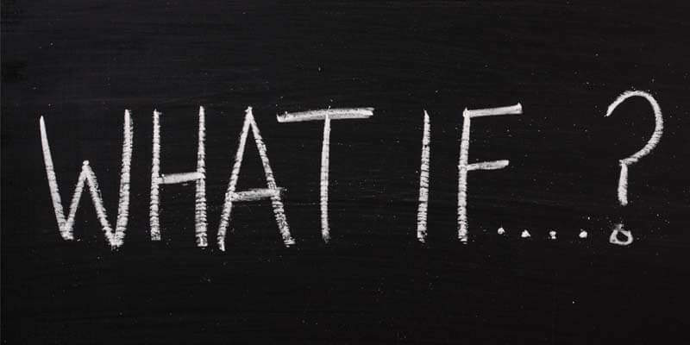

Slide 2
God Treated Us Like
We Treat Him?
God did not walk with us today because we failed to recognize it as His day?
God met our needs the way we give Him our lives?
Romans 12:1

Slide 3
God couldn’t take the time to bless us, because we couldn’t take the time to thank Him?
Luke 6:35
Luke 18:9-14
For people will be lovers of self, lovers of money, proud, arrogant, abusive, disobedient to their parents, ungrateful, unholy, heartless, unappeasable, slanderous, without self-control, brutal, not loving good, treacherous, reckless, swollen with conceit, lovers of pleasure rather than lovers of God, having the appearance of godliness, but denying its power. Avoid such people. 2Tim. 3:2-5

Slide 4
God decided to stop leading us because we didn’t follow Him?
Jeremiah 10:23
2 Timothy 3:16-17
Galatians 3:27 for in Christ Jesus you are all sons of God, through faith. For as many of you as were baptized into Christ have put on Christ.
John 8:31-32 So Jesus said to the Jews who had believed him, “If you abide in my word, you are truly my disciples, and you will know the truth, and the truth will set you free.”

Slide 5
God decided to stop leading us because we didn’t follow Him?
John 10:27-28 My sheep hear my voice, and I know them, and they follow me. I give them eternal life, and they will never perish, and no one will snatch them out of my hand.

Slide 6
God took away the bible because we wouldn’t read it?
How valuable is the scripture to you?
Psalm 19:10-11
1 Peter1:23-25 since you have been born again, not of perishable seed but of imperishable, through the living and abiding word of God; for “All flesh is like grass and all its glory like the flower of grass. The grass withers, and the flower falls, but the word of the Lord remains forever.” And this word is the good news that was preached to you.

Slide 7
God would not hear us because we wouldn’t listen to Him?
1 Peter 3:12 For the eyes of the Lord are on the righteous, and his ears are open to their prayer. But the face of the Lord is against those who do evil.”
He wants to hear our prayers & answer them.
A Husbands prayer hindered for ill treatment of the wife. 1 Pet. 3:7

Slide 8
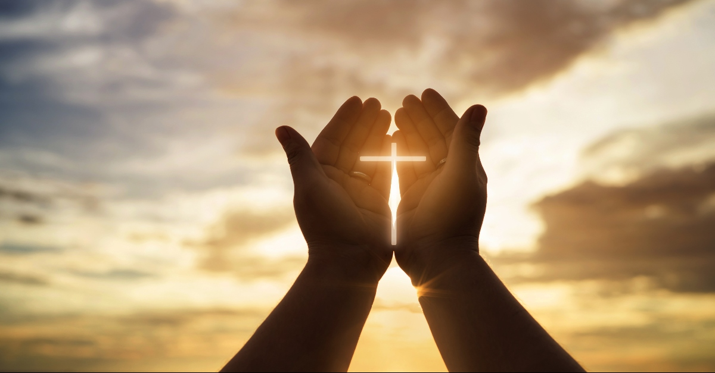
When we stop thanking Him, He continues to bless us.
When we stop following Him, He continues to show the way to the green pastures.
When we stop studying His word, He does not take His marvelous gift away.
When we stop listening, God is pleading still.
Romans 1:18-32
GOD GAVE THEM UP!

Slide 9
“You are beautiful beyond description,
Too marvelous for words,
Too wonderful for comprehension,
Like nothing ever seen or heard.
Who can grasp Your infinite wisdom,
Who can fathom the depths of Your love?
You are beautiful beyond description,
Majesty enthroned above.
And I stand, I stand in awe of You.
I stand, I stand in awe of You.
Holy God, to whom all praise is due,
I stand in awe of You.”

