Slide 1
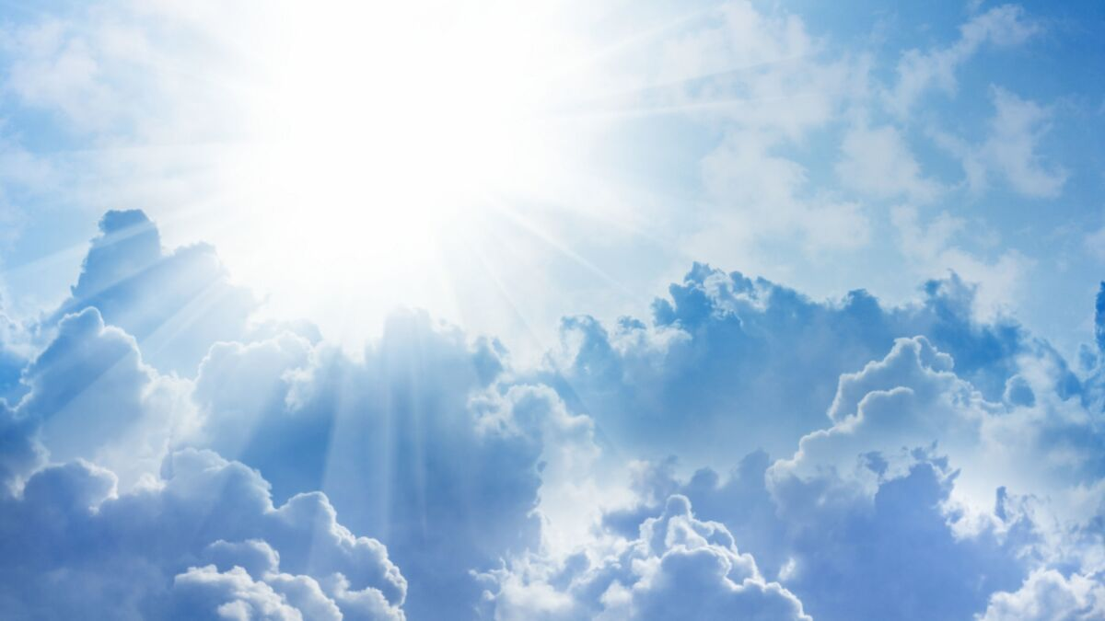
Will Only 144,000
Go To Heaven?

Slide 2
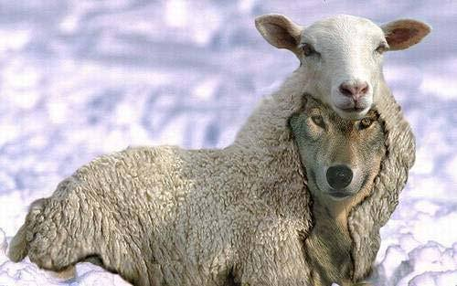
What The
JW Teach?
Two classes of followers. The elect (144,000) & “other sheep”.
NT mainly applies to the 144,000.
The 144,000 are equal to Christ.
Only the 144,000 can partake the LS.
They don’t want to go to Heaven but would rather remain on “Paradise Earth”.

Slide 3
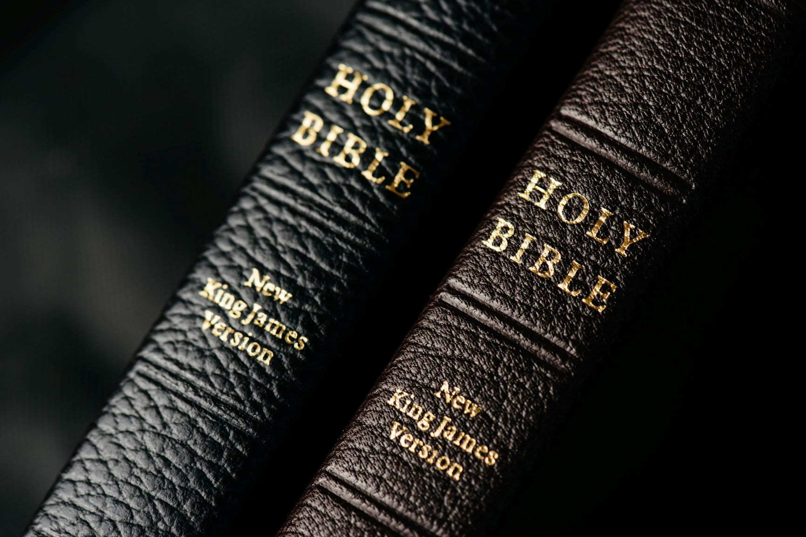
Revelation 6
The saints under the alter. V.9-11
A terrible judgment is coming on the earth.
Who shall be able to stand?
Will the saints on earth be able to stand & what will happen to the souls under the alter?

Slide 4
Revelation 7
4 Angels on the 4 corners holding the 4 winds. V.1
Winds of judgment. (conquest, war, famine, & death)
Given to hurt the earth.
Another Angel from the east calls for delay until God’s servants are sealed.
NONE Will Be Left Out!

Slide 5
Revelation 7:9-17
The great multitude has responded to the gospel in obedient faith!
Do you see 2 classes anywhere in the text?
Ephesians 2:11-16
“before the throne” is used of the great multitude & the 144,000 (14).
V. 11 this occurs in Heaven & not on the earth.
This multitude survived the ”great tribulation”.

Slide 6
Revelation 14:1-5
“before the throne” figurative for a place of comfort or paradise.
144,000 represents the whole of God’s people!
Describes the spiritually pure.
1 Peter 1:13-25
144,000 must not be taken literal!
If the number is literal so must be the description!
“firstfruits” indicates others would follow.
144,000 & The Great Multitude Are The Same!

Slide 7
2 Corinthians 5:1-2
For we know that if the tent that is our earthly home is destroyed, we have a building from God, a house not made with hands, eternal in the heavens. For in this tent we groan, longing to put on our heavenly dwelling,

Slide 8
Philippians 3: 20-21
But our citizenship is in heaven, and from it we await a Savior, the Lord Jesus Christ, who will transform our lowly body to be like his glorious body, by the power that enables him even to subject all things to himself.

Slide 9
Hebrews 5:9
And being made perfect, he became the source of eternal salvation to ALL who obey him,

Slide 10
Heaven Is Waiting For You!

Slide 11
But the day of the Lord will come like a thief, and then the heavens will pass away with a roar, and the heavenly bodies will be burned up and dissolved, and the earth and the works that are done on it will be exposed. Since all these things are thus to be dissolved, what sort of people ought you to be in lives of holiness and godliness,
waiting for and hastening the coming of the day of God, because of which the heavens will be set on fire and dissolved, and the heavenly bodies will melt as they burn! But according to his promise we are waiting for new heavens and a new earth in which righteousness dwells. Therefore, beloved, since you are waiting for these, be diligent to be found by him without spot or blemish, and at peace. 2 Peter 3:10-14

