Slide 2
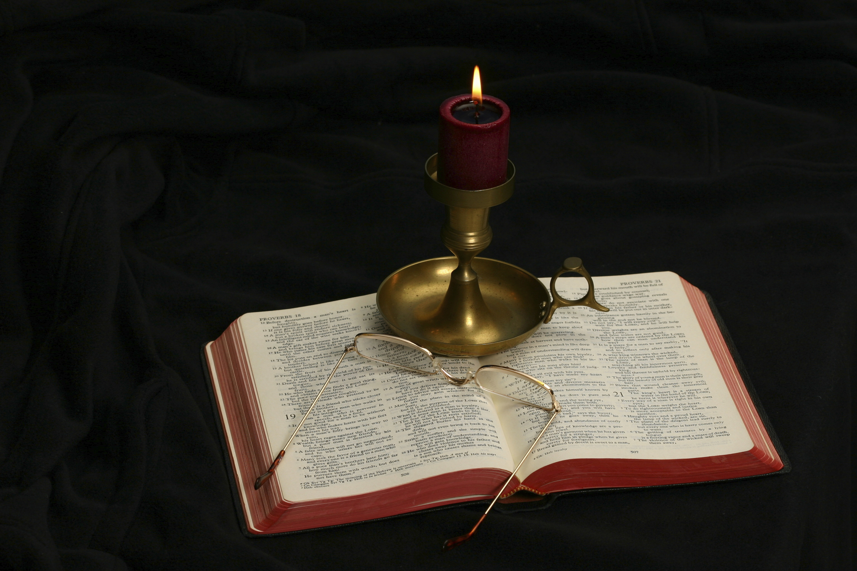
The Gospel of Matthew
Chapter 17

Slide 3
Outline of Chapter 17
The Transfiguration (17:1-13)
Healing of a demon possessed boy (17:14-21)
Jesus foretells His death and resurrection again (17:22-23)
The Temple tax (17:24-27)
In all of the events except the Temple tax, Matthew is following the same order as Mark.

Slide 4
The Transfiguration Matthew 17:1-13
And after six days Jesus took with him Peter and James, and John his brother, and led them up a high mountain by themselves. And he was transfigured before them, and his face shone like the sun, and his clothes became white as light. And behold, there appeared to them Moses and Elijah, talking with him. And Peter said to Jesus, “Lord, it is good that we are here. If you wish, I will make three tents here, one for you and one for Moses and one for Elijah.” He was still speaking when, behold, a bright cloud overshadowed them, and a voice from the cloud said, “This is my beloved Son, with whom I am well pleased; listen to him.” When the disciples heard this, they fell on their faces and were terrified. But Jesus came and touched them, saying, “Rise, and have no fear.” And when they lifted up their eyes, they saw no one but Jesus only. And as they were coming down the mountain, Jesus commanded them, “Tell no one the vision, until the Son of Man is raised from the dead.” And the disciples asked him, “Then why do the scribes say that first Elijah must come?” He answered, “Elijah does come, and he will restore all things. But I tell you that Elijah has already come, and they did not recognize him, but did to him whatever they pleased. So also the Son of Man will certainly suffer at their hands.” Then the disciples understood that he was speaking to them of John the Baptist.

Slide 5
Preliminary Information
This incident is recorded in both Mark (7:2-13) and Luke (9:28-36).
It does not appear in John’s gospel.
Peter mentions the transfiguration in his second epistle.

Slide 6
2 Peter 1:16-21
“For we did not follow cleverly devised myths when we made known to you the power and coming of our Lord Jesus Christ, but we were eyewitnesses of his majesty. For when he received honor and glory from God the Father, and the voice was borne to him by the Majestic Glory, ‘This is my beloved Son, with whom I am well pleased,’ we ourselves heard this very voice borne from heaven, for we were with him on the holy mountain. And we have the prophetic word more fully confirmed, to which you will do well to pay attention as to a lamp shining in a dark place, until the day dawns and the morning star rises in your hearts, knowing this first of all, that no prophecy of Scripture comes from someone’s own interpretation. For no prophecy was ever produced by the will of man, but men spoke from God as they were carried along by the Holy Spirit.”

Slide 7
Preliminary Information
This incident is recorded in both Mark (7:2-13) and Luke (9:28-36).
It does not appear in John’s gospel.
Peter mentions the transfiguration in his second epistle.
The Transfiguration draws on two Old Testament texts:
Exodus 24:9-18—God appearing to 70 elders of Israel to confirm the covenant at Mount Sinai.
Exodus 34:29-35—the shining of Moses’s face after God appeared to him when at the second giving of the Ten Commandments on stone tablets.

Slide 8
Exodus 24:9-18
“Then Moses and Aaron, Nadab, and Abihu, and seventy of the elders of Israel went up, and they saw the God of Israel. There was under his feet as it were a pavement of sapphire stone, like the very heaven for clearness. And he did not lay his hand on the chief men of the people of Israel; they beheld God, and ate and drank. The Lord said to Moses, ‘Come up to me on the mountain and wait there, that I may give you the tablets of stone, with the law and the commandment, which I have written for their instruction.’ So Moses rose with his assistant Joshua, and Moses went up into the mountain of God. And he said to the elders, ‘Wait here for us until we return to you. And behold, Aaron and Hur are with you. Whoever has a dispute, let him go to them.’ Then Moses went up on the mountain, and the cloud covered the mountain. The glory of the Lord dwelt on Mount Sinai, and the cloud covered it six days. And on the seventh day he called to Moses out of the midst of the cloud. Now the appearance of the glory of the Lord was like a devouring fire on the top of the mountain in the sight of the people of Israel. Moses entered the cloud and went up on the mountain. And Moses was on the mountain forty days and forty nights.”

Slide 9
Exodus 34:29-35
“When Moses came down from Mount Sinai, with the two tablets of the testimony in his hand as he came down from the mountain, Moses did not know that the skin of his face shone because he had been talking with God. Aaron and all the people of Israel saw Moses, and behold, the skin of his face shone, and they were afraid to come near him. But Moses called to them, and Aaron and all the leaders of the congregation returned to him, and Moses talked with them. Afterward all the people of Israel came near, and he commanded them all that the Lord had spoken with him in Mount Sinai. And when Moses had finished speaking with them, he put a veil over his face. Whenever Moses went in before the Lord to speak with him, he would remove the veil, until he came out. And when he came out and told the people of Israel what he was commanded, the people of Israel would see the face of Moses, that the skin of Moses’ face was shining. And Moses would put the veil over his face again, until he went in to speak with him.”

Slide 10
Preliminary Information
This incident is recorded in both Mark (7:2-13) and Luke (9:28-36).
It does not appear in John’s gospel.
Peter mentions the transfiguration in his second epistle.
The Transfiguration draws on two Old Testament texts:
Exodus 24:9-18
Exodus 34:29-35
The text also recalls Deuteronomy 18:15-18.
The Jewish expectation included the coming of a prophet like unto Moses.

Slide 11
Deuteronomy 18:15-18
“The Lord your God will raise up for you a prophet like me from among you, from your brothers—it is to him you shall listen— just as you desired of the Lord your God at Horeb on the day of the assembly, when you said, ‘Let me not hear again the voice of the Lord my God or see this great fire any more, lest I die.’ And the Lord said to me, ‘They are right in what they have spoken. I will raise up for them a prophet like you from among their brothers. And I will put my words in his mouth, and he shall speak to them all that I command him. And whoever will not listen to my words that he shall speak in my name, I myself will require it of him.’”

Slide 12
Matthew 17:1
“And after six days Jesus took with him Peter and James, and John his brother, and led them up a high mountain by themselves.”
Luke’s account has “Now about eight days after”; “after six days” and “about eight days” are equivalent ways of saying “a week later.”
Luke adds that Jesus went up the mountain to pray (9:28).
Leaving the other Apostles at the base of the mountain (to be rejoined later), the “inner three” (Peter, James, and John) accompanied Jesus up the mountain. Where else were these three men alone with Jesus?
Gethsemane
Raising of Jairus’s daughter (Luke 8:51).
The high mountain is not specifically named. The last place where the disciples were is Caesarea Philippi which is at the base of Mount Hermon.

Slide 13
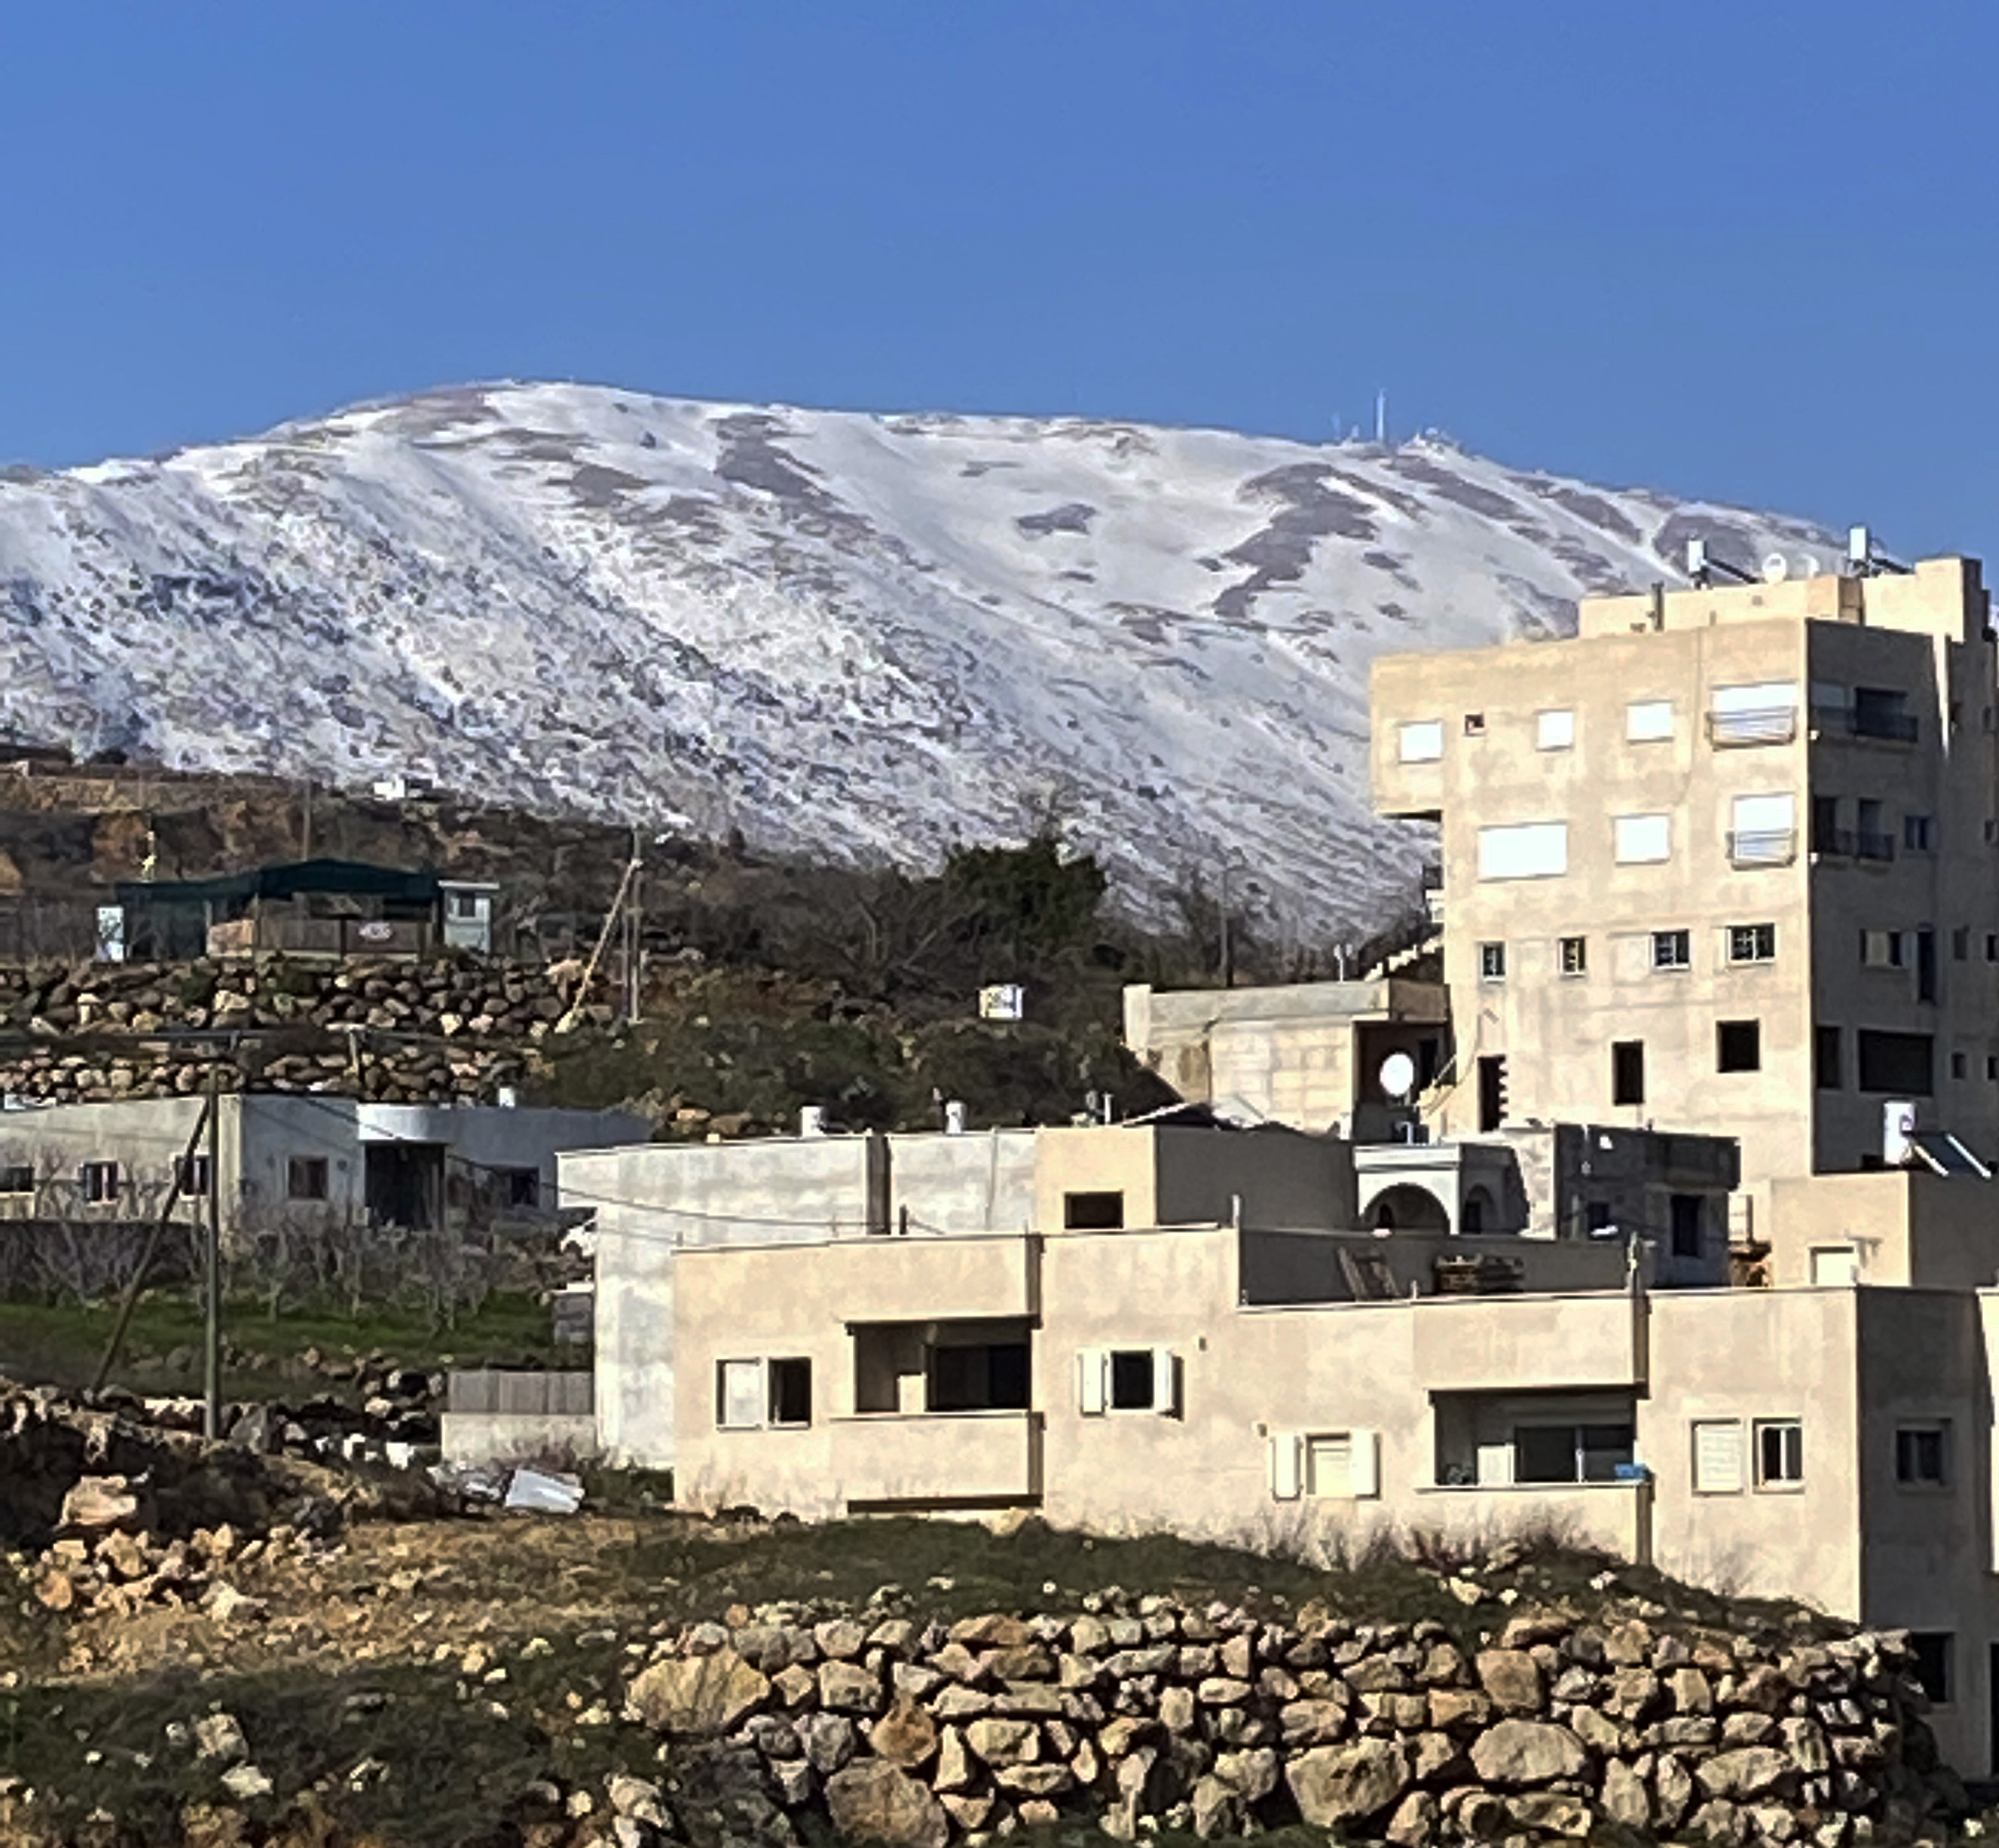
Mount Hermon

Slide 14
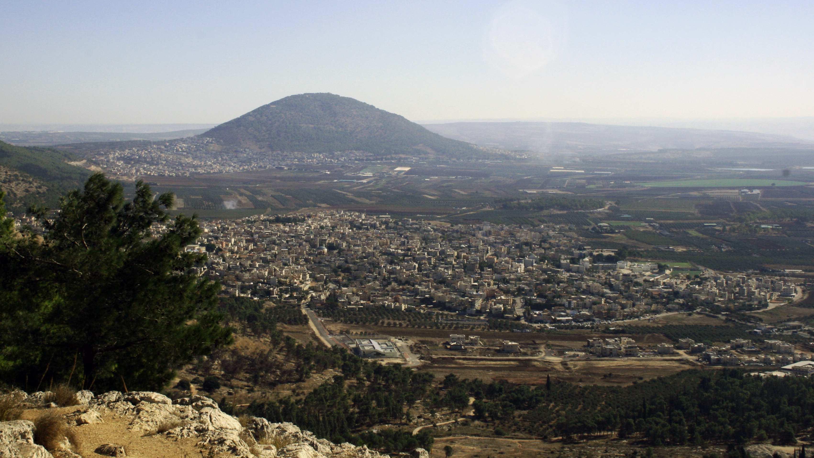
Mount Tabor as viewed from Nazareth

Slide 15
Matthew 17:2
“And he was transfigured before them, and his face shone like the sun, and his clothes became white as light.”
Transfigured (metamorphoō): “to change in a manner visible to others, be transfigured of Jesus, who took on the form of his heavenly glory” (BDAG, 639). The English word “metamorphosis” is derived from this Greek word. Its meaning is explained:
“His face shone like the sun.” Shone (lampō): “to emit rays of light, shine” (BDAG, 585). This reminds us of Moses’ face shining after being in the presence of God (Exod. 34:29, 30, 35). Cf. Rev. 1:16.
“His clothes became white as light.” White (leukos): “bright, shining, gleaming. . . Brilliant as light” (BDAG, 593).
The ultimate glory of the righteous was described as “Then the righteous will shine like the sun in the kingdom of their Father” (Matt. 13:43).

Slide 16
Matthew 17:3
“And behold, there appeared to them Moses and Elijah, talking with him.”
Matthew uses the word “behold” three times in this chapter (17:3, 5[2x]).
Possible reasons that it was Moses and Elijah:
They were key representatives of the law and prophets.
They lived through the two major periods of Old Testament miracles.
They were key messianic forerunners whose return was often expected with the advent of the Messiah.
Elijah had a miraculous departure from earth; Moses died but was buried by God.
Luke relates that they were “spoke of his departure (exodus), which he was about to accomplish at Jerusalem” (9:31).

Slide 17
Matthew 17:4
“And Peter said to Jesus, ‘Lord, it is good that we are here. If you wish, I will make three tents here, one for you and one for Moses and one for Elijah.’”
Peter’s comments are well intentioned (he was probably wishing to show hospitality to the heavenly visitors), but Mark adds, “For he did not know what to say, for they were terrified” (9:6).
What does “If you wish” show?
Submission to Jesus’s leadership and authority.
“I will make” in Matthew differs from Mark’s “we will make” (9:5).

Slide 18
Matthew 17:5
“He was still speaking when, behold, a bright cloud overshadowed them, and (behold, KJV and Greek) a voice from the cloud said, ‘This is my beloved Son, with whom I am well pleased; listen to him.’”
God interrupts Peter (“he was still speaking when . . .”).
Cloud recalls to mind the clouds present when God appears, to prevent men seeing the presence of God (BDAG, 378; cf. Exod. 24:15-18; 40:34-38).
This is my beloved Son, with whom I am well pleased reminds us of Matthew 3:17.
Listen to him is probably an echo of Deuteronomy 18:15, 19.
Deuteronomy 18:15-19 is quoted with application to Jesus in Acts 3:22; 7:37.

Slide 19
Matthew 17:6-7
“When the disciples heard this, they fell on their faces and were terrified. But Jesus came and touched them, saying, ‘Rise, and have no fear.’”
Leon Morris: “Prostration (falling on the face) was characteristically used for taking up a lowly position before God or on occasion before a great man. It was a sign of humility and devotion” (The Gospel according to Matthew, 441).
Sometimes, as in this text, one falls on one’s face in fear.
Jesus touched the disciples and calmed their fears.

Slide 20
Matthew 17:8
“And when they lifted up their eyes, they saw no one but Jesus only.”
Why have Moses and Elijah disappeared?
Why does the Transfiguration occur?
What should the disciples have learned from it?

Slide 21
Matthew 17:9
“And as they were coming down the mountain, Jesus commanded them, ‘Tell no one the vision, until the Son of Man is raised from the dead.’”
The event of Jesus’s transfiguration is called a vision (horama): “something that is viewed with one’s eye, something seen, sight, vision” (BDAG, 718).
Why would Peter wish to build three physical tents, if Moses and Elijah were not bodily present?
Why did Jesus command Peter, James, and John not to tell anyone about the events on the mount where Jesus was transfigured until His resurrection?
After the resurrection, they would naturally tell the narrative.
The death, burial, and resurrection of Jesus were essential to the Messiah’s mission and reminds us of 16:21.
This is the last time in Matthew’s gospel when Jesus commanded silence.

Slide 22
Matthew 17:10
“And the disciples asked him, ‘Then why do the scribes say that first Elijah must come?’”
This question is based on Malachi’s prophecy: “Behold, I will send you Elijah the prophet before the great and awesome day of the Lord comes. And he will turn the hearts of fathers to their children and the hearts of children to their fathers, lest I come and strike the land with a decree of utter destruction” (Mal. 4:5-6).
Must (dei) refers to a divine necessity (if God said it, it must occur).
The problem for the disciples was this: The Lord foretold the coming of Elijah and he will restore all things; therefore, why must the Messiah suffer?

Slide 23
Matthew 17:11
“He answered, ‘Elijah does come, and he will restore all things.’”
The future tense of “will restore all things” is “that of the scribal hope, not Jesus’ prediction of a still future coming of Elijah” (R. T. France, 268) or a future aspect of the work that the prophet has inaugurated” (Morris, 443).

Slide 24
Matthew 17:12
“But I tell you that Elijah has already come, and they did not recognize him, but did to him whatever they pleased. So also the Son of Man will certainly suffer at their hands.”
Note that “Elijah has already come (ēdē ēlthen).” His coming is past, not future.
The Jews, however, did not recognize John the Baptist as the fulfillment of the Elijah prophecies.
As a result they “did to him whatever they pleased,” a reference to the arrest, imprisonment and beheading of John.
Similarly, the Son of Man will suffer at their hands, reaffirming 16:21.
The suffering of John the Baptist foreshadowed what would be done to Jesus.

Slide 25
Matthew 17:13
“Then the disciples understood that he was speaking to them of John the Baptist.”
The paragraph closes with a statement that the disciples finally comprehend that the Elijah of Old Testament prophecy was John the Baptist.
Neither John nor Jesus fit the model of Jewish expectation.

Slide 26
Healing of a Demon Possessed Boy Matthew 17:14-21
And when they came to the crowd, a man came up to him and, kneeling before him, said, “Lord, have mercy on my son, for he has seizures and he suffers terribly. For often he falls into the fire, and often into the water. And I brought him to your disciples, and they could not heal him.” And Jesus answered, “O faithless and twisted generation, how long am I to be with you? How long am I to bear with you? Bring him here to me.” And Jesus rebuked the demon, and it came out of him, and the boy was healed instantly. Then the disciples came to Jesus privately and said, “Why could we not cast it out?” He said to them, “Because of your little faith. For truly, I say to you, if you have faith like a grain of mustard seed, you will say to this mountain, ‘Move from here to there,’ and it will move, and nothing will be impossible for you.”

Slide 27
Observations
Matthew is still following the order given in Mark’s gospel.
The healing appears in Mark 9:14-29 and Luke 9:37-43. It is 8 verses long in Matthew, 16 verses in Mark, and 7 verses in Luke.
Mark tells of an attack the demon made on the child when he was taken to Jesus and the father’s dialogue with Jesus when it occurred.
The parallel between Moses coming down from Mt. Sinai to find the Israelites worshipping a golden calf is somewhat parallel to Jesus coming down from the mount where He was transfigured to witness the disciples’ failure to heal a demon possessed lad.

Slide 28
More Information from Mark’s Account
And they brought the boy to him. And when the spirit saw him, immediately it convulsed the boy, and he fell on the ground and rolled about, foaming at the mouth. And Jesus asked his father, “How long has this been happening to him?” And he said, “From childhood. And it has often cast him into fire and into water, to destroy him. But if you can do anything, have compassion on us and help us.” And Jesus said to him, “‘If you can’! All things are possible for one who believes.” Immediately the father of the child cried out and said, “I believe; help my unbelief!” And when Jesus saw that a crowd came running together, he rebuked the unclean spirit, saying to it, “You mute and deaf spirit, I command you, come out of him and never enter him again.” And after crying out and convulsing him terribly, it came out, and the boy was like a corpse, so that most of them said, “He is dead.” But Jesus took him by the hand and lifted him up, and he arose.

Slide 29
Matthew 17:14
And when they came to the crowd, a man came up to him and, kneeling before him, . . .
Jesus and the three disciples rejoin the nine at the foot of the mount the day after the transfiguration (Luke 9:37).
When Jesus commissioned the Twelve, He charged them saying, “And proclaim as you go, saying, ‘The kingdom of heaven is at hand.’ Heal the sick, raise the dead, cleanse lepers, cast out demons. You received without paying; give without pay” (Matt. 10:7).
For some reason, the nine were unable to perform the miracle of casting the demon from this lad, v. 21.
This is the last miracle in which Jesus cast out a demon in Matthew’s gospel.
The father of the lad came to Jesus kneeling (gonupeteō) before Him, much as a person might fall before a king appealing for his help.
Mark adds that the scribes were disputing (suzēteō) with Jesus’s disciples.

Slide 30
Matthew 7:15
“. . . said, “Lord, have mercy on my son, for he has seizures and he suffers terribly. For often he falls into the fire, and often into the water.’”
The illness is described in the ESV (and most recent translations) as “he has seizures” (KJV: “he is a lunatik”; NKJV, “he is an epileptic”). The Greek word selēniazomai means “to experience epileptic seizures, be an epileptic (in the ancient world epileptic seizure was associated with transcendent powers of the moon” (BDAG, 919). It has previously appeared in 4:24.
Significantly, the English word “lunatic” is derived from “lunar” (moon).
This lad’s suffering is not caused by epilepsy but from demon possession.
The phrase he suffers terribly (kakōs paschei) emphasizes the intensity of the sickness. We might say that he had grand mal seizures. Often expresses their frequency.
The seizures would sometimes occur near fire or water that threatened the child’s life.

Slide 31
Mercy
The father pleaded for Jesus to show mercy to his son.
Mercy (eleeō) means “to be greatly concerned about someone in need, have compassion/mercy/pity τινά on or for someone” (BDAG, 315).
It reminds one of the Beatitude: “Blessed are the merciful, for they shall receive mercy” (Matt. 5:7).
How does mercy show itself in one’s life?
Why should one not dispense benevolence, compassion, and mercy based on what the suffering person deserves?

Slide 32
Matthew 17:16
“And I brought him to your disciples, and they could not heal him.”
The words of the desperate father continue in this verse.
He reports the failure of Jesus’s disciples to Jesus.
In light of modern Pentecostal claims about the miracles, we should take notice of what causes the miracle not to occur.

Slide 33
Matthew 17:17
“And Jesus answered, ‘O faithless and twisted generation, how long am I to be with you? How long am I to bear with you? Bring him here to me.’”
Who is being rebuked in this verse?
Generation is used here to mean “the sum total of those born at the same time, expanded to include all those living at a given time” (BDAG, 191).
What do these two descriptive words mean: “faithless” and “twisted”?
How well would those two adjectives describe our own generation?
What did Jesus mean when He said “How long am I to bear with you?”
What emotion is Jesus feeling?

Slide 34
Matthew 17:18
And Jesus rebuked the demon, and it came out of him, and the boy was healed instantly.
The inability of the disciples did not affect Jesus’s power.
The word rebuke (epitimaō) means “to express strong disapproval of someone, rebuke, reprove, censure also speak seriously, warn in order to prevent an action or bring one to an end” (BDAG, 384).
Just as the demons departed from demon possessed man to enter the swine when Jesus commanded them (Matt. 8:28-34), so also the demon departed from this young man.
The result was that he was healed instantly (Greek: “from that hour”).

Slide 35
Matthew 17:19
“Then the disciples came to Jesus privately and said, ‘Why could we not cast it out?’”
To whom had the father attributed the cause for the inability to cast out the demon (v. 16)?
To whom are the disciples blaming for their inability to heal the youth?
What does Mark’s account show about the father’s faith?
Who do modern Pentecostals blame when they cannot heal someone?

Slide 36
Matthew 17:20
“He said to them, ‘Because of your little faith. For truly, I say to you, if you have faith like a grain of mustard seed, you will say to this mountain, “Move from here to there,” and it will move, and nothing will be impossible for you.’”
Two figures of speech:
Like a grain of mustard seed = the smallest thing
Move a mountain = accomplishing something of very great difficulty.
Remember: It is not great faith that moves mountains, but the greatness of God Almighty.

Slide 37
Matthew 17:21
“However, this kind does not go out except by prayer and fasting.”
The ESV places this verse in a footnote because the text it is following does not include it. Here is the reasoning of the textual scholars:
“There is no satisfactory reason why this verse should have been omitted in such a wide variety of manuscripts if it were originally present in Matthew. Copyists frequently inserted material from one Gospel into another; and here it appears that most manuscripts have added ‘But this kind never comes out except by prayer and fasting’ from the parallel in Mark 9:29, on which see the comment” (Roger L. Omanson and Bruce Manning Metzger, A Textual Guide to the Greek New Testament: An Adaptation of Bruce M. Metzger’s Textual Commentary for the Needs of Translators, 28).
The verse appears in Mark 9:29 with a textual note that “and fasting” was a later addition to the Greek text.
However, the inclusion in Mark shows the authenticity of the sentence reported in Mark, but not Matthew. Jesus is therefore remarking on the power of prayer. Had the disciples begun to think of themselves as having sufficient power to heal?

Slide 38
Jesus Foretells His death and Resurrection Again (Matthew 17:22-23)
As they were gathering in Galilee, Jesus said to them, “The Son of Man is about to be delivered into the hands of men, and they will kill him, and he will be raised on the third day.” And they were greatly distressed.
Were gathering (sustrephō): “to come together as a gathering, be gathered, gather, come together” (BDAG, 979).
The scene has shifted to Galilee, near Capernaum (v. 24).
It is used here of the gathering of the Twelve with the intention to journey toward Jerusalem where Jesus would be crucified.
The announcement about the coming events recalls 16:21; 17:9, 12.
The effect it had on the Twelve was that they were greatly distressed (elupēthēsan sphodra). The verby lupeō means “to become sad, sorrowful, distressed” (BDAG, 604). Sphodra is an adverb of degree meaning “very (much), extremely, greatly” (BDAG, 980).

Slide 39
The Temple Tax (Matthew 17:24-27)
When they came to Capernaum, the collectors of the two-drachma tax went up to Peter and said, “Does your teacher not pay the tax?” He said, “Yes.” And when he came into the house, Jesus spoke to him first, saying, “What do you think, Simon? From whom do kings of the earth take toll or tax? From their sons or from others?” And when he said, “From others,” Jesus said to him, “Then the sons are free. However, not to give offense to them, go to the sea and cast a hook and take the first fish that comes up, and when you open its mouth you will find a shekel. Take that and give it to them for me and for yourself.”

Slide 40
Matthew 17:24
“When they came to Capernaum, the collectors of the two-drachma tax went up to Peter and said, ‘Does your teacher not pay the tax?’”
Matthew alone records this incident, perhaps because he was a tax collector.
The location: Capernaum.
Two drachma tax: Didrachmon means “a coin worth two Attic drachmas, but no longer in circulation in NT times; it was about equal to a half shekel (two days’ wage) among the Jews, and was the sum required of each person annually as the temple tax; even though this tax was paid with other coins, the amount was termed a δίδραχμον” (BDAG, 241).
The half-shekel taxed is based on Exodus 30:11-16 and Nehemiah 10:32-33 and was used to pay for the upkeep of the tabernacle/temple.
The wording of the question presupposes a positive answer.

Slide 41
More on the Temple Tax
Not every Jew paid the tax.
John Nolland: “Clearly not everyone paid the tax. The priests considered themselves exempt (m. Šeq. 1:4), some Jews were simply lax, and not everyone agreed that such a tax was mandated by the Law” (The Gospel of Matthew: A Commentary on the Greek Text, New International Greek Testament Commentary, 723).
R. T. France: “Rabbis were exempt from paying this tax, and so were the priests in Jerusalem” (Matthew: An Introduction and Commentary, 271).
Many Jewish people living in the Diaspora sent their temple tax funds to the Temple.
The question is worded in such a way that the questioner expects the answer to be “yes.”
Matthew’s inclusion of the incident leaves the impression that the Temple was still standing when he wrote his gospel.

Slide 42
Matthew 17:25
“He said, ‘Yes.’ And when he came into the house, Jesus spoke to him first, saying, ‘What do you think, Simon? From whom do kings of the earth take toll or tax? From their sons or from others?’”
When Peter entered the house to speak to Jesus about the tax, Jesus spoke first. The word prophthanō means “to be ahead of someone in some activity, be ahead of, come before, anticipate” (BDAG, 891).
This leaves the impression that Jesus was aware of the discussion that occurred outside the house.
Others (allotrios): “the stranger. . . Strange people. . . Aliens” (BDAG, 47). The question is not citizens vs. aliens, but members of the royal household vs. others. Citizens as well as non-citizens were taxed.
The question Jesus poses to Peter is based on this logic: “No ruler taxes his own family. But this is God’s tax, so God’s Son is not obliged to pay it” (R.T. France, 271).

Slide 43
Taxes
Two words are used to describe the tax:
Telē: “revenue obligation, (indirect) tax, toll-tax, custom duties” (BDAG, 999).
Kēnsos: the word comes from a Latin loanword meaning “census.” It is a “tax, poll-tax” (BDAG, 542). A “poll tax” is “a tax levied on every adult, without reference to income or resources.”
This is a temple tax, not a tax levy issued by a state or national government.
Regarding governmental taxes, Paul wrote, “Therefore one must be in subjection, not only to avoid God’s wrath but also for the sake of conscience. For because of this you also pay taxes, for the authorities are ministers of God, attending to this very thing. Pay to all what is owed to them: taxes to whom taxes are owed, revenue to whom revenue is owed, respect to whom respect is owed, honor to whom honor is owed” (Rom. 13:5-7).

Slide 44
Matthew 17:26
“And when he said, ‘From others,’ Jesus said to him, ‘Then the sons are free.’”
Peter answered the question correctly. When Caesar issues a tax, his children do not pay it. Those who are part of the royal household are exempt.
The implication is this: As the Son of God, Jesus is exempt from paying the Temple Tax!

Slide 45
Matthew 17:27
“However, not to give offense to them, go to the sea and cast a hook and take the first fish that comes up, and when you open its mouth you will find a shekel. Take that and give it to them for me and for yourself.”
At other times, Jesus was not so concerned about giving offence (15:12).
Jesus respected the social conventions of the society in which He lived.
The coin is called a statēr, “a silver coin = four drachmas” (BDAG, 940), enough for both Peter and Jesus.
What is the miracle of this narrative?

