Slide 1
Ephesians 5:22-32

Slide 2
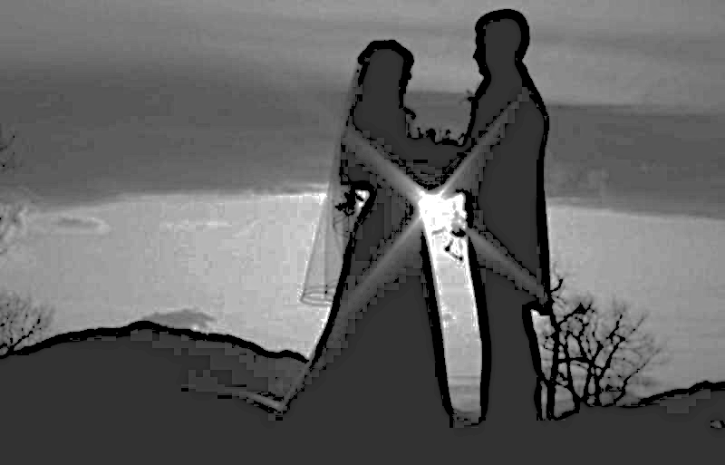
“I take you, ____, to be my wedded husband/wife, to have & to hold from this day forward; for better, or worse; for poorer; in sickness & in health; to love & to cherish, till death do us part, according to God’s holy ordinance; & thereto I pledge my love.”

Slide 3
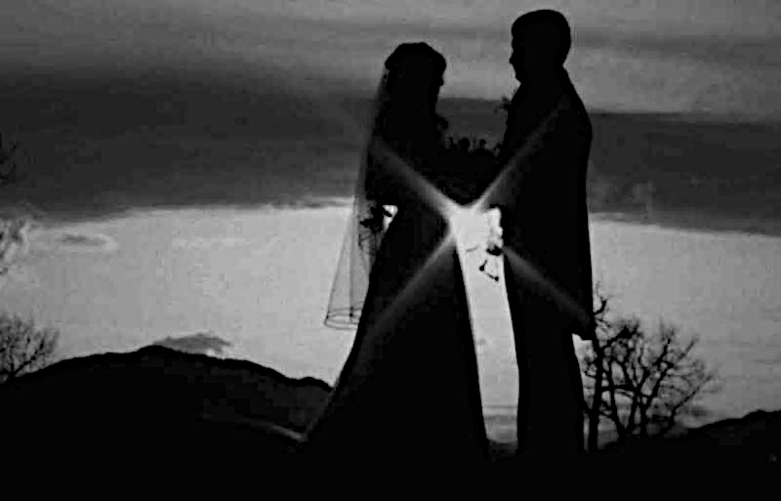
Wives, submit to your own husbands, as to the Lord. For the husband is head of the wife, as also Christ is head of the church; and He is the Savior of the body. (Eph. 5:22-23)

Slide 4
Faithful In ALL Circumstances
Sickness, health, richer, poorer, good times, bad times, joy & sorrow.
We pledged ourselves to Christ to be faithful regardless of ease or difficulty.
Christ has pledged Himself to faithfulness.
Marriage is for life. Rom. 7:1-4
Are we faithful to the vow we made?

Slide 5
Leave And Cleave
Leave all previous attachments.
We can not be bound to Christ & world at the same time. Luke 16:13
If we pledge ourselves to Christ all things are new and better. 2 Cor. 5:17
“Therefore, if anyone is in Christ, he is a new creation; old things have passed away; behold, all things have become new.”

Slide 6
Subject In ALL Things
“Wives, submit to your own husbands, as to the Lord. 23 For the husband is head of the wife, as also Christ is head of the church; and He is the Savior of the body. 24 Therefore, just as the church is subject to Christ, so let the wives be to their own husbands in everything.” (Eph. 5:22-24)

Slide 7
Subject In ALL Things
Jesus is not asking you to do something that He did not do Himself.
Nothing is excluded in this picture of yielding.
We must submit to His will as we forfeit our will.
We ought to obey Christ out of hearts full of love, honor, & respect.
Many have rebelled against Christ and His authority.

Slide 8
Love And Honor
Husbands & wives must love & honor one another. (Ephesians 5:25-29)
There is no question as to Christ’s love for His bride. Eph. 5:25
We can honor Him by keeping ourselves pure & holy. Eph. 5:26-27
Do we contribute to a pure and holy bride?

Slide 9
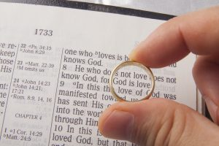
How do people see the bride of Christ through me?

Slide 10
God’s Plan for Your Salvation
Based on God’s GRACE-- Eph. 2:8
Hear the Word of God --John 20:30-31
Believe In Your Heart -- Acts 8:37
Repent Of Your Sins --Luke 13:3, 5
Confess faith in Jesus -- Matt. 10:32-33
Be Baptized Into Christ -- Acts 22:16
Be Faithful Until Death --Rev. 2:10

Slide 11
Faithful in ALL circumstances.
Leave sin behind & Cleave to Him.
Subject to Him in ALL things.
Love & Honor Him with your life.

