Slide 2
The Gospel of Matthew
Chapter 3

Slide 3
The Context
Years have passed between chapters 1-2 and chapter 3
Jesus was born sometime between 7-4 BC
Herod the Great died in 4 BC
The time is specifically defined by Luke:
“Now in the fifteenth year of the reign of Tiberius Caesar, Pontius Pilate being governor of Judea, Herod being tetrarch of Galilee, his brother Philip tetrarch of Iturea and the region of Trachonitis, and Lysanias tetrarch of Abilene, while Annas and Caiaphas were high priests, the word of God came to John the son of Zacharias in the wilderness” (Luke 3:1-2).
Tiberius Caesar reigned from AD 14-37, making this AD 29.
The event of Jesus’s baptism: “Now Jesus Himself began His ministry at about thirty years of age, being (as was supposed) the son of Joseph, the son of Heli” (Luke 3:23).
Somewhere between 25-30 years have passed between chapter 2 and chapter 3.

Slide 4
Jesus’s Childhood
The only incident from Jesus’s childhood (after His presentation in the Temple at 40 days old and Joseph and Mary’s flight to Egypt to protect the child), is the visit to the Temple when He was twelve years old (Luke 2:41-52).

Slide 5
Outline of Chapter 3
John the Baptist is introduced (3:1-6)
John and the Sadducees and Pharisees (3:7-12)
The baptism of Jesus (3:13-17)

Slide 6
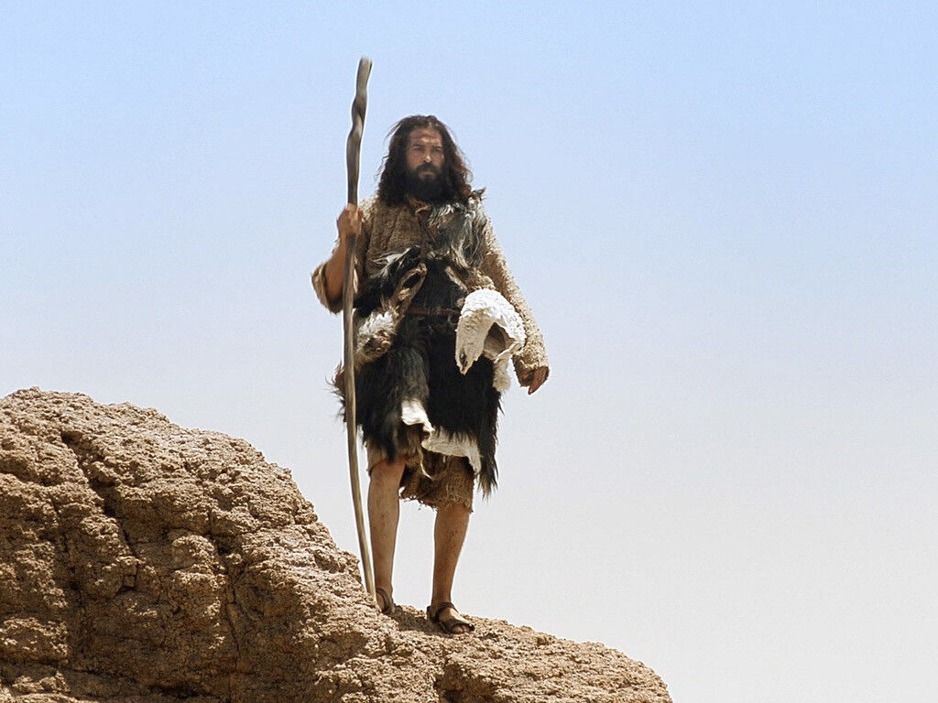
John the Baptist Is Introduced Matthew 3:1-6

Slide 7
John the Baptist
Matthew introduces a new player in the divine plan: John the Baptist.
Matthew did not include the narrative of the birth of John, as did Luke (1:5-25, 39-80)
The parallels to 3:1-6 appear in Mark 1:1-6; Luke 3:1-6

Slide 8
Matthew 3:1
In those days John the Baptist came preaching in the wilderness of Judea. . . .
The wilderness of Judea is not like what we think of when we think of wilderness.
The word erēmos means “an uninhabited region or locality, desert, grassland, wilderness. . . Of the Judean wilderness, the stony, barren eastern declivity of the Judean mountains toward the Dead Sea and lower Jordan Valley” (BDAG, 392).

Slide 9
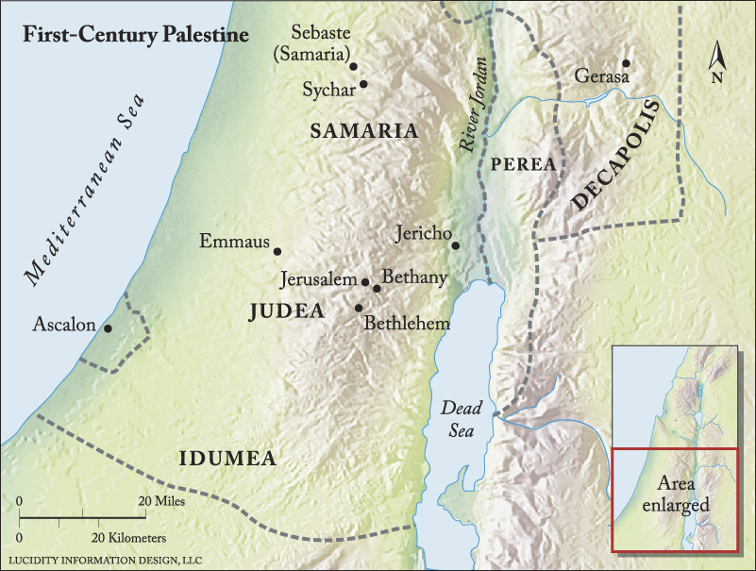

Slide 10
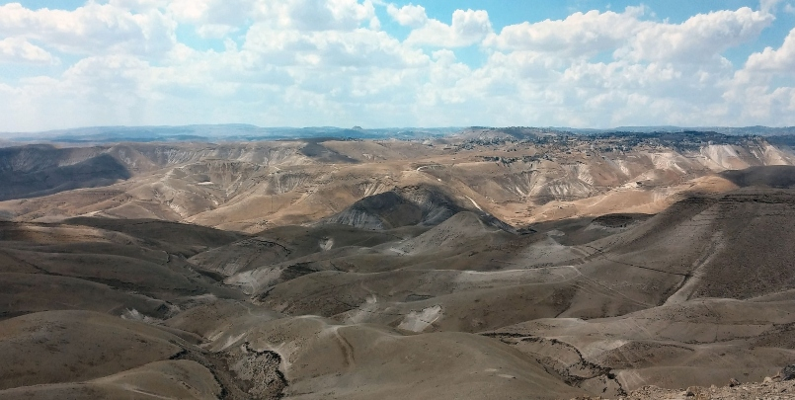
The Wilderness of Judea

Slide 11
Matthew 3:2
and saying, “Repent, for the kingdom of heaven is at hand!”
What is the meaning of the word “repent”?
“Kingdom of Heaven” appears 32 times and only in Matthew.
The phrase “kingdom of God” appears in the NT 69 times, five times in Matthew (6:33; 12:28; 19:24; 21:31, 43).
That the “kingdom of heaven” is the same as the “kingdom of God” is seen by the parallel verses where Matthew uses “kingdom of heaven” and Mark uses “kingdom of God” (Matt. 4:17; Mark 1:15).
The “of Heaven” is another way of saying “God,” used mostly by those Jews who so honored the word Yahweh that they did not use it lest they take the name of the Lord in vain.
Compare how we use “The White House says” to refer to the president.
What does “the kingdom of heaven is at hand” mean?

Slide 12
The Kingdom of Heaven Is at Hand
John the Baptist announces that God was acting in human history to establish the kingdom foretold by the prophets which will never be destroyed (Dan. 2:44; cf. Isa. 2:1-5).

Slide 13
Isaiah 2:1-4
The word that Isaiah the son of Amoz saw concerning Judah and Jerusalem. Now it shall come to pass in the latter days That the mountain of the Lord’s house Shall be established on the top of the mountains, And shall be exalted above the hills; And all nations shall flow to it. Many people shall come and say, “Come, and let us go up to the mountain of the Lord, To the house of the God of Jacob; He will teach us His ways, And we shall walk in His paths.” For out of Zion shall go forth the law, And the word of the Lord from Jerusalem. He shall judge between the nations, And rebuke many people; They shall beat their swords into plowshares, And their spears into pruning hooks; Nation shall not lift up sword against nation, Neither shall they learn war anymore.

Slide 14
And in the days of these kings the God of heaven will set up a kingdom which shall never be destroyed; and the kingdom shall not be left to other people; it shall break in pieces and consume all these kingdoms, and it shall stand forever (Dan. 2:44).

Slide 15
The Kingdom of Heaven Is at Hand
John the Baptist announces that God was acting in human history to establish the kingdom foretold by the prophets which will never be destroyed (Dan. 2:44; cf. Isa. 2:1-5).
The kingdom which plays so prominent a role in Matthew’s gospel has both a “has come” and a “has not yet come” aspect to it.
The “has come” aspect affirms that the kingdom was to be established within the lifetime of those living in Jesus’s day (Mark 9:1).
First century disciples were members of it (John 3:3, 5; Acts 8:12; 19:8; 20:25; 28:23; Col. 1:13; 4:11; 1 Thess. 2:12; Rev. 1:9).
In this perspective, the kingdom of God is the Lord’s church (Matt. 16:18-19).
The “not yet” aspect (Matt. 8:11; 25:1, 14; 2 Pet. 1:11) is because the kingdom of God is an eternal kingdom (Heb. 12:28; 1 Cor. 15:24) yet to be inherited (1 Cor. 6:9-10; 15:50; Gal. 5:21; 2 Thess. 1:5; 2 Tim. 4:1; James 2:5).

Slide 16
Matthew 3:3
For this is he who was spoken of by the prophet Isaiah, saying: “The voice of one crying in the wilderness: ‘Prepare the way of the Lord; Make His paths straight.’”
Matthew affirms that the appearance of John the Baptist was not because John on his own decided to make the announcement. Rather, his appearance and preaching was part of God’s divine plan, foretold by the prophets.

Slide 17
Isaiah 40:3-5
The voice of one crying in the wilderness:
“Prepare the way of the Lord;
Make straight in the desert
A highway for our God.
Every valley shall be exalted
And every mountain and hill brought low;
The crooked places shall be made straight
And the rough places smooth;
The glory of the Lord shall be revealed,
And all flesh shall see it together;
For the mouth of the Lord has spoken.”

Slide 18
Archelaus
Upon the death of Herod the Great, several of his relatives were vying for power. Herod the Great had named Archelaus as his successor.
Archelaus behaved so improperly that a state of unrest developed. Archelaus and his calvary put a stop to it by killing 3000 Jews in the Temple precincts.
The Jews petitioned Augustus not to allow Archelaus to become king. Eventually, he was appointed Ethnarch (higher than Tetrarch, but lower than king) over Judaea, Samaria, and Idumea with the promise that, if he ruled wisely, he could be appointed king at a later date.
He ruled ten years, from 4 BC to AD 6, at which time accusations were made against him and Caesar Augustus removed him from power and put the area under procurators (the office held by Pontius Pilate).

Slide 19
Malachi 3:1
“Behold, I send My messenger, And he will prepare the way before Me. And the Lord, whom you seek, Will suddenly come to His temple, Even the Messenger of the covenant, In whom you delight. Behold, He is coming,” Says the Lord of hosts.
This passage is quoted by Mark with reference to John in 1:5.

Slide 20
Malachi 4:5-6
“Behold, I will send you Elijah the prophet Before the coming of the great and dreadful day of the Lord. And he will turn The hearts of the fathers to the children, And the hearts of the children to their fathers, Lest I come and strike the earth with a curse.”
“And His disciples asked Him, saying, ‘Why then do the scribes say that Elijah must come first?’ Jesus answered and said to them, ‘Indeed, Elijah is coming first and will restore all things. But I say to you that Elijah has come already, and they did not know him but did to him whatever they wished. Likewise the Son of Man is also about to suffer at their hands.’ Then the disciples understood that He spoke to them of John the Baptist” (Matt. 17:10-13).

Slide 21
A Contemporary Expectation
The Dead Sea Essene community refers to these same passages in 1QS 8:12-16; 1QM 1:3; 4QpPsª 3:1; 4QpIsaª 2:18.
Davies and Allison commented: “So an eschatological reading of Isa. 40:3 with reference to activity around the Jordan—ethical activity preparing for the Lord’s coming—just may have been in the air around John’s time. . . .” (I:293).

Slide 22
Matthew 3:3
For this is he who was spoken of by the prophet Isaiah, saying: “The voice of one crying in the wilderness: ‘Prepare the way of the Lord; Make His paths straight.’”
What is said about John’s work from this passage?
Why is “Lord” written with small caps? What does that indicate?
Who is the Lord for whom John prepared the way?
How did John prepare the way of the Lord?

Slide 23
Matthew 3:4
And John himself was clothed in camel’s hair, with a leather belt around his waist; and his food was locusts and wild honey.
Of Elijah: “So they answered him, ‘A hairy man wearing a leather belt around his waist.’ And he said, ‘It is Elijah the Tishbite’” (2 Kings 1:8).
Elisha took up Elijah’s mantle: “He also took up the mantle of Elijah that had fallen from him, and went back and stood by the bank of the Jordan” (2 Kings 2:13).
Even to this day, the garment of camel’s hair is worn by Bedouins; it is rough desert clothing (Davies and Allison, I:295).
John the Baptist resembled Elijah. He is being depicted as the second Elijah, the prophet also foretold in Malachi 3:1; 4:5-6.
His diet:
Locusts were and are still eaten in the Middle East (cf. Lev. 11:20-23 which uses three different Hebrew words to describe locusts that can be eaten).
Wild honey (cf. Judg. 14:8-9; 2 Sam. 14:29, 43)

Slide 24
Matthew 3:5-6
Then Jerusalem, all Judea, and all the region around the Jordan went out to him and were baptized by him in the Jordan, confessing their sins.
John’s primary place of work was in Judea and around the Jordan.
Josephus mentions John’s widespread influence in the region (Antiquities, 18.5.2).
What is the difference in the confession demanded by John and that which the Ethiopian eunuch made (Acts 8:37)?
What does “confessing” sin require?
“And many who had believed came confessing and telling their deeds” (Acts 19:18).
What is wrong with this kind of confession: “I am sorry that you understood me to say that?”

Slide 25
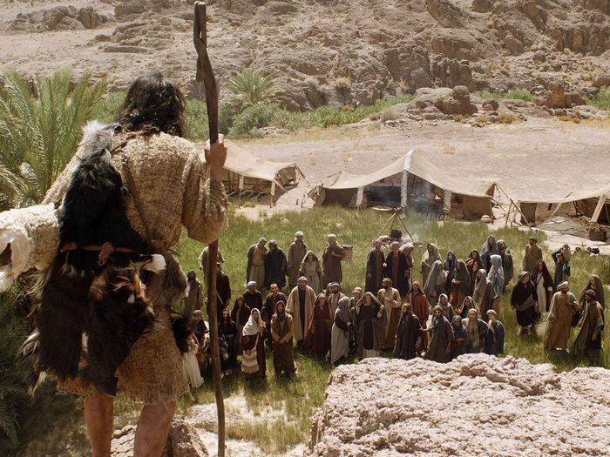
John and the Sadducees & Pharisees Matthew 3:7-12

Slide 26
Matthew 3:7
But when he saw many of the Pharisees and Sadducees coming to his baptism, he said to them, “Brood of vipers! Who warned you to flee from the wrath to come?”
We are introduced here to two powerful groups of people in first century Judaism, neither of which appear in the Old Testament.
Sadducees:
Appear in 14 verses, all in the NT
Best known for their denial of the resurrection of the dead, angels, and spirits (Matt. 22:23; Mark 12:18; Luke 20:27; Acts 23:7-8)
There are no surviving texts from the Sadducees themselves
They did not accept as authoritative the oral traditions of the Pharisees (Josephus, Antiquities of the Jews 13.10.6)
The Sadducees controlled the Temple and usually were more wealthy

Slide 27
Pharisees
The Pharisees are referred to in 85 verses in the NT
They are known, not only from NT references, but also from surviving literature in the Mishnah and Talmuds, the writings of Josephus (who was a Pharisee), etc.
Josephus says that there were about 6000 Pharisees (Antiquities, 17.2.4).
They accepted the passed down interpretations of Scripture as authoritative and confronted Jesus for not following them (Matt. 9:14; 12:2; 15:1ff.)
They controlled most of the synagogues
They were the only group to survive the destruction of Jerusalem and thus, they controlled what interpretation later documents provide for first century Judaism
They were the most popular and highly respected sect of Judaism

Slide 28
John’s Rebuke
What does John call the Sadducees and Pharisees and what does that mean?
Jesus called them the same thing:
“Brood of vipers! How can you, being evil, speak good things? For out of the abundance of the heart the mouth speaks” (Matt. 12:34).
“Serpents, brood of vipers! How can you escape the condemnation of hell?” (Matt. 23:33).
Cf. the mortal danger of snakebites to the spiritual danger of the Serpent of Gen. 3:1 and his offspring.
Why does John instruct them to “flee the wrath that is to come”?
Leon Morris: “The implication is that they had no real repentance but only a desire to escape divine retribution” (The Gospel according to Matthew, 58).
Davies and Allison: “John saw the Jews of his day headed for catastrophe and pleaded with them to make a radical and resolute break with the past” (I:306).
What did John require as a condition for receiving baptism?

Slide 29
The Coming Wrath
How does our modern American world view the idea of God’s wrath?
The phrase “wrath of God” occurs 31 times in the Bible.
“He who believes in the Son has everlasting life; and he who does not believe the Son shall not see life, but the wrath of God abides on him” (John 3:36).
“For the wrath of God is revealed from heaven against all ungodliness and unrighteousness of men, who suppress the truth in unrighteousness” (Rom. 1:18).
“Let no one deceive you with empty words, for because of these things the wrath of God comes upon the sons of disobedience” (Eph. 5:6; Col. 3:6).
“. . . he himself shall also drink of the wine of the wrath of God, which is poured out full strength into the cup of His indignation. He shall be tormented with fire and brimstone in the presence of the holy angels and in the presence of the Lamb” (Rev. 14:10).
Is it proper to use “fear” to motivate someone to obey the gospel?
“Knowing, therefore, the terror of the Lord, we persuade men; but we are well known to God, and I also trust are well known in your consciences” (2 Cor. 5:11).
What made Felix tremble at the preaching of Paul (Acts 24:25)?

Slide 30
Matthew 3:8
Therefore bear fruits worthy of repentance.
What is the difference between repentance and its fruit?
Which is made a condition before baptism can be administered (Acts 2:38)?
What fruits in one’s life are “worthy of repentance”?
Louw-Nida: “doing those things which are appropriate for repentance” or “which correspond to one’s having repented.”

Slide 31
Matthew 3:9
. . . and do not think to say to yourselves, “We have Abraham as our father.” For I say to you that God is able to raise up children to Abraham from these stones.
What belief among the Jews was John opposing?
“They answered and said to Him, ‘Abraham is our father.’ Jesus said to them, ‘If you were Abraham's children, you would do the works of Abraham’” (John 8:39).
“But it is not that the word of God has taken no effect. For they are not all Israel who are of Israel, nor are they all children because they are the seed of Abraham; but, ‘In Isaac your seed shall be called’” (Rom. 9:6-7).
What is a Jewish person to understand from the following: “For I say to you that God is able to raise up children to Abraham from these stones”?
“Then I will sow her for Myself in the earth, And I will have mercy on her who had not obtained mercy; Then I will say to those who were not My people, ‘You are My people!’ And they shall say, ‘You are my God!’” (Hos. 2:23; cf. Rom. 9:25).

Slide 32
Matthew 3:10
And even now the ax is laid to the root of the trees. Therefore every tree which does not bear good fruit is cut down and thrown into the fire.
What does “the ax is laid to the root of the trees” mean?
Cf. to trimming the tree of dead branches
Jesus’s parable of the unfruitful fig tree: “He also spoke this parable: A certain man had a fig tree planted in his vineyard, and he came seeking fruit on it and found none. Then he said to the keeper of his vineyard, ‘Look, for three years I have come seeking fruit on this fig tree and find none. Cut it down; why does it use up the ground?’ But he answered and said to him, ‘Sir, let it alone this year also, until I dig around it and fertilize it. And if it bears fruit, well. But if not, after that you can cut it down’” (Luke 13:6-9; cf. Matt. 7:19).
What does even now (ēdē) mean?
What is John saying about Israel?

Slide 33
Luke 3:10-14
So the people asked him, saying, “What shall we do then?” He answered and said to them, “He who has two tunics, let him give to him who has none; and he who has food, let him do likewise.” Then tax collectors also came to be baptized, and said to him, “Teacher, what shall we do?” And he said to them, “Collect no more than what is appointed for you.” Likewise the soldiers asked him, saying, “And what shall we do?” So he said to them, “Do not intimidate anyone or accuse falsely, and be content with your wages.”

Slide 34
Speculation: Is John the Messiah?
Now as the people were in expectation, and all reasoned in their hearts about John, whether he was the Christ or not, John answered, saying to all, “I indeed baptize you with water; but One mightier than I is coming, whose sandal strap I am not worthy to loose. He will baptize you with the Holy Spirit and fire” (Luke 3:15-16).

Slide 35
Matthew 3:11-12
I indeed baptize you with water unto repentance, but He who is coming after me is mightier than I, whose sandals I am not worthy to carry. He will baptize you with the Holy Spirit and fire. His winnowing fan is in His hand, and He will thoroughly clean out His threshing floor, and gather His wheat into the barn; but He will burn up the chaff with unquenchable fire.

Slide 36
Three Baptisms
John’s Water Baptism | Jesus’s Holy Spirit Baptism | Jesus’s Baptism of Fire
Administered by John | Administered by the One Coming after John: Jesus | Administered by the One Coming after John: Jesus
 | John: “He is mightier than I and I am unworthy to carry His sandals” | John: “He is mightier than I and I am unworthy to carry His sandals”
A baptism leading one to repentance
For the forgiveness of sins (Mark 1:4; Luke 3:3)

Slide 37
Matthew 3:12
His winnowing fan is in His hand, and He will thoroughly clean out His threshing floor, and gather His wheat into the barn; but He will burn up the chaff with unquenchable fire.

Slide 38
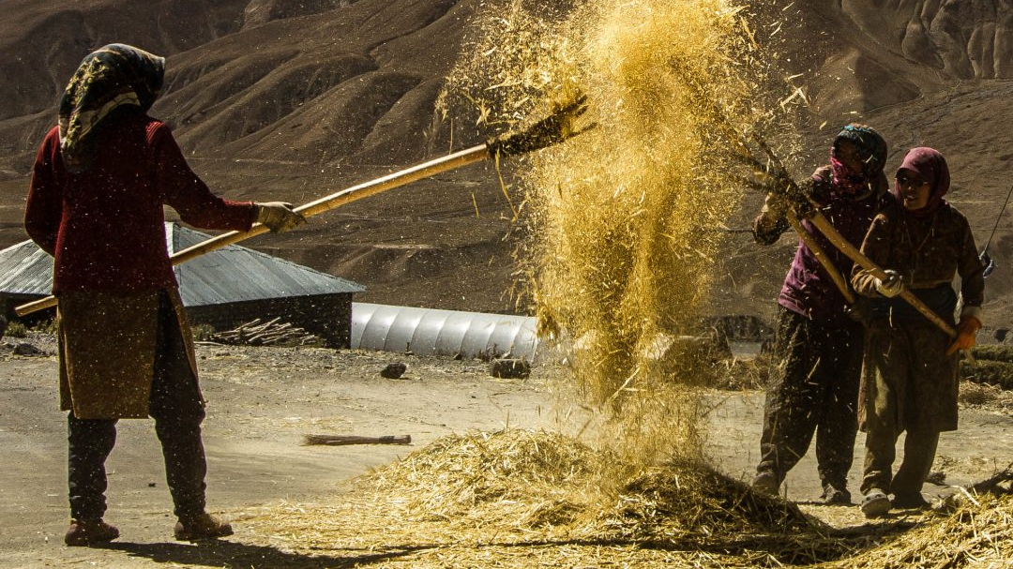

Slide 39
A Coming Separation
Separating the grain from the chaff
The grain is placed in the barn: this represents those who are saved.
The chaff is collected together and burned: this represents those who will be eternally lost.
The fire is unquenchable (asbestos): inextinguishable (cf. Mark 9:43, 45). Other passages speak of a fire of God’s wrath that is never quenched (Isa. 34:10; 66:24; Jer. 7:20).

Slide 40
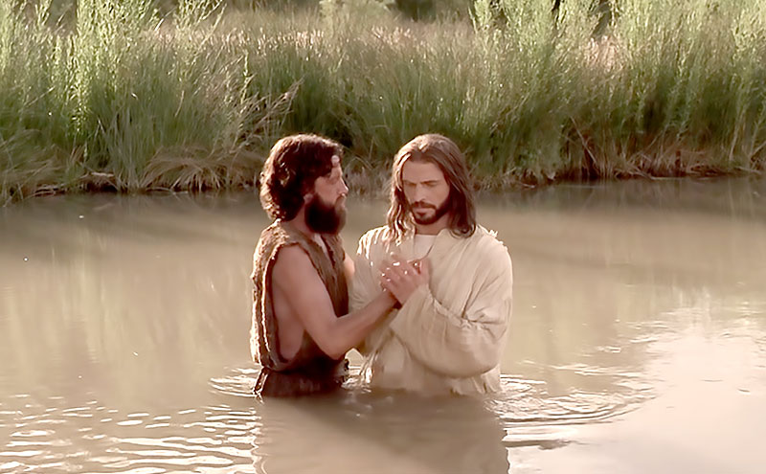
The Baptism of Jesus Matthew 3:13-17

Slide 41
Matthew 3:13-17
Then Jesus came from Galilee to John at the Jordan to be baptized by him. And John tried to prevent Him, saying, “I need to be baptized by You, and are You coming to me?” But Jesus answered and said to him, “Permit it to be so now, for thus it is fitting for us to fulfill all righteousness.” Then he allowed Him. When He had been baptized, Jesus came up immediately from the water; and behold, the heavens were opened to Him, and He saw the Spirit of God descending like a dove and alighting upon Him. And suddenly a voice came from heaven, saying, “This is My beloved Son, in whom I am well pleased.”

Slide 42
The Significance of the Baptism of Jesus
Jesus going out to be baptized by John the Baptist is treated in the synoptic gospels as a turning point—the moment in Jesus’s life at which He ceased to be a private citizen, a carpenter’s son, and began His appointed mission for being in the world.
Therefore, it was a decisive event marked by the descent of the Holy Spirit upon Jesus in a public manner witnessed by John the Baptist and others gathered to hear John preach and marked by such passages as the following:
“. . . beginning from the baptism of John to that day when He was taken up from us, one of these must become a witness with us of His resurrection” (Acts 1:22).
“. . . how God anointed Jesus of Nazareth with the Holy Spirit and with power, who went about doing good and healing all who were oppressed by the devil, for God was with Him” (Acts 10:38).

Slide 43
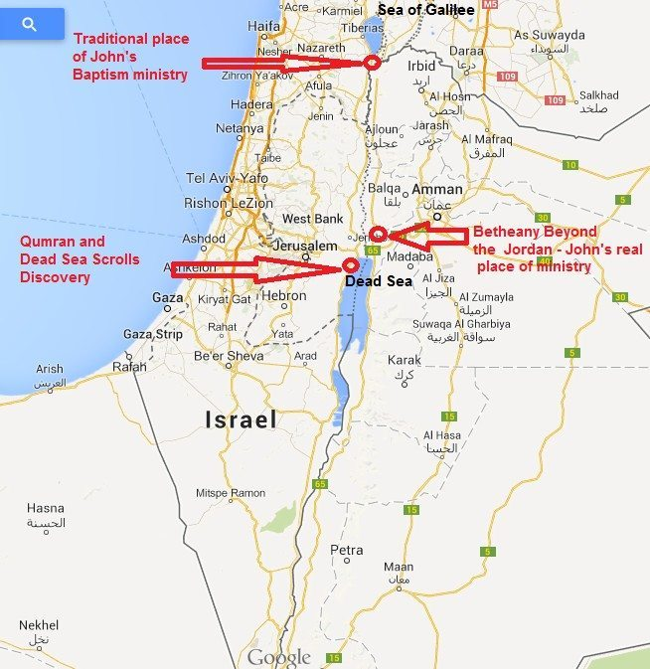
Map of Baptist of Jesus

Slide 44
Yardenit: Traditional Site for Jesus’s Baptism

Slide 45
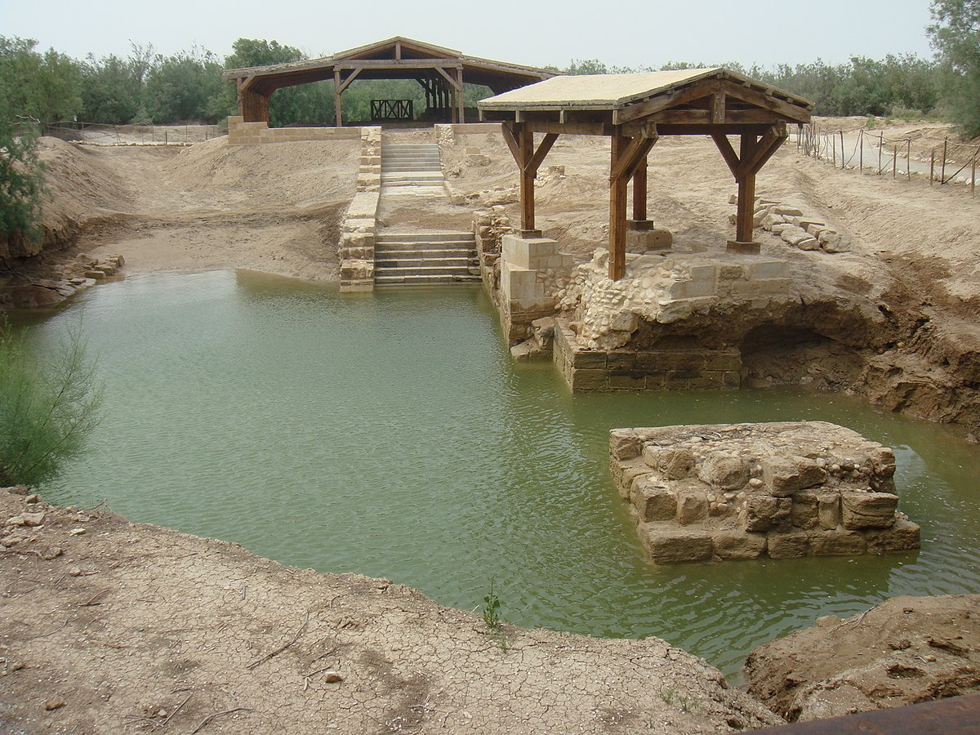
Bethany beyond the Jordan, where others think that Jesus was baptized.

Slide 46
Matthew 3:13
Then Jesus came from Galilee to John at the Jordan to be baptized by him.
Mark 1:9 explicitly says that Jesus came from Nazareth to be baptized by John.
The Greek word baptizō means “to immerse” (TDNT, 1:530). Liddell and Scott define the word as “dip, plunge” (305).
The English definition of “baptize” is this: “to immerse in water or sprinkle or pour water on in the Christian rite of baptism.”
The modern translators of the Greek word baptizō decided to transliterate (to change the letters from one language into the corresponding letters in another language) rather than to translate (to turn from one language into another or from a foreign language into one’s own) the word, which enabled them to avoid taking a stance on the action of Christian baptism (sprinkling, pouring, or immersion).

Slide 47
Matthew 3:14
And John tried to prevent Him, saying, “I need to be baptized by You, and are You coming to me?”
Jesus and John were related; Mary and Elizabeth were cousins (Luke 1:36). The presumption is that John knew his cousin Jesus. John was six months older than Jesus (Luke 1:36).
John had just said, “I indeed baptize you with water unto repentance, but He who is coming after me is mightier than I, whose sandals I am not worthy to carry. He will baptize you with the Holy Spirit and fire” (3:11), so we are not surprised by his statement.
His baptism was temporary and anticipatory.
He seems to think that the temporary should give way to that which it anticipates.

Slide 48
Matthew 3:15
But Jesus answered and said to him, “Permit it to be so now, for thus it is fitting for us to fulfill all righteousness.” Then he allowed Him.
These are the first words from Jesus’s lips in Matthew’s gospel.
Read Matthew 21:23-27.
If John’s baptism was “from heaven,” what was man’s obligation toward that baptism?
John Nolland: “Both John’s baptism of Jesus and Jesus’ submission to baptism at the hands of John (note the use of ‘for us’) are identified as having their part to play in the unfolding of God’s purpose. According to Jesus, this act of baptism administered and received strikes a fitting opening note (πρέπον ἐστιν [‘it is fitting’]) for the role to which he is called in the present period. It is not the baptism alone which ‘fulfil[s] all righteousness’; rather, the baptism constitutes the opening move of an unfolding sequence designed (building on John’s existing efforts) ‘to fulfil all righteousness’” (The Gospel of Matthew: A Commentary on the Greek Text, 153).

Slide 49
To Fulfill All Righteousness
What made Jesus’s baptism a problem for John and for a consistent theology of Jesus?
Passages that teach that Jesus was sinless (Isa. 53:9; John 8:46; 2 Cor. 5:21; 1 Pet. 2:22; 3:18; Heb. 4:15; 7:26; 9:14; 1 John 3:5).
There is no question that Jesus is superior to John, though some may have imagined John was superior because Jesus was baptized by John.
Jesus’s submission to baptism:
Showed His identification with men.
Provided an example for others to follow.
Demonstrates Jesus’s humility
As a result of Jesus’s answer, John yielded.

Slide 50
Matthew 3:16-17
When He had been baptized, Jesus came up immediately from the water; and behold, the heavens were opened to Him, and He saw the Spirit of God descending like a dove and alighting upon Him. And suddenly a voice came from heaven, saying, “This is My beloved Son, in whom I am well pleased.”
This is one of several passages of Scripture that mention the Father, Son, and Holy Spirit:
The Father: a voice from heaven, “My,” “I”
The Holy Spirit: coming from heaven to earth in bodily form like a dove
Jesus: in the water, “beloved Son”

Slide 51
Matthew 3:16
When He had been baptized, Jesus came up immediately from the water; and behold, the heavens were opened to Him, and He saw the Spirit of God descending like a dove and alighting upon Him.
Note what baptism required:
Going down into the water (one cannot come up out of what he never went down into)
Coming up out of the water.
The definition of “baptize” is “to immerse.”
Note the words “immediately” and “and behold” which mark off these events as important.

Slide 52
The Symbolism
The “heavens were opened” reminds one of other revelation scenes (John 1:51; Acts 7:56; 10:11; Rev. 19:11).
The prophecy of the Spirit coming to the Messiah.
The OT judges (Judg. 3:10; 6:34) and prophets (2 Chon. 15:1; 20:14) were empowered by the Holy Spirit.
“The Spirit of the Lord God is upon Me, Because the Lord has anointed Me To preach good tidings to the poor; He has sent Me to heal the brokenhearted, To proclaim liberty to the captives, And the opening of the prison to those who are bound” (Isa. 61:1).
“. . .that word you know, which was proclaimed throughout all Judea, and began from Galilee after the baptism which John preached: how God anointed Jesus of Nazareth with the Holy Spirit and with power, who went about doing good and healing all who were oppressed by the devil, for God was with Him” (Acts 10:37-38).
Why “a dove” (and not a hawk, a buzzard, a woodpecker)?

Slide 53
Matthew 3:17
And suddenly a voice came from heaven, saying, “This is My beloved Son, in whom I am well pleased.”
“Son of God” can be used in at least three senses: (a) “we are all sons of God through faith” (Gal. 3:26); (b) affirming the deity of Jesus; (c) a synonym of Messiah/Christ (Matt. 16:16; 26:63; 27:43). How is it used in this verse?
“Beloved Son” is used at the baptism of Jesus and again at His transfiguration (Matt. 17:5; 2 Pet. 1:17).
Isaac is described as Abraham’s son “whom you love” (Gen. 22:2), “your son, your only son” (Gen. 22:12), “only begotten son” (Heb. 11:17).
“By faith Abraham, when he was tested, offered up Isaac, and he who had received the promises offered up his only begotten son, of whom it was said, ‘In Isaac your seed shall be called,’ concluding that God was able to raise him up, even from the dead, from which he also received him in a figurative sense” (Heb. 11:17-19).
How would this event shape both Jesus’s own view of who He was and also that of his disciples’ view of who He was?

Slide 54
In Whom I Am Well Pleased
These words bear significance because of the outcome of the life of this man.
The Jewish High Priest Caiaphas judged Jesus at His trial: “But Jesus kept silent. And the high priest answered and said to Him, ‘I put You under oath by the living God: Tell us if You are the Christ, the Son of God!’ Jesus said to him, ‘It is as you said. Nevertheless, I say to you, hereafter you will see the Son of Man sitting at the right hand of the Power, and coming on the clouds of heaven.’ Then the high priest tore his clothes, saying, ‘He has spoken blasphemy! What further need do we have of witnesses? Look, now you have heard His blasphemy! What do you think?’ They answered and said, ‘He is deserving of death’” (Matt. 26:63-66).
But God’s assessment of Jesus was this: “in whom I am well pleased!”

Slide 55
John the Baptist’s Testimony
“John bore witness of Him and cried out, saying, ‘This was He of whom I said, “He who comes after me is preferred before me, for He was before me.”’ And of His fullness we have all received, and grace for grace. For the law was given through Moses, but grace and truth came through Jesus Christ. No one has seen God at any time. The only begotten Son, who is in the bosom of the Father, He has declared Him” (John 1:15-18).

Slide 56
John the Baptist’s Testimony
“The next day John saw Jesus coming toward him, and said, ‘Behold! The Lamb of God who takes away the sin of the world! This is He of whom I said, “After me comes a Man who is preferred before me, for He was before me.” I did not know Him; but that He should be revealed to Israel, therefore I came baptizing with water.’ And John bore witness, saying, ‘I saw the Spirit descending from heaven like a dove, and He remained upon Him. I did not know Him, but He who sent me to baptize with water said to me, “Upon whom you see the Spirit descending, and remaining on Him, this is He who baptizes with the Holy Spirit.” ‘And I have seen and testified that this is the Son of God’” (John 1:29-34).

