Slide 1
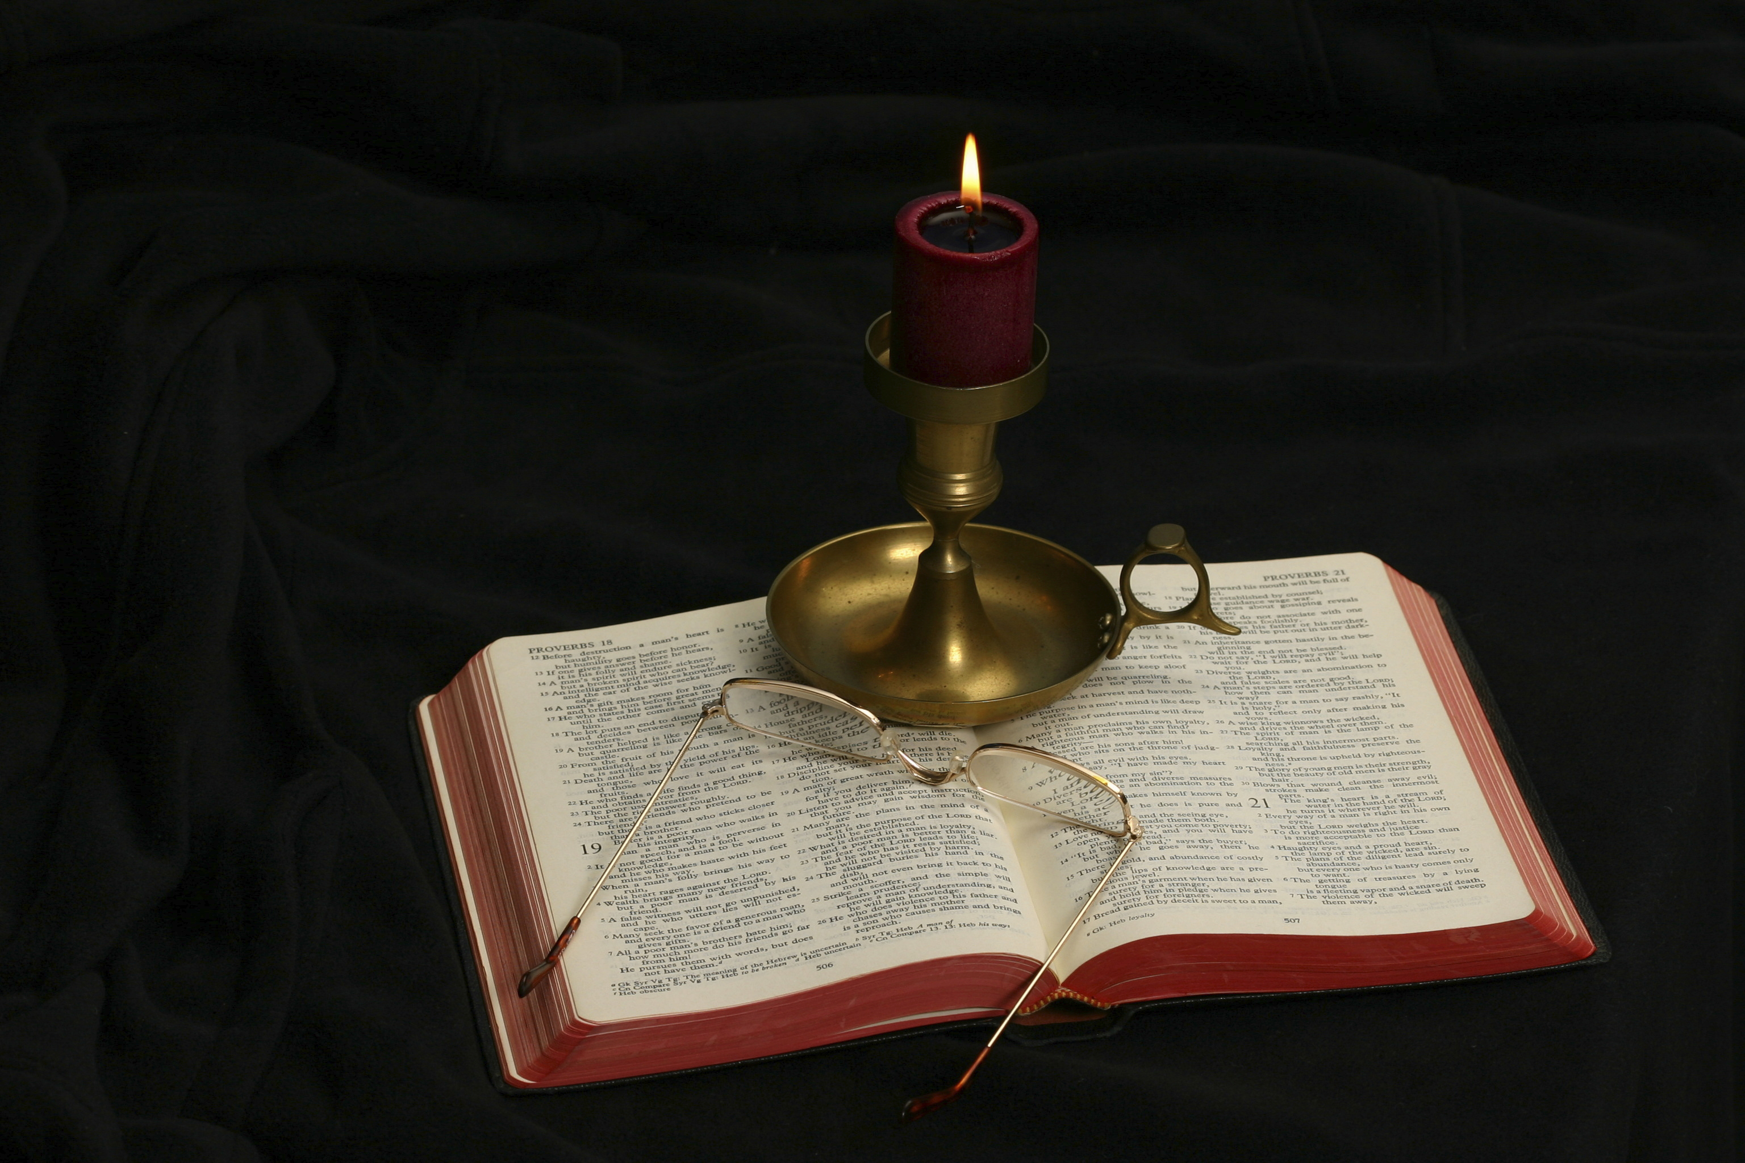
The Gospel of Matthew
Chapter 18

Slide 2
Chapter 18
This chapter contains the fourth sermon in Matthew’s gospel:
Sermon on the Mount (Matt. 5-7)
The Missionary Discourse (Matt. 10:5-42)
Sermon on the Parables (Matt. 13)
Sermon on Relationships Among the Disciples (Matt. 18)

Slide 3
Outline of Chapter 18
Teaching on relationship among the disciples (18:1-35)
Who is the Greatest? (18:1-5)
Temptations to Sin (18:6-9)
The Parable of the Lost Sheep (18:10-14)
If Your Brother Sins Against You (18:15-20)
The Parable of the Unforgiving Servant (18:21-35)

Slide 4
Who Is the Greatest? Matthew 18:1-5
At that time the disciples came to Jesus, saying, “Who is the greatest in the kingdom of heaven?” And calling to him a child, he put him in the midst of them and said, “Truly, I say to you, unless you turn and become like children, you will never enter the kingdom of heaven. Whoever humbles himself like this child is the greatest in the kingdom of heaven. Whoever receives one such child in my name receives me, but whoever causes one of these little ones who believe in me to sin, it would be better for him to have a great millstone fastened around his neck and to be drowned in the depth of the sea.”

Slide 5
Matthew 18:1
“At that time the disciples came to Jesus, saying, ‘Who is the greatest in the kingdom of heaven?’”
Mark’s introduction to this section: “And they came to Capernaum. And when he was in the house he asked them, ‘What were you discussing on the way?’ But they kept silent, for on the way they had argued with one another about who was the greatest” (9:33-34).
The question is introduced by the particle ara which is defined as “frequently in questions which draw an inference from what precedes; but often simply to enliven the question” (BDAG, 127). The particle is usually passed over in translation, but the NKJV uses “then.”
Greatest (meizōn): the Greek adjective is in the comparative form (greater) used with the superlative meaning (greatest) (BDAG, 624).
Given the Catholic interpretation of Matthew 16:13-19, one would expect the answer to be simple, “Peter!”

Slide 6
Least and Greatest
“Therefore whoever relaxes one of the least of these commandments and teaches others to do the same will be called least in the kingdom of heaven, but whoever does them and teaches them will be called great in the kingdom of heaven” (Matt. 5:19).
“Truly, I say to you, among those born of women there has arisen no one greater than John the Baptist. Yet the one who is least in the kingdom of heaven is greater than he” (Matt. 11:11).

Slide 7
Kingdom of Heaven
Kingdom of heaven appears four times in this chapter (18:1, 3, 4, 23). In each of them, it is referring to the Kingdom while it is present on earth:
“At that time the disciples came to Jesus, saying, ‘Who is the greatest in the kingdom of heaven?’” (18:1).
“. . .and said, ‘Truly, I say to you, unless you turn and become like children, you will never enter the kingdom of heaven’” (18:3).
“Whoever humbles himself like this child is the greatest in the kingdom of heaven” (18:4).
“Therefore the kingdom of heaven may be compared to a king who wished to settle accounts with his servants” (18:23).
In the midst of speaking of the kingdom of heaven, Jesus inserts “tell it to the church. . . refuses to listen to the church” (18:17), making the “kingdom of heaven” = to the church (cf. Matt. 16:18-19).

Slide 8
Matthew 18:2
“And calling to him a child, he put him in the midst of them. . .”
Calling (proskaleō) is used in the sense of “summon, call on, call to oneself” (BDAG, 881).
Child (paidion): “very young child, infant, used of boys and girls . . . Child with reference to age” (BDAG, 749).
Jesus uses the child to teach an object lesson, almost an enacted parable.

Slide 9
Matthew 18:3
“. . . and said, ‘Truly, I say to you, unless you turn and become like children, you will never enter the kingdom of heaven.
Truly, I say to you appears 68 times in the four gospels, 20 of which are “Truly, truly, I say unto you” in John’s gospel. It is a solemn formula of affirmation. What is the significance of this phrase?
Turn (KJV: “be converted”) is from strephō: The word is a passive form with an active sense (as the later translations confirm); it has the sense of turn “for the better: make a turn-about, turn around” (BDAG, 948-949).
The thing they must change is their preoccupation with status (Blomberg, 273), “who is the greatest?”
One thinks of the lesson Jesus taught when He washed the apostles’ feet.
In what sense must one become “like children”?

Slide 10
Matthew 18:4
“Whoever humbles himself like this child is the greatest in the kingdom of heaven.”
Humble (tapeinoō): “to cause to be or become humble in attitude, humble, make humble in a favorable sense” (BDAG, 990).
Leon Morris: “The kingdom of heaven is not like earthly kingdoms. In earthly kingdoms military might or earthly wealth is what counts. It is the ability to overthrow others or to outsmart them or to outbid them that matters. The person who asserts himself is the one who gets on. But Jesus’ kingdom is quite different. Paradoxically it is the person who is like the little child who is the greatest. Being in the kingdom does not mean entering a competition for the supreme place, but engaging in lowly service. True greatness consists not in receiving service but in giving it. The genuinely humble person is the one that really counts in that kingdom” (The Gospel according to Matthew, The Pillar New Testament Commentary, 460).
The child is humble by his natural state; what one must become is a deliberately chosen kind of humility. Jesus’s disciple must exchange self-assertion for self-chosen subordination.

Slide 11
Matthew 18:5
“Whoever receives one such child in my name receives me.”
Receive (dechomai): “to be receptive of someone, receive, welcome” (BDAG, 221).
Craig Blomberg: “Jesus has in mind people who welcome disciples because they accept their message and thus become disciples themselves” (Matthew, The New American Commentary, 274).
Matthew 25:35-40 makes the point that how one treats a disciple is tantamount to how they treat Jesus.

Slide 12
Temptations to Sin Matthew 18:6-9
“. . . but whoever causes one of these little ones who believe in me to sin, it would be better for him to have a great millstone fastened around his neck and to be drowned in the depth of the sea. Woe to the world for temptations to sin! For it is necessary that temptations come, but woe to the one by whom the temptation comes! And if your hand or your foot causes you to sin, cut it off and throw it away. It is better for you to enter life crippled or lame than with two hands or two feet to be thrown into the eternal fire. And if your eye causes you to sin, tear it out and throw it away. It is better for you to enter life with one eye than with two eyes to be thrown into the hell of fire.”

Slide 13
Observations about This Paragraph
I checked four translations and no two of them divide the paragraphs in the same place.
Verses 5-6 are kept together in the NIV and ESV, but the United Bible Society Greek New Testament separates them.
The theme shifts in v. 6 to those who cause someone to sin in contrast to the welcoming of those little ones of 18:4-5.
The paragraph uses the verb skandalizō (“cause to sin”) three times in vv. 6, 8, 9 and the noun skandalon (“temptation to sin”) in v. 7, making it a key thought binding these verses together.
Paul’s letters (1 Cor. 8-10; Rom. 14:1-15:7) show an awareness of Jesus’s teaching in this section.

Slide 14
Matthew 18:6
“. . .but whoever causes one of these little ones who believe in me to sin, it would be better for him to have a great millstone fastened around his neck and to be drowned in the depth of the sea.”
How is “little ones” used in this verse?
Note the transition from literal “child” to spiritual children.
How would you characterize the seriousness of doing something that causes another Christian to sin?
What could happen to a person that is worse than having a great millstone fastened to one’s neck and drowned in the sea (an immediate and certain death) be?

Slide 15
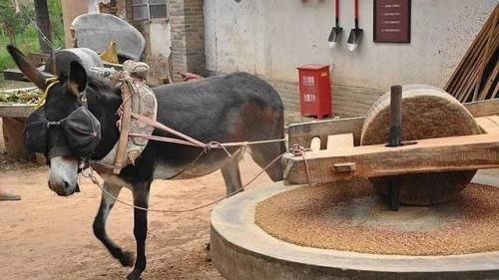

Slide 16
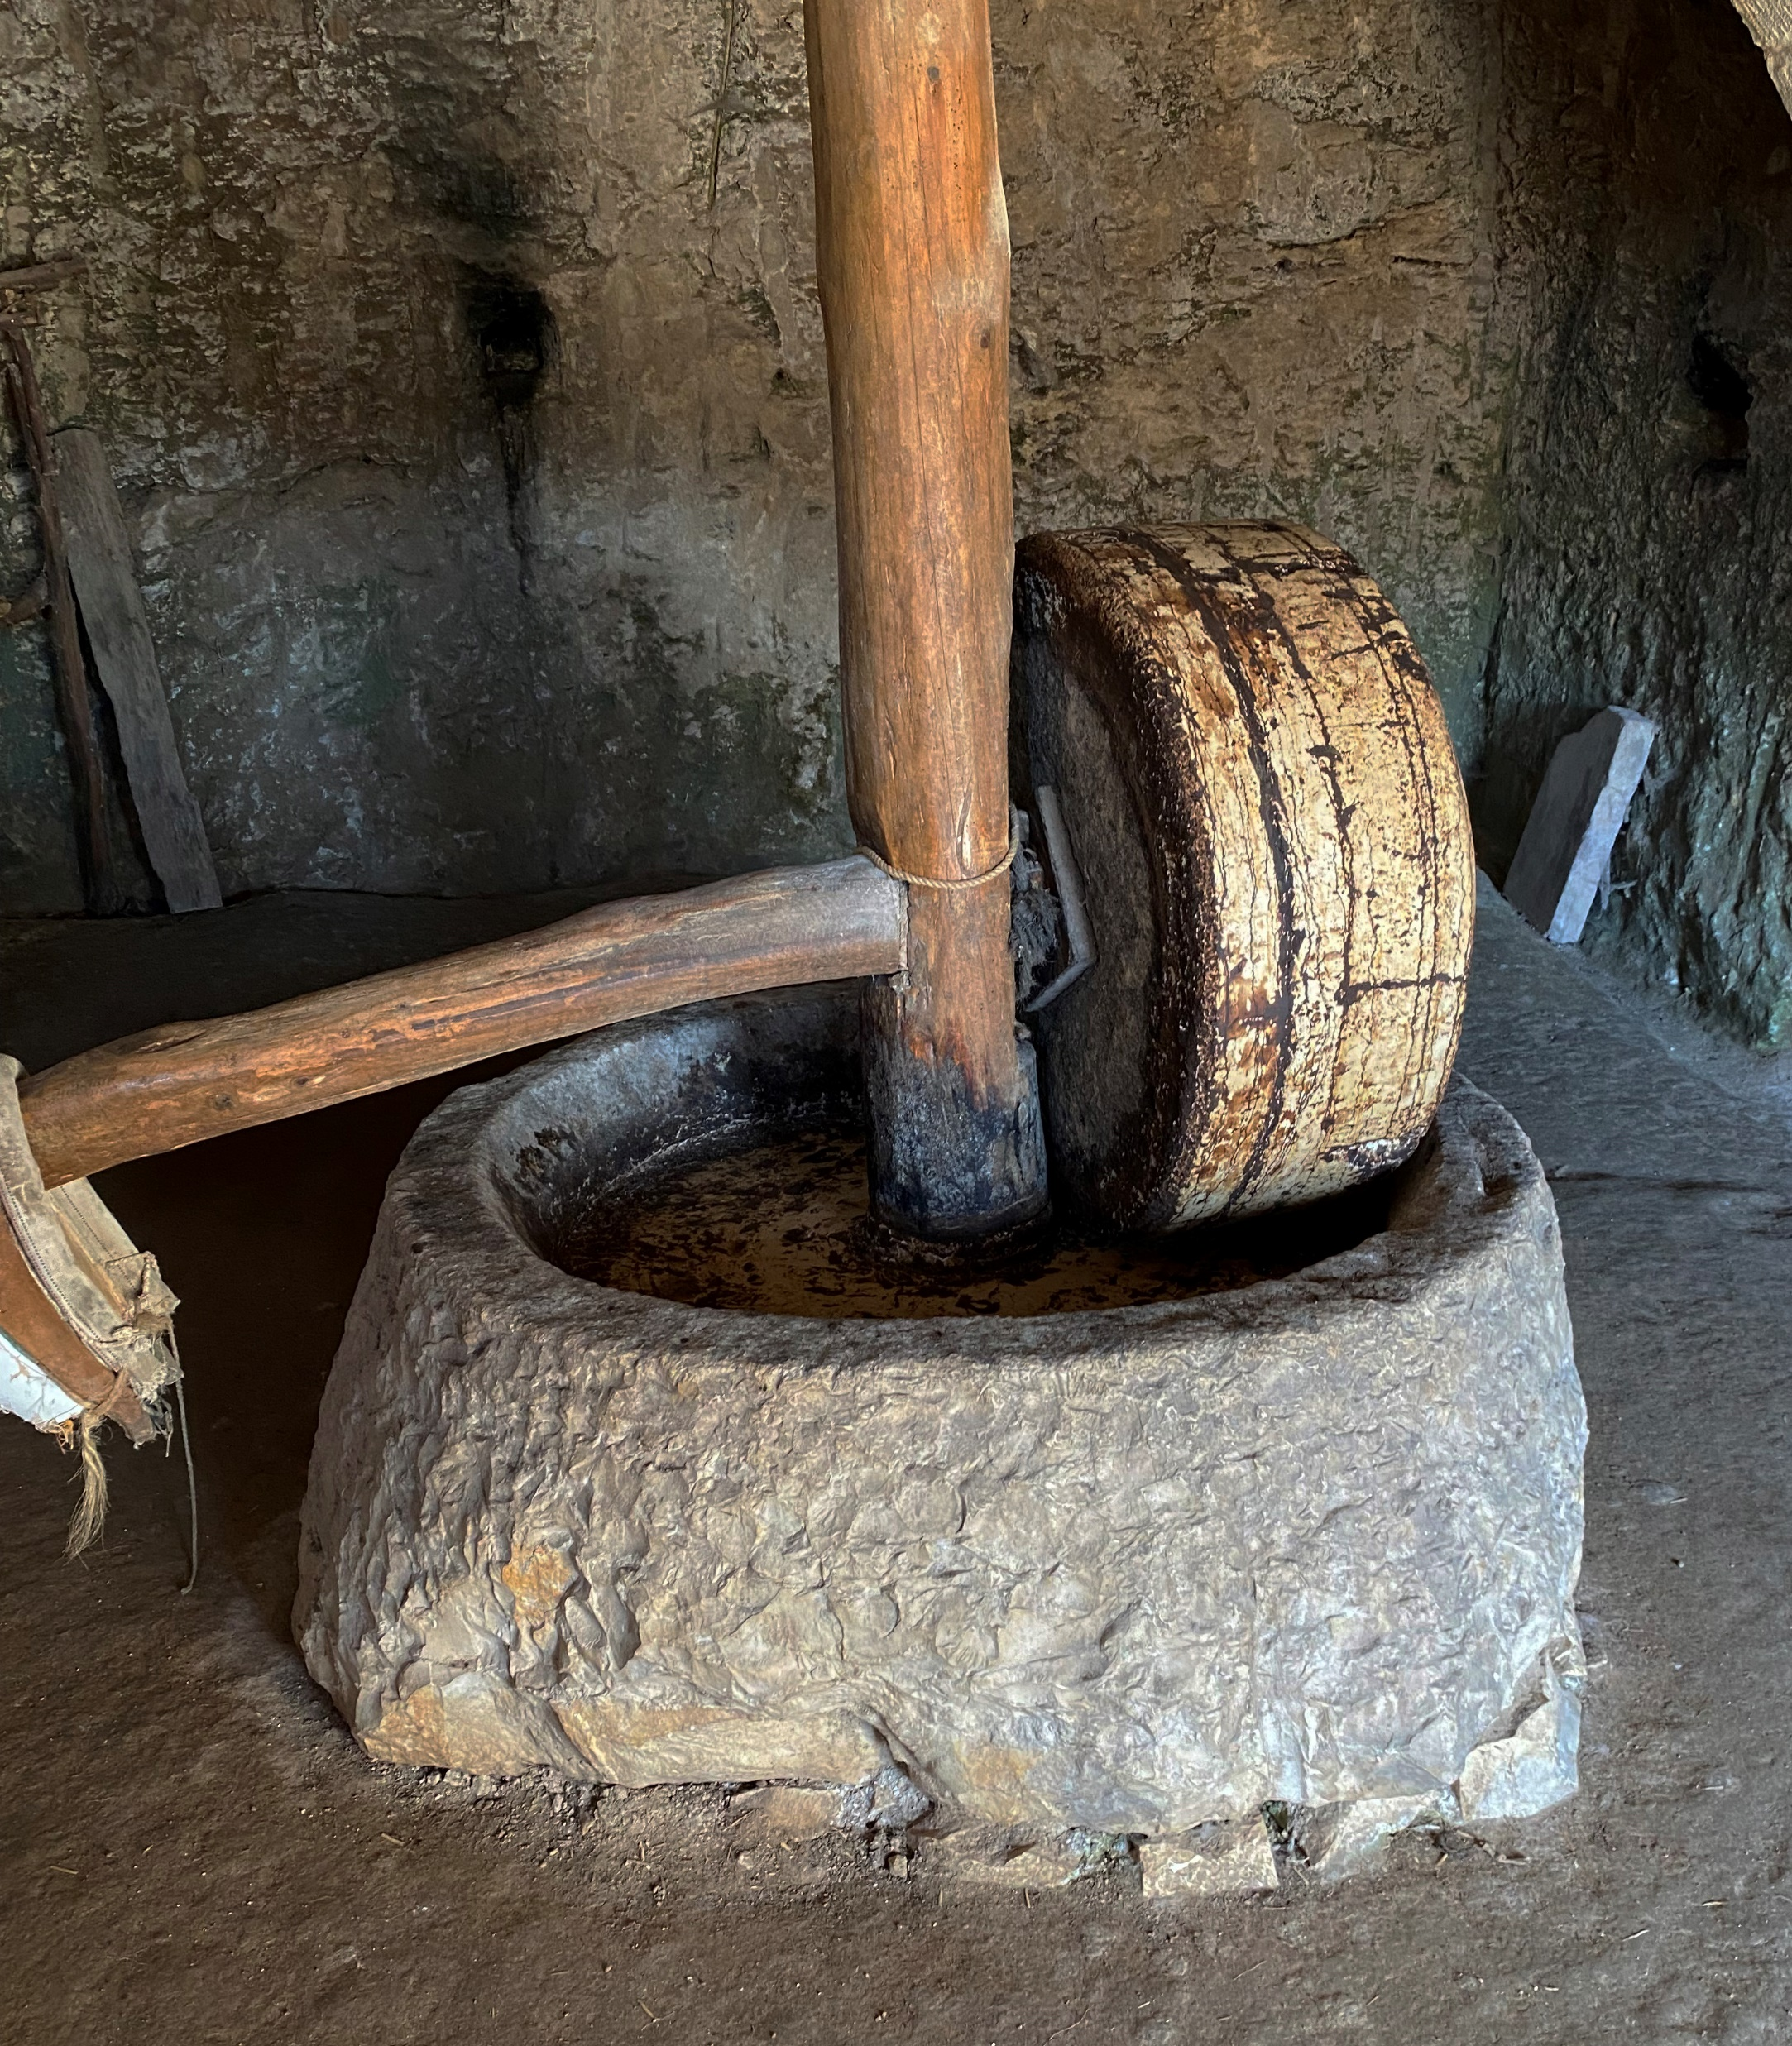
Millstone from Nazareth Village, Israel

Slide 17
Matthew 18:7
“Woe to the world for temptations to sin! For it is necessary that temptations come, but woe to the one by whom the temptation comes!”
What is the meaning of “woe”?
Ouai an “interjection denoting pain or displeasure, woe, alas” (BDAG, 734).
It corresponds to the suffering mentioned in v. 6.
What are temptations?
Skandalon: “an action or circumstances that leads one to act contrary to a proper course of action or set of beliefs, temptation to sin, enticement to apostasy, false belief” (BDAG, 926).
What are some examples of temptations?
Leon Morris: “The sinner is in trouble because of the evil he does, and the person who leads another into sin is in a worse position, as Jesus is now saying” (The Gospel according to Matthew, The Pillar New Testament Commentary, 462).

Slide 18
Temptations
What is the sense of “for it is necessary that temptations come”?
Necessary (anagkē): “necessity or constraint as inherent in the nature of things” (BDAG, 60).
“And he said to his disciples, ‘Temptations to sin are sure to come, but woe to the one through whom they come!’” (Luke 17:1).
When was the first temptation in human history?
How long will there continue to be temptations?
How does knowledge of this affect one’s individual responsibility for falling into temptations?
How does recognition of this fact affect. . .
How we live?
How we raise our children?

Slide 19
Matthew 18:8-9
And if your hand or your foot causes you to sin, cut it off and throw it away. It is better for you to enter life crippled or lame than with two hands or two feet to be thrown into the eternal fire. And if your eye causes you to sin, tear it out and throw it away. It is better for you to enter life with one eye than with two eyes to be thrown into the hell of fire.
Jesus said much the same in the Sermon on the Mount (5:29-30).
What are these two verses teaching?
Do we act like we believe this?
What is the meaning of “enter life”?
What is the opposite of “life” called in these verses?
How long does “hell” last?

Slide 20
The Parable of the Lost Sheep Matthew 18:10-14
“See that you do not despise one of these little ones. For I tell you that in heaven their angels always see the face of my Father who is in heaven. What do you think? If a man has a hundred sheep, and one of them has gone astray, does he not leave the ninety-nine on the mountains and go in search of the one that went astray? And if he finds it, truly, I say to you, he rejoices over it more than over the ninety-nine that never went astray. So it is not the will of my Father who is in heaven that one of these little ones should perish.”

Slide 21
Matthew 10:10
“See that you do not despise one of these little ones. For I tell you that in heaven their angels always see the face of my Father who is in heaven.”
Who are intended by “these little ones”?
What is the second sentence in this verse saying?
“See the face of my Father” = have access to the Father
What is the significance of “my Father who is in heaven”?
Jesus is aware of any act that is done to one of His disciples, even the weakest one (Matt. 25:31-45; Acts 9:4).

Slide 22
Do We Despise One of These Little Ones?
Despise (kataphroneō): “to look down on someone or something with contempt or aversion, with implication that one considers the object of little value, look down on, despise, scorn, treat with contempt” (BDAG, 529).
John Nolland: “. . . to despise the little ones here is to treat as of no real significance the loss to the Christian community of one of them who has been led astray” (The Gospel of Matthew: A Commentary on the Greek Text, New International Greek Testament Commentary, 741).
How does this church treat those “little ones” (weak Christians)? Do we look down upon them?
Do we follow the instructions of vv. 12-17 to save them when they wander away?

Slide 23
Guardian Angels?
The thought of guardian angels stems from Psa. 34:7; 91:11. It resulted in Jewish belief in guardian angels for each person.
Read Psalms 91 and 34.
“Are they not all ministering spirits sent out to serve for the sake of those who are to inherit salvation?” (Heb. 1:14).
It is impossible for us to know whether or not each individual is protected by his own personal angel; what is more likely is that God uses His angels to provide the protection God commands them to provide.

Slide 24
(Matthew 18:11)
(“For the Son of Man came to save the lost.”)
“The words ‘For the Son of Man came (to seek and) to save the lost’ are absent from the earliest manuscripts representing several textual types (Alexandrian, Egyptian, Antiochian) and are taken from Luke 19:10. These words were apparently added in order to provide a connection between v. 10 and vv. 12–14” (Roger L. Omanson and Bruce Manning Metzger, A Textual Guide to the Greek New Testament: An Adaptation of Bruce M. Metzger’s Textual Commentary for the Needs of Translators, 29).
The texts supporting the reading are #579 (dated 13th century) and #892 (9th century).

Slide 25
Matthew 18:12
“What do you think? If a man has a hundred sheep, and one of them has gone astray, does he not leave the ninety-nine on the mountains and go in search of the one that went astray?”
Would it be wise for a shepherd to leave 99 sheep to themselves in seach of 1?
It is assumed that the good shepherd would provide for the care of the 99 just as much as he would the 1.

Slide 26
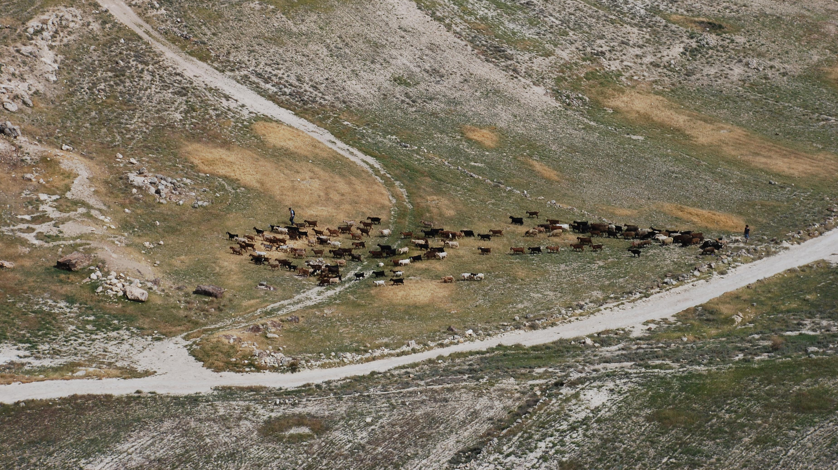
Note the Two Shepherds

Slide 27
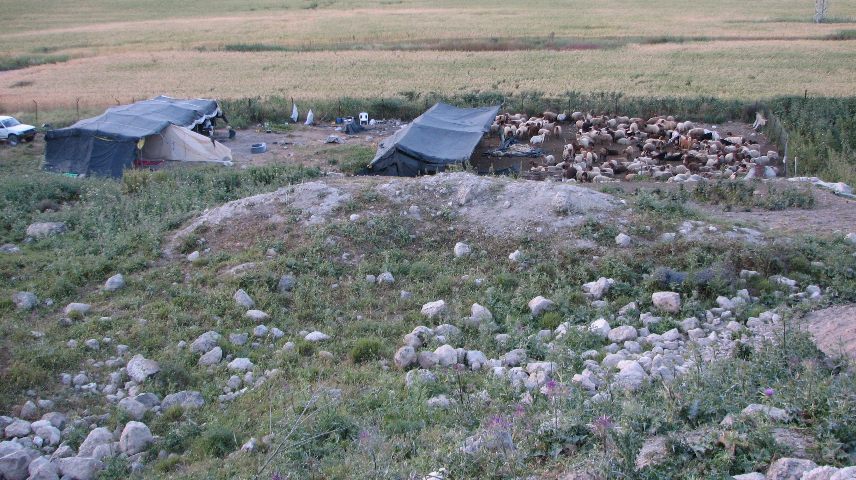
Note the Pens to Keep the Sheep Safe

Slide 28
Matthew 18:12
“What do you think? If a man has a hundred sheep, and one of them has gone astray, does he not leave the ninety-nine on the mountains and go in search of the one that went astray?”
Would it be wise for a shepherd to leave 99 sheep to themselves in seach of 1?
It is assumed that the good shepherd would provide for the care of the 99 just as much as he would the 1.
What is being stressed in this example?
Does the shepherd love this one sheep more than 99 others?

Slide 29
Matthew 18:13
“And if he finds it, truly, I say to you, he rejoices over it more than over the ninety-nine that never went astray.”
What is the significance of “if he finds it”?
Why does the shepherd rejoice move over the 1 than the 99?
Think of a mother who has four children and one becomes ill and is taken in the hospital. How does she feel when the sick one recovers? Does she rejoice over it more than over the three who were not ill?

Slide 30
Matthew 18:14
“So it is not the will of my Father who is in heaven that one of these little ones should perish.”
What is this verse saying?
Lessons:
God takes the initiative to go to great lengths to bring those who are estranged from him.
Reclaiming such people should lead to joyous celebration.
The faithfulness of the majority may never excuse us for ignoring anyone who still remains distant from God (Craig Blomberg, Matthew, The New American, 277).

Slide 31
If Your Brother Sins Against You Matthew 18:15-20
“If your brother sins against you, go and tell him his fault, between you and him alone. If he listens to you, you have gained your brother. But if he does not listen, take one or two others along with you, that every charge may be established by the evidence of two or three witnesses. If he refuses to listen to them, tell it to the church. And if he refuses to listen even to the church, let him be to you as a Gentile and a tax collector. Truly, I say to you, whatever you bind on earth shall be bound in heaven, and whatever you loose on earth shall be loosed in heaven. Again I say to you, if two of you agree on earth about anything they ask, it will be done for them by my Father in heaven. For where two or three are gathered in my name, there am I among them.”

Slide 32
Preliminary Remarks
The Lord has just finished speaking about the wandering sheep and the effort the shepherd makes to find it. This passage is a practical guide to how a disciple can imitate the good shepherd.
Jesus’s teaching is rooted in the Old Testament:
“You shall do no injustice in court. You shall not be partial to the poor or defer to the great, but in righteousness shall you judge your neighbor. You shall not go around as a slanderer among your people, and you shall not stand up against the life of your neighbor: I am the Lord. You shall not hate your brother in your heart, but you shall reason frankly with your neighbor, lest you incur sin because of him. You shall not take vengeance or bear a grudge against the sons of your own people, but you shall love your neighbor as yourself: I am the Lord” (Lev. 19:15-18).

Slide 33
Testament of the Patriarchs
The Testament of Gad is one of the Pseudepigraphical writings written between the testaments.
It purports to be written by the son of Jacob, Gad, but it is obviously much too late to have been written by him.
R. H. Charles dated them to 109-107 BC (The Testaments of the Twelve Patriarchs, liii).

Slide 34
Testament of Gad 6:1-7
¹ And now, my children, I exhort you, love ye each one his brother, and put away hatred from ² your hearts, love one another in deed, and in word, and in the inclination of the soul. For in the presence of my father I spake peaceably to Joseph; and when I had gone out, the spirit of hatred darkened my mind, and stirred up my soul to slay him. ³ Love ye, therefore, one another from the heart; and if a man sin against thee, cast forth the poison of hate and speak peaceably to him, and in thy soul hold not guile; and if he confess and repent, forgive him. ⁴ But if he deny it, do not get into a passion with him, lest catching the poison from thee he take ⁵ to swearing and so thou sin doubly. [Let not another man hear thy secrets when engaged in legal strife, lest he come to hate thee and become thy enemy, and commit a great sin against thee; for ⁶ ofttimes he addresseth thee guilefully or busieth himself about thee with wicked intent.] And though he deny it and yet have a sense of shame when reproved, give over reproving him. For he who denieth may repent so as not again to wrong thee; yea, he may also honour thee, and [fear ⁷ and] be at peace with thee And if he be shameless and persist in his wrong-doing, even so forgive him from the heart, and leave to God the avenging.

Slide 35
Dead Sea Scrolls Rule of the Community
“And their spirit and their deeds must be tested, year after year, in order to upgrade each one to the extent of his insight and the perfection of his path, or to demote him according to his failings. Each should reproach ²⁵ his fellow in truth, in meekness and in compassionate love for the man. Blank No-one should speak to his brother in anger or muttering, ²⁶ or with a hard neck or with passionate] spiteful intent and he should not detest him [in the stubbornness] of his heart, but instead reproach him that day so as not ^{Col. Vi 1} to incur a sin for his fault. And in addition, no-one should raise a matter against his fellow in front of the Many unless it is with reproof in the presence of witnesses” (1QS 5:24-6:1).

Slide 36
Matthew 18:15
“If your brother sins against you, go and tell him his fault, between you and him alone. If he listens to you, you have gained your brother.”
Some Greek texts omit against you, in which case it would make this text applicable to any sin a person may commit, whether or not it was “against you.”
In the event that it should be missing, the passage has much the same thrust as the shepherd going in search of any lost sheep.
In the event that it should be included, it adds the problem of breakdowns in interpersonal relationships within the church that should be addressed for the good of the congregation.
“Between you and him alone” seems to give contextual reason for retaining “against you.”

Slide 37
Looking at the Text
To sin (hamartanō): “to commit a wrong, to sin” (BDAG, 49). Sin involves a transgression of divine law.
Tell him his fault (elegchō): “to express strong disapproval of someone’s action, reprove, correct” (BDAG, 315).
Why should this be done between you and him alone?
Go (hupagō): It reminds one of the shepherd going after his sheep.
Who is charged with going to see the other?
He listens to you (akouō): “to give careful attention to, listen to, heed” (BDAG, 38). Blomberg suggests “responds properly” (278).
You have gained (kerdainō): “figuratively, (to gain) someone for the Reign of God” (BDAG, 541); contrast to the “lost” sheep.

Slide 38
Matthew 18:16
“But if he does not listen, take one or two others along with you, that every charge may be established by the evidence of two or three witnesses.”
This verses explains what to do when the brother refuses to hear the one who convicted him of his sin.
The next step is to take two or three witnesses with you.
What is a witness?
Martus: “one who testifies in legal matters, witness” (BDAG, 619).
What is the purpose for bringing them?
The meaning is drawn from its Old Testament uses.

Slide 39
At the Mouth of Two or Three Witnesses
“A single witness shall not suffice against a person for any crime or for any wrong in connection with any offense that he has committed. Only on the evidence of two witnesses or of three witnesses shall a charge be established” (Deut. 19:15-16).
“On the evidence of two witnesses or of three witnesses the one who is to die shall be put to death; a person shall not be put to death on the evidence of one witness” (Deut. 17:6).
“Do not admit a charge against an elder except on the evidence of two or three witnesses” (1 Tim. 5:19).
“Every charge must be established by the evidence of two or three witnesses” (2 Cor. 13:1).
What are the witnesses to give testimony of, the original offense or the obdurate behavior of the brother when confronted?

Slide 40
Matthew 18:17
“If he refuses to listen to them, tell it to the church. And if he refuses to listen even to the church, let him be to you as a Gentile and a tax collector.”
Refuses to hear (parakouō): “refuse to listen to, disobey” (BDAG, 767). This word intensifies “does not listen” (mē akousē) in v. 16.
What does the word “church” mean in this verse? What does it mean in 16:18?
What does “let him be to you as a Gentile and a tax collector” mean?
For instances of OT “cutting” someone “off,” see Gen. 17:14; Exod. 12:15, 19; 30:33, 38).
For NT instances of withdrawing fellowship, see 1 Cor. 5:1-7; 2 Cor. 2:5-11.
“If anyone does not obey what we say in this letter, take note of that person, and have nothing to do with him, that he may be ashamed. Do not regard him as an enemy, but warn him as a brother” (2 Thess. 3:14-15).

Slide 41
How to Treat a Disciplined Member
“I appeal to you, brothers, to watch out for those who cause divisions and create obstacles contrary to the doctrine that you have been taught; avoid them” (Rom. 16:17).
“I wrote to you in my letter not to associate with sexually immoral people— not at all meaning the sexually immoral of this world, or the greedy and swindlers, or idolaters, since then you would need to go out of the world. But now I am writing to you not to associate with anyone who bears the name of brother if he is guilty of sexual immorality or greed, or is an idolater, reviler, drunkard, or swindler—not even to eat with such a one” (1 Cor. 5:9-11).
Would it be wrong to meet with someone at a restaurant to talk to them about being restored?
If anyone does not obey what we say in this letter, take note of that person, and have nothing to do with him, that he may be ashamed. Do not regard him as an enemy, but warn him as a brother” (2 Thess. 3:14-15).
“If anyone comes to you and does not bring this teaching, do not receive him into your house or give him any greeting, for whoever greets him takes part in his wicked works” (2 John 10-11).

Slide 42
Matthew 18:18
“Truly, I say to you, whatever you bind on earth shall be bound in heaven, and whatever you loose on earth shall be loosed in heaven.”
This verse is a repeat of Matthew 16:19. It is introduced with an emphatic “truly, I say to you.”
Leon Morris: “And again we must bear in mind that the verbs are future perfect: ‘shall have been bound’ and ‘shall have been loosed.’ Jesus is not giving the church the right to make decisions that will then become binding on God. Such a thought is alien from anything in his teaching. He is saying that as the church is responsive to the guidance of God it will come to the decisions that have already been made in heaven” (The Gospel according to Matthew, The Pillar New Testament Commentary, 469).
The tense of “shall be bound” and “shall be loosed” is a perfect passive participle, “shall have been bound” and “shall have been loosed.” It is not that God in heaven is waiting to hear what men have decided to determine what He binds. Rather, these men are seeking to apply what God in heaven has already bound and loosed.

Slide 43
Matthew 18:19
“Again I say to you, if two of you agree on earth about anything they ask, it will be done for them by my Father in heaven.”
The idea is not that God will give a positive answer to any prayer that any two agree to ask Him. This “anything” is limited by those things that heaven has bound and loosed. Compare the following:
“Whatever you ask in my name, this I will do, that the Father may be glorified in the Son” (John 14:13).
“And this is the confidence that we have toward him, that if we ask anything according to his will he hears us” (1 John 5:14).

Slide 44
James 5:16-20
“Therefore, confess your sins to one another and pray for one another, that you may be healed. The prayer of a righteous person has great power as it is working. Elijah was a man with a nature like ours, and he prayed fervently that it might not rain, and for three years and six months it did not rain on the earth. Then he prayed again, and heaven gave rain, and the earth bore its fruit. My brothers, if anyone among you wanders from the truth and someone brings him back, let him know that whoever brings back a sinner from his wandering will save his soul from death and will cover a multitude of sins.”
Note that the context is forgiveness of the sin of a brother.
In Elijah’s prayer, the power for sending or not sending rain was not dependent upon whether or not he prayed, but that his prayer was answered because his will aligned with the will of God.
When our prayers align with God’s will, He will answer our prayer. In this case, brothers are praying for the forgiveness of the sins of one who has confessed his sin. It is perfectly aligned with the Father’s will that he will be forgiven.

Slide 45
Matthew 18:20
“For where two or three are gathered in my name, there am I among them.”
The Mishnah says, “if two sit together and there are words of Torah [spoken] between them, then the Shekhinah abides among them” (Aboth 3:2).
The Shekhinah means “the presence of God in a very special sense.”
By “if two sit together” (at any time and any place) implies the omnipresence of God.
Jesus’s saying of the same about Himself is a strong affirmation of His own divine nature!
Jesus concluded the Great Commission by saying, “And behold, I am with you always, to the end of the age” (Matt. 28:20).
Jesus expects His people to assemble together in His name. “In my name” means “with me as their reason for assembling” (Morris, 470).

Slide 46
The Parable of the Unforgiving Servant Matthew 18:21-35
Then Peter came up and said to him, “Lord, how often will my brother sin against me, and I forgive him? As many as seven times?” Jesus said to him, “I do not say to you seven times, but seventy-seven times. “Therefore the kingdom of heaven may be compared to a king who wished to settle accounts with his servants. When he began to settle, one was brought to him who owed him ten thousand talents. And since he could not pay, his master ordered him to be sold, with his wife and children and all that he had, and payment to be made. So the servant fell on his knees, imploring him, ‘Have patience with me, and I will pay you everything.’ And out of pity for him, the master of that servant released him and forgave him the debt. But when that same servant went out, he found one of his fellow servants who owed him a hundred denarii, and seizing him, he began to choke him, saying, ‘Pay what you owe.’ So his fellow servant fell down and pleaded with him, ‘Have patience with me, and I will pay you.’ He refused and went and put him in prison until he should pay the debt. When his fellow servants saw what had taken place, they were greatly distressed, and they went and reported to their master all that had taken place. Then his master summoned him and said to him, ‘You wicked servant! I forgave you all that debt because you pleaded with me. And should not you have had mercy on your fellow servant, as I had mercy on you?’ And in anger his master delivered him to the jailers, until he should pay all his debt. So also my heavenly Father will do to every one of you, if you do not forgive your brother from your heart.” Now when Jesus had finished these sayings, he went away from Galilee and entered the region of Judea beyond the Jordan.

Slide 47
Matthew 18:21
“Then Peter came up and said to him, ‘Lord, how often will my brother sin against me, and I forgive him? As many as seven times?’”
Note Peter’s leading role.
Peter’s question pertains to relationships between brethren.
It reminds one of the Sermon on the Mount (6:12, 14-15).
Peter’s offer to forgive seven times was generous.
The Jewish Talmud says, “It was taught in a baraita that Rabbi Yosei bar Yehuda says: When a person commits a transgression the first time, he is forgiven; a second time, he is forgiven; a third time, he is forgiven; but the fourth time, he is not forgiven, as it is stated: ‘Thus said the Lord: For three transgressions of Israel, but for four I will not reverse it’ (Amos 2:6)” (b. Yoma 86b).

Slide 48
Matthew 18:22
“Jesus said to him, ‘I do not say to you seven times, but seventy-seven times.’”
Translators are disagreed about whether the Greek phrase hebdomēkontakis hepta means 77 (ESV, NIV, NASB) or 490 (KJV, NKJV, NASB 1977, 1995). There may be a contrast between Lamech’s avenging those who wronged him 77-fold (Gen. 4:24).
Jesus’s point is irrelevant to whether it is 77 or 490. His point is that we dare not keep track of the number of times we grant forgiveness.
The focus of the parable shifts the focus from confronting the one who sinned against a person to the innocent person’s willingness to forgive.
“Pay attention to yourselves! If your brother sins, rebuke him, and if he repents, forgive him, and if he sins against you seven times in the day, and turns to you seven times, saying, ‘I repent,’ you must forgive him” (Luke 17:4).

Slide 49
Matthew 18:23
“Therefore the kingdom of heaven may be compared to a king who wished to settle accounts with his servants.”
The parable is directly linked to the question Peter asked by “therefore” (dia touto, BDAG, 225).
The parable is unique to Matthew.
Craig L. Blomberg explains the gist of the parable: “God eternally and unconditionally forgives those who repent of so immense a debt against him that it is unconscionable for believers to refuse to grant forgiveness to each other for sins that remain trivial in comparison” (Matthew, The New American Commentary, 282).
To settle accounts (sunarai logon): a technical term in a commercial sense, “settle accounts, cast up accounts” (BDAG, 964). Settling accounts is a natural metaphor for judgment.
The characters:
King = God
Servants = God’s people

Slide 50
Matthew 18:24
“When he began to settle, one was brought to him who owed him ten thousand talents.”
Talent: “at 6,000 drachmas or denarii to the Tyrian talent, a day laborer would need to work 60,000,000 days to pay off the debt. Even assuming an extraordinary payback rate of 10 talents per year, the staggering amount would ensure imprisonment for at least 1,000 years” (BDAG, 988).
Ten thousand (murioi): “in our lit. used hyperbolically, as in Engl. informal usage ‘zillion’, of an extremely large or incalculable number” (BDAG, 661).
This enormous debt corresponds to the debt of sin each of us owes to God.

Slide 51
Matthew 18:25
“And since he could not pay, his master ordered him to be sold, with his wife and children and all that he had, and payment to be made.”
Certainly, the amount of money recouped would come nowhere near the amount that was owed, but selling people into slavery to pay their debts was very common in the ancient world.
He could not declare bankruptcy and walk away owing nothing!
In a first century context, selling a creditor into debt slavery was a means of warning other debtors (2 Kings 4:1; Neh. 5:5; Isa. 50:1).

Slide 52
Matthew 18:26
“So the servant fell on his knees, imploring him, ‘Have patience with me, and I will pay you everything.’”
The servant showed submission and homage to the lord whom he owed.
Patience (makrothumeō): “to bear up under provocation without complaint, be patient, forbearing” (BDAG, 612).
In the Greek construction of the second clause, “everything” appears first: “Everything I will pay you.” The desperation of the man causes him to make promises he could never keep.
The debt that he owed was impossible for him ever to repay.

Slide 53
Matthew 18:27
“And out of pity for him, the master of that servant released him and forgave him the debt.”
Pity (

