Slide 2
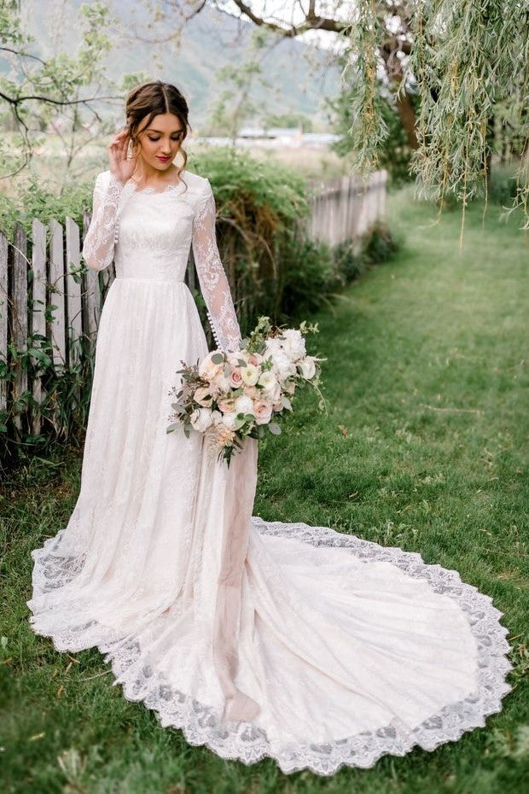
Role of Woman
As a Wife

Slide 3
My Wife Is . . .
My Companion

Slide 4
Made in the Image of God
“Then God said, ‘Let us make man in our image, after our likeness. And let them have dominion over the fish of the sea and over the birds of the heavens and over the livestock and over all the earth and over every creeping thing that creeps on the earth.’ So God created man in his own image, in the image of God he created him; male and female he created them” (Gen. 1:26-27).
Woman is equal with man.

Slide 5
Same Standing Before God
Peter admonishes Christian men to show honor to their wives, even though they are physically stronger than them, because both “they are heirs with you of the grace of life” (1 Pet. 3:7).
Paul said, “There is neither Jew nor Greek, there is neither slave nor free, there is no male and female, for you are all one in Christ Jesus. And if you are Christ’s, then you are Abraham’s offspring, heirs according to promise” (Gal. 3:28-29).

Slide 6
Companionship
“Then the LORD God said, ‘It is not good that the man should be alone; I will make him a helper fit for him’” (Gen. 2:18).
That need is fundamental to man and woman.
Paul spoke of circumstances in which it might be wiser not to be married, but recognized that the strong desires of man and woman may lead them to a marriage, even though that might increase problems for both of them (1 Cor. 7:25-38).

Slide 7
I think of Sandra Walker, Lois Wright, and Susy Capps.
.If I think of VBS, you think of Paul Thornberry.
.If you think of teachers of our children, we think of Joyce Willis.
.If you think of servant women, you must think of Michelle Willis.
.When I think of those who led their husband to the Lord, I think of Connie Newland.
.When I think of strong single women, I think of Carol Key, Linda Robbins, Linda Larimore, and Cammi Capps.
My Wife Is . . .
My Lover

Slide 8
Back to Creation
“And God blessed them. And God said to them, ‘Be fruitful and multiply and fill the earth and subdue it, and have dominion over the fish of the sea and over the birds of the heavens and over every living thing that moves on the earth’” (Gen. 1:28).
“And the man and his wife were both naked and were not ashamed” (Gen. 1:25).

Slide 9
Human Sexuality
1 Corinthians 6:12-20 condemns sexual cohabitation outside of wedlock. “Flee from sexual immorality” (1 Cor. 6:18).
“Now concerning the matters about which you wrote: ‘It is good for a man not to have sexual relations with a woman.’ But because of the temptation to sexual immorality, each man should have his own wife and each woman her own husband. The husband should give to his wife her conjugal rights, and likewise the wife to her husband. For the wife does not have authority over her own body, but the husband does. Likewise the husband does not have authority over his own body, but the wife does. Do not deprive one another, except perhaps by agreement for a limited time, that you may devote yourselves to prayer; but then come together again, so that Satan may not tempt you because of your lack of self-control” (1 Cor. 7:1-5).

Slide 10
Equal Responsibilities
“For the wife does not have authority over her own body, but the husband does” (1 Cor. 7:4).
“Likewise the husband does not have authority over his own body, but the wife does” (1 Cor. 7:4).
Both male and female have sexual needs that the other commits to fulfill.

Slide 11
My Wife Is . . .
My Most Loyal Fan

Slide 12
Don’t Forget Sarah
She went with him to “the land that I will show you” (Gen. 12:5).
She went with him to Egypt and protected Abram (Gen. 12:10-20).
She gave Hagar to Abram (Gen. 16:1-2).
She prepared a meal for their unknown guests (Gen. 18:6).
She did not interfere with Abraham’s offering Isaac (Gen. 22).
She stayed with him all of her life (Gen. 23:1-2).

Slide 13
My Wife Is . . .
My Advisor

Slide 14
Godly Women Help Their Husbands
Rebekah knew that the leader would be Jacob: “And the LORD said to her, “Two nations are in your womb, and two peoples from within you shall be divided; the one shall be stronger than the other, the older shall serve the younger” (Gen. 25:23).
When Jacob husband planned to give the birthright blessing to the wrong son, Rebekah prevented that from occurring. We might disagree with her tactics but her commitment was to give the birthright blessing to the right child (Gen. 27).
When Jacob realized what had happened, he accepted it. “Then Isaac trembled very violently and said, ‘Who was it then that hunted game and brought it to me, and I ate it all before you came, and I have blessed him? Yes, and he shall be blessed’” (Gen. 27:33).

Slide 15
Abigail and Nabal
Abigail learned the facts of what her foolish husband had done (1 Sam. 25:14-14).
His name is Nabal. The Hebrew word, nābāl, means “traditionally foolish (intellectually and morally). . . someone who, within a sphere of influence counts for nothing, has nothing to offer, gives no help, commands no respect, is nothing” (HALOT, 663).
Nabal “may be considered a nickname, or a term of abuse which has suppressed the original name” (ibid., 663-664).
Abigail acted immediately (1 Sam. 25:18-19).
Abigail saved her family (1 Sam. 25:20-31).
Abigail advised the future king (David, 1 Sam. 25:24-31).

Slide 16
The Wise Woman of Proverbs 31
“She is far more precious than jewels” (Prov. 31:10).
“The heart of her husband trusts her” (Prov. 31:11).
“She does him good, and not harm, all the days of her life” (Prov. 31:12).
She works hard.
She actively participated in providing for the family (Prov. 31:16-24).
She has good advice: “She opens her mouth with wisdom, and the teaching of kindness is on her tongue” (Prov. 31:26).
She is honored by her children (Prov. 31:28).
He husband praises her: “Many women have done excellently, but you surpass them all” (Prov. 31:29).

Slide 17
My Wife Is . . .
An Example

Slide 18
1 Peter 3:1-4
“Likewise, wives, be subject to your own husbands, so that even if some do not obey the word, they may be won without a word by the conduct of their wives, when they see your respectful and pure conduct. Do not let your adorning be external—the braiding of hair and the putting on of gold jewelry, or the clothing you wear— but let your adorning be the hidden person of the heart with the imperishable beauty of a gentle and quiet spirit, which in God’s sight is very precious” (1 Pet. 3:1-4).
No man or woman will ever be perfect, but still each of us can be an example to others.

Slide 19
Dorcas
“Now there was in Joppa a disciple named Tabitha, which, translated, means Dorcas. She was full of good works and acts of charity. In those days she became ill and died, and when they had washed her, they laid her in an upper room. Since Lydda was near Joppa, the disciples, hearing that Peter was there, sent two men to him, urging him, “Please come to us without delay.” So Peter rose and went with them. And when he arrived, they took him to the upper room. All the widows stood beside him weeping and showing tunics and other garments that Dorcas made while she was with them” (Acts 9:36-39).

Slide 20
Priscilla
Left Rome with her husband when Claudius expelled the Jews from the city (Acts 18:2).
Opened her home to Paul while he worked in Corinth (Acts 18:3).
Priscilla and Aquila moved to Ephesus to continue associating with Paul in the preaching of the gospel (Acts 18:18). The couple took Apollos aside and instructed him in the way of the Lord (Acts 18:26).
When Paul wrote to the Roman saints, he described Priscilla and Aquila as “my helpers in Christ Jesus” (Rom. 16:3).

Slide 21
Strong Women at DT
I started a list but for fear of hurting the feelings of someone I might inadvertently overlook, I decided not to list them here.

Slide 22
My Wife Is . . .
A Joint Heir of the Grace of Life

Slide 23
Conclusion

Slide 24
Honor to Whom Honor Is Due
Both Sandy and I understand that our salvation depends upon God’s grace.
Neither of us claims anything near perfection.
Remember, we are just two beggars showing other beggars where there is food.
On this mother’s day, it is appropriate that we think of the contribution our women make in being our wives and to give “honor to whom honor is owed” (Rom. 13:7).
The Ten Commandments reminds us to “honor . . . thy mother” (Exod. 20:12).

