Slide 2
It Starts Like This
Many families have experienced or likely will experience severe tragedies that come upon them without warning.
The whole direction of one’s life can change instantly.
The day when life tumbles in will begin in an ordinary way. They all do. Before the day is over your life, your family, and your future may be completely and forever changed.

Slide 3
Sometimes Troubles Are Foreseen
Medical conditions: heart attacks, strokes, cancer, Alzheimer’s, old age.
A financial crisis can occur that totally wrecks a person’s life.
Sometimes a deer can run into your car and create changes you did not anticipate.
A layoff at work or being fired can occur.
Learning of unfaithfulness in one’s mate.
A teenaged daughter becomes pregnant outside of wedlock.
A divorce.
Church problems that result in division.

Slide 4
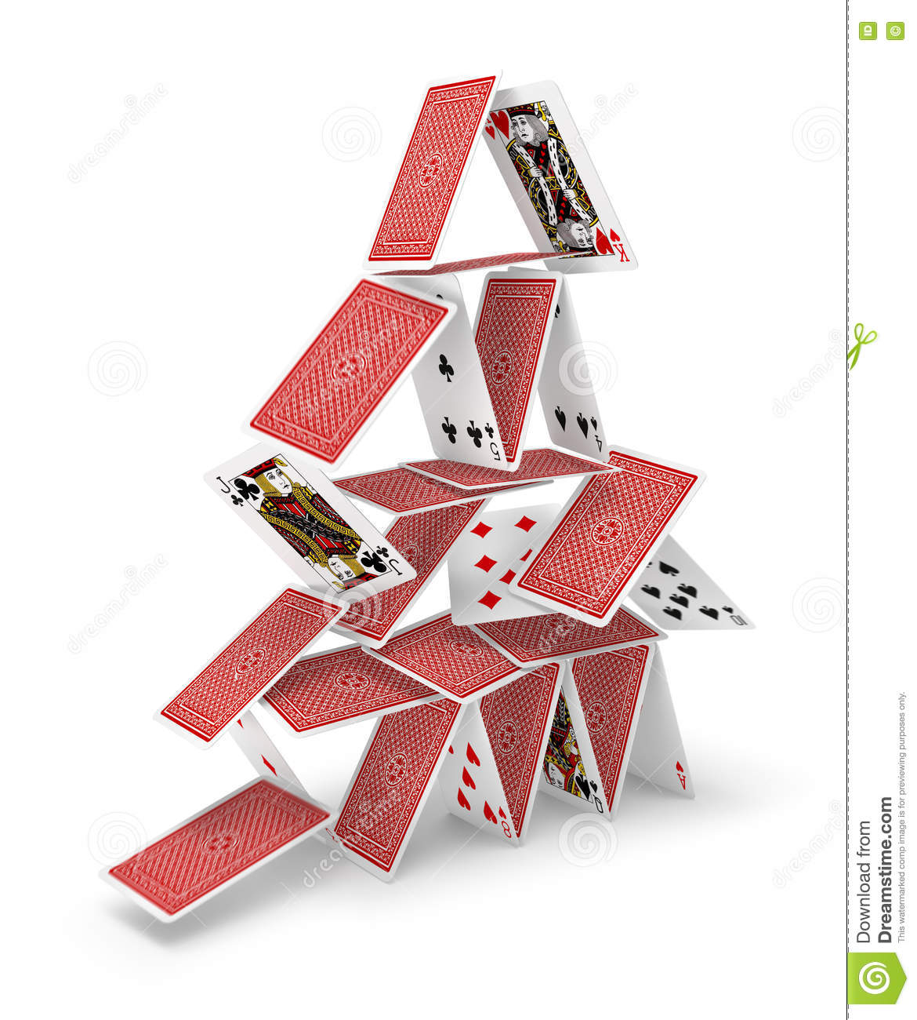
What Should I Do. . .
When Life Tumbles In

Slide 5
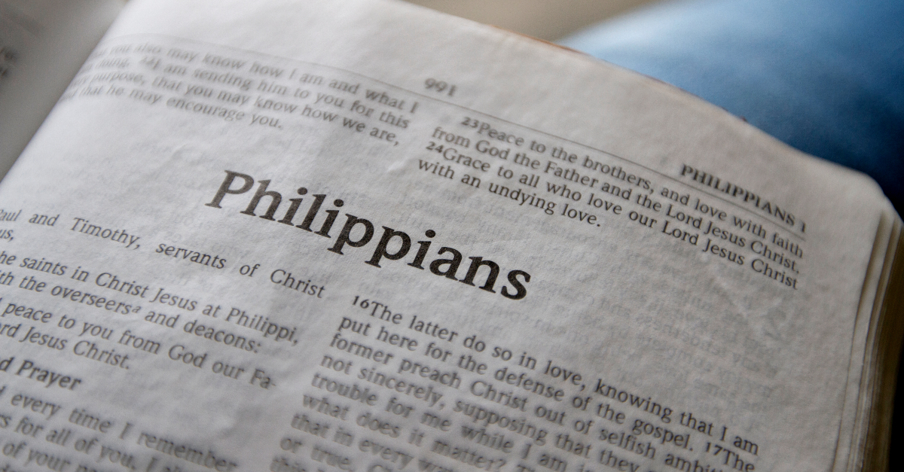

Slide 6
Background
The short letter was written by Paul, a man under house arrest in Rome, attached to a Roman guard and dependent upon others to supply food and clothing.
Already he had spent two years in a prison in Caesarea, being incarcerated by the procurators Felix and Festus (Acts 24:27).
After being transferred to Rome, he was limited in what he could do.
“He lived there two whole years at his own expense, and welcomed all who came to him, proclaiming the kingdom of God and teaching about the Lord Jesus Christ with all boldness and without hindrance” (Acts 28:30-31).
These conditions would lead most of us to despondency.

Slide 7
Yet The Book Emphasizes “Joy”
Surprisingly, one of the main themes of this letter is “joy” (chara). The word appears five times in Philippians (1:4, 25; 2:2, 29; 4:1).
The cognate word “rejoice” (chairō) appears seven times (1:18; 2:17, 18, 28; 3:1; 4:4, 10).
I marvel that one who faced the problems that Paul was experiencing could write a letter so full of joy.
Let’s see what we can learn from this strong man.

Slide 8
What Should I Do. . .
When Life Tumbles In
“Therefore, my brothers, whom I love and long for, my joy and crown, stand firm thus in the Lord, my beloved” (Phil. 4:1).

Slide 9
Not the Time
For doubting or wavering.
To run, hide, or quit.
Paul exhorted in another letter, “Be watchful, stand firm in the faith, act like men, be strong” (1 Cor. 16:13).

Slide 10
Don’t Quit
Edgar Guest (1881-1959)
When things go wrong, as they sometimes will,
When the road you’re trudging seems all uphill,
When the funds are low and debts are high,
And you want to smile but have to sigh.
When care is pressing you down a bit,
Rest, if you must, but don’t you quit.
Life is queer with its twists and turns,
As everyone of us sometimes learns,
And many a failure turns about,
When he might have won if he’d stuck it out.
Don’t give up though the pace seems slow,
You might succeed with another blow.
Often the struggler has given up,
When he might captured the victor’s cup.
And he learned too late, when the night slipped down,
How close he was to the golden crown.
Success is failure turned inside out,
The silver tint of clouds of doubt,
And you never can tell how close you are,
It may be near when it seems afar.
So stick to the fight when you’re hardest hit,
It’s when things seem worst that you mustn’t quit.

Slide 11
Revelation 2:9-10
“Do not fear what you are about to suffer. Behold, the devil is about to throw some of you into prison, that you may be tested, and for ten days you will have tribulation. Be faithful unto death, and I will give you the crown of life” (Rev. 2:9-10).

Slide 12
What Should I Do. . .
When Life Tumbles In
“Rejoice in the Lord always; again I will say, rejoice” (Phil. 4:1).

Slide 13
Some Things Don’t Mean As Much
There are things that may have brought you much joy at a different times of your life, such as fishing, golfing, cooking, sewing, gaming, athletic competition, dollying yourself up for a date, etc.
You may no longer be able to participate in things that gave you so much pleasure, leaving you memories of fun times, but impossible to give you pleasure at the time life tumbles in.
You will find that nothing gives you as much pleasure and joy as your relationship with the Lord—to know that you can present yourself at His throne of grace and pour out the deepest needs of your heart.

Slide 14
Romans 5:1-5
“Therefore, since we have been justified by faith, we have peace with God through our Lord Jesus Christ. Through him we have also obtained access by faith into this grace in which we stand, and we rejoice in hope of the glory of God. Not only that, but we rejoice in our sufferings, knowing that suffering produces endurance, and endurance produces character, and character produces hope, and hope does not put us to shame, because God’s love has been poured into our hearts through the Holy Spirit who has been given to us” (Rom. 5:1-5).

Slide 15
Remember What James Wrote
“Count it all joy, my brothers, when you meet trials of various kinds, for you know that the testing of your faith produces steadfastness. And let steadfastness have its full effect, that you may be perfect and complete, lacking in nothing” (1:2-4).
“As an example of suffering and patience, brothers, take the prophets who spoke in the name of the Lord. Behold, we consider those blessed who remained steadfast. You have heard of the steadfastness of Job, and you have seen the purpose of the Lord, how the Lord is compassionate and merciful” (James 5:10-11).

Slide 16
What Should I Do. . .
When Life Tumbles In
“Let your reasonableness be known to everyone. The Lord is at hand” (Phil. 4:5).

Slide 17
Defining Epeikēs
The definition of the Greek word epeikēs is “not insisting on every right of the letter of law or custom, yielding, gentle, kind, tolerant” (BDAG, 371).
Richard R. Melick: “No single word translates epieikes well, and commentators consistently insist that the word contains an element of selflessness. The gentle person does not insist on his rights. ‘It is that considerate courtesy and respect for the integrity of others which prompts a man not to be for ever standing on his rights; and it is preeminently the character of Jesus (2 Cor 10:1)’” (Philippians, Colossians, Philemon, The New American Commentary, 149).

Slide 18
Different Translations
“Let your gentleness be evident to all” (NIV, NKJV).
“Let your reasonableness be known to everyone” (ESV).
“Let your moderation be known unto all men” (KJV).
“Let your forbearance be known unto all men” (ASV, RSV).

Slide 19
How Do You Handle Troubles?
This word describes how we should deal with others during our times of trouble.
Are you difficult to live with when you are beset with problems?
When we are overwhelmed with problems, it is easy to become overbearing, short-tempered, irritable, moody, and downcast.
Don’t! Do not be hard to live with when troubles come.

Slide 20
What Should I Do. . .
When Life Tumbles In
“. . . do not be anxious about anything, but in everything by prayer and supplication with thanksgiving let your requests be made known to God. And the peace of God, which surpasses all understanding, will guard your hearts and your minds in Christ Jesus” (Phil. 4:6-7).

Slide 21
Matthew 6:25-34
“Therefore I tell you, do not be anxious about your life, what you will eat or what you will drink, nor about your body, what you will put on. Is not life more than food, and the body more than clothing? Look at the birds of the air: they neither sow nor reap nor gather into barns, and yet your heavenly Father feeds them. Are you not of more value than they? And which of you by being anxious can add a single hour to his span of life? And why are you anxious about clothing? Consider the lilies of the field, how they grow: they neither toil nor spin, yet I tell you, even Solomon in all his glory was not arrayed like one of these. But if God so clothes the grass of the field, which today is alive and tomorrow is thrown into the oven, will he not much more clothe you, O you of little faith? Therefore do not be anxious, saying, ‘What shall we eat?’ or ‘What shall we drink?’ or ‘What shall we wear?’ For the Gentiles seek after all these things, and your heavenly Father knows that you need them all. But seek first the kingdom of God and his righteousness, and all these things will be added to you. Therefore do not be anxious about tomorrow, for tomorrow will be anxious for itself. Sufficient for the day is its own trouble”

Slide 22
Matthew 6:25-34
“Therefore I tell you, do not be anxious about your life, what you will eat or what you will drink, nor about your body, what you will put on. Is not life more than food, and the body more than clothing? Look at the birds of the air: they neither sow nor reap nor gather into barns, and yet your heavenly Father feeds them. Are you not of more value than they? And which of you by being anxious can add a single hour to his span of life? And why are you anxious about clothing? Consider the lilies of the field, how they grow: they neither toil nor spin, yet I tell you, even Solomon in all his glory was not arrayed like one of these. But if God so clothes the grass of the field, which today is alive and tomorrow is thrown into the oven, will he not much more clothe you, O you of little faith? Therefore do not be anxious, saying, ‘What shall we eat?’ or ‘What shall we drink?’ or ‘What shall we wear?’ For the Gentiles seek after all these things, and your heavenly Father knows that you need them all. But seek first the kingdom of God and his righteousness, and all these things will be added to you. Therefore do not be anxious about tomorrow, for tomorrow will be anxious for itself. Sufficient for the day is its own trouble”

Slide 23
Matthew 6:25-34
“Therefore I tell you, do not be anxious about your life, what you will eat or what you will drink, nor about your body, what you will put on. Is not life more than food, and the body more than clothing? Look at the birds of the air: they neither sow nor reap nor gather into barns, and yet your heavenly Father feeds them. Are you not of more value than they? And which of you by being anxious can add a single hour to his span of life? And why are you anxious about clothing? Consider the lilies of the field, how they grow: they neither toil nor spin, yet I tell you, even Solomon in all his glory was not arrayed like one of these. But if God so clothes the grass of the field, which today is alive and tomorrow is thrown into the oven, will he not much more clothe you, O you of little faith? Therefore do not be anxious, saying, ‘What shall we eat?’ or ‘What shall we drink?’ or ‘What shall we wear?’ For the Gentiles seek after all these things, and your heavenly Father knows that you need them all. But seek first the kingdom of God and his righteousness, and all these things will be added to you. Therefore do not be anxious about tomorrow, for tomorrow will be anxious for itself. Sufficient for the day is its own trouble”

Slide 24
Matthew 6:25-34
“Therefore I tell you, do not be anxious about your life, what you will eat or what you will drink, nor about your body, what you will put on. Is not life more than food, and the body more than clothing? Look at the birds of the air: they neither sow nor reap nor gather into barns, and yet your heavenly Father feeds them. Are you not of more value than they? And which of you by being anxious can add a single hour to his span of life? And why are you anxious about clothing? Consider the lilies of the field, how they grow: they neither toil nor spin, yet I tell you, even Solomon in all his glory was not arrayed like one of these. But if God so clothes the grass of the field, which today is alive and tomorrow is thrown into the oven, will he not much more clothe you, O you of little faith? Therefore do not be anxious, saying, ‘What shall we eat?’ or ‘What shall we drink?’ or ‘What shall we wear?’ For the Gentiles seek after all these things, and your heavenly Father knows that you need them all. But seek first the kingdom of God and his righteousness, and all these things will be added to you. Therefore do not be anxious about tomorrow, for tomorrow will be anxious for itself. Sufficient for the day is its own trouble”

Slide 25
Matthew 6:25-34
“Therefore I tell you, do not be anxious about your life, what you will eat or what you will drink, nor about your body, what you will put on. Is not life more than food, and the body more than clothing? Look at the birds of the air: they neither sow nor reap nor gather into barns, and yet your heavenly Father feeds them. Are you not of more value than they? And which of you by being anxious can add a single hour to his span of life? And why are you anxious about clothing? Consider the lilies of the field, how they grow: they neither toil nor spin, yet I tell you, even Solomon in all his glory was not arrayed like one of these. But if God so clothes the grass of the field, which today is alive and tomorrow is thrown into the oven, will he not much more clothe you, O you of little faith? Therefore do not be anxious, saying, ‘What shall we eat?’ or ‘What shall we drink?’ or ‘What shall we wear?’ For the Gentiles seek after all these things, and your heavenly Father knows that you need them all. But seek first the kingdom of God and his righteousness, and all these things will be added to you. Therefore do not be anxious about tomorrow, for tomorrow will be anxious for itself. Sufficient for the day is its own trouble”

Slide 26
Hebrews 4:14-16
Since then we have a great high priest who has passed through the heavens, Jesus, the Son of God, let us hold fast our confession. For we do not have a high priest who is unable to sympathize with our weaknesses, but one who in every respect has been tempted as we are, yet without sin. Let us then with confidence draw near to the throne of grace, that we may receive mercy and find grace to help in time of need.”

Slide 27
Don’t Forget Your Blessings
Don’t forget to be thankful in your prayers: “but in everything by prayer and supplication with thanksgiving let your requests be made known to God” (Phil. 4:6).
In the midst of all of our troubles, let them not blind you to all of the good, sweet blessings we have already received from the hands of the Lord.
Name them one by one!
The result is this: “ And the peace of God, which surpasses all understanding, will guard your hearts and your minds in Christ Jesus” (Phil. 4:7).

Slide 28
What Should I Do. . .
When Life Tumbles In
“Finally, brothers, whatever is true, whatever is honorable, whatever is just, whatever is pure, whatever is lovely, whatever is commendable, if there is any excellence, if there is anything worthy of praise, think about these things” (Phil. 4:8).

Slide 29
Keep Thinking Straight
Keep thinking on those things that pertain to holiness.
Remember these great truth taught in Proverbs:
“Keep your heart with all vigilance, for from it flow the springs of life” (4:23).
“Let your eyes look directly forward, and your gaze be straight before you” (4:25).
Jesus said, “The good person out of the good treasure of his heart produces good, and the evil person out of his evil treasure produces evil, for out of the abundance of the heart his mouth speaks” (Luke 6:45).

Slide 30
What Should I Do. . .
When Life Tumbles In
“Not that I am speaking of being in need, for I have learned in whatever situation I am to be content” (Phil. 4:11).

Slide 31
Paul Did Not Find This Easy to Do
“So to keep me from becoming conceited because of the surpassing greatness of the revelations, a thorn was given me in the flesh, a messenger of Satan to harass me, to keep me from becoming conceited. Three times I pleaded with the Lord about this, that it should leave me. But he said to me, ‘My grace is sufficient for you, for my power is made perfect in weakness.’ Therefore I will boast all the more gladly of my weaknesses, so that the power of Christ may rest upon me. For the sake of Christ, then, I am content with weaknesses, insults, hardships, persecutions, and calamities. For when I am weak, then I am strong” (2 Cor. 12:7-10).
Given the wording of Philippians 4:11, he learned how to be content during hard times. If Paul can learn to be content in his situation, so can we learn to accept our own situations.

Slide 32
What Should I Do. . .
When Life Tumbles In
“I know how to be brought low, and I know how to abound. In any and every circumstance, I have learned the secret of facing plenty and hunger, abundance and need. I can do all things through him who strengthens me” (Phil. 4:12-13).

Slide 33
Romans 8:35-39
“Who shall separate us from the love of Christ? Shall tribulation, or distress, or persecution, or famine, or nakedness, or danger, or sword? As it is written, ‘For your sake we are being killed all the day long; we are regarded as sheep to be slaughtered.’ No, in all these things we are more than conquerors through him who loved us. For I am sure that neither death nor life, nor angels nor rulers, nor things present nor things to come, nor powers, nor height nor depth, nor anything else in all creation, will be able to separate us from the love of God in Christ Jesus our Lord” (Rom. 8:35-39).

Slide 34
Conclusion

Slide 35
Don’t Forget!
You may be experiencing troubles in your own life brought on by the care and worries of this world. This last message I want you to remember today is the most important: “Jesus cares for you.”
His invitation in Matthew 11:28-30 is addressed all of mankind who one time or the other will experience these the same burdens: “Come to me, all who labor and are heavy laden, and I will give you rest. Take my yoke upon you, and learn from me, for I am gentle and lowly in heart, and you will find rest for your souls. For my yoke is easy, and my burden is light.”
Jesus loves you and me enough to want to help. Jesus has the ability to help. Jesus will show you the way to find relief from your heavy burdens.
Jesus expects us to yield ourselves to His yoke and carry His burden, which is easy and light.

