Slide 1
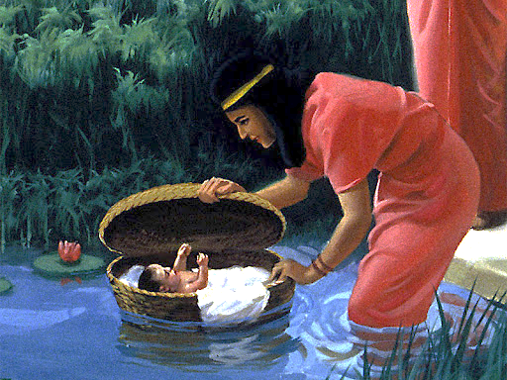
5
“Saved For A Purpose”

Slide 2
“Saved For A Purpose”
By faith Moses, when he became of age, refused to be called the son of Pharaoh's daughter, choosing rather to suffer affliction with the people of God than to enjoy the passing pleasures of sin, esteeming the reproach of Christ greater riches than the treasures in Egypt; for he looked to the reward. (Hebrews 11:24-26 )
Serve & Obey God!

Slide 3
My Purpose & Priorities
I need to know what’s most important!
Parable of the Great Supper (Luke 14:16-24)
Excuse #1 – Land/Possessions
Excuse #2 – Animals/Livelihood
Excuse #3 – Marriage/Family
God approves of each of these activities.
These are not God’s great purpose for me!
“Saved For A Purpose”

Slide 4
Purpose & Priorities Out Of Focus
Material things!
Livelihood!
Family!
What Is Our Purpose?
It’s not to have houses, jobs, or children.

Slide 5
My Purpose & Priorities
Glorify God!
By example. Matt. 5:16
In Worship. John 4:24
With Reverence. Heb. 12:28
With Fear. Eccl.12:13
In Obedience. Rom. 1:5
“Saved For A Purpose”

Slide 6
My Purpose & Priorities
Exalting Jesus!
"I have been crucified with Christ; it is no longer I who live, but Christ lives in me; and the life which I now live in the flesh I live by faith in the Son of God, who loved me and gave Himself for me. (Galatians 2:20 )
“Saved For A Purpose”

Slide 7
My Purpose & Priorities
Spread The Gospel!
Jesus – “One soul is worth more than the whole world!”
"By this My Father is glorified, that you bear much fruit; so you will be My disciples. (John 15:8 )
……… he who wins souls is wise. (Proverbs 11:30 )
“Saved For A Purpose”

Slide 8
My Purpose & Priorities
Glorify God!
Exalting Jesus!
Spread The Gospel!
If then you were raised with Christ, seek those things which are above, where Christ is, sitting at the right hand of God. Set your mind on things above, not on things on the earth. (Colossians 3:1-2 )
“Saved For A Purpose”

Slide 9
God’s Plan For Salvation:
Based on God’s GRACE-- Eph. 2:8
Hear the Word of God –Rom. 10:17
Believe In Your Heart -- Acts 8:37
Repent Of Your Sins --Luke 13:3,5
Confess faith in Jesus -- Matt. 10:32-33
Be Baptized Into Christ -- Acts 22:16
Be Faithful Until Death --Rev. 2:10

