Slide 2
John 3:3-5
Jesus answered him, ‘Truly, truly, I say to you, unless one is born again he cannot see the kingdom of God.’ Nicodemus said to him, ‘How can a man be born when he is old? Can he enter a second time into his mother’s womb and be born?’ Jesus answered, ‘Truly, truly, I say to you, unless one is born of water and the Spirit, he cannot enter the kingdom of God.’”

Slide 4
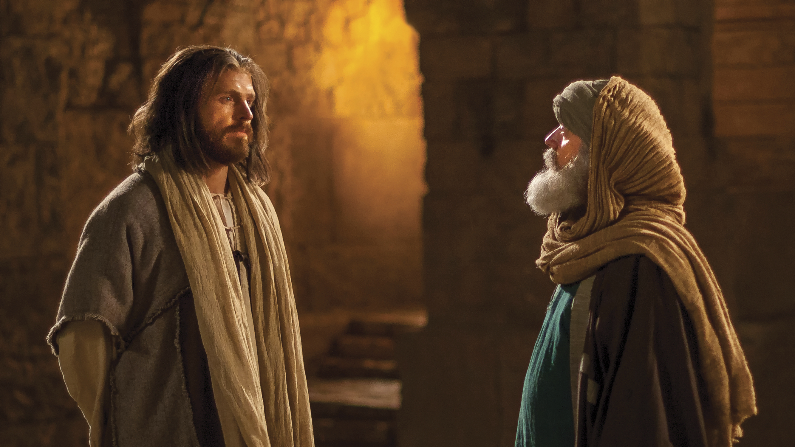
Meet Nicodemus

Slide 5
What We Know About Nicodemus
He was a Pharisee, a member of the Jewish sect who were committed to a life of holiness. This commitment led to their feeling holier than other men (Luke 18:9-14) and sometimes to hypocrisy.
He was a member of the ruling class (John 3:1), sitting on the Jewish Sanhedrin.
He was wealthy, as indicated by purchasing and bringing 75 pounds of myrrh and aloes for the burial of Jesus (John 19:39).
Sometime later he protested the efforts of the chief priests and Pharisees to have Jesus arrested as deceiver (John 7:32, 45-52), arguing that the Law required them to give Jesus a fair hearing.
Such a man likely would have thought of himself as one of those fitted to enter the kingdom of God.

Slide 6
Born Again?
He must have been startled to hear Jesus say, “Truly, truly, I say to you, unless one is born again he cannot see the kingdom of God” (John 3:3).
Nicodemus did not understand what Jesus was saying, so he replied, “How can a man be born when he is old? Can he enter a second time into his mother’s womb and be born?” (John 3:4).
Jesus answered, “Truly, truly, I say to you, unless one is born of water and the Spirit, he cannot enter the kingdom of God” (John 3:5).
Jesus’s reply makes obvious that Jesus is not speaking about a person experiencing a second physical birth.
He is speaking of the spiritual transformation that God works on men.

Slide 7
Why Does One Need to Be Reborn?

Slide 8
John 8:39-47
“They answered him, ‘Abraham is our father.’ Jesus said to them, ‘If you were Abraham’s children, you would be doing the works Abraham did, but now you seek to kill me, a man who has told you the truth that I heard from God. This is not what Abraham did. You are doing the works your father did.’ They said to him, ‘We were not born of sexual immorality. We have one Father—even God.’ Jesus said to them, ‘If God were your Father, you would love me, for I came from God and I am here. I came not of my own accord, but he sent me. Why do you not understand what I say? It is because you cannot bear to hear my word. You are of your father the devil, and your will is to do your father’s desires. He was a murderer from the beginning, and does not stand in the truth, because there is no truth in him. When he lies, he speaks out of his own character, for he is a liar and the father of lies. But because I tell the truth, you do not believe me. Which one of you convicts me of sin? If I tell the truth, why do you not believe me? Whoever is of God hears the words of God. The reason why you do not hear them is that you are not of God’” (John 8:39-47).

Slide 9
John 8:39-47
“They answered him, ‘Abraham is our father.’ Jesus said to them, ‘If you were Abraham’s children, you would be doing the works Abraham did, but now you seek to kill me, a man who has told you the truth that I heard from God. This is not what Abraham did. You are doing the works your father did.’ They said to him, ‘We were not born of sexual immorality. We have one Father—even God.’ Jesus said to them, ‘If God were your Father, you would love me, for I came from God and I am here. I came not of my own accord, but he sent me. Why do you not understand what I say? It is because you cannot bear to hear my word. You are of your father the devil, and your will is to do your father’s desires. He was a murderer from the beginning, and does not stand in the truth, because there is no truth in him. When he lies, he speaks out of his own character, for he is a liar and the father of lies. But because I tell the truth, you do not believe me. Which one of you convicts me of sin? If I tell the truth, why do you not believe me? Whoever is of God hears the words of God. The reason why you do not hear them is that you are not of God’” (John 8:39-47).

Slide 10
John 8:39-47
“They answered him, ‘Abraham is our father.’ Jesus said to them, ‘If you were Abraham’s children, you would be doing the works Abraham did, but now you seek to kill me, a man who has told you the truth that I heard from God. This is not what Abraham did. You are doing the works your father did.’ They said to him, ‘We were not born of sexual immorality. We have one Father—even God.’ Jesus said to them, ‘If God were your Father, you would love me, for I came from God and I am here. I came not of my own accord, but he sent me. Why do you not understand what I say? It is because you cannot bear to hear my word. You are of your father the devil, and your will is to do your father’s desires. He was a murderer from the beginning, and does not stand in the truth, because there is no truth in him. When he lies, he speaks out of his own character, for he is a liar and the father of lies. But because I tell the truth, you do not believe me. Which one of you convicts me of sin? If I tell the truth, why do you not believe me? Whoever is of God hears the words of God. The reason why you do not hear them is that you are not of God’” (John 8:39-47).

Slide 11
John 8:39-47
“They answered him, ‘Abraham is our father.’ Jesus said to them, ‘If you were Abraham’s children, you would be doing the works Abraham did, but now you seek to kill me, a man who has told you the truth that I heard from God. This is not what Abraham did. You are doing the works your father did.’ They said to him, ‘We were not born of sexual immorality. We have one Father—even God.’ Jesus said to them, ‘If God were your Father, you would love me, for I came from God and I am here. I came not of my own accord, but he sent me. Why do you not understand what I say? It is because you cannot bear to hear my word. You are of your father the devil, and your will is to do your father’s desires. He was a murderer from the beginning, and does not stand in the truth, because there is no truth in him. When he lies, he speaks out of his own character, for he is a liar and the father of lies. But because I tell the truth, you do not believe me. Which one of you convicts me of sin? If I tell the truth, why do you not believe me? Whoever is of God hears the words of God. The reason why you do not hear them is that you are not of God’” (John 8:39-47).

Slide 12
John 8:39-47
“They answered him, ‘Abraham is our father.’ Jesus said to them, ‘If you were Abraham’s children, you would be doing the works Abraham did, but now you seek to kill me, a man who has told you the truth that I heard from God. This is not what Abraham did. You are doing the works your father did.’ They said to him, ‘We were not born of sexual immorality. We have one Father—even God.’ Jesus said to them, ‘If God were your Father, you would love me, for I came from God and I am here. I came not of my own accord, but he sent me. Why do you not understand what I say? It is because you cannot bear to hear my word. You are of your father the devil, and your will is to do your father’s desires. He was a murderer from the beginning, and does not stand in the truth, because there is no truth in him. When he lies, he speaks out of his own character, for he is a liar and the father of lies. But because I tell the truth, you do not believe me. Which one of you convicts me of sin? If I tell the truth, why do you not believe me? Whoever is of God hears the words of God. The reason why you do not hear them is that you are not of God’” (John 8:39-47).

Slide 13
Dead in Sin
“And you were dead in the trespasses and sins in which you once walked, following the course of this world, following the prince of the power of the air, the spirit that is now at work in the sons of disobedience— among whom we all once lived in the passions of our flesh, carrying out the desires of the body and the mind, and were by nature children of wrath, like the rest of mankind” (Eph. 2:1-3).
Our condition as Gentiles was desperate: “Therefore remember that at one time you Gentiles in the flesh, called ‘the uncircumcision’ by what is called the circumcision, which is made in the flesh by hands— remember that you were at that time separated from Christ, alienated from the commonwealth of Israel and strangers to the covenants of promise, having no hope and without God in the world” (Eph. 2:11-12).
What mankind needs is to be born again, experience a spiritual rebirth.

Slide 14
Our Need: To Be Born Again!
The sins which we have personally committed have penetrated into the dark recesses of the human spirit.
We do not need a “spit bath.”
We need new birth—a birth that reaches deep into the human spirit and changes it.
Jesus metaphorically described what we need as a new birth: “But to all who did receive him, who believed in his name, he gave the right to become children of God, who were born, not of blood nor of the will of the flesh nor of the will of man, but of God” (John 1:13)

Slide 15
The Carnal Mind Doesn’t Get It
When Peter tried to stop Jesus from foretelling His death, burial, and resurrection, Jesus replied to Peter, “Get behind me, Satan! You are a hindrance to me. For you are not setting your mind on the things of God, but on the things of man” (Matt. 16:23).
His carnal mind was not on the same page with Jesus.
“For the word of the cross is folly to those who are perishing, but to us who are being saved it is the power of God. . . .but we preach Christ crucified, a stumbling block to Jews and folly to Gentiles” (1 Cor. 1:18, 23).

Slide 16
Romans 8:5-8
“For those who live according to the flesh set their minds on the things of the flesh, but those who live according to the Spirit set their minds on the things of the Spirit. For to set the mind on the flesh is death, but to set the mind on the Spirit is life and peace. For the mind that is set on the flesh is hostile to God, for it does not submit to God’s law; indeed, it cannot. Those who are in the flesh cannot please God” (Rom. 8:5-8).
This is very similar to what Jesus said to Nicodemus: “That which is born of the flesh is flesh, and that which is born of the Spirit is spirit” (John 3:6).
“The natural person does not accept the things of the Spirit of God, for they are folly to him, and he is not able to understand them because they are spiritually discerned” (1 Cor. 2:14).

Slide 17
How Is One Born Again?

Slide 18
Through the Teaching of God’s Word
“Having purified your souls by your obedience to the truth for a sincere brotherly love, love one another earnestly from a pure heart, since you have been born again, not of perishable seed but of imperishable, through the living and abiding word of God; for ‘All flesh is like grass and all its glory like the flower of grass. The grass withers, and the flower falls, but the word of the Lord remains forever.’ And this word is the good news that was preached to you” (1 Pet. 1:22-15).
“Of his own will he brought us forth (the Greek word apokueō means “give birth to,” BDAG, 114) by the word of truth, that we should be a kind of firstfruits of his creatures” (James 1:18).

Slide 19
The New Birth Is Not Mysterious
God divinely revealed His word in the gospel.
The gospel is preached to those who are lost.
They believe the word of the gospel.
They make a willful choice to obey what the Lord has spoken through His word, leading them to repent of their sins.
John described the effects of repentance: “Bear fruit in keeping with repentance” (Matt. 3:8).

Slide 20
What Do Your Mean “Born of Water”?
The only thing related to water in the new birth is baptism.
“And Jesus came and said to them, ‘All authority in heaven and on earth has been given to me. Go therefore and make disciples of all nations, baptizing them in the name of the Father and of the Son and of the Holy Spirit, teaching them to observe all that I have commanded you. And behold, I am with you always, to the end of the age’” (Matt. 28:18-20).
“And he said to them, ‘Go into all the world and proclaim the gospel to the whole creation. Whoever believes and is baptized will be saved, but whoever does not believe will be condemned’” (Mark 16:15-16).

Slide 21
Look at Pentecost
“‘Let all the house of Israel therefore know for certain that God has made him both Lord and Christ, this Jesus whom you crucified.’ Now when they heard this they were cut to the heart, and said to Peter and the rest of the apostles, ‘Brothers, what shall we do?’ And Peter said to them, ‘Repent and be baptized every one of you in the name of Jesus Christ for the forgiveness of your sins, and you will receive the gift of the Holy Spirit’” (Acts 2:36-38). Three thousand were baptized on that day of Pentecost.

Slide 22
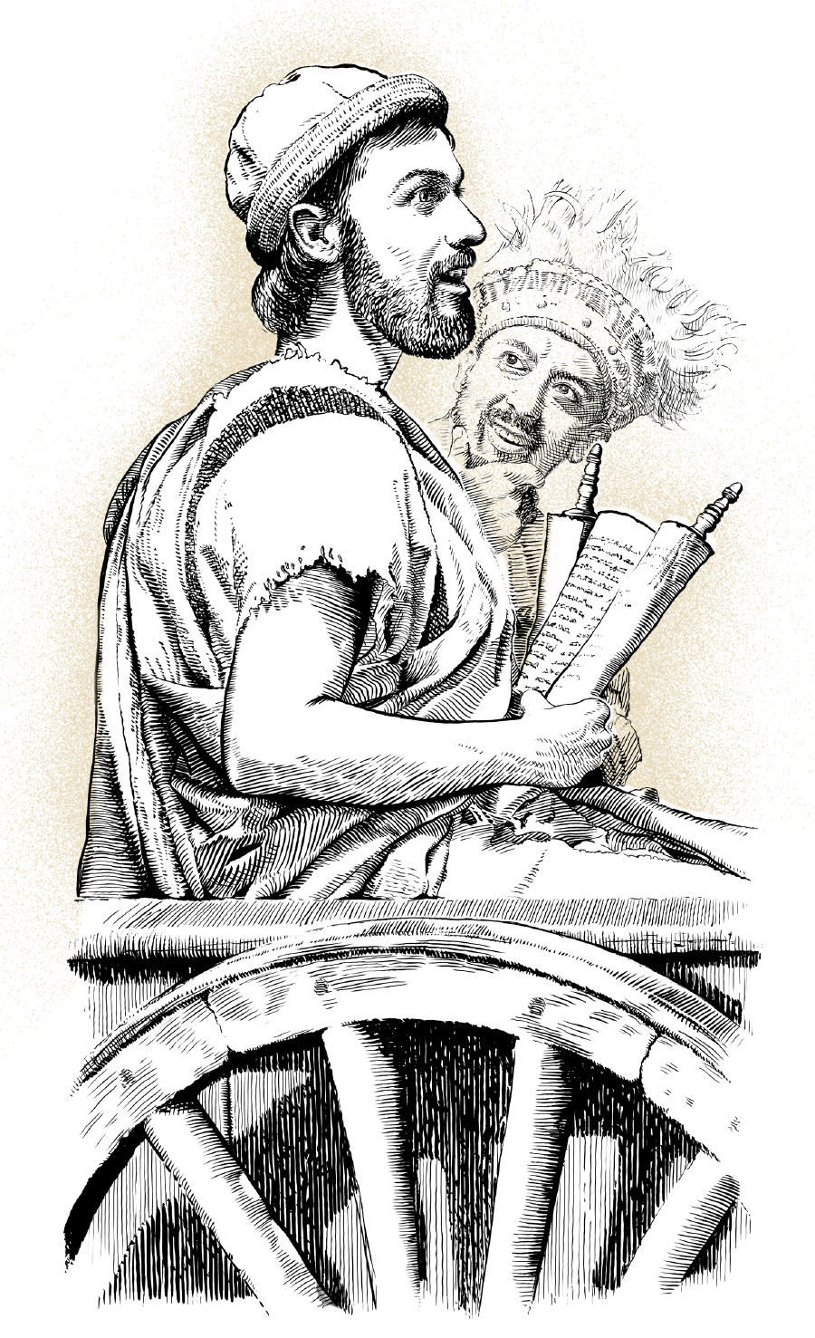
How The Ethiopian Queen’s Treasurer Was Born Again

Slide 23
Acts 8:26-31
Now an angel of the Lord said to Philip, “Rise and go toward the south to the road that goes down from Jerusalem to Gaza.” This is a desert place. And he rose and went. And there was an Ethiopian, a eunuch, a court official of Candace, queen of the Ethiopians, who was in charge of all her treasure. He had come to Jerusalem to worship and was returning, seated in his chariot, and he was reading the prophet Isaiah. And the Spirit said to Philip, “Go over and join this chariot.” So Philip ran to him and heard him reading Isaiah the prophet and asked, “Do you understand what you are reading?” And he said, “How can I, unless someone guides me?” And he invited Philip to come up and sit with him.

Slide 24
Acts 8:32-35
Now the passage of the Scripture that he was reading was this: “Like a sheep he was led to the slaughter and like a lamb before its shearer is silent, so he opens not his mouth. In his humiliation justice was denied him. Who can describe his generation? For his life is taken away from the earth.” And the eunuch said to Philip, “About whom, I ask you, does the prophet say this, about himself or about someone else?” Then Philip opened his mouth, and beginning with this Scripture he told him the good news about Jesus.

Slide 25
Acts 8:36-39
And as they were going along the road they came to some water, and the eunuch said, “See, here is water! What prevents me from being baptized?” Then Philip said, “If you believe with all your heart, you may.” And he answered and said, “I believe that Jesus Christ is the Son of God.”* And he commanded the chariot to stop, and they both went down into the water, Philip and the eunuch, and he baptized him. And when they came up out of the water, the Spirit of the Lord carried Philip away, and the eunuch saw him no more, and went on his way rejoicing.
* Verse 37 is omitted by some translations (including the ESV) because it is not included in some of the earliest manuscripts.

Slide 26
Titus 3:5
Paul spoke of baptism as the “washing of regeneration”:
“he saved us, not because of works done by us in righteousness, but according to his own mercy, by the washing of regeneration and renewal of the Holy Spirit” (Tit. 3:5).
Baptism is specifically distinguished from works by which one earns his salvation.
It is called a “washing of regeneration” (palinggenesia—“state of being renewed, renewal, experience of a complete change of life, rebirth of a redeemed person,” BDAG, 752).
It is both a “washing of regeneration” and a “renewal of the Holy Spirit.”

Slide 27
“Jesus answered him, ‘Truly, truly, I say to you, unless one is born again he cannot see the kingdom of God.’ Nicodemus said to him, ‘How can a man be born when he is old? Can he enter a second time into his mother’s womb and be born?’ Jesus answered, ‘Truly, truly, I say to you, unless one is born of water and the Spirit, he cannot enter the kingdom of God’” (John 3:3-5).

Slide 28
Conclusion

Slide 29
Who Is Lord of Your Life?
“Do you not know that if you present yourselves to anyone as obedient slaves, you are slaves of the one whom you obey, either of sin, which leads to death, or of obedience, which leads to righteousness?” (Rom. 6:16).
We show who is Lord over one’s life by looking at what one does. Who does he obey? Have you submitted your will to the will of the heavenly Father?

