Slide 1
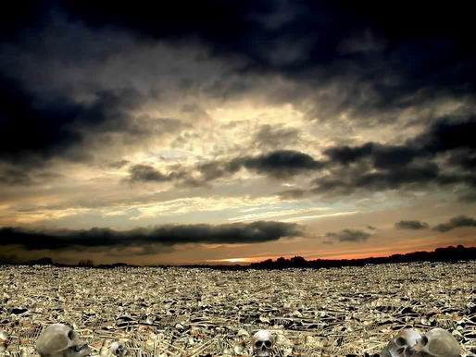
The Valley Of Dry Bones

Slide 2
For whatever things were written before were written for our learning, that we through the patience and comfort of the Scriptures might have hope. (Romans 15:4)

Slide 3
Lessons From God In Unusual Ways:
Hosea told to marry a harlot. Hosea 1:2
Naaman told to dip in Jordan. 2 Kings 5:10
Moses told to make a serpent. Num. 21:4-9
Ezekiel told to lay on his side for 390 days. Ezek. 4:4-8

Slide 4
The Valley Of Dry Bones
Ezekiel 37:1-14

Slide 5
The Valley Of Dry Bones
Ezekiel 37:1-14
Obey God Regardless!

Slide 6
The Valley Of Dry Bones
Ezekiel 37:1-14
Obey God Regardless!
Nothing Is Impossible With God!

Slide 7
The Valley Of Dry Bones
Ezekiel 37:1-14
Obey God Regardless!
Nothing Is Impossible With God!
Ezekiel Preached What He Was Told!

Slide 8
God’s Plan for Your Salvation:
Based on God’s GRACE-- Eph. 2:8
Hear the Word of God –Rom. 10:17
Believe In Your Heart -- Acts 8:37
Repent Of Your Sins --Luke 13:3, 5
Confess faith in Jesus -- Matt. 10:32-33
Be Baptized Into Christ -- Acts 22:16
Be Faithful Until Death --Rev. 2:10

