Slide 2
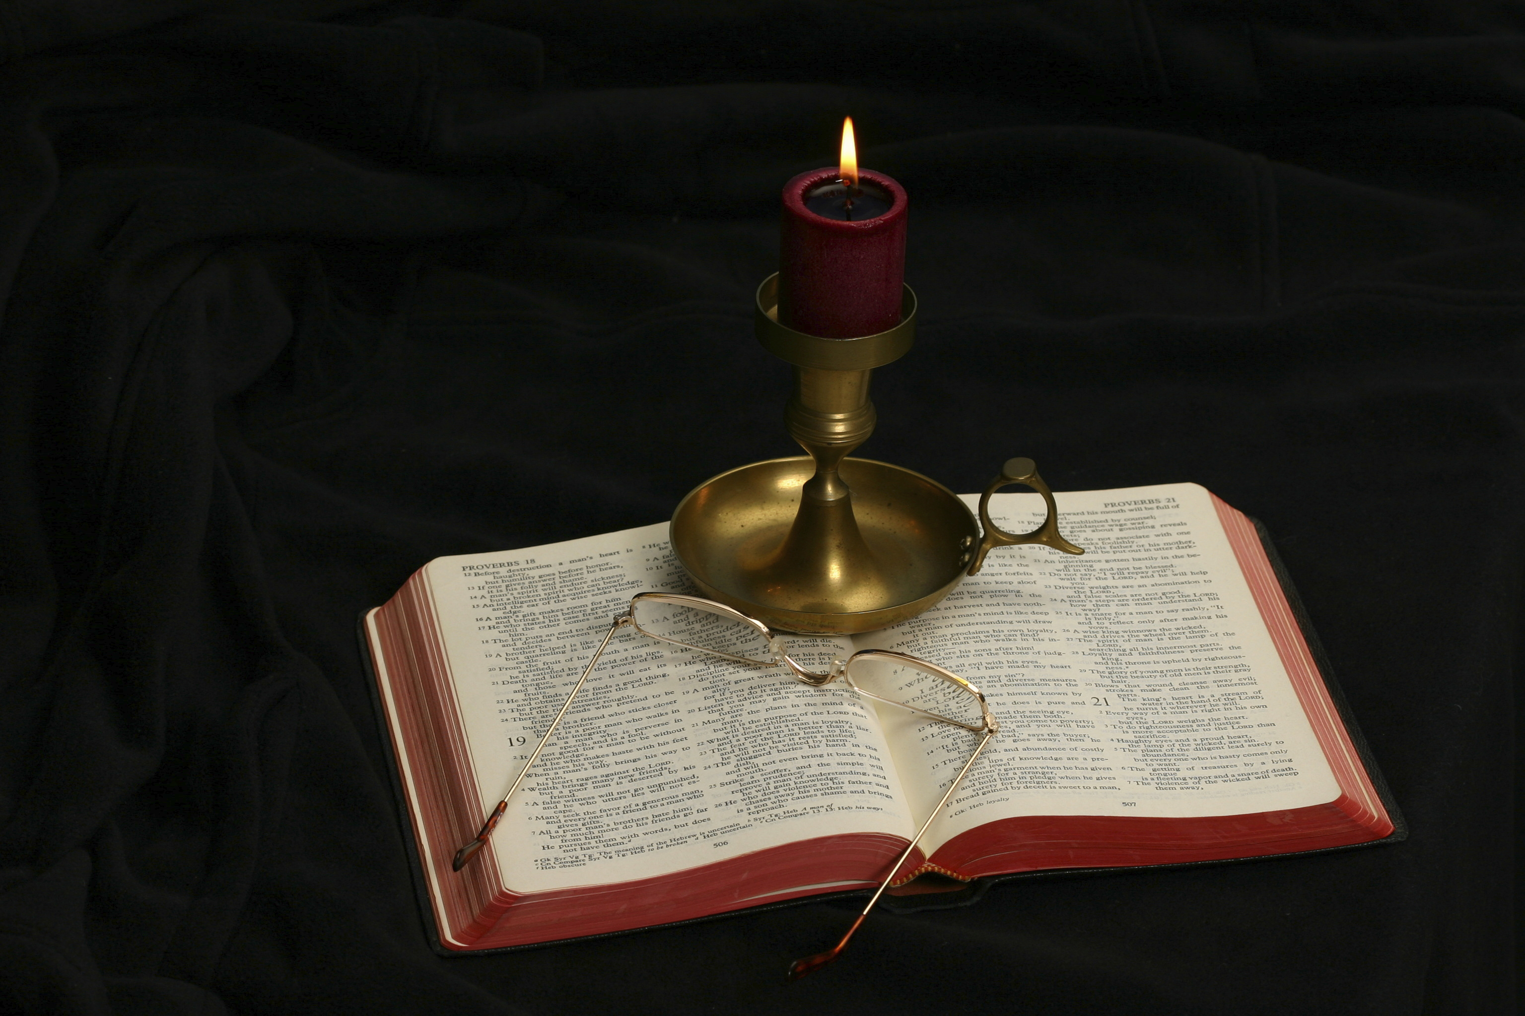
The Gospel of Matthew
Chapter 21

Slide 3
Outline of Chapter 21
Jesus’s Last Week in Jerusalem: Sunday
The Triumphal Entry (21:1-10)
Arrival in Jerusalem (21:11)
Jesus’s Last Week in Jerusalem: Monday
Jesus Cleanses the Temple (21:12-17)
Jesus Curses the Fig Tree (21:18-22)
The Authority of Jesus Challenged (21:23-27)
The Parable of the Two Sons (21:28-32)
The Parable of the Tenants (21:33-44)
Closing Comment (22:45-46)

Slide 4
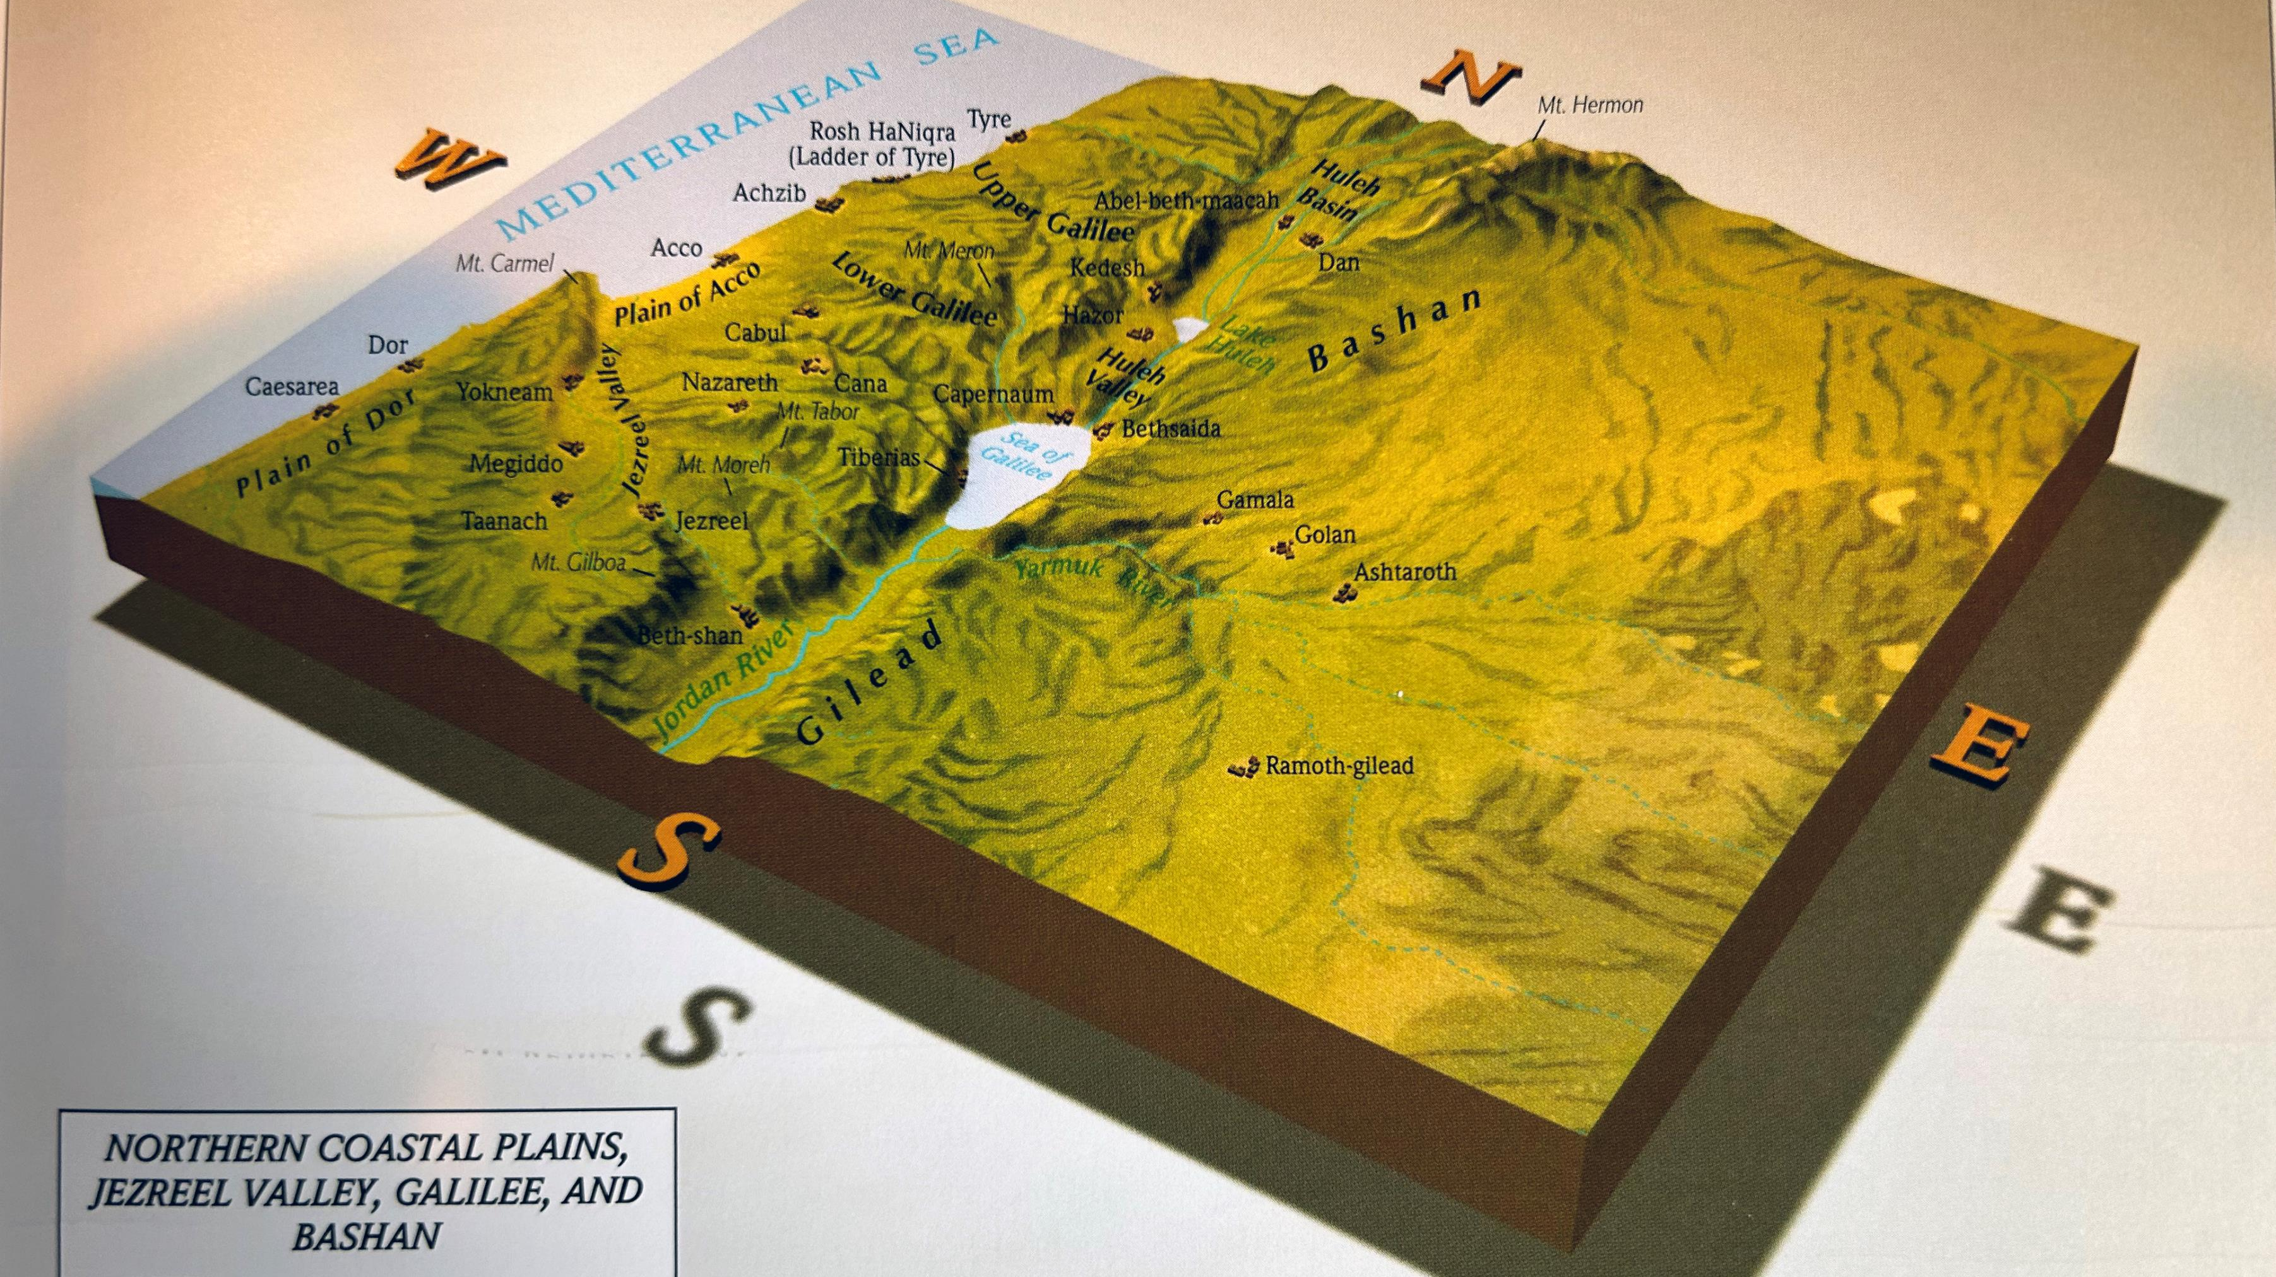

Slide 5
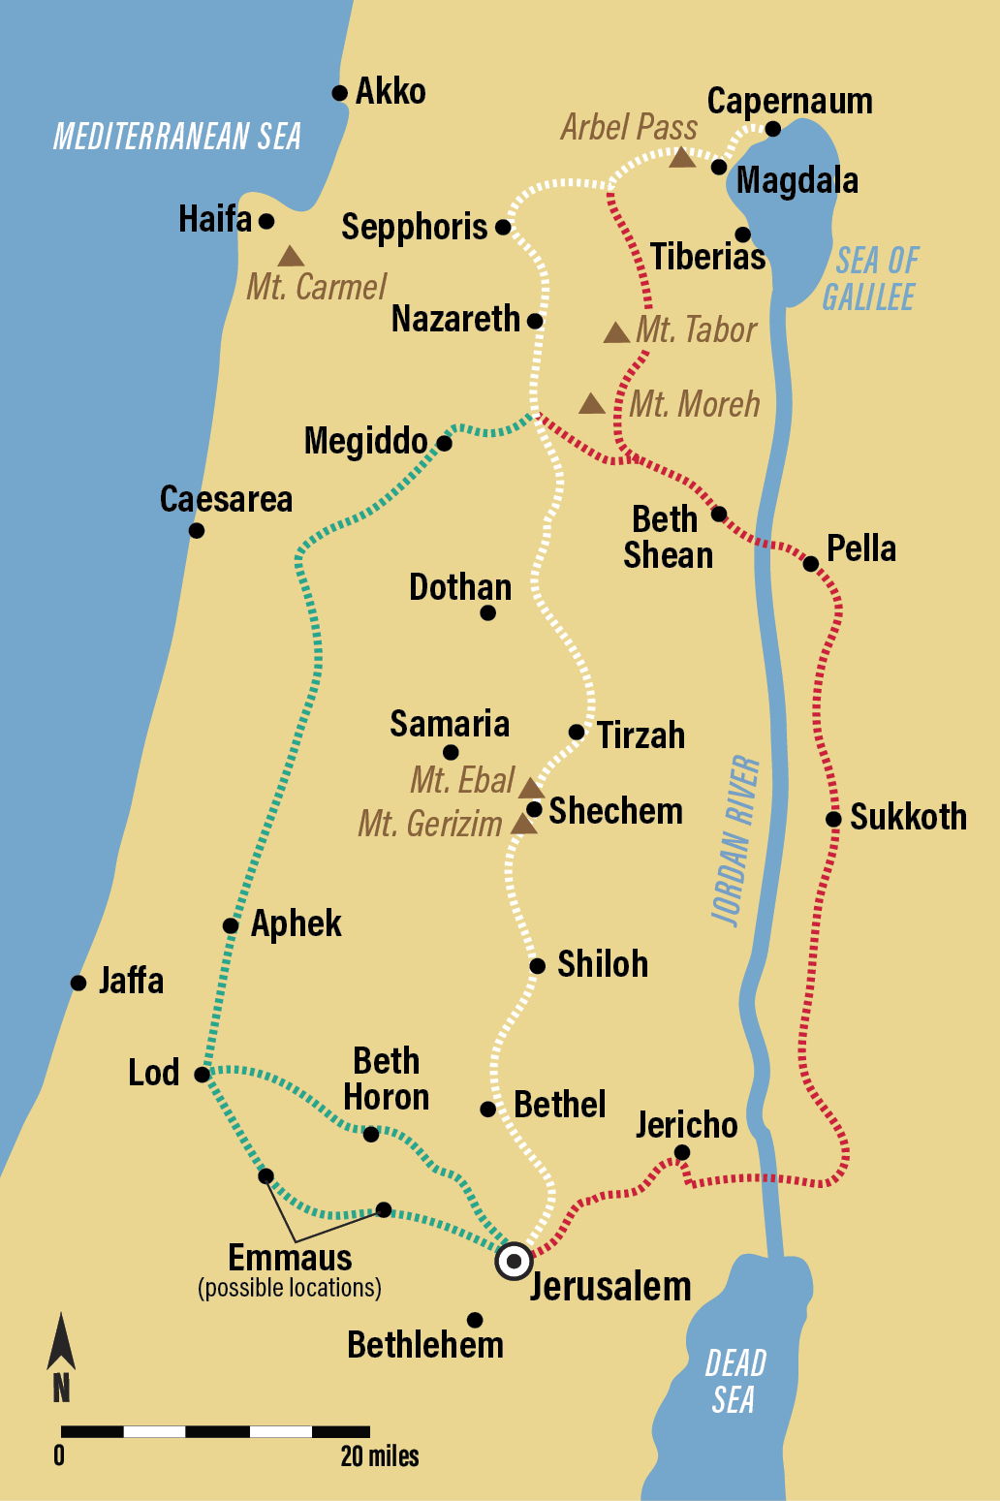
Of the three possible routes people from Galilee took to go to Jerusalem, the one highlighted in red seems to be the route Jesus took, given that He healed two blind men at Jericho immediately before arriving at Jerusalem.

Slide 6
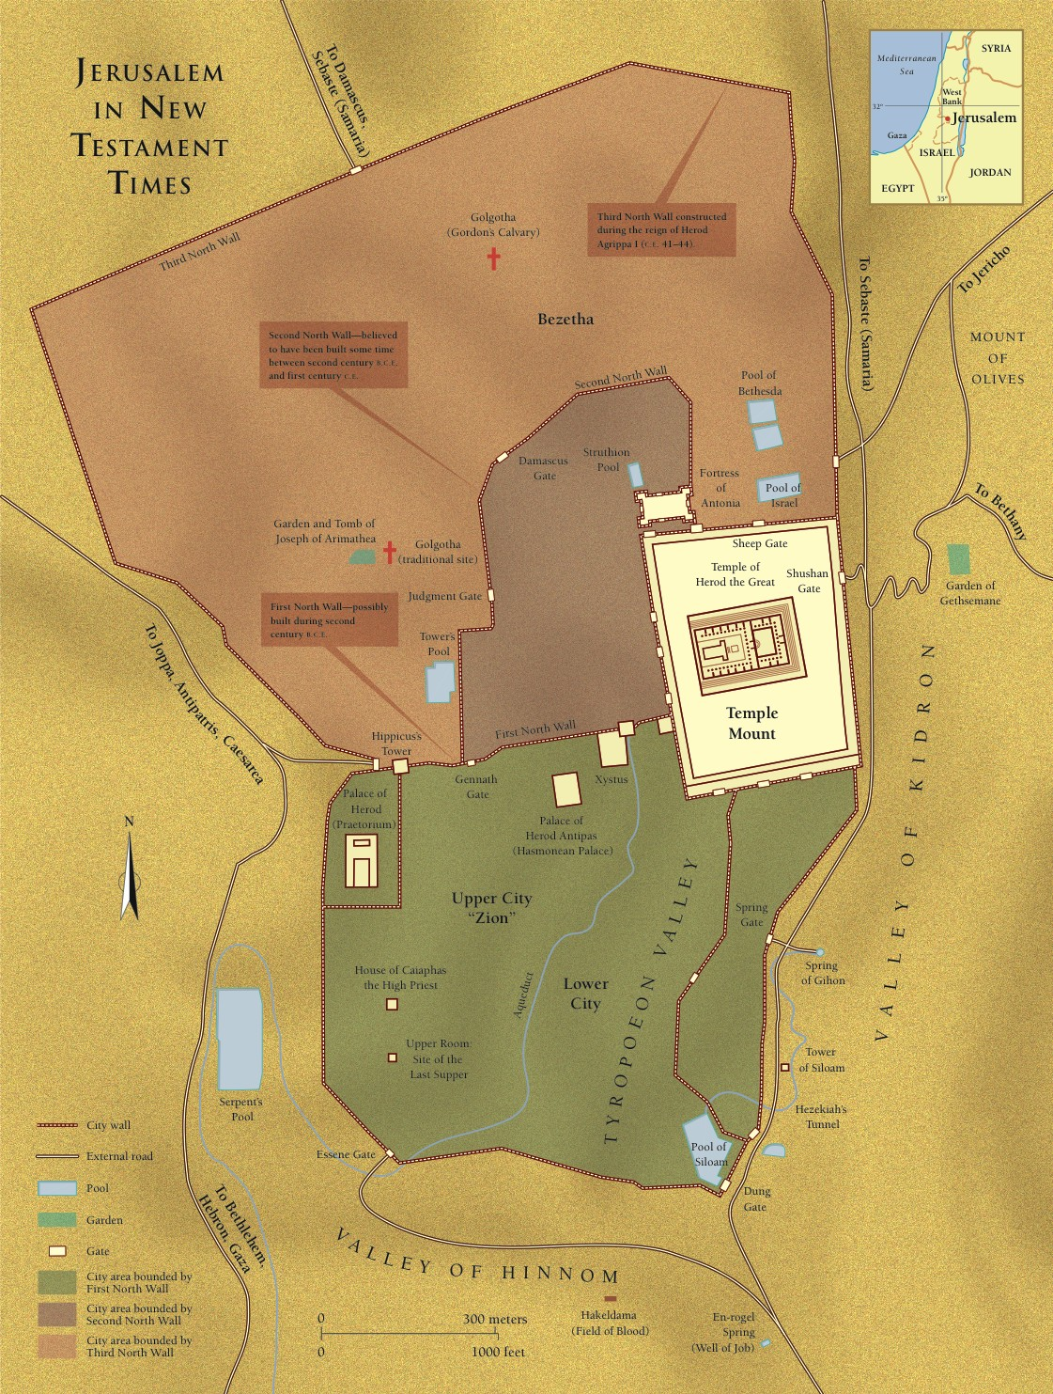

Slide 7
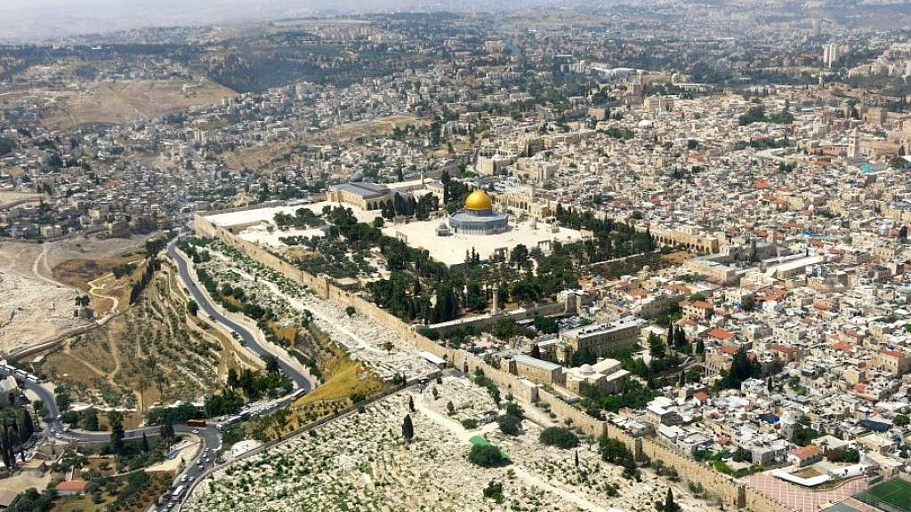
West
South
North
East

Slide 8
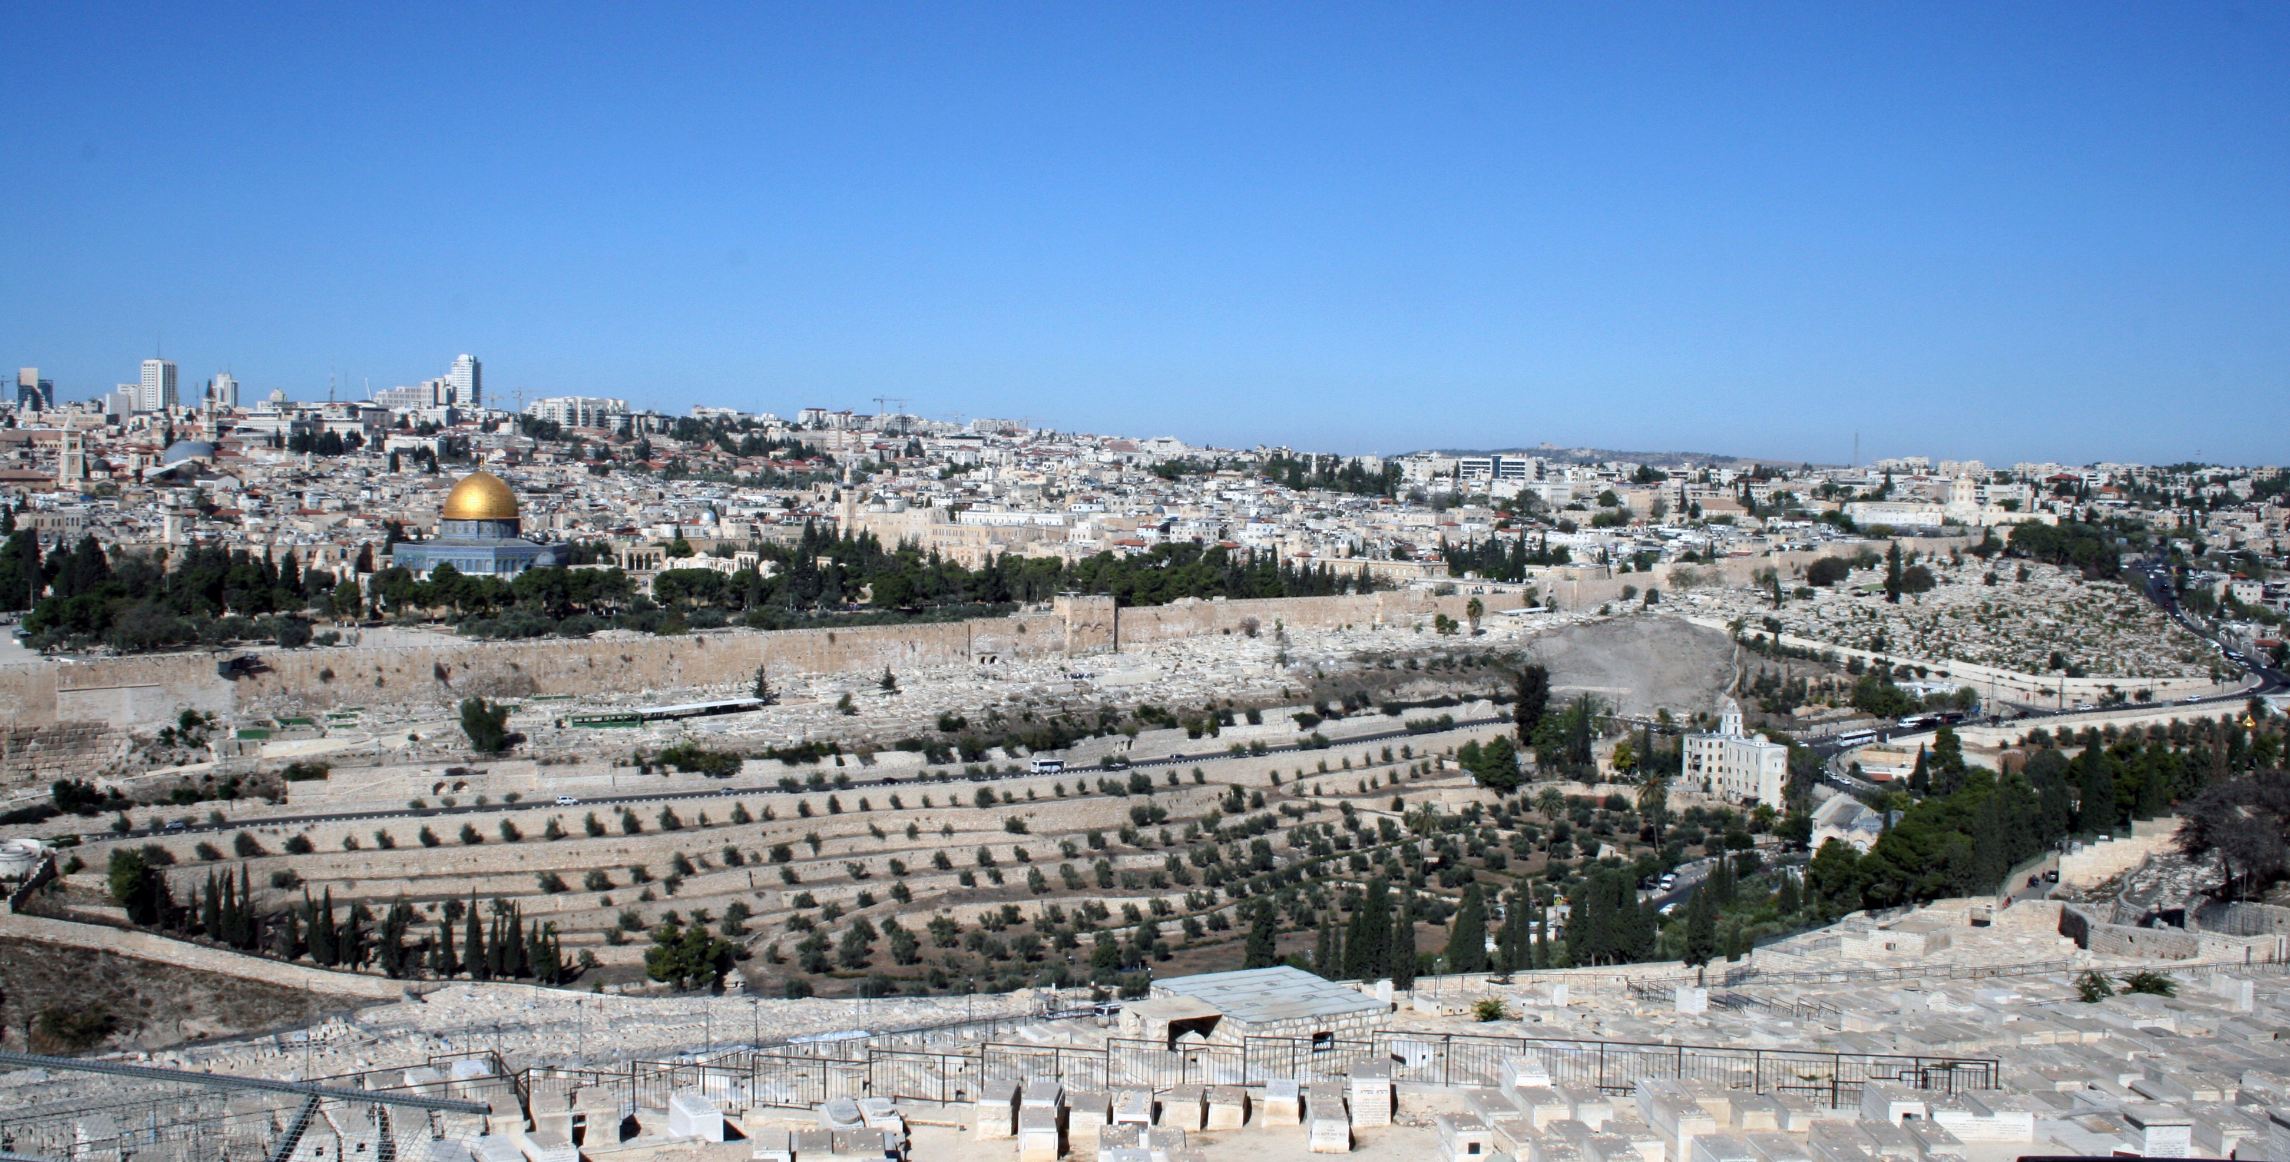
View of the Temple Mount from the Mount of Olives

Slide 9
Significant Events That Have Occurred But Are Not in Matthew
Visit to Jerusalem at the Feast of Tabernacles (John 7:1-52)
Woman taken in adultery (John 8:12-30)
Visit to the house of Mary and Martha (Luke 10:38-42)
Healing of the blind man (John 9)
Jesus at the Feast of Dedication (John 10:22-42)
Raising of Lazarus (John 11:1-46)
Withdrawal to the village of Ephraim (John 11:47-54)
Anointing by Mary of Bethany six days before the Passover (John 11:55‐12:11)

Slide 10
The Chronology of Jesus’s Final Ten Days
Friday | John 12:1 | Arrival in Bethany
Saturday | Matthew 26:6-16 | Anointing in Bethany
Sunday | Matthew 21:1-11 | Entry into Jerusalem
Monday | Matthew 21:12-17 | Cleansing of Temple
Tuesday | Matthew 21:18-26:2 | Teaching on Authority
Wednesday | Luke 21:38 | Teaching in the Temple
Thursday | Matthew 26:17-75 | The Passover
Friday | Matthew 27:1-61 | Crucifixion
Saturday | Matthew 27:62-66 | Sabbath Day
Sunday | Matthew 28:1-15 | Resurrection
Chart: Kyle Pope, The Book of Matthew, Truth Commentaries, 692

Slide 11
Sunday: The Triumphal Entry Matthew 21:1-9
Now when they drew near to Jerusalem and came to Bethphage, to the Mount of Olives, then Jesus sent two disciples, saying to them, “Go into the village in front of you, and immediately you will find a donkey tied, and a colt with her. Untie them and bring them to me. If anyone says anything to you, you shall say, ‘The Lord needs them,’ and he will send them at once.” This took place to fulfill what was spoken by the prophet, saying, “Say to the daughter of Zion, ‘Behold, your king is coming to you, humble, and mounted on a donkey, on a colt, the foal of a beast of burden.’” The disciples went and did as Jesus had directed them. They brought the donkey and the colt and put on them their cloaks, and he sat on them. Most of the crowd spread their cloaks on the road, and others cut branches from the trees and spread them on the road. And the crowds that went before him and that followed him were shouting, “Hosanna to the Son of David! Blessed is he who comes in the name of the Lord! Hosanna in the highest!”

Slide 12
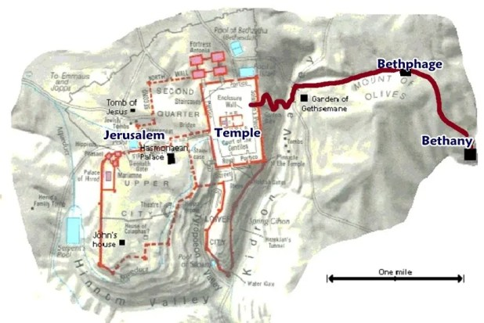
The precise location of Bethphage is unknown.

Slide 13
Matthew 21:1
“Now when they drew near to Jerusalem and came to Bethphage, to the Mount of Olives, then Jesus sent two disciples. . . .”
The triumphal entry is recorded in all four gospels (cf. Mark 11:1-10; Luke 19:28-40; John 12:12-19).
Two Old Testament references seem relevant:
David crossed over the Mount of Olives in the Old Testament when he fled from Absalom who rebelled against his father (2 Sam. 15:30).
Zechariah had prophesied of the Lord’s victory from the nations attacking His people in Jerusalem (Zech. 14:4). This tied the mount to Messianic hope.
Having spent the night at Bethany, Jesus came to Bethphage where He sent out two disciples to secure a donkey.

Slide 14
Matthew 21:2
“. . . saying to them, ‘Go into the village in front of you, and immediately you will find a donkey tied, and a colt with her. Untie them and bring them to me.’”
How does Jesus know about the donkey and her colt?
Matthew alone mentions the mother and her colt.
Both Mark and Matthew describe the donkey on which sat Jesus saying, “on which no one has ever yet sat” (Luke 19:30; Mark 11:12). This means that Jesus road in on the colt, not the mother.
What usually happens when one mounts a horse or donkey on which one has never sat?

Slide 15
Riding on a Donkey
What is the difference in the message with Jesus riding into Jerusalem on a donkey versus Him riding into Jerusalem on a white stallion?

Slide 16
Matthew 21:3
If anyone says anything to you, you shall say, ‘The Lord needs them,’ and he will send them at once.”
There is discussion about whether Jesus had already arranged for the donkeys, just as He had arranged for a place for the Lord’s Supper on Thursday (26:18; cf. Mark 14:12-16).
Henry Morris treats “The Lord needs them” as a signal, a password, to the owner that had been previously arranged (519-520).
Others (Pope, 697; France, 301) believe that Jesus was exercising His right as a rabbi to requisition animals or people for service (cf. to how the Romans made Simon of Cyrene carry Jesus’s cross, 27:32).
Jesus’s reference to Himself as Lord is unusual. Jesus was certainly not the owner of the animals. It could mean Jesus as the “Lord” of all things.

Slide 17
Matthew 21:4
“This took place to fulfill what was spoken by the prophet, saying. . . ,”
This is the twelfth time Matthew has cited a prophecy about the Messiah from the Old Testament to prove that Jesus fulfills those Old Testament prophecies.
The prophecy is from the prophet Zechariah.

Slide 18
Zechariah Prophecies Applied to Jesus
Riding on a colt | Zechariah 9:9 | Matthew 21:4-5
Sheep scattered | Zechariah 13:7 | Matthew 26:31
Gazing on the one pierced | Zechariah 12:10 | (John 19:37)
Thirty pieces of silver | Zechariah 11:12 | Matthew 27:9
The potter’s field | Zechariah 11:13 | Matthew 27:10
Table taken from Kyle Pope, The Gospel of Matthew, Truth Commentaries, 698.

Slide 19
Matthew 21:5
“Say to the daughter of Zion,
‘Behold, your king is coming to you,
righteous and having salvation is he,
humble, and mounted on a donkey,
on a colt, the foal of a beast of burden.’”
Both Matthew and John (12: 15) quoted from Zechariah 9:9. I have printed text in such a manner as to show the poetic parallelism of the Hebrew text.
The first line is taken from Isaiah 62:11, a passage promising the coming of a savior.
The rest of the verse comes from Zechariah emphasizing that the Messianic king is “humble,” as demonstrated by His coming, not on a white stallion, but the foal of a donkey, a burden bearing animal.
The line in lighter type appears in Zechariah, but is omitted by Matthew.
John’s account adds that the disciples did not initially understand that Jesus’s actions were fulfilling Zechariah’s prophecy.

Slide 20
Matthew 21:6
The disciples went and did as Jesus had directed them.
Directed (suntassō): “to direct that something be done in an explicit fashion, order, direct, prescribe” (BDAG, 974).
The sentence emphasizes the obedience of those sent to bring the donkey.
Mark’s account involves more detail: “And they went away and found a colt tied at a door outside in the street, and they untied it. And some of those standing there said to them, ‘What are you doing, untying the colt?’ And they told them what Jesus had said, and they let them go” (Mark 11:4-5).

Slide 21
Matthew 21:7
They brought the donkey and the colt and put on them their cloaks, and he sat on them.
Them appears two times in this sentence. In the first case, it refers to the donkeys, who had garments laid upon them. In the second case, it refers to the cloaks.
Some have interpreted the second use of them to refer to the mother donkey and her colt, as if Jesus sat upon two animals at the same time.

Slide 22
Matthew 21:8
And many spread their cloaks on the road, and others spread leafy branches that they had cut from the fields.
Many (polus): “very great, very large (ὁ) πλεῖστος ὄχλος Mt 21:8 (ὁ πλεῖστος ὄχλος could also be the greatest part of the crowd” (BDAG, 849).
Garments were strewn before Jehu to honor him as the newly anointed king (2 Kings 9:13). The garments are similar to spreading out a ceremonial red carpet to honor dignitaries.
The cutting of “branches” (klados), Mark has “leafy branches” (stibadas), and John has “branches of palm trees.” John’s wording is the basis for calling the entrance of Jesus into Jerusalem “Palm Sunday.”

Slide 23
Matthew 21:9
And those who went before and those who followed were shouting, “Hosanna! Blessed is he who comes in the name of the Lord!”
There can be no doubt that the crowd accompanying Jesus is excited by their view that Jesus is the Messiah, tainted as their view was by their political expectations.
The people of Jerusalem who had heard of Jesus recently raising Lazarus from the dead joined in with those who came to the city (John 12:16).
Both Luke 19:38 and John 12:13, 15 refer to Jesus as “king.”
Their response is to shout “Hosanna” (Save us!), from Psalm 118:25, followed by Psalm 118:26, “Blessed is he who comes in the name of the LORD! We bless you from the house of the LORD.”

Slide 24
The Significance of the Triumphal Entry
What is the significance of the triumphal entry?
What has changed that Jesus had previously told His disciples not to refer to Him as the Christ but now He allowed this public event of riding on a donkey down the Mount of Olives as it approached the city of Jerusalem?
What effect would it have on:
His disciples?
The Jewish leaders?
The Romans?
The Romans typically sent troops from Caesarea to Jerusalem to be sure that the Jews did not incite rebellion during their annual feasts.

Slide 25
Sunday: Arrival in Jerusalem Matthew 24:10-11
And when he entered Jerusalem, the whole city was stirred up, saying, “Who is this?” And the crowds said, “This is the prophet Jesus, from Nazareth of Galilee.”

Slide 26
Matthew 24:10
And when he entered Jerusalem, the whole city was stirred up, saying, “Who is this?”
Stirred up (seiō): “to cause to be in a state of commotion, shake, agitate” (BDAG, 918).
The NEB translates this as “wild with excitement.”
The word is used of what happens in an earthquake (note the instrument used to measure the strength of an earthquake is called a seismograph).
What is the significance of whole city?
Compare Matthew 2:3 at the birth of Jesus. When the magi arrived in Jerusalem with their announcement that they had seen the star of the king of Israel, “all Jerusalem was troubled.”

Slide 27
Matthew 24:11
And the crowds said, “This is the prophet Jesus, from Nazareth of Galilee.”
What is the significance of identifying Jesus as a “prophet”?
Could it be an allusion to Deut. 18:15-17, the prophet like Moses?

Slide 28
Monday: Jesus Cleanses the Temple Matthew 21:12-17
And Jesus entered the temple and drove out all who sold and bought in the temple, and he overturned the tables of the money-changers and the seats of those who sold pigeons. He said to them, “It is written, ‘My house shall be called a house of prayer,’ but you make it a den of robbers.” And the blind and the lame came to him in the temple, and he healed them. But when the chief priests and the scribes saw the wonderful things that he did, and the children crying out in the temple, “Hosanna to the Son of David!” they were indignant, and they said to him, “Do you hear what these are saying?” And Jesus said to them, “Yes; have you never read, ‘Out of the mouth of infants and nursing babies you have prepared praise’?” And leaving them, he went out of the city to Bethany and lodged there.

Slide 29
Mark’s Sequence of Events
And he entered Jerusalem and went into the temple. And when he had looked around at everything, as it was already late, he went out to Bethany with the twelve.
On the following day, when they came from Bethany, he was hungry. And seeing in the distance a fig tree in leaf, he went to see if he could find anything on it. When he came to it, he found nothing but leaves, for it was not the season for figs. And he said to it, “May no one ever eat fruit from you again.” And his disciples heard it.
And they came to Jerusalem. And he entered the temple and began to drive out those who sold and those who bought in the temple, and he overturned the tables of the money-changers and the seats of those who sold pigeons. And he would not allow anyone to carry anything through the temple. And he was teaching them and saying to them, “Is it not written, ‘My house shall be called a house of prayer for all the nations’? But you have made it a den of robbers.” And the chief priests and the scribes heard it and were seeking a way to destroy him, for they feared him, because all the crowd was astonished at his teaching. And when evening came they went out of the city (Mark 11:11-18).

Slide 30
Observations
Matthew’s order of events is different than Mark’s.
The reason for this arrangement seems to be to tie together the significance of the two events:
The triumphal entry: Jesus presents Himself as the Jewish Messiah, King over the city.
The cleansing of the Temple: Jesus presents Himself as having authority over the Temple.
Both events aroused opposition (21:10, 23).
John has a record of Jesus cleansing the Temple earlier in Jesus’s ministry (John 2:12-17). The chronology in John inserts the account of the cleansing of the Temple after Jesus’s first miracle in Cana of Galilee (John 2:1-11).
The two events form an inclusio around Jesus’s whole public ministry.

Slide 31
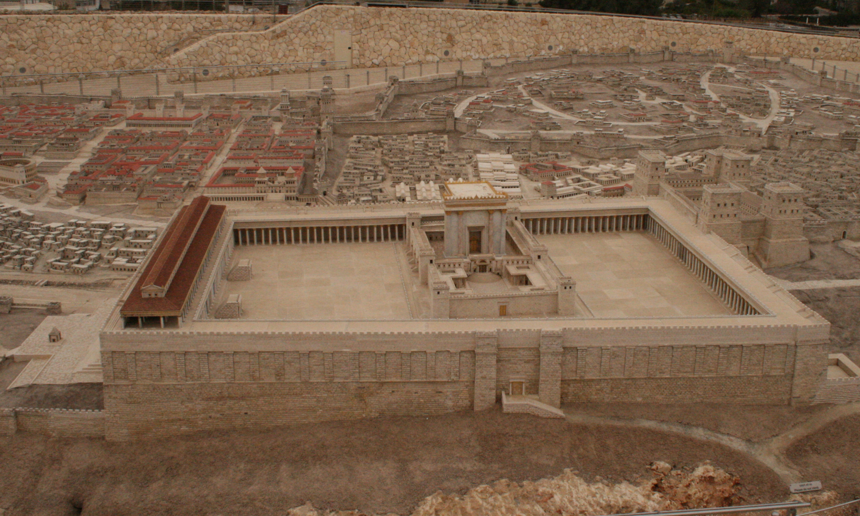

Slide 32
Matthew 21:12
And Jesus entered the temple and drove out all who sold and bought in the temple, and he overturned the tables of the money-changers and the seats of those who sold pigeons.
What was going on in the Temple?
Animal sacrifices required unblemished animals. John 2:17 relates, “In the temple he found those who were selling oxen and sheep and pigeons, and the money-changers sitting there.” We would expect the same here.
It would have been a convenience to the worshippers for such animals to be readily available.
The pigeons were the smallest animal sacrifices and were especially offered by the poor.
The money changers were necessary because the only coin accepted was the Tyrian coins (Mishnah Bekhorot 8:7), most likely because of its retaining its value.

Slide 33
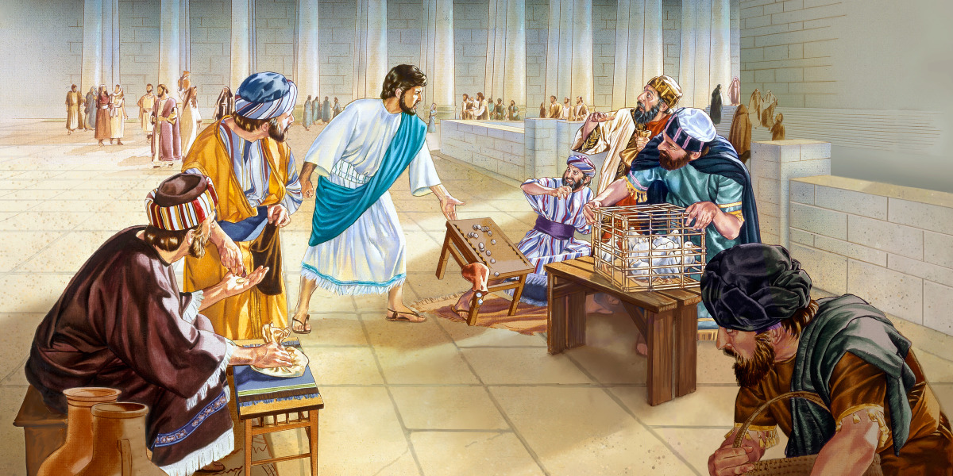
Jesus Cleanses the Temple

Slide 34
Matthew 21:13
“He said to them, ‘It is written, “My house shall be called a house of prayer,’ but you make it a den of robbers.’”
Jesus quotes from Isaiah 56:7—“these I will bring to my holy mountain, and make them joyful in my house of prayer; their burnt offerings and their sacrifices will be accepted on my altar; for my house shall be called a house of prayer for all peoples.”
Matthew does not include “for all peoples,” although Mark does.
There is also an allusion to Jeremiah 7:11—“Has this house, which is called by my name, become a den of robbers in your eyes? Behold, I myself have seen it, declares the LORD.”
Den (spēlaion): “hideout . . . As a place of refuge” (BDAG, 938). A den is a place where thieves and animals would take their loot and prey.
Robbers (lēstēs): “robber, highwayman, bandit” (BDAG, 594). “Robbers” demands the idea of theft.
Jesus is making a comment about the dishonest business practices going on in the temple courts! Think of how much a cola costs at the movie theater! Its robbery!

Slide 35
What Would Jesus Say?
About buying and selling in the church building?
Some churches have places to buy Starbucks and a snack.
Some churches sell day care services, pre-school, elementary, middle school, and high school educations.
This involves selling meals to students.
Having churches to provide soccer fields, basketball and volleyball courts, stages for performances, etc.?
Has modern America allowed our worship facilities to become secular places?

Slide 36
Matthew 21:14
And the blind and the lame came to him in the temple, and he healed them.
These are the last recorded miracles that Jesus performed.
This verse confirms that the blind and lame were allowed in the Temple courts.

Slide 37
Matthew 21:15
“But when the chief priests and the scribes saw the wonderful things that he did, and the children crying out in the temple, ‘Hosanna to the Son of David!’ they were indignant, . . .”
Chief priests (archiereus): “The plural is used in the NT and Josephus to denote members of the Sanhedrin who belonged to highpriestly families: ruling high priests, whose who had been deposed, and adult male members of the most prominent families” (BDAG, 139).
Scribes (grammateus): “specialists in the law of Moses: experts in the law, scholars versed in the law, scribes” (BDAG, 206).
What did they see?
Wonderful things (thaumasios): “pertaining to being a cause of wonder or worthy of amazement, wonderful, remarkable, admirable” (BDAG, 445).
Hosanna: “a shout of praise” that literally means “save, I pray” (BDAG, 1106).
Why were the chief priests and scribes indignant?

Slide 38
Matthew 21:16
“. . . and they said to him, ‘Do you hear what these are saying?’ And Jesus said to them, ‘Yes; have you never read, “Out of the mouth of infants and nursing babies you have prepared praise”?’”
Jesus quoted Psalm 8:2—“Out of the mouth of babies and infants, you have established strength because of your foes, to still the enemy and the avenger.”
Of whom is Psalm 8 speaking?
To whom is it applied in this verse?
Leon Morris: “It is not without its interest that they picked on the easiest target they could find—little children. They had no criticism of the unholy traders who defiled the sacred place, but they objected to the praises of children” (The Gospel according to Matthew, The Pillar New Testament Commentary, 528–529).

Slide 39
Matthew 21:17
And leaving them, he went out of the city to Bethany and lodged there.
This verse marks the end of the activities of Monday of Passion week.
Note that Jesus stays at Bethany, the village where Lazarus and Simon the Leper lived (Mark 11:1, 11, 12; cf. John 12:1; Matt. 26:6).

Slide 40
Events Occurring on Tuesday of Passion Week
The Fig Tree Withered (Matt. 21:20-22)
Christ’s Authority Challenged (Matt. 21:23-27)
Three Parables of Warning (Matt. 21:28‐22:14)
Three Questions by the Jewish Rulers (Matt. 22:15-40)
Jesus’s Unanswerable Question (Matt. 22:41-46).
Woes Against the Scribes and Pharisees (Matt. 23)
Sermon on the Destruction of Jerusalem and the End of the World (Matt. 24:1‐26:2)

Slide 41
Tuesday: Jesus Curses the Fig Tree Matthew 21:18-22
In the morning, as he was returning to the city, he became hungry. And seeing a fig tree by the wayside, he went to it and found nothing on it but only leaves. And he said to it, “May no fruit ever come from you again!” And the fig tree withered at once. When the disciples saw it, they marveled, saying, “How did the fig tree wither at once?” And Jesus answered them, “Truly, I say to you, if you have faith and do not doubt, you will not only do what has been done to the fig tree, but even if you say to this mountain, ‘Be taken up and thrown into the sea,’ it will happen. And whatever you ask in prayer, you will receive, if you have faith.”

Slide 42
Mark’s Account
On the following day, when they came from Bethany, he was hungry. And seeing in the distance a fig tree in leaf, he went to see if he could find anything on it. When he came to it, he found nothing but leaves, for it was not the season for figs. And he said to it, “May no one ever eat fruit from you again.” And his disciples heard it. And they came to Jerusalem. And he entered the temple and began to drive out those who sold and those who bought in the temple, and he overturned the tables of the money-changers and the seats of those who sold pigeons. And he would not allow anyone to carry anything through the temple. And he was teaching them and saying to them, “Is it not written, ‘My house shall be called a house of prayer for all the nations’? But you have made it a den of robbers.” And the chief priests and the scribes heard it and were seeking a way to destroy him, for they feared him, because all the crowd was astonished at his teaching. And when evening came they went out of the city. As they passed by in the morning, they saw the fig tree withered away to its roots. And Peter remembered and said to him, “Rabbi, look! The fig tree that you cursed has withered.” And Jesus answered them, “Have faith in God. Truly, I say to you, whoever says to this mountain, ‘Be taken up and thrown into the sea,’ and does not doubt in his heart, but believes that what he says will come to pass, it will be done for him. Therefore I tell you, whatever you ask in prayer, believe that you have received it, and it will be yours. And whenever you stand praying, forgive, if you have anything against anyone, so that your Father also who is in heaven may forgive you your trespasses.”

Slide 43
Observations
Matthew has separated the cleansing of the Temple account from the cursing of the fig tree. Matthew compresses the cursing of the fig tree and its effect occurred into one event .
Mark gives details Matthew did not include.
Monday:
Jesus curses the fig tree (Mark 11:12-14).
Jesus cleanses the Temple (Mark 11:15-18)
Tuesday:
Jesus explains the lesson from the Withered Tree (Mark 11:20-25)

Slide 44
Three Symbolic Acts
The triumphal entry: the Messiah is coming to take authority over His people
The cleansing of the Temple: the Messiah takes authority over His temple
The cursing of the fig tree: the Messiah foretells His judgment over Jerusalem

Slide 45
Matthew 21:18
In the morning, as he was returning to the city, he became hungry.
Sunday evening, Jesus left the Temple and returned to Bethany.
Monday morning is when Jesus hungered and pronounced a curse on the fig tree.
Morning (prōï): the fourth watch of night was 3-6 am. This Greek word prōï means “in the early part of the daylight period, early, early in the morning” (BDAG, 892).
What does “he became hungry” show about Jesus?

Slide 46
Matthew 21:19
And seeing a fig tree by the wayside, he went to it and found nothing on it but only leaves. And he said to it, “May no fruit ever come from you again!” And the fig tree withered at once.
That the tree was “by the wayside” is indicative that it was one that had grown up along the path people traveled. In East Texas, we had wild plum trees growing up along the roadside, from which anyone who wished could eat.
Jesus found the fig tree having leaves, but no fruit.
Mark tells us that “it was not the season for figs” (11:13).
Fig trees produce between June and September.
Jesus was in Jerusalem for the Passover, in March/April.
We should not imagine Jesus cursing a tree for not producing figs out of season.

Slide 47
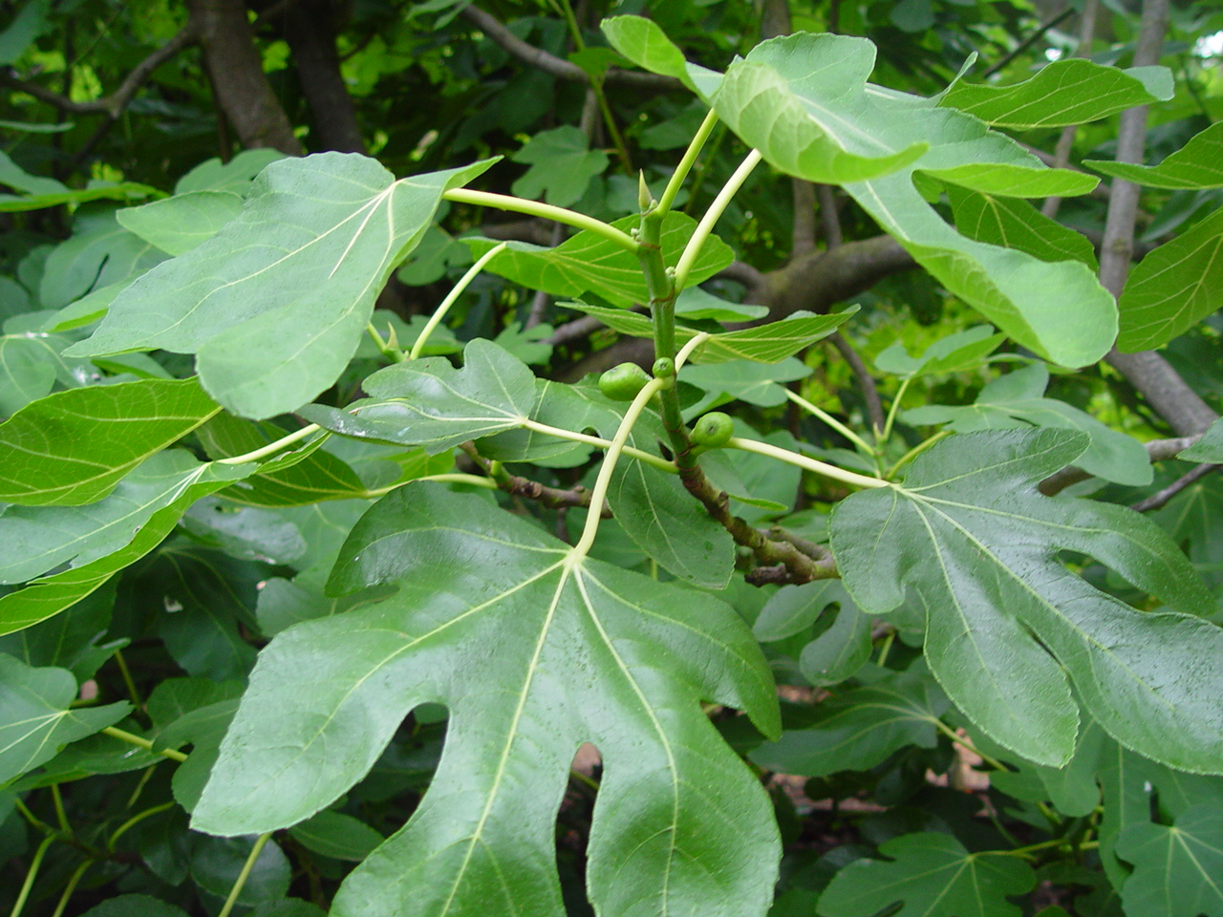
Fig Tree Horticulture
R. K. Harrison: “When the young leaves are appearing in spring, every fertile fig will have some taksh on it, even though the season for edible figs (Mk. 11:13, AV) has not arrived. When the leaves are fully developed the fruit ought to be mature also. But if a tree with leaves has no fruit, it will be barren for the entire season” (ISBE, II, p. 302; he explains taksh as “underdeveloped fruit” that nevertheless “is often gathered for sale in the markets”)” (quoted in Leon Morris, 530).
Photo taken in Caesarea Philippi in March/April

Slide 48
Explanation
Jesus recognizes that because there are leaves, but no unripe figs, on the tree, it will not produce fruit that season.
Jesus “curses” the tree does not mean that He used profanity. The curse is this: “May no fruit ever come from you again!”
Jesus’s action on this occasion reminds me of the incident when the demons whom Jesus expelled from a man asked to be sent into the hogs and the hogs ran over a cliff into the Sea of Galilee (Matt. 8:28-34).

Slide 49
Matthew 21:20
When the disciples saw it, they marveled, saying, “How did the fig tree wither at once?”
In Mark’s account, Jesus curses the tree on Monday morning and the disciples do not see the withered tree until Tuesday morning.
They did not see the cursed tree as they returned to Bethany at the close of Monday.
Kyle Pope quotes R.C. Foster: “Foster explains: ‘. . . The winding road around the Mount of Olives was regularly used in climbing up to Bethany and the shorter, steeper road leading straight down from the crest was the usual means of entry to Jerusalem from the east. Entering and leaving the city by these different roads, they did not pass by the fig tree on their return trip in the evening’” (1104).

Slide 50
The Effect of Jesus’s Curse
The tree was withered (xērainō): “become dry, dry up, wither of trees” (BDAG, 684).
Marveled (thaumazō): “wonder, marvel, be astonished” (BDAG, 445).
At once (parachrēma): “pertaining to a point of time that is immediately subsequent to an action, at once, immediately” (BDAG, 773). For a plant that was flourishing with many green leaves to be withered the next morning shows the immediacy of the effect.
Why were they marveling?
What does this tell us about Jesus?
Today, men use chemicals to kill plants (such as bushes growing in a fence row).

Slide 51
What Are We to Learn?
Why is Jesus reacting as He does toward the fig tree?
What is Jesus teaching through this fig tree with green leaves but no figs?

Slide 52
Matthew 21:20
“And Jesus answered them, ‘Truly, I say to you, if you have faith and do not doubt, you will not only do what has been done to the fig tree, but even if you say to this mountain, “Be taken up and thrown into the sea,” it will happen.’”
This verse reminds one of another: “He said to them, ‘Because of your little faith. For truly, I say to you, if you have faith like a grain of mustard seed, you will say to this mountain, “Move from here to there,” and it will move, and nothing will be impossible for you’” (Matt. 17:20).
Doubt (diakrinō): “to be uncertain, be at odds with oneself, doubt, waver” (BDAG, 231).

Slide 53
This Mountain
Craig Blomberg: “The demonstrative adjective ‘this’ is probably significant. As Jesus and company were traveling from Bethany to Jerusalem, they would be facing Mount Zion, the temple mount. Jesus’ community will therefore see the overthrow of the temple—physically in A.D. 70 and spiritually with Jesus’ death and resurrection in just a few days. Given that the Old Testament described judgment on Israel in terms of the land producing no fig trees (e.g., Mic 7:1–6; Jer 8:13), and given that Mark sandwiches this episode around the temple purification (Mark 11:12–25), it is almost certainly correct to see in this passage a foreshadowing of the destruction of the sacrificial system in Israel” (Matthew, The New American Commentary, 318).
The prophecy of the destruction of Jerusalem will be given from the Mount of Olives on the evening of this same day (Matt. 24-25).

Slide 54
Matthew 21:21
“And whatever you ask in prayer, you will receive, if you have faith.”
Jesus’s promise reminds one of Matthew 7:7-11.
What is the verse teaching us about prayer?
“If any of you lacks wisdom, let him ask God, who gives generously to all without reproach, and it will be given him. But let him ask in faith, with no doubting, for the one who doubts is like a wave of the sea that is driven and tossed by the wind. For that person must not suppose that he will receive anything from the Lord; he is a double-minded man, unstable in all his ways” (James 1:5-8).
This verse is not a blank check for prayer.
“You ask and do not receive, because you ask wrongly, to spend it on your passions” (James 4:3).
This passage emphasizes one aspect of prayer using hyperbole to express it. To get a full concept about prayer, one must study all of the Bible passages that relate to prayer.

Slide 55
The Authority of Jesus Challenged Matthew 21:23-27
And when he entered the temple, the chief priests and the elders of the people came up to him as he was teaching, and said, “By what authority are you doing these things, and who gave you this authority?” Jesus answered them, “I also will ask you one question, and if you tell me the answer, then I also will tell you by what authority I do these things. The baptism of John, from where did it come? From heaven or from man?” And they discussed it among themselves, saying, “If we say, ‘From heaven,’ he will say to us, ‘Why then did you not believe him?’ But if we say, ‘From man,’ we are afraid of the crowd, for they all hold that John was a prophet.” So they answered Jesus, “We do not know.” And he said to them, “Neither will I tell you by what authority I do these things.”

Slide 56
Background Information
Sunday: Triumphal entry
Monday: Cleansing the Temple and cursing of the fig tree
Tuesday: Seeing the cursed tree and entering the Temple

Slide 57
The Events of Tuesday occur in the Outer Courts of the Temple

Slide 58
A Series of Confrontations in the Temple Matthew 21:23‐24:1
Challenge to Jesus’s authority (21:23-27)
Three parables against the Jews
Parable of the Two Sons (21:28-32)
Parable of the Tenants (21:33-45)
Parable of the Wedding Feast (22:1-14)
Question about Paying Taxes to Caesar (22:15-22)
Sadducees’ Question about the Resurrection (22:23-32)
Pharisees’ Question about the Greatest Commandment (22:34-40)
Jesus’s Question about Whose Son is the Christ (22:41-45)
Sermon on Seven Woes to the Scribes & Pharisees (23:1-36)
Jesus’s lamentation over Jerusalem (23:37-39)
Jesus leaves the Temple (24:1)
The events of Tuesday do not end until 26:5!

Slide 59
Jesus’s Opponents
Chief priests and scribes (21:15)
Chief priests and elders of the people (21:23)
Chief priests and Pharisees (21:45)
Pharisees and Herodians (22:15–16)
Sadducees (22:23)
Pharisees (22:34, 41)
These are the various power groups in Judaism (R. T. France, Matthew: An Introduction and Commentary, Tyndale New Testament Commentaries 308).

Slide 60
Matthew 21:23
And when he entered the temple, the chief priests and the elders of the people came up to him as he was teaching, and said, “By what authority are you doing these things, and who gave you this authority?”
What place does the Temple hold in Judaism?
Who are the “chief priests and elders” (mark includes “scribes”)?
Who do they represent?
What things had Jesus done that are included in “these things”?
Why were the chief priests and elders asking this question? How relevant is this question?
What is the significance of Jesus teaching in the Temple?
What is the correct answer to the question the Jewish leaders asked of Jesus? See 11:27; 17:5; 28:18.

Slide 61
What Were the Jewish Leaders Thinking?
Leon Morris: “Jesus must, they would have reasoned, cite some source of authority, and since they represented temple authority, it could not be any authority that justified him in taking action in the way he did in the place he used. Any human authority he claimed must necessarily be inferior” (The Gospel according to Matthew, The Pillar New Testament Commentary, 534).

Slide 62
Matthew 21:24
“Jesus answered them, ‘I also will ask you one question, and if you tell me the answer, then I also will tell you by what authority I do these things.’”
Why does Jesus answer their question with a question?
This kind of discussion was typical Rabbinical style (question, counterquestion; cf. also 19:3-5).
Why is their question relevant?
Jesus’s comments about John the Baptist in 11:7-15.
John’s endorsement of Jesus (John 1:29-34).
Jesus’s ministry is the fulfillment of what John came to do.
Jesus Himself did not speak on His own authority (John 5:19; 7:16; 8:28; 10:38; 12:49; 14:10).
Jesus condemned traditions imposed by men (15:2-9).

Slide 63
How to Establish Authority
Roy E. Cogdill: “But how may scriptural authority be established? In order for a thing to be in harmony with the Scriptures there must be either; first, an express command or statement; second, an approved example; or third, a necessary inference, in the word of God for it. In other words, it must either be specifically authorized, or included within the scope of the thing that God has authorized (13)” (Kyle Pope, The Gospel of Matthew, 723).

Slide 64
Matthew 21:25
“The baptism of John, from where did it come? From heaven or from man?” And they discussed it among themselves, saying, ‘If we say, “From heaven,” he will say to us, “Why then did you not believe him?”’”
Discussed (dialogizomai): “to think or reason carefully, especially about the implications of something, consider, ponder, reason” (BDAG, 232).
What question does Jesus ask the Jewish leaders?
What is the meaning of “from heaven” and “from men”?
What is the guiding principle of the responses considered by the Jewish leaders?
What is missing from the Jewish discussion?

Slide 65
Matthew 21:26
“‘But if we say, “From man,” we are afraid of the crowd, for they all hold that John was a prophet.’”
What did the Jewish leaders honestly believe about John the Baptist?
What does their reasoning tell us about the influence of John the Baptist?
Remember the goal of John’s ministry when the angel announced his birth to Zechariah the priest: “And he will turn many of the children of Israel to the Lord their God, and he will go before him in the spirit and power of Elijah, to turn the hearts of the fathers to the children, and the disobedient to the wisdom of the just, to make ready for the Lord a people prepared” (Luke 1:16-17).
This may help explain that 3000 were obedient to the gospel on Pentecost.
What does the Jewish leaders’ reasoning tell us about them?
The Jewish leaders are acting like Herod Antipas “And though he wanted to put him (John the Baptist) to death, he feared the people, because they held him to be a prophet” (Matt. 14:5).

Slide 66
Matthew 21:27
“So they answered Jesus, ‘We do not know.’ And he said to them, ‘Neither will I tell you by what authority I do these things.’”
Why do the Jewish leaders give this answer?
What does their answer tell us about the Jewish leaders?
Since the Jewish leaders refused to answer Jesus’s question, He refused to answer their question.
What is the answer to the Jewish leaders’ questions:
“By what authority are you doing these things?”
“Who gave you this authority?”

Slide 67
What Has Jesus Taught Us?
About authority?
About how to answer religious critics?
“Answer not a fool according to his folly, lest you be like him yourself” (Prov. 26:4).
“Answer a fool according to his folly, lest he be wise in his own eyes” (Prov. 26:5).

Slide 68
The Parable of the Two Sons Matthew 21:28-32
“What do you think? A man had two sons. And he went to the first and said, ‘Son, go and work in the vineyard today.’ And he answered, ‘I will not,’ but afterward he changed his mind and went. And he went to the other son and said the same. And he answered, ‘I go, sir,’ but did not go. Which of the two did the will of his father?” They said, “The first.” Jesus said to them, “Truly, I say to you, the tax collectors and the prostitutes go into the kingdom of God before you. For John came to you in the way of righteousness, and you did not believe him, but the tax collectors and the prostitutes believed him. And even when you saw it, you did not afterward change your minds and believe him.”

Slide 69
Observations
This is the first of three parables in a row:
The Parable of the Two Sons (21:28-32)
The Parable of the Tenants (21:33-44)
The Parable of the Wedding Feast (22:1-14)
The theme of the three parables is the same: the theme of the failure and rejection of official Israel.
This theme has previously been developed in 3:7-10; 8:11-12; 12:38-42; 13:10-17; 15:1-9; 16:5-12.

Slide 70
Matthew 21:28
“What do you think? A man had two sons. And he went to the first and said, ‘Son, go and work in the vineyard today.’”
Think (dokeō): “to consider as probably, think, believe, suppose, consider” (BDAG, 254).
Jesus will draw out of those who opposing Him, their own indictment for their sins.
Persons in the parable:
Father who owns a vineyard: Represents God.
Two sons
Son 1: When instructed to work, he refuses, but later changes his mind and then goes to work: represents those sinners who, at first disobeyed God, but when called by John the Baptist and Jesus, obeyed.
Son 2: When instructed to work, he consents to go but does not go: represents those who agreed to work, but refused to do what God commanded.

Slide 71
Matthew 28:29
“And he answered, ‘I will not,’ but afterward he changed his mind and went.”
Son 1:
Blatantly refused (I will not) to do what his father told him. “The refusal is a major afront to the father” (John Nolland, 861).
Afterward (husteros): “in the second place, later, then, thereafter” (BDAG, 1044).
Changed his mind (metamelomai): “to change one’s mind about something, without focus on regret, change one’s mind, have second thoughts” (BDAG, 639).
Went. The implication is that he obeyed what his father commanded.

Slide 72
Matthew 21:30
“And he went to the other son and said the same. And he answered, ‘I go, sir,’ but did not go.”
The same commandment was given to both sons.
I go, sir (egō, kurie: literally, “I, Lord”). He answers kindly and obediently.
He calls his father “lord,” but does not do what he says.

Slide 73
Matthew 21:31
“‘Which of the two did the will of his father?’ They said, ‘The first.’ Jesus said to them, ‘Truly, I say to you, the tax collectors and the prostitutes go into the kingdom of God before you.’”
Note the dialogue:
Jesus: Which of the two did the will of his father?”
The Jews leaders: The first.
The application:
Truly I say unto you: What is the significance of this phrase?
It seems to be a response to the “we do not know” of v. 21:27.
What attributes of tax collectors and prostitutes is noted?
Refusal: this is what made them the sinners they were consider to be.
Worked in the vineyard: “go into the kingdom before you.”

Slide 74
The Parallels
The three points of the passage, one per character, may thus be summed up as follows:
“Like the father sending his sons to work, God commands all people to carry out his will.
“Like the son who ultimately disobeyed, some promise but do not perform rightly and so are rejected by God.
“Like the son who ultimately obeyed, some rebel but later submit and so are accepted” (Craig Blomberg, Matthew, 322).
“Did the will of his father” recalls Matthew 7:21-23; 12:50.

Slide 75
Matthew 21:32
“For John came to you in the way of righteousness, and you did not believe him, but the tax collectors and the prostitutes believed him. And even when you saw it, you did not afterward change your minds and believe him.”
The reference to John the Baptist joins this parable to the chief priests and elders questioning of Jesus.
Came to you: John’s message was not hidden and known only to a select few. It was widely published and proclaimed.
Righteousness (dikaiosunē): “the quality or characteristic of upright behavior, uprightness, righteousness” (BDAG, 248). “Way of righteousness” is “the right way.”
Jesus clearly affirms that John’s baptism was “from heaven,” the “right way.”
When the chief priests and elders saw the effect John’s preaching was having in men’s life, even this was not enough to convince them that the “baptism of John” was “from heaven.”

Slide 76
Indictment of the Chief Priests & Elders
You did not believe him.
The word “believe” is used three times in this sentence.
The word recalls the thinking process the chief priests and elders went through as they thought about Jesus’s question to them. If they should reply “from heaven,” they knew Jesus would say to them, “Why then did you not believe him?”
When you saw the effect his preaching was having on the lives of sinful men, still you did not change your mind and believe him.
People who they despised as vile sinners opened their hearts to the message from heaven and believed. They entered the kingdom.
Jesus emphasizes their obstinance.

Slide 77
The Parable of the Tenants Matthew 21:33-44
“Hear another parable. There was a master of a house who planted a vineyard and put a fence around it and dug a winepress in it and built a tower and leased it to tenants, and went into another country. When the season for fruit drew near, he sent his servants to the tenants to get his fruit. And the tenants took his servants and beat one, killed another, and stoned another. Again he sent other servants, more than the first. And they did the same to them. Finally he sent his son to them, saying, ‘They will respect my son.’ But when the tenants saw the son, they said to themselves, ‘This is the heir. Come, let us kill him and have his inheritance.’ And they took him and threw him out of the vineyard and killed him. When therefore the owner of the vineyard comes, what will he do to those tenants?” They said to him, “He will put those wretches to a miserable death and let out the vineyard to other tenants who will give him the fruits in their seasons.” Jesus said to them, “Have you never read in the Scriptures: “ ‘The stone that the builders rejected has become the cornerstone; this was the Lord’s doing, and it is marvelous in our eyes’? Therefore I tell you, the kingdom of God will be taken away from you and given to a people producing its fruits. And the one who falls on this stone will be broken to pieces; and when it falls on anyone, it will crush him.”

Slide 78
The Symbols
Owner of the vineyard: God
The vineyard: Israel
The fruit: righteousness
The tenants: nation’s leaders
Slaves sent to collect owner’s share of harvest: prophets
Son: Jesus

Slide 79
Observations
This is another vineyard parable (see 20:1; 21:28).
Jesus is drawing from a familiar image of comparing Israel to the Lord’s vineyard:
“Let me sing for my beloved my love song concerning his vineyard: My beloved had a vineyard on a very fertile hill. He dug it and cleared it of stones, and planted it with choice vines; he built a watchtower in the midst of it, and hewed out a wine vat in it; and he looked for it to yield grapes, but it yielded wild grapes” (Isa. 5:1-2).
To plant a new vineyard was a major and long-term investment. One could expect no returns on his investment for at least four years.
Therefore, the householder is a man of capital and an absentee landowner.
The tenants are the actual growers responsible to pay a fixed percentage of the crops to the householder who provided the funds for the investment.

Slide 80
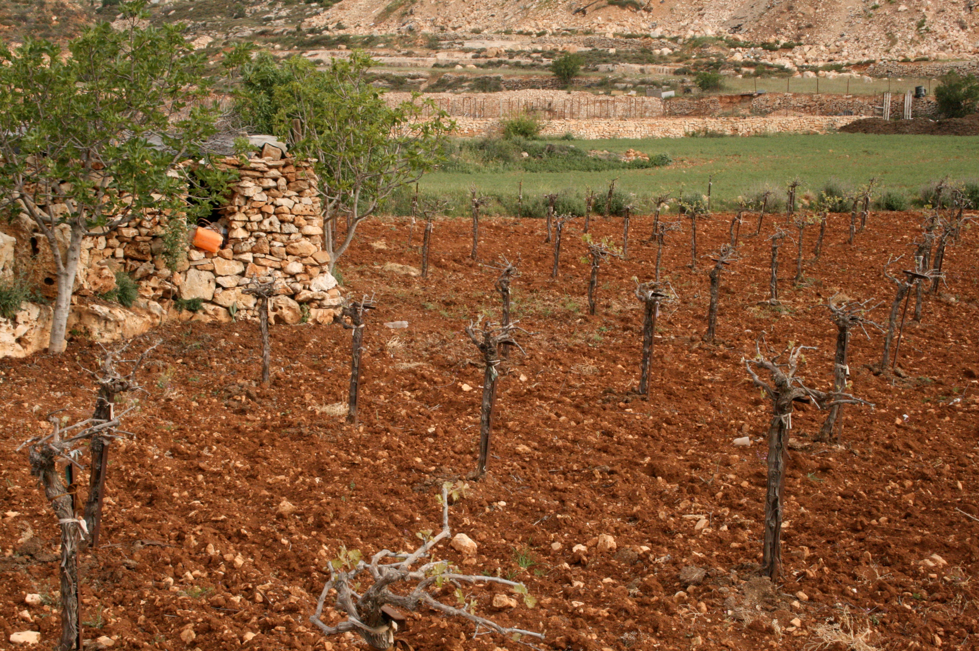
A Vineyard in Israel

Slide 81
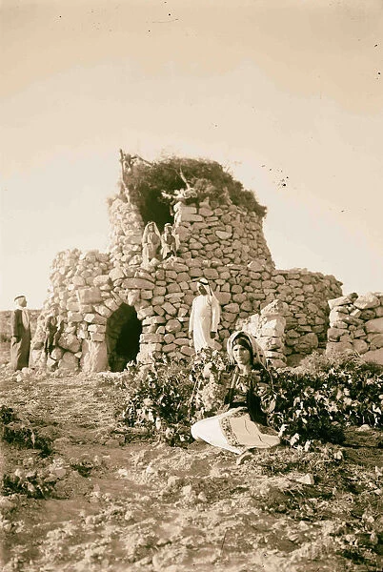
A watchtower would enable a watchman to survey the vineyard and the surrounding terrain so that he could take action against marauders, human or animal (Leon Morris, The Gospel According to Matthew, The Pillar New Testament Commentary, 540).
Watch tower vineyard 1937 Middle East Israel photo from Liszt Collection.

Slide 82
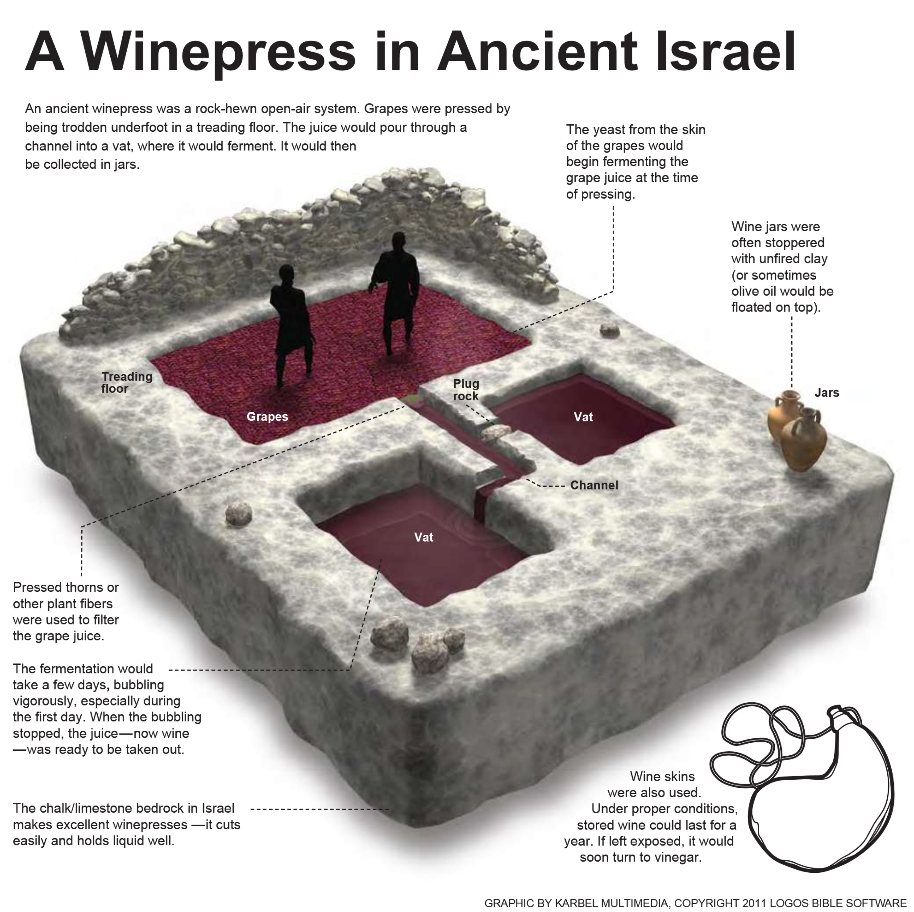

Slide 83
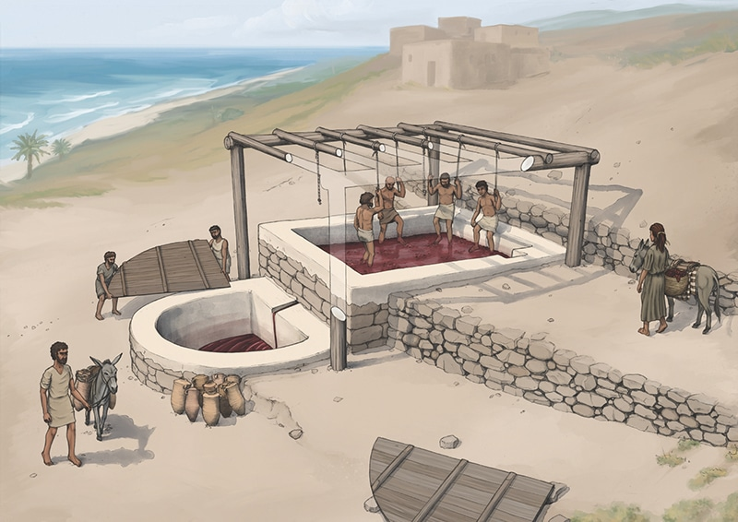
Photo taken from Tell el-Burak: reconstruction of the wine press from the southeast.(https://www.asor.org/anetoday/2021/09/phoenician-wine)

Slide 84
Matthew 21:33
“Hear another parable. There was a master of a house who planted a vineyard and put a fence around it and dug a winepress in it and built a tower and leased it to tenants, and went into another country.”
Fence: It was built to keep out animals that might destroy the vineyard (boars, jackals, foxes) (see Psa. 80:13; Song of Sol. 2:15).
Towers: used for watch-houses and dwellings for the vine keeper.
The things provided for the vineyard (fence, winepress, tower) shows that the householder did all that should be done to ensure its success and has legitimate reason to expect to share in its produce.
Hear another parable is an imperative (command). Its significance lies in the timing, being presented on Tuesday before Jesus was crucified on Friday.
Went into another country (apodēmeō): “to travel away from one’s domicile, go on a journey . . . To be distant from, be away, absent” (BDAG, 109).
Tenant (geōrgos): “one who does agricultural work on a contractual basis, vine-dresser, tenant farmer” (BDAG, 196).

Slide 85
Matthew 21:34
When the season for fruit drew near, he sent his servants to the tenants to get his fruit.
“When you come into the land and plant any kind of tree for food, then you shall regard its fruit as forbidden. Three years it shall be forbidden to you; it must not be eaten. And in the fourth year all its fruit shall be holy, an offering of praise to the LORD. But in the fifth year you may eat of its fruit, to increase its yield for you: I am the LORD your God” (Lev. 19:23-25).
“He is like a tree planted by streams of water that yields its fruit in its season, and its leaf does not wither. In all that he does, he prospers” (Psa. 1:3).
The household had a right and a responsibility to demonstrate his ownership of the vineyard and hold accountable a fair distribution of the fruit.

Slide 86
The Householder’s Right
“With regard to the presumptive ownership of houses; and of pits; and of ditches; and of caves, which are used to collect water; and of dovecotes; and of bathhouses; and of olive presses; and of irrigated fields, which must be watered by people; and of slaves; and all similar property that constantly, i.e., throughout the year, generates profits, their presumptive ownership is established by working and profiting from them for a duration of three years from day to day. If the one in possession of the property can prove that he worked and profited from it for the previous three full years, there is a presumption that it belongs to him, and would remain in his possession if another were to claim that the property belonged to him or to his ancestors. With regard to a non-irrigated field, i.e., one that is watered by rain, in which produce grows during certain seasons during the year, its presumption of ownership is established in three years, but they are not from day to day, since the fields are not worked and harvested continually throughout the three-year period” (Mishnah, Bava Batra 3:1; Morris, 540-541).

Slide 87
Matthew 21:35
And the tenants took his servants and beat one, killed another, and stoned another.
The three injurious treatments (beat, killed, stoned) implies a minimum of three servants.
Mark’s account (12:2-5) uses four verses to describe the householder as sending three consecutive individuals—one beaten and sent away empty-handed, a second struck on the head and treated shamefully, and the third was killed and then adds, “And so with many others: some they beat, and some they killed.” Luke has the householder sending three individuals who are mistreated (20:10-12).
Stoned (lithoboleō): “throw stone at someone. . . stone (to death)” (BDAG, 595).
Craig Blomberg: “The servants’ fate recalls the treatment of God’s prophets throughout Old Testament history (e.g., Jer 20:1–2; 1 Kgs 18:4; 2 Chr 24:20–21; and cf. Matt 23:34)” (Matthew, The New American Commentary, 323).
“O Jerusalem, Jerusalem, the city that kills the prophets and stones those who are sent to it!” (Matt. 23:37).

Slide 88
Matthew 21:36
“Again he sent other servants, more than the first. And they did the same to them.”
The wording of this verse depicts God’s repeated appeal to Israel, particularly through His prophets.
The plural “servants” and “more than the first” indicates the seriousness of the offence and the land owner’s intention to enforce his claims on the fruit.

Slide 89
Matthew 21:37
“Finally he sent his son to them, saying, ‘They will respect my son.’”
There can be no doubt that Jesus is speaking about Himself in this part of the parable. Mark’s narrative describes the son as “a beloved son” (12:6).
This statement from Jesus is a strong claim to being deity.
Finally (husteros): This is the last effort the householder will make before dealing with the rebellious tenants.
“Long ago, at many times and in many ways, God spoke to our fathers by the prophets, but in these last days he has spoken to us by his Son, whom he appointed the heir of all things, through whom also he created the world” (Heb. 1:1-2).
Will respect (entrepō): “to show deference to a person in recognition of special status, turn toward something/someone, have regard for, respect” (BDAG, 341).

Slide 90
The Parable Is Illustrative
Some have criticized the father in the parable for putting in danger, knowing full well that these tenants had already killed some of his servants.

Slide 91
Matthew 21:38-39
“But when the tenants saw the son, they said to themselves, ‘This is the heir. Come, let us kill him and have his inheritance.’ And they took him and threw him out of the vineyard and killed him.””
The text contrasts the reasoning of the owner and the reasoning of the tenants.
The reasoning of the tenant farmers:
Leon Morris: “From their point of view their title was now secure. They had never paid rent for the vineyard, they had been in it a number of years to secure their claim, and they were sure that the owner, who had never been back since he established the vineyard, would not care (and perhaps not dare) to prosecute his claim. The vineyard was theirs” (The Gospel according to Matthew, The Pillar New Testament Commentary, 542).
The reasoning of the tenants exposes their motive and their character. They have one concern: their own gain.

Slide 92
Matthew 21:40-41
“‘When therefore the owner of the vineyard comes, what will he do to those tenants?’ They said to him, ‘He will put those wretches to a miserable death and let out the vineyard to other tenants who will give him the fruits in their seasons.’”
Jesus’s question results in the Jewish leaders to pronounce sentence upon themselves (cf. Nathan’s question to David, 2 Sam. 12:1-7).
In the challenge to Jesus’s authority (vv. 23-27) and the Parable of the Two Sons (vv. 28-32), Jesus poses a question which requires an answer that is self indicting.
What will become of the householder’s vineyard?
What will the householder expect from the new tenants?

Slide 93
The Punishment of the Wicked
Wretches (kakos): plural form of persons who are “socially or morally reprehensible, bad, evil” (BDAG, 501).
Miserable (kakōs): used as an adverb “pertaining to experiencing harm in a physical sense, bad, badly. . . with expression of intensity” (BDAG, 502).
Put . . . to . . . death (apollumi): “he will put the evildoers to a miserable death” (BDAG, 116).

Slide 94
Matthew 21:42
“Jesus said to them, ‘Have you never read in the Scriptures: “The stone that the builders rejected has become the cornerstone; this was the Lord’s doing, and it is marvelous in our eyes”?’”
How would the chief priests and elders have reacted to “Have you never read the Scriptures?”
The passage quoted taken from Psalm 118:22-23.
The passage is quoted in the following places in the New Testament: Matt. 21:42 (and parallels in Mark 12:10; Luke 20:17); Acts 4:11; Eph. 2:20; 1 Pet. 2:4-7).

Slide 95
The Cornerstone
Cornerstone (kephalēn gōnias): “cornerstone or keystone” (BDAG, 209).
“So then you are no longer strangers and aliens, but you are fellow citizens with the saints and members of the household of God, built on the foundation of the apostles and prophets, Christ Jesus himself being the cornerstone, in whom the whole structure, being joined together, grows into a holy temple in the Lord” (Eph. 2:20).
“As the NIV and margin indicate, there is a problem in determining which of these is the correct translation. Verse 44a fits more naturally the cornerstone (something over which someone can stumble); v. 44b, the capstone (something that can fall on a person)” (Blomberg, 324).

Slide 96
Messianic Implications
“Israel’s leaders’ rejection of Jesus does not disprove his messiahship. God specifically predicted that the one whom he would honor would first be rejected” (Blomberg, 325).
“The Psalm speaks of an unexpected revolution: a stone that the builders thought they could not use—it was unsuitable and they rejected it—in due course became the most important stone in the building” (Morris, 543).
What does this was the Lord’s doing emphasize?
Why would make the Lord’s doing so marvelous?
Marvelous (thaumastos: “pertaining to being a cause of wonder or worthy of amazement, wonderful, marvelous, remarkable” [BDAG, 445])?

Slide 97
Matthew 21:43
Therefore I tell you, the kingdom of God will be taken away from you and given to a people producing its fruits.
Therefore I tell you introduces a solemn announcement.
What is the new announcement?
Who was represented by “taken from you”?
Who is represented by “given to a people producing its fruits”?
Read Matthew 8:11-12.
“But you are a chosen race, a royal priesthood, a holy nation, a people for his own possession, that you may proclaim the excellencies of him who called you out of darkness into his marvelous light” (1 Pet. 2:9).
“And as for all who walk by this rule, peace and mercy be upon them, and upon the Israel of God” (Gal. 6:17).
Israel is replaced by the church!

Slide 98
Matthew 21:44
“And the one who falls on this stone will be broken to pieces; and when it falls on anyone, it will crush him.”
This verse recalls Isaiah 8:13-14—“But the LORD of hosts, him you shall honor as holy. Let him be your fear, and let him be your dread. And he will become a sanctuary and a stone of offense and a rock of stumbling to both houses of Israel, a trap and a snare to the inhabitants of Jerusalem. And many shall stumble on it. They shall fall and be broken; they shall be snared and taken.”
The same theme is repeated in Romans 9:32-33 and 1 Peter 2:4-8.
What does this text say about those who reject Jesus today?

Slide 99
Matthew 21:45-46
“When the chief priests and the Pharisees heard his parables, they perceived that he was speaking about them. And although they were seeking to arrest him, they feared the crowds, because they held him to be a prophet.”
What did the chief priests and Pharisees understand from the parables given on Tuesday—the Parable of the Two Sons (21:28-32) and the Parable of the Tenants (21:33-44)?
What does v. 46 tell us about Jewish plans that Tuesday before the crucifixion of Jesus?
How did the chief priest and Pharisees react to Jesus’s parables?
How did the crowds react to Jesus’s teaching?

