Slide 1
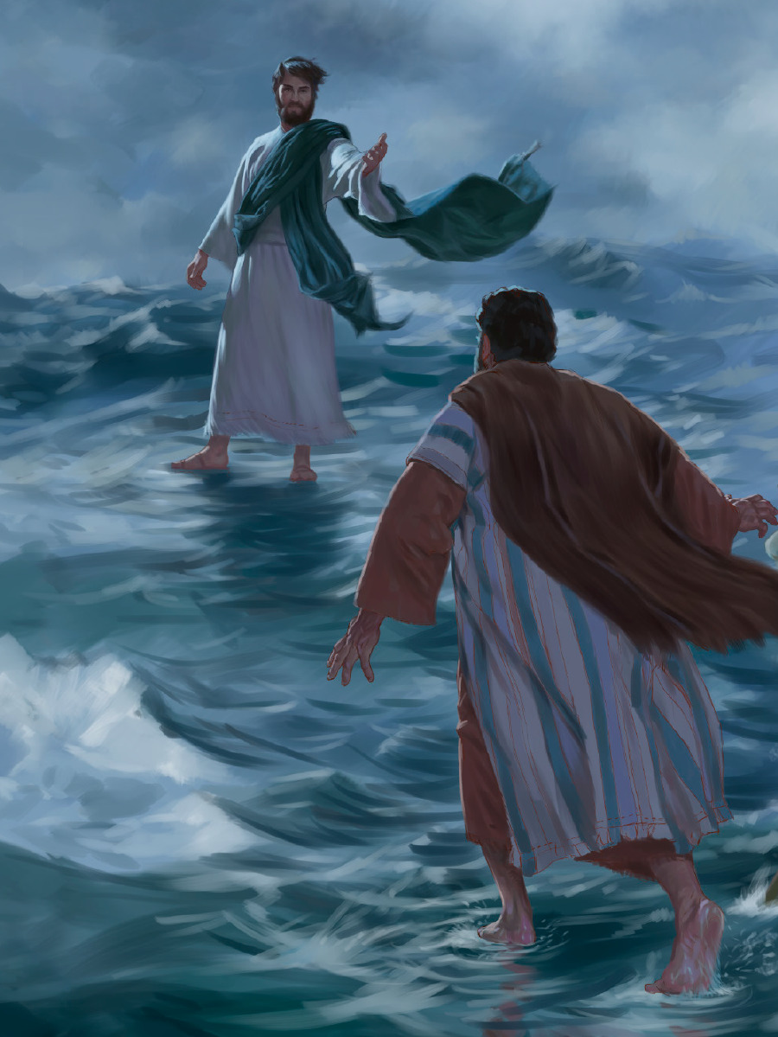
Could You Walk On Water?
Matt. 14:22-33

Slide 2
Why Could Peter Walk On Water?
He believed in the POWER of Christ!

Slide 3
He believed in the POWER of Christ!
“ Peter, come to me.”
He saw Jesus turn water into wine. John 2:1-11
He saw Jesus raise Jairus’ daughter. Luke 8:40-56
He saw Jesus heal. Matt. 12:9-16
He saw Jesus feed the 5,000. Matt. 14:13-21

Slide 4
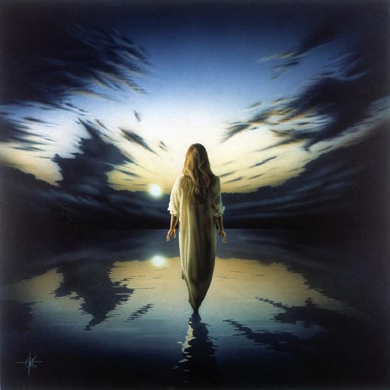
We Can Believe In The POWER Of Christ
We have the written record. John 20:30-31
Jesus has all POWER. Matt. 28:18
Jesus is the Son of God with POWER. Rom. 1:4
Jesus is King of Kings. 1Tim. 6:13-16

Slide 5
Our Faith Allows Us Justification & Fellowship
We are justified by faith in Christ. Gal.2:16
We are children of God by faith. Gal. 3:26-27
Christ will be in us if we have faith in Him. 2 Cor. 13:5
Christ dwells in our heart by faith. Eph. 3:17

Slide 6
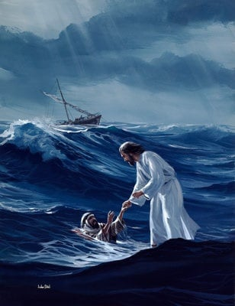
What Caused Peter To Sink?
…."O you of little faith, why did you doubt?" (Matt. 14:31)
Peter Became Distracted!

Slide 7
Diverted Attention Brings “Doubt”
Family difficulties.
Economic challenges.
Personal challenges.
Temptations.
Problems at work.
Consider our faith when facing:

Slide 8
How Do We Keep From Sinking?
Always look to Jesus. Heb. 12:1-2
Study the word. Rom. 10:17
Remember what we can do. Phil. 4:11-13
But my eyes are upon You, O GOD the Lord; In You I take refuge; Do not leave my soul destitute. 9 Keep me from the snares they have laid for me, And from the traps of the workers of iniquity. Psalm 141:8-9

Slide 9
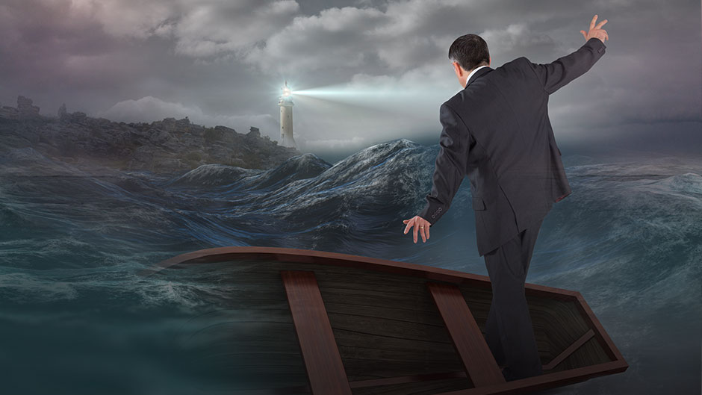
How Great Is Your Faith In Christ?
Hear the Word of God --John 20:30-31
Believe In Your Heart -- Acts 8:37
Repent Of Your Sins --Luke 13:3, 5
Confess faith in Jesus -- Matt. 10:32-33
Be Baptized Into Christ -- Acts 22:16
Be Faithful Until Death --Rev. 2:10

