Slide 2
Some Circumstances in Life Are Painful
It is an undeniable fact!
Sometimes these painful experiences in life are the expected consequences of poor life choices.
However, on other occasions, they come upon those who are living a righteous life through no fault of their own.

Slide 3
Adam & Eve
Made a sinful choice.
The consequences were painful to all their descendants:
Increased pain in childbirth.
Difficulty in earning a living.
Physical death.

Slide 4
King David
David’s choice to commit adultery with Bathsheba brought many painful consequences to him.
The death of their infant child.
The revolution of Absalom, which resulted in the defilement of David’s own wives.

Slide 5
Luke 13:1-5
“There were some present at that very time who told him about the Galileans whose blood Pilate had mingled with their sacrifices. And he answered them, ‘Do you think that these Galileans were worse sinners than all the other Galileans, because they suffered in this way? No, I tell you; but unless you repent, you will all likewise perish. Or those eighteen on whom the tower in Siloam fell and killed them: do you think that they were worse offenders than all the others who lived in Jerusalem? No, I tell you; but unless you repent, you will all likewise perish’” (Luke 13:1-5).

Slide 6
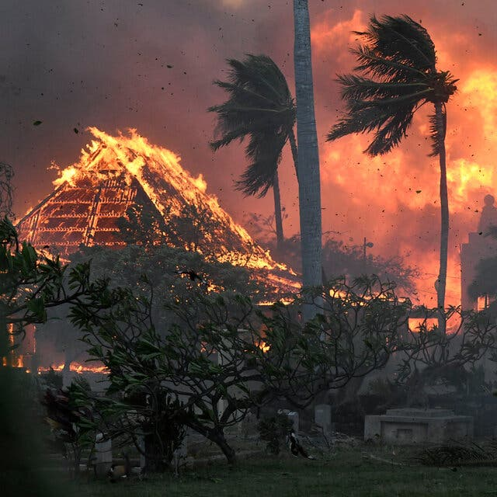
Auto Accident That Is Not Your Fault
Wildfires in Hawaii

Slide 7
The Problem of Suffering
We have some hurting in our congregation through devastating diseases with which they are struggling to cope.
In view of these circumstances and others who have similar problems in their lives, I have chosen to speak to you about heaven.
Let’s focus on heaven.

Slide 8
HEAVEN
Focus on Your Target

Slide 9
HEAVEN
Focus on Your Target
What Is Heaven?

Slide 10
What Does “Heaven” Mean?
The atmosphere, as opposed to the earth (see Heb. 1:10; 2 Pet. 3:5, 10, 12). This is the heavens in which the birds fly.
The phrase “the heavens and the earth” is the equivalent to what we mean by the “universe.”
The starry heavens (see Heb. 11:12; Deut. 1:10; 10:22; etc.). This refers to outer space, the place of the sun, moon, stars, planets and galaxies.
The abode of God: the seat of the order of things eternal and consummately perfect, where God dwells and other heavenly beings (Isa. 57:15; 63:15; Matt. 6:9-10).
God is described as the “God of heaven” (2 Chron. 35:23; Neh. 1:4-5).

Slide 11
The Throne of God
“In the year that King Uzziah died I saw the Lord sitting upon a throne, high and lifted up; and the train of his robe filled the temple. Above him stood the seraphim. Each had six wings: with two he covered his face, and with two he covered his feet, and with two he flew. And one called to another and said: ‘Holy, holy, holy is the LORD of hosts; the whole earth is full of his glory!’” (Isa. 6:1-3). Isaiah’s vision is similar to Revelation 4-5.
“The LORD is in his holy temple; the LORD’s throne is in heaven; his eyes see, his eyelids test the children of man” (Psa. 11:4).

Slide 12
HEAVEN
Focus on Your Target
Heaven: God Is Separated From His Creation

Slide 13
God’s Separateness From His Creation
This is the transcendence of God.
One of Job’s three friends, Eliphaz, said, “Is not God high in the heavens? See the highest stars, how lofty they are! But you say, ‘What does God know? Can he judge through the deep darkness? Thick clouds veil him, so that he does not see, and he walks on the vault of heaven’” (Job. 22:12-14).
Jeremiah spoke of Israel’s feelings when Jerusalem was destroyed by the Babylonians, “You have wrapped yourself with anger and pursued us, killing without pity; you have wrapped yourself with a cloud so that no prayer can pass through. You have made us scum and garbage among the peoples” (Lam. 3:43-45).
Do Your Ever Feel the Same Way?

Slide 14
You Are Not Alone
Maybe in your grief, you have the same feeling—feeling that God is so far removed from how you are feeling in these moments of grief.
We find ourselves, like Isaiah, wishing that God would act in some way to show Himself and His concern for us: “Oh that you would rend the heavens and come down, that the mountains might quake at your presence— as when fire kindles brushwood and the fire causes water to boil— to make your name known to your adversaries, and that the nations might tremble at your presence!” (Isa. 64:1-2).
I hope that these verses make those who are hurting and feel the same way realize that you are not the first person to have these feelings.

Slide 15
HEAVEN
Focus on Your Target
Heaven: God Is Involved in His Creation

Slide 16
God Is Involved In His Creation
This is known as God’s immanence of God.
It refers to His presence within His creation.
It is not to be confused with imminence, which refers to the timing of Jesus’ return to earth.
A belief in God’s immanence holds that God is present in all of creation, while remaining distinct from it.
In other words, there is no place where God is not.

Slide 17
God Was Present
In the Garden of Eden
Before, during, and after the Flood
When Israel was in Egyptian slavery
When Israel was escaping from slavery
The point is: God is ever present and with His people.

Slide 18
God’s Promises
“I will dwell among the people of Israel and will be their God. And they shall know that I am the LORD their God, who brought them out of the land of Egypt that I might dwell among them. I am the LORD their God” (Exod. 29:45-46).
The same thought is expressed in the New Testament where the church is viewed as the Temple of God (1 Cor. 3:16; Eph. 2:21-22).

Slide 19
HEAVEN
Focus on Your Target
Heaven Is the Source of Man’s Salvation

Slide 20
Heaven Is the Source
The bread which fed the Israelites in the wilderness came from heaven (Exod. 16:4).
Blessings upon God’s people come from heaven (Gen. 49:25; Deut. 33:13).
Elijah is taken up into heaven in a whirlwind (2 Kings 2:11).
When the idea of life after death developed within Judaism, the location of such existence was often situated in heaven with God (Dan. 12:2–3).

Slide 21
Focus on God’s Promises
Father’s house with rooms for all of His children:
“Let not your hearts be troubled. Believe in God; believe also in me. In my Father’s house are many rooms. If it were not so, would I have told you that I go to prepare a place for you? And if I go and prepare a place for you, I will come again and will take you to myself, that where I am you may be also” (John 14:1-3).
The destiny of those risen from the dead to everlasting life:
“And many of those who sleep in the dust of the earth shall awake, some to everlasting life, and some to shame and everlasting contempt. And those who are wise shall shine like the brightness of the sky above; and those who turn many to righteousness, like the stars forever and ever” (Dan. 12:2-3).

Slide 22
Focus on God’s Promises
The believer’s eternal house:
“For we know that if the tent that is our earthly home is destroyed, we have a building from God, a house not made with hands, eternal in the heavens. For in this tent we groan, longing to put on our heavenly dwelling, if indeed by putting it on we may not be found naked. For while we are still in this tent, we groan, being burdened —not that we would be unclothed, but that we would be further clothed, so that what is mortal may be swallowed up by life. He who has prepared us for this very thing is God, who has given us the Spirit as a guarantee. So we are always of good courage. We know that while we are at home in the body we are away from the Lord, for we walk by faith, not by sight. Yes, we are of good courage, and we would rather be away from the body and at home with the Lord. So whether we are at home or away, we make it our aim to please him. For we must all appear before the judgment seat of Christ, so that each one may receive what is due for what he has done in the body, whether good or evil” (2 Cor. 5:1-10).

Slide 23
Focus on God’s Promises
The believer’s eternal house:
“For we know that if the tent that is our earthly home is destroyed, we have a building from God, a house not made with hands, eternal in the heavens. For in this tent we groan, longing to put on our heavenly dwelling, if indeed by putting it on we may not be found naked. For while we are still in this tent, we groan, being burdened —not that we would be unclothed, but that we would be further clothed, so that what is mortal may be swallowed up by life. He who has prepared us for this very thing is God, who has given us the Spirit as a guarantee. So we are always of good courage. We know that while we are at home in the body we are away from the Lord, for we walk by faith, not by sight. Yes, we are of good courage, and we would rather be away from the body and at home with the Lord. So whether we are at home or away, we make it our aim to please him. For we must all appear before the judgment seat of Christ, so that each one may receive what is due for what he has done in the body, whether good or evil” (2 Cor. 5:1-10).

Slide 24
Focus on God’s Promises
The believer’s eternal house:
“For we know that if the tent that is our earthly home is destroyed, we have a building from God, a house not made with hands, eternal in the heavens. For in this tent we groan, longing to put on our heavenly dwelling, if indeed by putting it on we may not be found naked. For while we are still in this tent, we groan, being burdened —not that we would be unclothed, but that we would be further clothed, so that what is mortal may be swallowed up by life. He who has prepared us for this very thing is God, who has given us the Spirit as a guarantee. So we are always of good courage. We know that while we are at home in the body we are away from the Lord, for we walk by faith, not by sight. Yes, we are of good courage, and we would rather be away from the body and at home with the Lord. So whether we are at home or away, we make it our aim to please him. For we must all appear before the judgment seat of Christ, so that each one may receive what is due for what he has done in the body, whether good or evil” (2 Cor. 5:1-10).

Slide 25
Focus on God’s Promises
The believer’s eternal house:
“For we know that if the tent that is our earthly home is destroyed, we have a building from God, a house not made with hands, eternal in the heavens. For in this tent we groan, longing to put on our heavenly dwelling, if indeed by putting it on we may not be found naked. For while we are still in this tent, we groan, being burdened —not that we would be unclothed, but that we would be further clothed, so that what is mortal may be swallowed up by life. He who has prepared us for this very thing is God, who has given us the Spirit as a guarantee. So we are always of good courage. We know that while we are at home in the body we are away from the Lord, for we walk by faith, not by sight. Yes, we are of good courage, and we would rather be away from the body and at home with the Lord. So whether we are at home or away, we make it our aim to please him. For we must all appear before the judgment seat of Christ, so that each one may receive what is due for what he has done in the body, whether good or evil” (2 Cor. 5:1-10).

Slide 26
Focus on God’s Promises
The vindication of the faithful:
“Then they heard a loud voice from heaven saying to them, ‘Come up here!’ And they went up to heaven in a cloud, and their enemies watched them” (Rev. 11:12).
The place of the Christian’s citizenship:
“But our citizenship is in heaven, and from it we await a Savior, the Lord Jesus Christ, who will transform our lowly body to be like his glorious body, by the power that enables him even to subject all things to himself” (Phil. 3:20-21).

Slide 27
Focus on God’s Promises
A better country:
“These all died in faith, not having received the things promised, but having seen them and greeted them from afar, and having acknowledged that they were strangers and exiles on the earth. For people who speak thus make it clear that they are seeking a homeland. If they had been thinking of that land from which they had gone out, they would have had opportunity to return. But as it is, they desire a better country, that is, a heavenly one. Therefore God is not ashamed to be called their God, for he has prepared for them a city” (Heb. 11:13-16).

Slide 28
Conclusion

Slide 29
“Where the Gates Swing Outward Never”
Charles H. Gabriel (1856-1932)
Just a few more days to be filled with praise,
And to tell the old, old story;
Then, when twilight falls, and my Savior calls,
I shall go to Him in glory.
Just a few more years with their toil and tears,
And the journey will be ended;
Then I’ll be with Him, where the tide of time
With eternity is blended.
Tho’ the hills be steep and the valleys deep,
With no flow’rs my way adorning;
Tho’ the night be lone and my rest a stone,
Joy awaits me in the morning.
What a joy ’twill be when I wake to see
Him for whom my heart is burning!
Nevermore to sigh, nevermore to die—
For that day my heart is yearning.
Chorus:
I’ll exchange my cross for a starry crown,
Where the gates swing outward never;
At His feet I’ll lay ev’ry burden down,
And with Jesus reign forever.

Slide 30
I’m not telling you it is going to be easy,
I am telling you it’s going to be worth it !

