Slide 1
Psalm 139:13-18

Slide 2
The Christian’s Response
to the
GENDER Debate

Slide 3
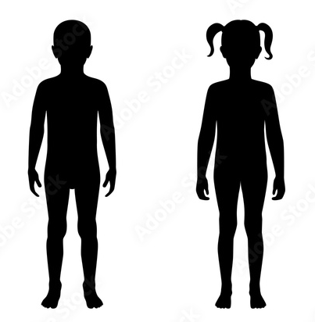
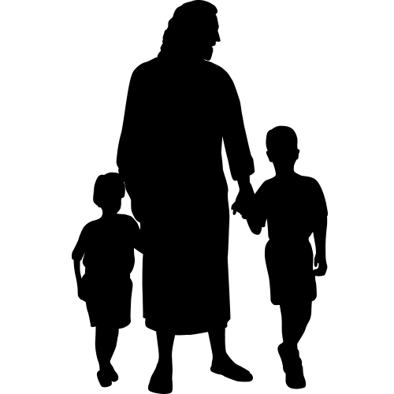
Our Children’s MINDS
Our Children’s BODIES
Our Children’s QUESTIONS
Our Children’s SOULS

Slide 4
2 Timothy 2:22-26
So flee youthful passions and pursue righteousness, faith, love, and peace, along with those who call on the Lord from a pure heart. Have nothing to do with foolish, ignorant controversies; you know that they breed quarrels. And the Lord's servant must not be quarrelsome but kind to everyone, able to teach, patiently enduring evil, correcting his opponents with gentleness. God may perhaps grant them repentance leading to a knowledge of the truth, and they may come to their senses and escape from the snare of the devil, after being captured by him to do his will.

Slide 5
2 Timothy 2:22-26
The Lord’s Servant
may save souls
ENSARED
by Satan

Slide 6
The Christian’s Response
to the GENDER Debate
HOW to respond
WHAT to respond

Slide 7
1. How to Respond?
2 Timothy 2:22-26
The Lord’s Servant must approach the gender debate with
LOVE

Slide 8
1. How to Respond?
2 Timothy 2:22-26
The Lord’s Servant must approach the gender debate with
UNDERSTANDING

Slide 9
1. How to Respond?
2 Timothy 2:22-26
The Lord’s Servant must approach the gender debate with
DISCERNMENT

Slide 10
1. How to Respond?
2 Timothy 2:22-26
The Lord’s Servant must approach the gender debate with
CORRECTION

Slide 11
Loving
Understanding
Discernment
Correction
HOW?
2 Tim. 2:22-26
The Lord’s Servant
Must Respond

Slide 12
Loving
Understanding
Discernment
Correction
2 Timothy 2:22-26
The Lord’s Servant
may save souls
ENSARED
by Satan

Slide 13
God values the body thru
CREATION
2. What
to Respond?
Gen. 1:27 “male and female He created them”
bodies are NOT an accident or prison
bodies are God’s magnificent handiwork!
God fashioned your body for you

Slide 14
God values the body thru
IMAGE BEARING
2. What to Respond?
Gen. 1:26- 27 “make man in our image…in the image of God He created him, male & female He created them”
God created your body to bear His image to the world!

Slide 15
God values the body thru
MARITAL ONENESS
2. What to Respond?
male & female, uniquely different, yet magnificently complimentary
Gen. 2:24 “they shall become one flesh”
Gen. 2:18 “not good that man should be alone. I will make him a helper comparable to him”
Prov. 18:22 “He who finds a wife finds a good thing”
Mt. 19:3f Jesus validates moral order based on m/f created order
God blessed m/f bodies w/perfect compliment in marriage!

Slide 16
God values the body thru
PHYSICAL FUNCTION
2. What to Respond?
evolutionists agree body parts have function and purpose
different male & female body parts give purpose in function
parts of the body are not random accidents
empowered to “be fruitful and multiply” Gen. 1:28

Slide 17
God values the body thru
CHRIST’s INCARNATION
2. What to Respond?
John 1:1,14 “the Word became flesh”
Col. 2:9 “in Him the whole fulness of deity dwells bodily”
Jesus presence in fleshly body demonstrates perfect manifestation of the image of God
It was not BENEATH Jesus to be born and live in a biologically gendered human body, is it beneath you?

Slide 18
God values the body thru
SPIRIT’s INDWELLING
2. What to Respond?
1 Cor. 6:19 “your body is a temple of the Holy Spirit within you”
Your value is not from
objectifying your body immodestly
pursuing illicit sexual passions
worshipping your body
God values your body and wants to dwell in and with you
Satan wants to use, abuse, and discard your body

Slide 19
God values the body thru
Christ’s SACRIFICE
2. What to Respond?
1 Cor. 6:20 “you were bought with a price. So glorify God in your body”
1 Pet. 1:19 “you were redeemed … with the precious blood of Christ”
Your body is so valuable, God paid highest price!

Slide 20
2. What to Respond?
God values the body thru enabling
HOLY LIVING
God elevates humanity to use bodies in purity & holiness
1 Cor. 6:13-18 “the body is not meant for sexual immorality, but for the Lord, and the Lord for the body… the sexually immoral person sins against his own body"
See also Deut. 22:5; Rom. 1:26-27; 1 Cor. 6:9; Lev. 18:22-23
Rom. 6:12-13 “let not sin therefore reign in your mortal body, to make you obey its passions. Do not let present your members to sin as instruments for unrighteousness, but present… your members (body) to God as instruments for righteousness"

Slide 21
God values the body thru
RESURRECTION
2. What to Respond?
Rom. 8:11,23 “If the Spirit of Him who raised Jesus from the dead dwells in you, He who raised Christ Jesus from the dead will also give life to your mortal bodies through His Spirit who dwells in you”
1 Cor. 15:50-58 “the dead will be raised imperishable and we shall be changed. For this perishable body must put on the imperishable , and this mortal body must put on immortality”
Your body is so important God promises to raise it from the dead!

Slide 22
Loving
Understanding
Discernment
Correction
HOW?
2 Tim. 2:22-26
The Lord’s Servant
Must Respond

Slide 23
2. WHAT?
GENDER DEBATE RESPONSE:
God Values the Body!
Creation
Image Bearing
Marital Oneness
Physical Function
Incarnation
Spirit’s
Indwelling
Christ’s Sacrifice
Holy Living
Resurrection

Slide 24
God says
“I made you,
I love you,
I hear you”
“Will you love
and hear Me?”

Slide 25
Submit your BODY in faith, repentance, and confession, to the waters of baptism and be WASHED anew!

