Slide 1
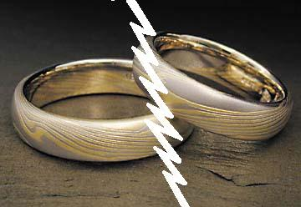
Remarriage
Divorce
&
Who Has The
Right?

Slide 2
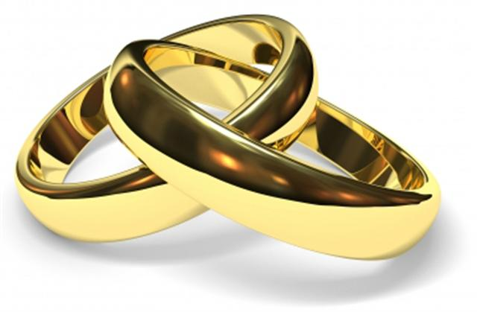
Who Has The Right?
Problems relating to divorce & remarriage are nothing new.
The question of divorce & remarriage has become very controversial.
There are many sinful marriages in our society.
We can’t condone or excuse sinful marriages.
Divorce & Remarriage

Slide 3
Who Has The Right?
The world we live in recognizes easy divorce for any cause.
Despite men’s attitude, God’s law reigns supreme.
God’s design for marriage was set forth in the garden.
Divorce & Remarriage

Slide 4
18 And the LORD God said, "It is not good that man should be alone; I will make him a helper comparable to him.“ ………….21 And the LORD God caused a deep sleep to fall on Adam, and he slept; and He took one of his ribs, and closed up the flesh in its place. 22 Then the rib which the LORD God had taken from man He made into a woman, and He brought her to the man. 23 And Adam said: "This is now bone of my bones And flesh of my flesh; She shall be called Woman, Because she was taken out of Man." 24 Therefore a man shall leave his father and mother and be joined to his wife, and they shall become one flesh. (Gen. 2:18, 21-24)

Slide 5
Gen. 2:18, 21-24
One man for one woman!
God’s design eliminates:
Homosexuality
Polygamy
Polyandry
Must Heed & Teach!

Slide 6
18 And the LORD God said, "It is not good that man should be alone; I will make him a helper comparable to him.“ ………….21 And the LORD God caused a deep sleep to fall on Adam, and he slept; and He took one of his ribs, and closed up the flesh in its place. 22 Then the rib which the LORD God had taken from man He made into a woman, and He brought her to the man. 23 And Adam said: "This is now bone of my bones And flesh of my flesh; She shall be called Woman, Because she was taken out of Man." 24 Therefore a man shall leave his father and mother and be joined to his wife, and they shall become one flesh. (Gen. 2:18, 21-24)

Slide 7
Who Has The Right?
3 The Pharisees also came to Him, testing Him, and saying to Him, "Is it lawful for a man to divorce his wife for just any reason?" 4 And He answered and said to them, "Have you not read that He who made them at the beginning 'made them male and female,' 5 "and said, 'For this reason a man shall leave his father and mother and be joined to his wife, and the two shall become one flesh'? 6 "So then, they are no longer two but one flesh. Therefore what God has joined together, let not man separate.“ (Matt. 19:3-6)
Jesus places an emphasis on the life long commitment of marriage!
No man can divide what God has joined!
Divorce & Remarriage

Slide 8
Who Has The Right To Be Married Again?
One Whose Mate Has Died
“A wife is bound by law as long as her husband lives; but if her husband dies, she is at liberty to be married to whom she wishes, only in the Lord.” (1 Cor. 7:39)
Romans 7:1-3
Considered husband/wife of one mate although now in a 2nd marriage.
A person is released from the marriage covenant only upon conditions given by God!
Divorce & Remarriage

Slide 9
Who Has The Right?
General rules regarding divorced persons found in Luke 16:18 & Mark 10:11-12.
"Whoever divorces his wife and marries another commits adultery; and whoever marries her who is divorced from her husband commits adultery. (Luke 16:18)
Divorce & Remarriage

Slide 10
Who Has The Right?
General rules regarding divorce persons found in Luke 16:18 & Mark 10:11-12.
So He said to them, "Whoever divorces his wife and marries another commits adultery against her. "And if a woman divorces her husband and marries another, she commits adultery." (Mark 10:11-12)
Divorce & Remarriage

Slide 11
God intended marriage to be a permanent arrangement. (Rom. 7:2; 1Cor. 7:39)
Divorce breaks a vow witnessed by God!
We should strive for peace in every relationship! (Rom. 12:18)
Divorce prevents partners from fulfilling their responsibility.
God “HATES” divorce! (Mal. 2:14-16)

Slide 12
Who Has The Right?
An exception to the general rule is found in Matt. 19:7-9.
7 They said to Him, "Why then did Moses command to give a certificate of divorce, and to put her away?" 8 He said to them, "Moses, because of the hardness of your hearts, permitted you to divorce your wives, but from the beginning it was not so. 9 "And I say to you, whoever divorces his wife, except for sexual immorality, and marries another, commits adultery; and whoever marries her who is divorced commits adultery."
Divorce & Remarriage

Slide 13
31 "Furthermore it has been said, 'Whoever divorces his wife, let him give her a certificate of divorce.' 32 "But I say to you that whoever divorces his wife for any reason except sexual immorality causes her to commit adultery; and whoever marries a woman who is divorced commits adultery. (Matt. 5:31-32)
“Whosoever divorces his wife due to her unfaithfulness & shall marry another does not commit adultery.”

Slide 14
Who Has The Right To Be Married Again?
What About The Guilty Party?
Some Advocate: “if a marriage bond is so severed during the lifetime of both parties that one of the parties is freed from the marriage bond to the extent of being free to remarry, the other party is free to the same extent….”
Only two instances when one can be remarried.
when one mate dies.
when one puts their spouse away for fornication.
Divorce & Remarriage

Slide 15
Who Has The Right To Be Married Again?
The right to divorce & remarry is clearly only given to one of the mates.
If both can remarry then that implies that one can profit from sin.
The guilty has no right!
When one commits fornication, he has sinned against God & his companion.
Only the innocent party has a right!
Divorce & Remarriage

Slide 16
Will baptism wash away an adulterous marriage?
The blood of Christ will save us from all our sin. (1 Tim. 1:15)
We are saved by the blood ONLY when we OBEY the commands of Christ.
One command is repentance. Luke 13:3
Some sins require a definite fruit to be brought forth.

Slide 17
Will baptism wash away an adulterous marriage?
If someone steals money then obeys the gospel, can they keep the money?
If one is in a homosexual relationship, could he be baptized & remain in that relationship?
One can’t repent & continue in the same sin!

Slide 18
God’s law is always the same!
Divorce breaks what God has joined.
Divorce breaks a vow.
Divorce breaks fulfillment of sexual obligations.
Divorce is “HATED” by God.

Slide 19
Who Has The Right To Be Married Again?
The ONLY people who can remarry without committing sin?
Those whose mate has died.
Those who divorce their mate because of fornication.
Let us have the courage to stand firmly for these truths!
“Marriage is honorable among all, and the bed undefiled; but fornicators and adulterers God will judge. Heb. 13:4
Divorce & Remarriage

