Slide 2
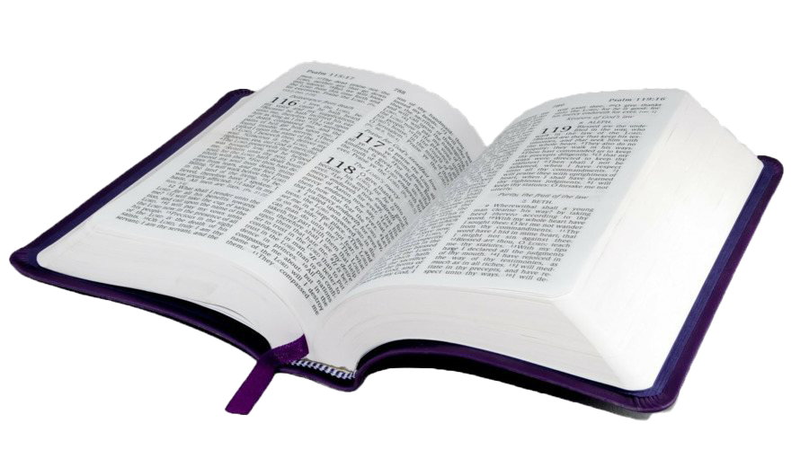
“We. . . appeal to you not to receive the grace of God in vain.”
2 Corinthians 6:1

Slide 3
In Vain
The word “vain” points to that which is “without purpose or result.”
There are ways in which a person can receive the grace of God in vain.
It could happen should one hear the gospel and perhaps believe it, but never obey it.
It could happen that, having obeyed the gospel, one turns back into sin.
Then all of the labor and effort God and His Son, as well as the apostle Paul, had done would be for no benefit.

Slide 4
The Grace of God

Slide 5
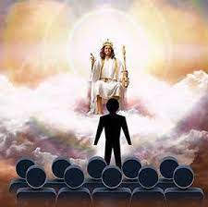
Man’s Need of Grace
“For we must all appear before the judgment seat of Christ, so that each one may receive what is due for what he has done in the body, whether good or evil. Therefore, knowing the fear of the Lord, we persuade others” (2 Cor. 5:10-11).

Slide 6
Grace Available for All
“For the love of Christ controls us, because we have concluded this: that one has died for all, therefore all have died; and he died for all, that those who live might no longer live for themselves but for him who for their sake died and was raised” (2 Cor. 5:14-15).

Slide 7
Sufficient Grace
“Therefore, if anyone is in Christ, he is a new creation. The old has passed away; behold, the new has come. All this is from God, who through Christ reconciled us to himself and gave us the ministry of reconciliation” (2 Cor. 5:17-18).

Slide 8
Our Task of Presenting God’s Grace
“All this is from God, who through Christ reconciled us to himself and gave us the ministry of reconciliation; that is, in Christ God was reconciling the world to himself, not counting their trespasses against them, and entrusting to us the message of reconciliation. Therefore, we are ambassadors for Christ, God making his appeal through us. We implore you on behalf of Christ, be reconciled to God. For our sake he made him to be sin who knew no sin, so that in him we might become the righteousness of God” (2 Cor. 5:18-21).
“But we see him who for a little while was made lower than the angels, namely Jesus, crowned with glory and honor because of the suffering of death, so that by the grace of God he might taste death for everyone” (Heb. 2:9).

Slide 9
Titus 2:11-14
“For the grace of God has appeared, bringing salvation for all people, training us to renounce ungodliness and worldly passions, and to live self-controlled, upright, and godly lives in the present age, waiting for our blessed hope, the appearing of the glory of our great God and Savior Jesus Christ, who gave himself for us to redeem us from all lawlessness and to purify for himself a people for his own possession who are zealous for good works” (Tit. 2:11-14):
Offered salvation to every man.

Slide 10
Titus 2:11-14
“For the grace of God has appeared, bringing salvation for all people, training us to renounce ungodliness and worldly passions, and to live self-controlled, upright, and godly lives in the present age, waiting for our blessed hope, the appearing of the glory of our great God and Savior Jesus Christ, who gave himself for us to redeem us from all lawlessness and to purify for himself a people for his own possession who are zealous for good works” (Tit. 2:11-14):
Offered salvation to every man.
Taught us to deny ungodliness and worldly lust.

Slide 11
Titus 2:11-14
“For the grace of God has appeared, bringing salvation for all people, training us to renounce ungodliness and worldly passions, and to live self-controlled, upright, and godly lives in the present age, waiting for our blessed hope, the appearing of the glory of our great God and Savior Jesus Christ, who gave himself for us to redeem us from all lawlessness and to purify for himself a people for his own possession who are zealous for good works” (Tit. 2:11-14):
Offered salvation to every man.
Taught us to deny ungodliness and worldly lust.
Taught us to live soberly, righteously and godly.

Slide 12
Titus 2:11-14
“For the grace of God has appeared, bringing salvation for all people, training us to renounce ungodliness and worldly passions, and to live self-controlled, upright, and godly lives in the present age, waiting for our blessed hope, the appearing of the glory of our great God and Savior Jesus Christ, who gave himself for us to redeem us from all lawlessness and to purify for himself a people for his own possession who are zealous for good works” (Tit. 2:11-14):
Offered salvation to every man.
Taught us to deny ungodliness and worldly lust.
Taught us to live soberly, righteously and godly.
Taught us to await the Lord’s coming.

Slide 13
The Grace of God
How the Grace of God Is Received

Slide 14
Through the Preaching of the Gospel
“For since, in the wisdom of God, the world did not know God through wisdom, it pleased God through the folly of what we preach to save those who believe” (1 Cor. 1:21).

Slide 15
How the Corinthians Were Saved
The conversion of the Corinthians is given very briefly in Acts: “Crispus, the ruler of the synagogue, believed in the Lord, together with his entire household. And many of the Corinthians hearing Paul believed and were baptized.”

Slide 16
Paul Preached
Paul preached the pure word of God’s grace:
“And I, when I came to you, brothers, did not come proclaiming to you the testimony of God with lofty speech or wisdom. For I decided to know nothing among you except Jesus Christ and him crucified. And I was with you in weakness and in fear and much trembling, and my speech and my message were not in plausible words of wisdom, but in demonstration of the Spirit and of power, so that your faith might not rest in the wisdom of men but in the power of God” (1 Cor. 2:1-4).

Slide 17
The Corinthians Believed
“Now I would remind you, brothers, of the gospel I preached to you, which you received, in which you stand, and by which you are being saved, if you hold fast to the word I preached to you—unless you believed in vain. For I delivered to you as of first importance what I also received: that Christ died for our sins in accordance with the Scriptures, that he was buried, that he was raised on the third day in accordance with the Scriptures, and that he appeared to Cephas, then to the twelve. Then he appeared to more than five hundred brothers at one time, most of whom are still alive, though some have fallen asleep. Then he appeared to James, then to all the apostles. Last of all, as to one untimely born, he appeared also to me. For I am the least of the apostles, unworthy to be called an apostle, because I persecuted the church of God. But by the grace of God I am what I am, and his grace toward me was not in vain. On the contrary, I worked harder than any of them, though it was not I, but the grace of God that is with me. Whether then it was I or they, so we preach and so you believed” (1 Cor. 15:1-11).

Slide 18
The Corinthians Repented
“Or do you not know that the unrighteous will not inherit the kingdom of God? Do not be deceived: neither the sexually immoral, nor idolaters, nor adulterers, nor men who practice homosexuality, nor thieves, nor the greedy, nor drunkards, nor revilers, nor swindlers will inherit the kingdom of God. And such were some of you. But you were washed, you were sanctified, you were justified in the name of the Lord Jesus Christ and by the Spirit of our God” (1 Cor. 6:9-11).

Slide 19
The Corinthians Were Baptized
“For just as the body is one and has many members, and all the members of the body, though many, are one body, so it is with Christ. For in one Spirit we were all baptized into one body—Jews or Greeks, slaves or free—and all were made to drink of one Spirit” (1 Cor. 12:12-13).

Slide 20
The Grace of God
How the Grace of God Is Received in Vain

Slide 21
When Men Hear Without Believing
“When anyone hears the word of the kingdom and does not understand it, the evil one comes and snatches away what has been sown in his heart. This is what was sown along the path” (Matt. 13:19).
“Indeed, in their case the prophecy of Isaiah is fulfilled that says: ‘“You will indeed hear but never understand, and you will indeed see but never perceive.” For this people’s heart has grown dull, and with their ears they can barely hear, and their eyes they have closed, lest they should see with their eyes and hear with their ears and understand with their heart and turn, and I would heal them’” (Matt. 13:14-15).

Slide 22
When Men Believe But Do Not Obey
“Not everyone who says to me, ‘Lord, Lord,’ will enter the kingdom of heaven, but the one who does the will of my Father who is in heaven. On that day many will say to me, ‘Lord, Lord, did we not prophesy in your name, and cast out demons in your name, and do many mighty works in your name?’ And then will I declare to them, ‘I never knew you; depart from me, you workers of lawlessness’” (Matt. 7:21-23).
“But be doers of the word, and not hearers only, deceiving yourselves. For if anyone is a hearer of the word and not a doer, he is like a man who looks intently at his natural face in a mirror. For he looks at himself and goes away and at once forgets what he was like. But the one who looks into the perfect law, the law of liberty, and perseveres, being no hearer who forgets but a doer who acts, he will be blessed in his doing” (Jas. 1:22-25)
“Although he was a son, he learned obedience through what he suffered. And being made perfect, he became the source of eternal salvation to all who obey him” (Heb. 5:8-9).

Slide 23
When One Falls Away
When the Galatians reverted to Judaism, they “nullified the grace of God.”
“I do not nullify the grace of God, for if righteousness were through the law, then Christ died for no purpose” (Gal. 2:21).
“You are severed from Christ, you who would be justified by the law; you have fallen away from grace” (Gal. 5:4).

Slide 24
When One Gets Discouraged and Quits
“Therefore lift your drooping hands and strengthen your weak knees, and make straight paths for your feet, so that what is lame may not be put out of joint but rather be healed. Strive for peace with everyone, and for the holiness without which no one will see the Lord. See to it that no one fails to obtain the grace of God; that no ‘root of bitterness’ springs up and causes trouble, and by it many become defiled” (Heb. 12:12-15).

Slide 25
Apostasy Comes in Many Forms
Apostasy into false doctrine, such as Judaism or any other false teaching which causes one to commit damnable heresy (2 Pet. 2:1).
Negligence (Heb. 2:1-3).
Forsaking the gospel (Heb. 10:24-25).
Becoming too wrapped up in the world (Matt. 13:22).
In each of these cases, a person’s condition is one and the same as if Christ had never died for him. The grace of God has been of no benefit to him.

Slide 26
The Grace of God
Now Is the Day of Salvation

Slide 27
Paul’s Fervent Pleading
Paul reminded the Corinthians: “Working together with him, then, we appeal to you not to receive the grace of God in vain. For he says, ‘In a favorable time I listened to you, and in a day of salvation I have helped you.’ Behold, now is the favorable time; behold, now is the day of salvation” (2 Cor. 6:2).
The opportunity to obey the gospel is available to every man.
It is limited to the time he is in the body.

Slide 28
Postponing Obedience
There is a strong human tendency to postpone obedience to the gospel. Such pleas as the following have appeal to men:
There is time enough yet!
After temporal matters are arranged, I will attend to the spiritual matters. Felix looked for that convenient season:
“And as he reasoned about righteousness and self-control and the coming judgment, Felix was alarmed and said, ‘Go away for the present. When I get an opportunity I will summon you’” (Acts 24:25).
I want to enjoy the pleasures of sin for a season, which is something Moses refused to do (Heb. 11:25).
It will be easier to obey the gospel tomorrow.

Slide 29
The Dangers of Delay
Life may be cut short: “And I will say to my soul, ‘Soul, you have ample goods laid up for many years; relax, eat, drink, be merry.’ But God said to him, ‘Fool! This night your soul is required of you, and the things you have prepared, whose will they be?’” (Luke 12:19-20).
Painful sickness may render it impossible to attend to spiritual matters.
The desire to be saved may pass away.
The heart may become hardened.

Slide 30
Luke 14:15-24
When one of those who reclined at table with him heard these things, he said to him, “Blessed is everyone who will eat bread in the kingdom of God!” But he said to him, “A man once gave a great banquet and invited many. And at the time for the banquet he sent his servant to say to those who had been invited, ‘Come, for everything is now ready.’ But they all alike began to make excuses. The first said to him, ‘I have bought a field, and I must go out and see it. Please have me excused.’ And another said, ‘I have bought five yoke of oxen, and I go to examine them. Please have me excused.’ And another said, ‘I have married a wife, and therefore I cannot come.’ So the servant came and reported these things to his master. Then the master of the house became angry and said to his servant, ‘Go out quickly to the streets and lanes of the city, and bring in the poor and crippled and blind and lame.’ And the servant said, ‘Sir, what you commanded has been done, and still there is room.’ And the master said to the servant, ‘Go out to the highways and hedges and compel people to come in, that my house may be filled. For I tell you, none of those men who were invited shall taste my banquet.’ ”

Slide 31
Think About What You Are Doing!
It is an insult to God!
It is an insult to the love and sacrifice of the Christ who died for you.
It is a bad example to others.
It is destructive to yourself.

Slide 32
Conclusion

Slide 33
Hebrews 3:7-8
“Therefore, as the Holy Spirit says, ‘Today, if you hear his voice, do not harden your hearts as in the rebellion, on the day of testing in the wilderness’” (Heb. 3:7-8).
Have you counted the cost, if you lose your own soul (Matt. 16:26)?

Slide 34
“We. . . appeal to you not to receive the grace of God in vain.”
2 Corinthians 6:1

