Slide 1
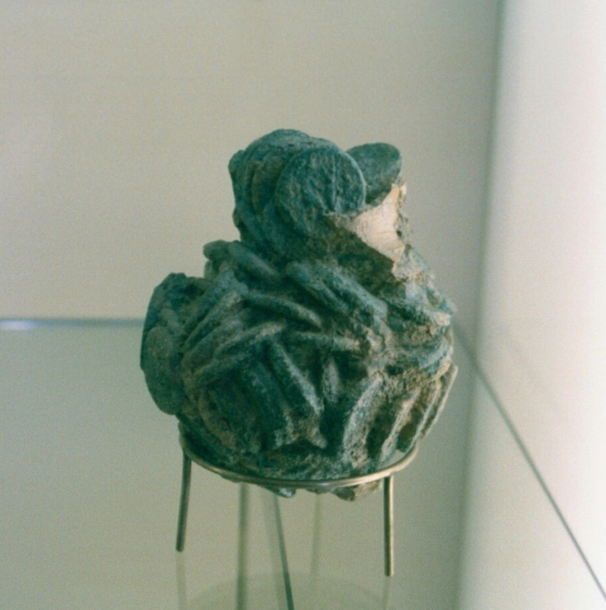
The Parable of the Talents
A Study in Personal Responsibility

Slide 2
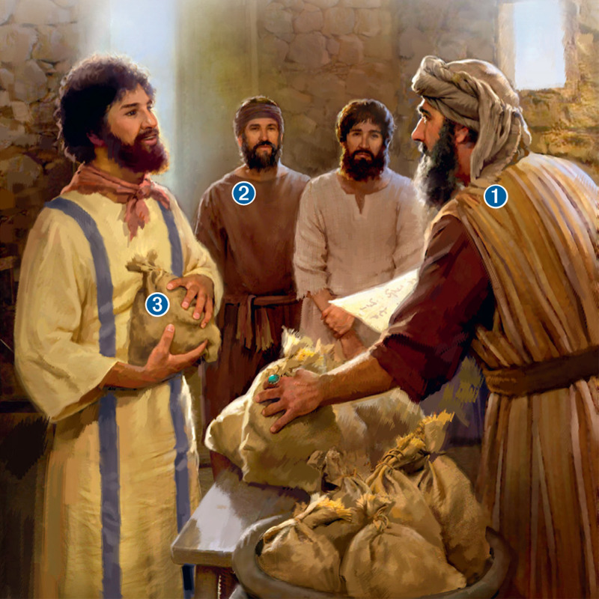
Scene 1
“For it will be like a man going on a journey, who called his servants and entrusted to them his property. (Matt. 24:15).

Slide 3
The Parable
A rich man leaves his estate in charge of her servants
He divides his estate to three servants
5 talents to one
2 talents to another
1 talent to another
He goes away for a time.

Slide 4
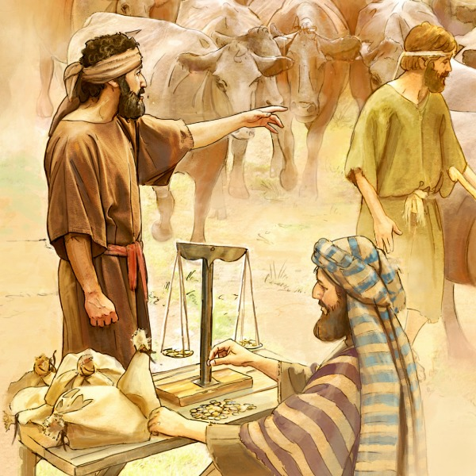
Scene 2
“Now after a long time the master of those servants came and settled accounts with them” (Matt. 25:19).

Slide 5
The Rich Man’s Return
Upon his return, he calls the servants to give account of their stewardship
5-talent man: gained 5 others
2-talent man: gained two others
1-talent man: buried his talent and returned it to his Master
Judgment is pronounced on each man.

Slide 6
Interpreting the Parable
Lord: The Lord Jesus
Servants: His disciples
Talents: Things entrusted to us
His journey: Jesus’ Ascension to heaven
His return: the second coming
His accounting: Judgment

Slide 7
Distribution of the Talents
What is a talent?
Difficulty in translating money
Correlate it to a day’s wages
A day’s wage was 1 denarius; a talent was 6,000 denarii
Using $100 for a day’s wage, a talent was $600,000
5 talents = $3 Million; 2 talents = $1.2 million
How would you feel if your investment advisor gave you exactly what you invested over 30 years?

Slide 8
Basis for Distribution
He gave the same thing to every servant: What he had ability to manage (v. 15)
Those with greater ability have greater responsibility
God knows what each of us is capable of doing
We need not to compare ourselves with one another (2 Cor. 10:12-13).
The requirement is faithfulness (1 Cor. 4:2)

Slide 9
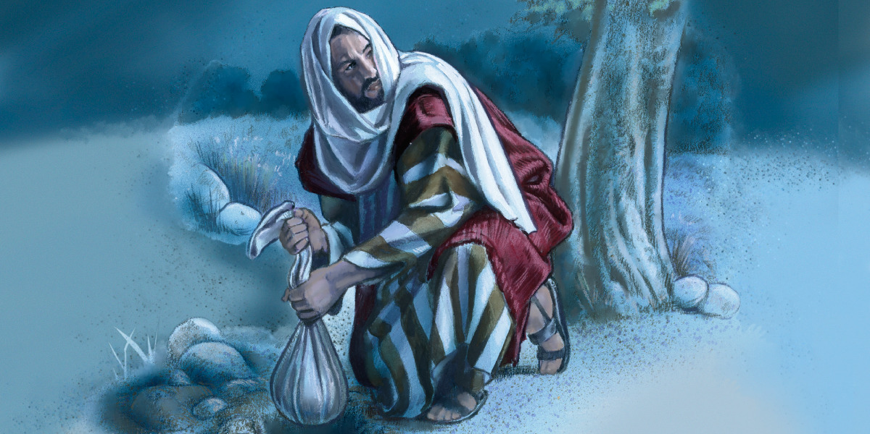
The One-Talent Servant

Slide 10
What Made The One-Talent Servant Unprofitable?
There is no indication that he was:
Wasteful (not like the prodigal son, Luke 15:13)
Dishonest
Lustful
Drunkard
Immoral

Slide 11
The One-Talent Servant
What he had done: buried his talent
His concept of his master was wrong
His master was hard
His master reaps where he has not sown
He was intimidated by his fear of failure
He was afraid
He buried his talent

Slide 12
Think About Your Financial Manager
You have been contributing to your retirement fund for years and he has been investing it for you.
How would you feel if, at your retirement, he just returned to you what you had sent him?

Slide 13
The Master’s Reply
Did the one-talent man accurately depict his master?
Is God hard? Cf. John 3:16; Rom. 5:7-8
Does God reap where He has not sown?
His mistaken concept of his master or his excuses kept him from obeying him

Slide 14
An Excuse
Is an attempt to seek release from an obligation
An effort to explain why one did not do what he was supposed to do but did not want to do!

Slide 15
The Lord’s Assessment of the 1-Talent Servant
Wicked (v. 26).
One can be wicked because of what he does not do (Jas. 4:17)
Slothful (v. 26; cf. Rom. 12:11; Heb. 6:12)
Worthless (v. 30)

Slide 16
What Became of the 1-Talent Servant?
His talent was taken from him
He was cast into outer darkness
In outer darkness, there is suffering—weeping and gnashing of teeth

Slide 17
The Five & Two-Talent Servants

Slide 18
Two Approved Servants
Both were approved despite different gains (25:21, 23)
Both servants worked
Both men were profitable
Both received the same reward
They entered into “the joys of their lord”

Slide 19
What Does It Mean to be Profitable?
Matthew 25:31-46 gives an example:
“Then the King will say to those on his right, ‘Come, you who are blessed by my Father, inherit the kingdom prepared for you from the foundation of the world. For I was hungry and you gave me food, I was thirsty and you gave me drink, I was a stranger and you welcomed me, I was naked and you clothed me, I was sick and you visited me, I was in prison and you came to me.’”

Slide 20
Being a Profitable Servant
Seek first the kingdom of God (Matt. 6:33)
Take care of widows and orphans (James 1:27)
Restore a fallen brother (Gal. 6:1)
Bear one another’s burdens (Gal. 6:2)
Show brotherly love (Heb. 13:1)
Be hospital to strangers (Heb. 13:2)
Be a light in this world (Matt. 5:14-16)

Slide 21
How the Church Functions
Every individual has something he can contribute (1 Cor. 12:15-26)
The body grows when each person does his individual part (Eph. 4:16)
Find your niche (1 Cor. 12:12-26). You may be an eye, an ear, a foot, a leg, a heart. Whichever you are, this body cannot continue to exist without you doing your part!

Slide 22
Think of Some Early Examples
Barnabas, a son of encouragement (Acts 4:36)
Dorcas: full of good works & charity (Acts 9:36)
John Mark (Acts 13:5, 13; 2 Tim. 4:11)
Aquila and Priscilla (Acts 18:1-3; Rom 16:3-4)
Phoebe (Rom. 16:1-2)

Slide 23
Don’t Bury Your Talents!
If you have the ability to be an/a . . .
Elder: use that ability
Deacon: use that ability
Bible class teacher: use that ability
Song leader: use that ability
Show hospitality: invite new people to your home
Minister to the sick

Slide 24
Be An Encourager of Others
Let Us . . .
Draw near with a true heart
Hold fast the confession of our hope
Consider one another to provoke unto love and good works
How? “. . . not neglecting to meet together, as is the habit of some, but encouraging one another, and all the more as you see the Day drawing near” (Heb. 10:19-25).

Slide 25
Be A Footwasher
Jesus washed His disciples’ feet (John 13:1-20)
You call me Teacher and Lord, and you are right, for so I am. If I then, your Lord and Teacher, have washed your feet, you also ought to wash one another’s feet. For I have given you an example, that you also should do just as I have done to you” (John 13:13-15)

Slide 26
There Is An Accounting Day Coming!
“Moreover it is required in stewards, that a man be found faithful” (1 Cor. 4:2).
Not measured by others
Measured by whether or not you used the abilities God gave you!
Are you ready for the judgment day?

Slide 27
1 John 5:13
“I write these things to you who believe in the name of the Son of God, that you may know that you have eternal life.”
Do you have confidence in your salvation?
Do you keep your fingers crossed and hope?
You can know that you have eternal life!

Slide 28
What Is In Your Toolbox? What Are Your Talents?

Slide 29
Are You Using the Talents God Gave to Your in His Service?
Which servant illustrates your service to the Lord, the five and two-talent servant or the one-talent servant?
We too will stand before God to give account.

