Slide 2
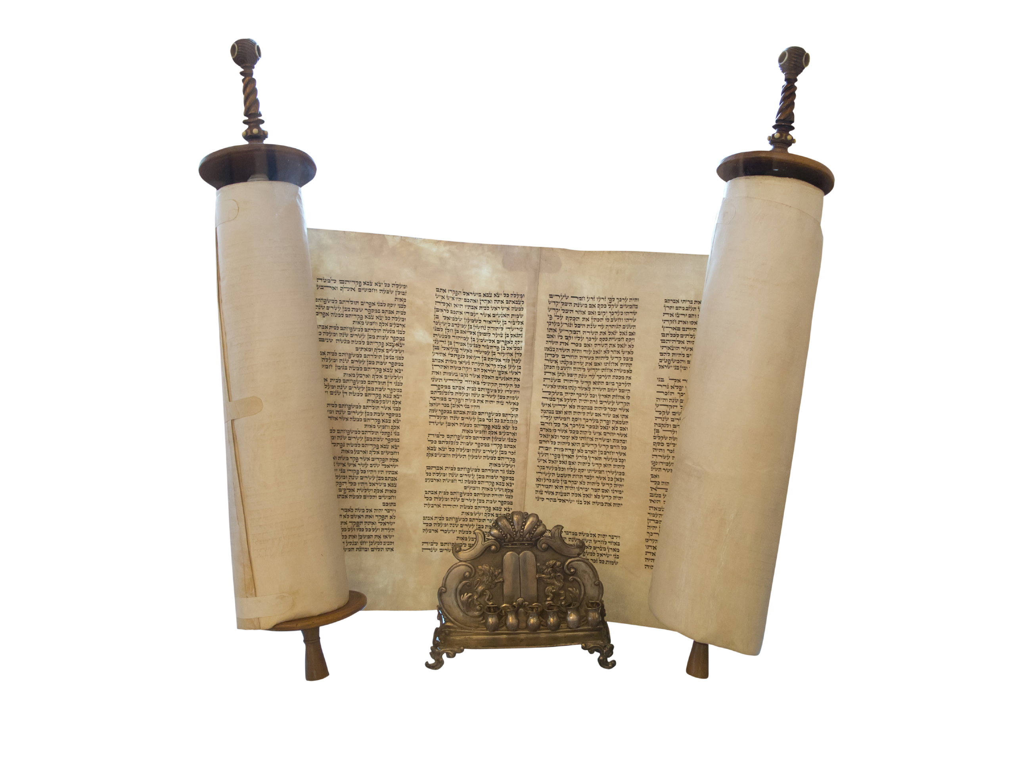
Psalm 119
“Your word is a lamp to my feet and a light to my path” (119:105).

Slide 3
Psalm 119
Your word is a lamp to my feet and a light to my path (119:105).
ג Gimel

Slide 4
Introduction
The third letter of the Hebrew alphabet is Gimel ג)). All of the words of this stanza begin with Gimel.
The theme of this section is the soul’s longing for the word of God and his resolution to follow its commandments. He asks God . . .
To deal bountifully with him (17).
To open his eyes so that he could see the wondrous things in His Law (18).
To not hide His commandment from him (19).
To take away from me scorn and contempt (22).

Slide 5
Psalm 119:17-24 Gimel
Deal bountifully with your servant,
that I may live and keep your word.
Open my eyes, that I may behold
wondrous things out of your law.
I am a sojourner on the earth;
hide not your commandments from me!
My soul is consumed with longing
for your rules at all times.
You rebuke the insolent, accursed ones,
who wander from your commandments.
Take away from me scorn and contempt,
for I have kept your testimonies.
Even though princes sit plotting against me,
your servant will meditate on your statutes.
Your testimonies are my delight;
they are my counselors.

Slide 6
“Deal bountifully with your servant, that I may live and keep your word” (119:17).
David begins this stanza with a prayer, a prayer that God will deal bountifully with him, in spite of the fact that he is a mere servant.
It is not disrespectful to God, as if one were not satisfied with the blessings he presently is receiving, to ask God to deal bountifully with him.
Jesus reminds His disciples of the attitude they should have toward themselves: “So you also, when you have done all that you were commanded, say, ‘We are unworthy servants; we have only done what was our duty’” (Luke 17:10).

Slide 7
Our Life Depends Upon God’s Grace
Physical life depends upon God’s sustaining of His creation. Paul said to the citizens of Lystra: “Yet he did not leave himself without witness, for he did good by giving you rains from heaven and fruitful seasons, satisfying your hearts with food and gladness” (Acts 14:17).
Spiritual life also depends upon God. Paul wrote, “But God, being rich in mercy, because of the great love with which he loved us, even when we were dead in our trespasses, made us alive together with Christ—by grace you have been saved—and raised us up with him and seated us with him in the heavenly places in Christ Jesus” (Eph. 2:4-6).
True life for David consisted in keeping God’s word. Spurgeon wrote, “Life is only worth keeping while we can keep God’s word” (171).
The disciple of the LORD “plainly perceives that his own strength is insufficient, and that he cannot even so much as live without the bounteous assistance of Lord his God” (ibid., 172).

Slide 8
“Open my eyes, that I may behold wondrous things out of your law” (119:18).
“He (David) felt that God had laid up great bounties in his word, and he begs for power to perceive, appreciate, and enjoy the same. We need not so much that God should give us more benefits, as the ability to see what he has given” (Spurgeon, 172).
David had already tasted enough of God’s blessings to realize that there were many other treasures in God’s word that he had not yet identified.

Slide 9
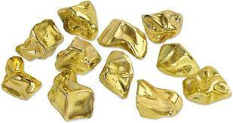
The Bible Is A Gold Mine, Waiting for Someone to Take Out Its Riches!

Slide 10
Treasures in God’s Word
God is our Creator.
God made man in His image.
God continued to love and provide for mankind even after men sinned.
God promised special blessings through Abraham that are available to all of mankind.
God has paid the price of redemption.
There is hope of eternal, even after the death of the body.
Guidance along one’s journey of life.

Slide 11
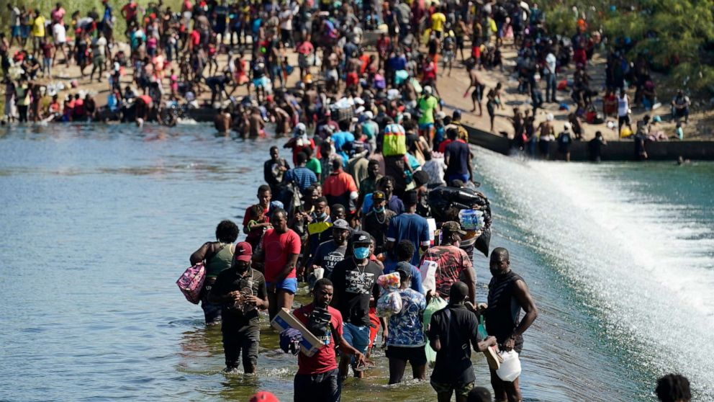
I Am A Pilgrim and Sojourner!

Slide 12
“I am a sojourner on the earth; hide not your commandments from me!” (119:19).
“For we are strangers before you and sojourners, as all our fathers were. Our days on the earth are like a shadow, and there is no abiding” (1 Chron. 29:15).
“These all died in faith, not having received the things promised, but having seen them and greeted them from afar, and having acknowledged that they were strangers and exiles on the earth. For people who speak thus make it clear that they are seeking a homeland. If they had been thinking of that land from which they had gone out, they would have had opportunity to return. But as it is, they desire a better country, that is, a heavenly one. Therefore God is not ashamed to be called their God, for he has prepared for them a city” (Heb. 11:13-16).
“This world is not my home, I’m just a-passin’ thru.”

Slide 13
The Bible Is Our Google Map!

Slide 14
We Need A Map
The psalmist prays for the LORD to enlighten him for his earthly journey.
There is a recognition of the need for enlightenment.
Some think they already have it all figured out. A person will not listen to God until he recognizes his need!
This verse acknowledges man’s utter dependence upon God’s gracious revealing of His will to mankind.
We would be at sea without a compass, in a desert without a guide, and in enemy territory without a friend were we without God’s word.
There is the recognition of one’s difficulty in understanding some of the texts of Scripture.
The psalmist recognizes that God has given mankind “commandments.” These commandments require obedience to the will of God.

Slide 15
“My soul is consumed with longing for your rules at all times” (119:20).
The text shows the Psalmist’s felt need for God’s word.
“A high value of the Lord’s commandment leads to a pressing desire to know and to do it, and this so weighs upon the soul that it is ready to break in pieces under the crush of its own longings” (Spurgeon, 173).
Just as Americans look to the official decisions of the Supreme Court, so also God’s word is the divine decision of the highest court, an infallible and immutable ruling on moral or spiritual matters.
Longing expresses the desire of one’s soul for that which he misses.
The word of God is God’s revelation of Himself to mankind and our heart longs for what only He can provide.

Slide 16
Riches?
Stardom?
Family?
Political power?
A New Car?

Slide 17
Longing for God’s Rules
There is an emptiness in man that can only be filled by one’s relationship with God.
“At all times” expresses the longings that cannot be quenched with anything else.
“Desires which can be put off and on like our garments are at best but mere wishes, and possibly they are hardly true enough to be called by that name, they are temporary emotions born of excitement, and doomed to die when the heat which created them has cooled down. He who always longs to know and do the right is the truly right man. His judgment is sound, for he loves all God’s judgments, and follows them with constancy” (Spurgeon, 173).

Slide 18
“You rebuke the insolent, accursed ones, who wander from your commandments” (119:21).
The two designations of the wicked call attention to their pride. They reject God’s claim to govern and control human conduct, which is a denial of God’s sovereignty over their own life.
Only humble hearts are obedient, for they alone will yield to rule and government.
Proud men, following their own will, inevitably depart from God’s word at some point. Their direct intent may not be to rebel against God’s will, but their pride leads to this.
Wandering from God’s word, even unintentionally, brings one under the curse of the LORD, as the LORD’S striking Uzzah to death vividly demonstrates. Uzzah’s reason for touching the ark of the covenant, was to steady it to keep from falling.

Slide 19
How Do You React to Arrogant, Scornful People?

Slide 20
“Take away from me scorn and contempt, for I have kept your testimonies” (119:22).
Scorn and contempt are not easily removed. Taking someone to civil court to vindicate one’s name sometimes results in more contempt toward an individual.
It is better to take your scorn and contempt to the Judge of all the earth through prayer.
The best defense one has from scorn and contempt is to keep the Lord’s testimonies.
If all that one’s enemies can say against a person is that he keeps the commandments of the Lord, all will be well.
Righteous people will respect that, whereas wicked people will despise us for what we do and preach.
Regardless of what people think, God will be pleased.

Slide 21
Where Do You Turn In Times of Crisis?

Slide 22
“Even though princes sit plotting against me, your servant will meditate on your statutes” (119:23).
Despite the fact that David’s enemies are men of power, he is assured that God will protect him.
It is the nature of those seeking positions of power to consider others as their rivals, men who must be undermined and their influence destroyed, in order to advance one’s own position.
“It is very beautiful to see the two sittings : the princes sitting to reproach David, and David sitting with his God and his Bible, answering his traducers by never answering them at all. Those who feed upon the word grow strong and peaceful, and are by God s grace hidden from the strife of tongues” (Spurgeon, 174).
This verse teaches one of how to handle attacks against his character.

Slide 23
Who Is Your Counsellor?

Slide 24
“Your testimonies are my delight; they are my counselors” (119:24).
David’s enemies collaborated with each other to bring him down to nothing; David turned to God’s revelation, His word.
In v. 16, David said, “I will delight in your statutes” and here he says “Your testimonies are my delight.”
This is what provides stability for a person in difficult situations:
“This is well seen in the threatening situation of verse 23, where Scripture fills and occupies a potentially distracted mind. This is not escapism but attention to the best advice (‘thy testimonies are my counsellors’, 24) and to the main issue, which is the will and promises of God, more real and more relevant than the plots of men” (Derek Kidner, Psalms 73–150: An Introduction and Commentary, Tyndale Old Testament Commentaries, 457).

Slide 25
God Is My Counsellor
The text of Scripture tells us that divine wisdom (Prov. 8:30) and divine instruction should be sources of one’s pleasure, desire, and joy.
Spurgeon wrote, “The words of the Lord serve us for many purposes; in our sorrows they are our delight, and in our difficulties they are our guide; we derive joy from them and discover wisdom in them. If we desire to find comfort in the Scriptures we must submit ourselves to their counsel, and when we follow their counsel it must not be with reluctance but with delight. This is the safest way of dealing with those who plot for our ruin; let us give more heed to the true testimonies of the Lord than to the false witness of our foes. The best answer to accusing princes is the word of the justifying King” (175).

Slide 26
Conclusion

Slide 27
Take Aways
David’s determination was to live and keep God’s word (119:17). So he searched the word of the Lord to behold the wondrous things in His law (119:18).
He realized his need, because he was a sojourner on this earth (119:19).
His soul was consumed with longing for God’s rule at all times (119:20). They were his counselors (119:24).
God’s word enabled him to have stability in the midst of proud and insolent men determined to destroy him. He resolved to meditate on God’s word (119:22-23).

